Slide 1


US Presidencies Database
Michael Hart

Slide 2

Introduction
I created a database of US Presidencies. My main tables are: US Presidents, Vice Presidents, Presidencies, Vice Presidencies, and Universities. I created three linking tables to handle many-to-many relationships. I thought this topic would be relatively straightforward, but the complexities of the US presidential system had to be accounted for in my databases.
Initially I attempted to build a database of video game sales, but it was far too complex for me at this point. The topic of US presidents ended up being a better way for me to work through common mistakes, errors, and bugs. Also, the topic is probably familiar to everyone, so it should be easier to present my results.

Slide 3
Mission Statement & Objectives
Provide researchers quick access data about US presidents and vice presidents.
Create insightful views that demonstrate a presence or absence of trends/correlations or reveal some interesting quirks in the institution of the US presidency.
Information would only need to be updated when the current president or vice president changes.
A complete version of this project would have an online interactive database where users can look up specific information or build their own custom views.
The database would be useful for journalists, historians, political scientists, and anyone interested in US history.

Slide 4
Rules
Every vice president must have at least once president.
Presidents don’t need to have a vice president.
Vice presidents can later become presidents.
Presidents can later become vice presidents.
Neither presidents nor vice presidents need to have attended a university.
Presidents and vice presidents can have attended multiple universities.
Presidents can be more than one president number if they serve non-consecutive terms, such as Grover Cleveland being the 22nd and 24th president.
Presidents and vice presidents must have a term start, but term end can be null in the case of terms being currently served.

Slide 5
Field Specification
 | Field Name | Description | Key Type | Data Type | Length | Null Support | Index | Default Value | Value Range
USPresidents | PresidentName | The president’s full name. | PK | VarChar | 25 | NOT NULL | Yes
 | FormerOccupation | The president’s job before becoming president. |  | Text |  | NULL
 | PresPoliticalParty | The president’s political party. |  | VarChar | 25 | NULL | Yes
 | PresHomeState | The president’s home state. |  | VarCar | 50 | NOT NULL | Yes
 | HeightCM | The president’s height in cm. |  | Int |  | NOT NULL | Yes
Presidencies | PresidentNumber | The president’s numerical order in history. | PK | Int |  | NOT NULL | Yes
 | PresidentName | The president’s full name. | FK | VarChar | 25 | NOT NULL
 | PresTermStart | The starting year of the president’s term(s). |  | Int |  | NOT NULL | Yes
 | PresTermEnd | The end of the president’s term(s). |  | Int |  | NULL | Yes
VicePresidents | VPName | The vice president’s full name. | PK | VarChar | 25 | NOT NULL | Yes
 | VPPoliticalParty | The vice president’s political party. |  | VarChar | 25 | NULL | Yes
 | VPHomeState | The vice president’s home state. |  | VarChar | 50 | NOT NULL | Yes
VicePresidencies | VPNumber | The vice president’s numerical order in history. | PK | Int |  | NOT NULL | Yes
 | VPName | The vice president’s full name. | FK | VarChar | 25 | NOT NULL
VicePresPairings | VicePresPairingID | An arbitrary pairing ID for the president and the vice president. | PK | Int |  | NOT NULL | Yes
 | PresidentName | The president’s full name. | FK | VarChar | 25 | NOT NULL
 | VPName | The vice president’s full name. | FK | VarChar | 25 | NOT NULL
 | PairingTermStart | The starting year of the pairing’s term(s) together. |  | Int |  | NOT NULL | Yes
 | PairingTermEnd | The ending year of the pairing’s term(s) together. |  | Int |  | NULL | Yes
Universities | UniversityName | The name of the university. | PK | VarChar | 200 | NOT NULL | Yes
 | State | The state where the university’s campus is located. |  | VarChar | 50 | NOT NULL
 | Ranking | The university’s Forbes 2019 ranking. |  | Int |  | NOT NULL | Yes
PresidentAttendance | PresAttendanceID | An arbitrary ID for the president’s attendance at a university. | PK | Int |  | NOT NULL | Yes
 | UniversityName | The name of the university that the president attended. | FK | VarChar | 200 | NOT NULL
 | PresidentName | The president’s full name. | FK | VarChar | 25 | NOT NULL
 | PresWithdrawYesNo | Whether or not the president withdrew from the university. |  | VarChar | 3 | NOT NULL | Yes |  | “Yes” or “No”
 | PresTransferOutYesNo | Whether or not the president transferred out of the university. |  | VarChar | 3 | NOT NULL | Yes |  | “Yes” or “No”
VPAttendance | VPAttendanceID | An arbitrary ID for the vice president’s attendance at a university. | PK | Int |  |  | Yes
 | UniversityName | The name of the university that the vice president attended. | FK | VarChar | 200 | NOT NULL
 | VPName | The vice president’s full name. | FK | VarChar | 25 | NOT NULL
 | VPWithdrawYesNo | Whether or not the vice president withdrew from the university. |  | VarChar | 3 | NOT NULL | Yes |  | “Yes” or “No”

Slide 6
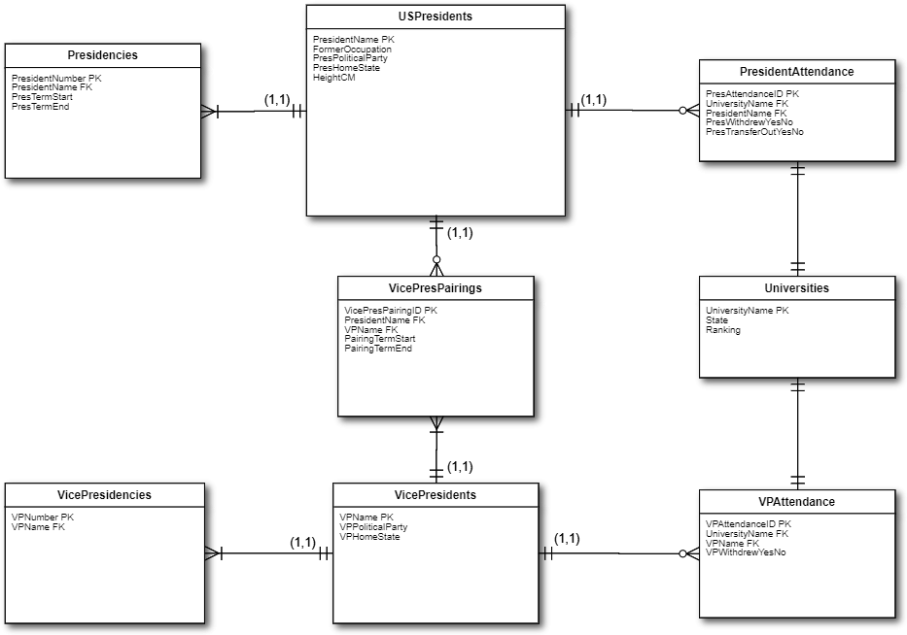
ER Diagram

Slide 7
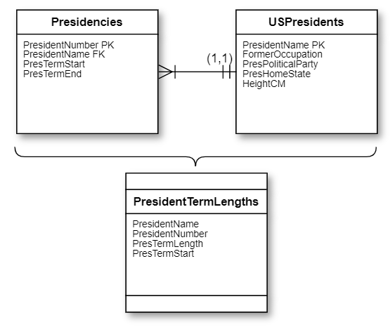
View 1: Term Length
Presidential term length, ascending chronologically.

Slide 8
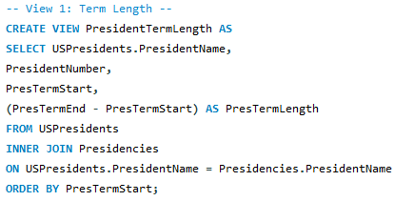
View 1: Term Length
Presidential term length, ascending chronologically.

Slide 9
View 1: Term Length
Presidential term length, ascending chronologically.

Slide 10
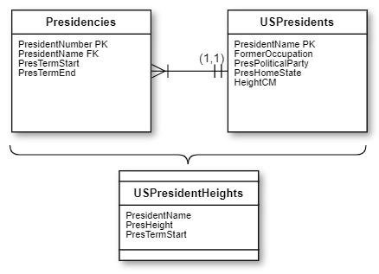
View 2: President height
Who are the tallest presidents?
Ordered from shortest to tallest.

Slide 11
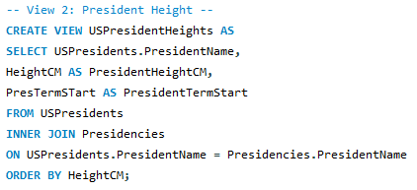
View 2: President height
Who are the tallest presidents?
Ordered from shortest to tallest.

Slide 12
View 2: President height
Who are the tallest presidents?
Ordered from shortest to tallest.

Slide 13
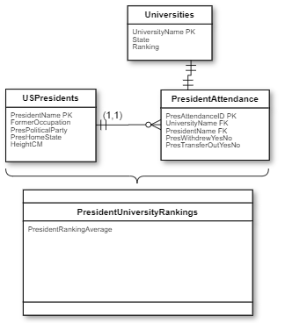
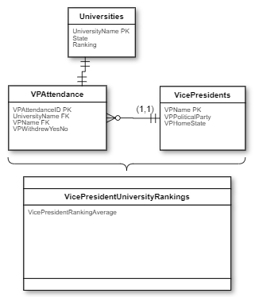
View 3: university rankings
Is there a difference in president university rankings vs VP university rankings?

Slide 14
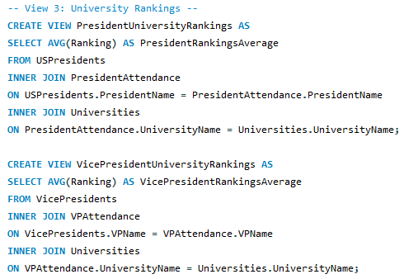
View 3: university rankings
Is there a difference in president university rankings vs VP university rankings?

Slide 15


View 3: university rankings
Is there a difference in president university rankings vs VP university rankings?

Slide 16
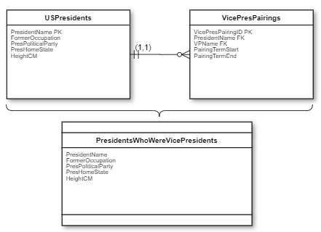
View 4: vp → President
Which presidents used to be vice presidents?

Slide 17
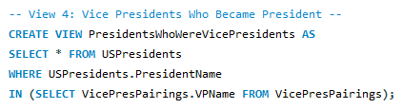
View 4: vp → President
Which presidents used to be vice presidents?

Slide 18
View 4: vp → President
Which presidents used to be vice presidents?

Slide 19
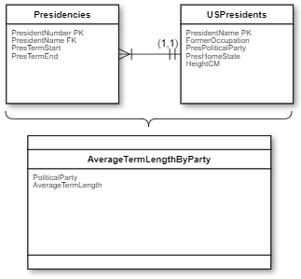
View 5: Term Length by Party
Which party has longer average presidential term lengths?

Slide 20
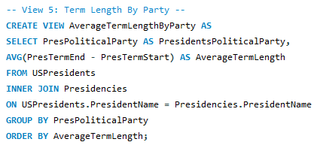
View 5: Term Length by Party
Which party has longer average presidential term lengths?

Slide 21
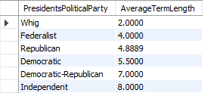
View 5: Term Length by Party
Which party has longer average presidential term lengths?

Slide 22
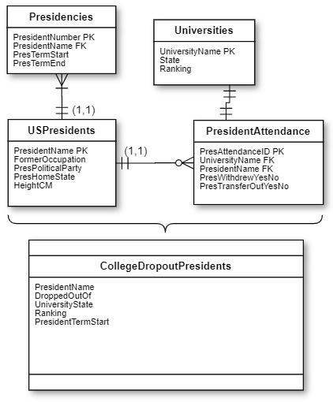
View 6: College Dropouts
Which presidents dropped out of their college or university?

Slide 23
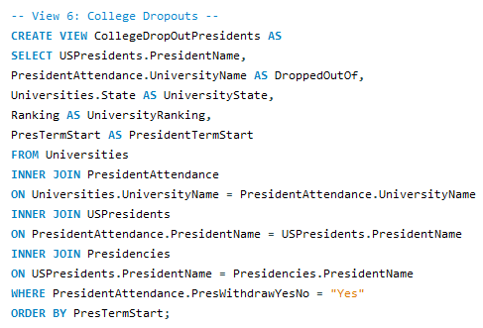
View 6: College Dropouts
Which presidents dropped out of their college or university?

Slide 24
View 6: College Dropouts
Which presidents dropped out of their college or university?

Slide 25
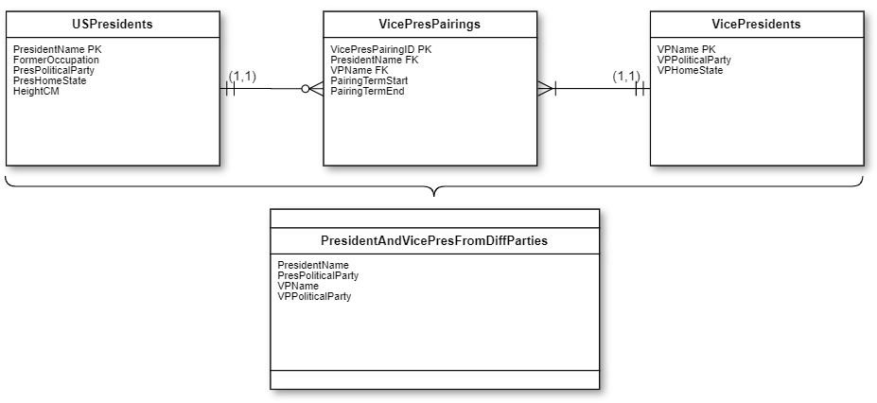
View 7: Different Parties
Which presidents and vice presidents were from different political parties?

Slide 26
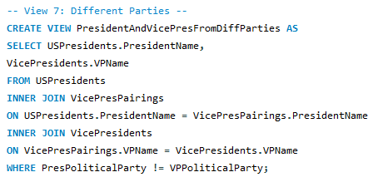
View 7: Different Parties
Which presidents and vice presidents were from different political parties?

Slide 27
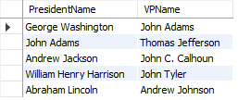
View 7: Different Parties
Which presidents and vice presidents were from different political parties?

Slide 28
Interesting Bugs and Problems
Year() won’t allow year dates before 1901, so I had to input my term start and end years as type Int instead.
I repeatedly had to troubleshoot issues with the president full names as the primary keys due to variant uses of the middle initial or full middle name.
If I were to start this project over, I would separate the first and last names, and use a meaningless unique ID number as the primary keys.
Middle names are necessary for many cases, such as George W. Bush vs George H.W. Bush, so I would also include a MiddleName column.

Slide 29
Lessons Learned
Better to overestimate the field sizes by a factor of 3 or so.
Should *not* just copy-and-paste lists from online sources, as that can accidentally convert to nonstandard characters such as longer dashes or spaces.
Planning things out with the ER diagrams is extremely helpful.
Must account for how data could be entered in the future (e.g. a vice president may have non-consecutive terms in the future, so we need a linking table between vice presidents and vice presidencies).

Slide 30
What Data/Features to Add
Couldn’t easily find vice president heights, but that would be an interesting comparison.
Familial relationships between presidents (father-son, siblings, cousins, etc.) are publicly available, but seemed rather complicated to put into a database.
Adding fields for assassinations, involvement in wars, or economic trends for each presidency would be interesting and useful.

Slide 31
Questions and Answers

Slide 32
Sources
US President Heights from Kaggle user Zurda:
https://www.kaggle.com/hakabuk/us-presidents-heights-how-low-can-u-go
US Presidents List from Kaggle user HARSHITA GUPTA:
https://www.kaggle.com/harshitagpt/us-presidents
US University Rankings From Forbes’ THE LIST: AMERICA’S TOP COLLEGES 2019:
https://www.forbes.com/top-colleges/#fa4c47d19877
Wikipedia President and Vice President Lists:
https://en.wikipedia.org/wiki/List_of_presidents_of_the_United_States_by_education
https://en.wikipedia.org/wiki/List_of_vice_presidents_of_the_United_States_by_education
https://en.wikipedia.org/wiki/List_of_vice_presidents_of_the_United_States_by_place_of_primary_affiliation

