Slide 1
Augmented Reality to Wirelessly Stream and Display the Reality
Chen Lan
Dennis Simon
James Medel
Michael Josh Dangcil
Tian Peng
Advisor : Harry Li

Slide 2
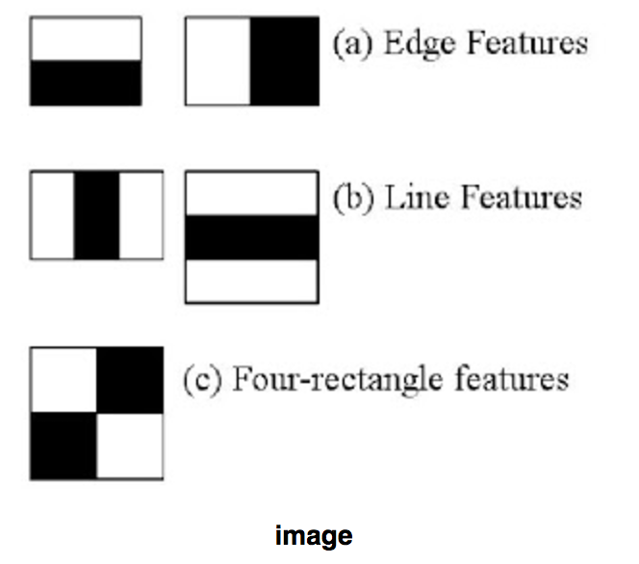
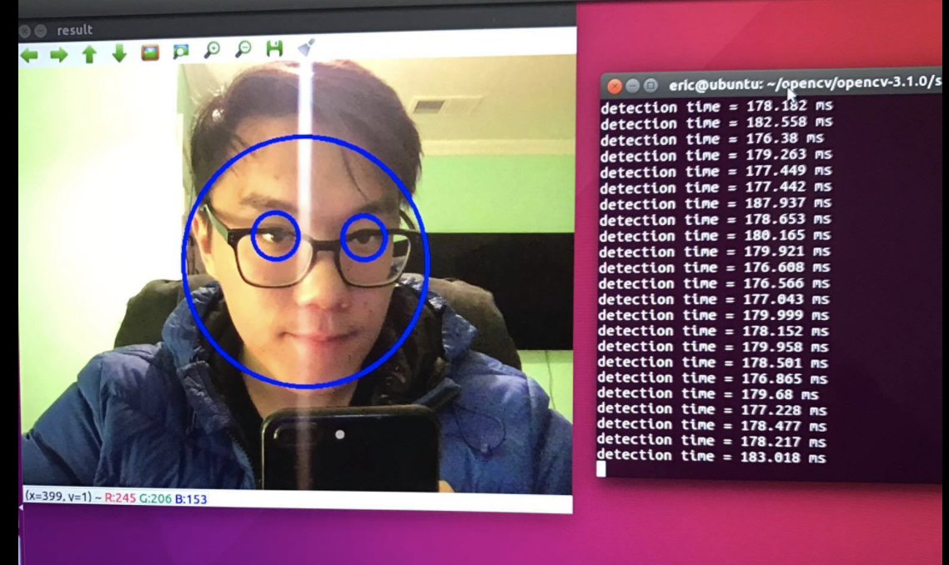
Project Design
Real-time Machine Learning
Linux OpenCV Configuration & Face Detection
It is a machine learning based approach where a cascade function is trained from a lot of positive and negative images. It is then used to detect objects in other images.

Slide 3
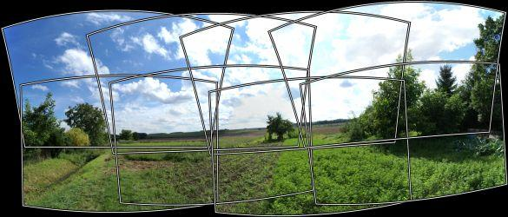
Project Design
Image Stitching with Multiple Cameras
Jetson Tx1/Tk1 integration
Processes complex data on fast, accurate inference in everything from robots and drones to enterprise collaboration devices and intelligent cameras.

Slide 4
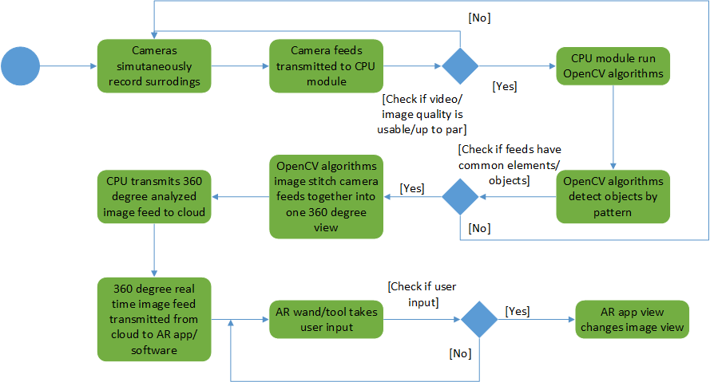
Project Design

Slide 5
Current Challenges
Time Constraint
Summer Group
Multiple layers to project
Produce minimum viable product (MVP) on time
Funding
Project requires several hardware pieces (e.g. IP Cameras, Jetson Tk1, Drone/RC car).
Algorithms
Image stitching
Database
Save streaming data to database effectively

Slide 6
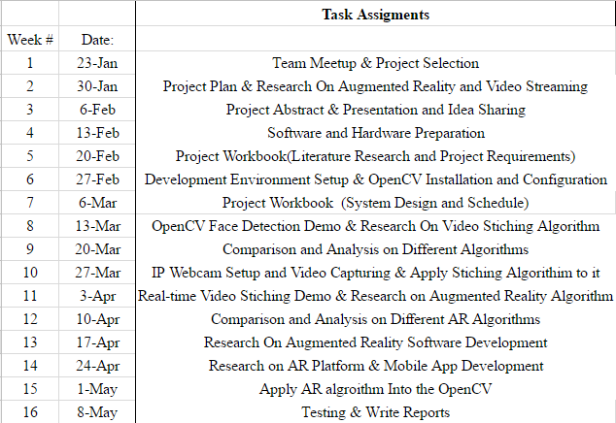
Project Schedule

Slide 7
Team Roles
James - Networking & Databases
Chen - Research & Software development
Dennis - Hardware development & Jetson TK1 focus
Michael - Hardware development & OpenCV/Jetson TK1 Integration
Tian - Software Development & Software Testing

