Slide 1
Augmented Reality to Wirelessly Stream and Display the Reality
Chen Lan
Dennis Simon
James Medel
Michael Josh Dangcil
Tian Peng
Advisor : Harry Li

Slide 2
Overview
Description of the project
Progress and Problem Encountered
Future Plans

Slide 3
Roles
Chen Lan - Research and Software Development
Dennis Simon - Algorithm Design and Hardware Development
James Medel - Networking and Databases
Michael Josh Dangcil - Hardware Development and Implementation
Tian Peng - Software Development

Slide 4
Tradeoffs/Constraints
Software/Algorithms
Image registration algorithm must be fast (near real-time speeds to account for streaming)
May sacrifice some precision/reliability.
Image registration algorithm must be able to work on images under different circumstances.
Lighting, rotation, etc.
Hardware
Cameras must have low latency.
IPS cameras better usability than USB cameras for this usage (but more expensive).
Cameras must be lightweight/compact to fit on drone/RC.
Cameras must have wide enough FOV and placement such that they cover 360 degrees while overlapping.

Slide 5
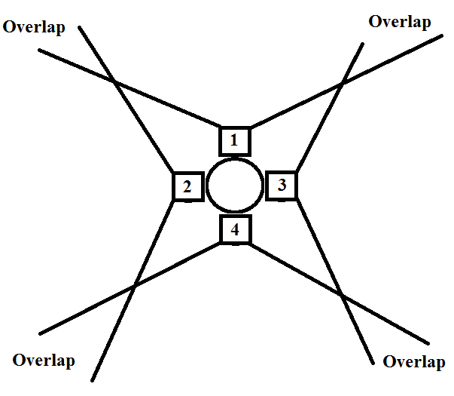
System Design - Hardware Architecture
Hardware Block Diagram
IPS Camera Placement

Slide 6
Software Development
Multi-camera capture and store last two minute video by FIFO algorithm
Access multiple camera streams at once.
Apply image stitching later on and store streamed video to an .avi file by FIFO.
OpenCV implementation and SIFT algorithm
Detect and describe local features in images
Key Stages: Scale-invariant feature detection, feature matching and indexing, cluster identification, model verification, outlier detection

Slide 7
Future Plan
Figure Out Mix Programming (Python & C++)
Image Registration Algorithm Implementation
Video Registration Algorithm Implementation
Video Transfer
Hardware Implementation & Testing
Software Implementation & Testing
Delivery the Project On Time

Slide 8
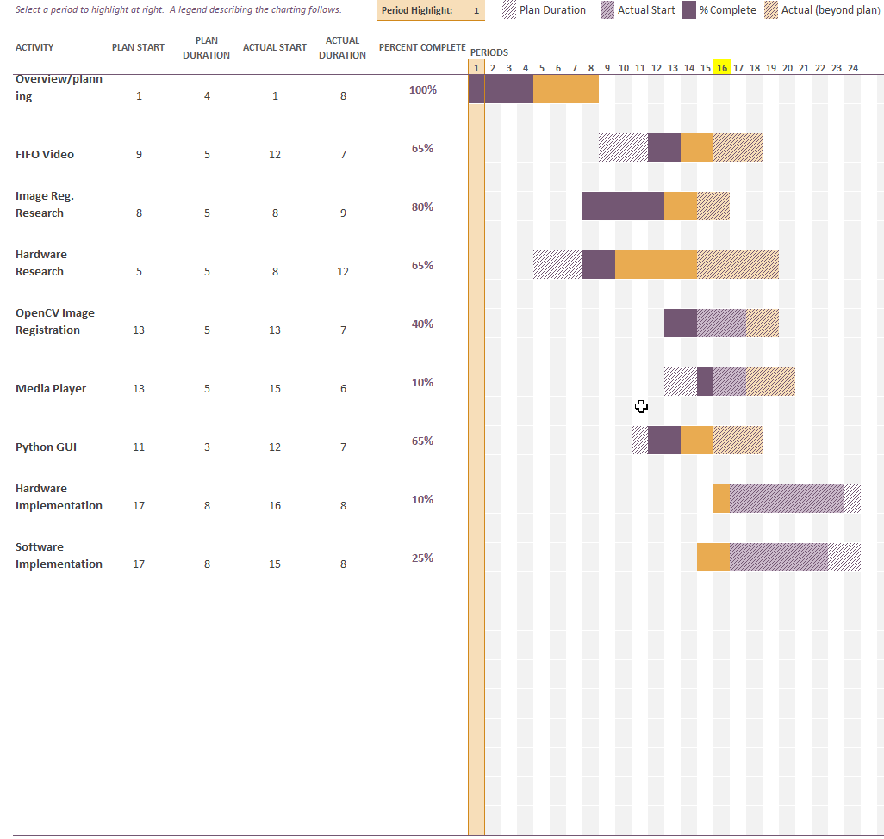
Schedule/Future Plan
Each week of semester is a period
Week 15 marks end of Spring semester
Week 16 marks start of Summer semester
Rough estimates for Implementation

