Slide 1
AR Streaming 360 Display
Shi-Tomasi Corner Detector
Dennis Simon
Chen Lan, Michael Josh Dangcil, Chris Peng, James Medel
Advisor: Harry Li
San Jose State University

Slide 2
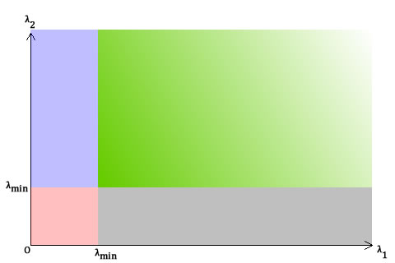
Shi-Tomasi
Based on Harris Corner Detector
Small modifications in 1994 to create Shi-Tomasi detector
Significant improvement over Harris
Has a corner selection criteria for each pixel based on a score
If a pixel’s score (R) is greater than criteria it is labeled a corner
Score is based off of two eigenvalues
R = min(λ₁,λ₂)
Notes:
Harris originally used a function that manipulated two eigenvalues fed in and returned a score r to determine if edge
Green: both λ1 and λ2 are greater than a certain value. Thus, this region is for pixels "accepted" as corners.
In the blue and gray regions, either λ1 or λ2 is less than he required minimum.
In the red region, both λ1 and λ2 are less than the required minimum. Compare the above with a similar graph for Harris corner detector... You'll see the blue and gray areas are equivalent to the "edge" areas. The red region is for "flat" areas. The green is for corners.
- See more at: http://aishack.in/tutorials/shitomasi-corner-detector/#sthash.LDgapuHX.dpuf

