Slide 1
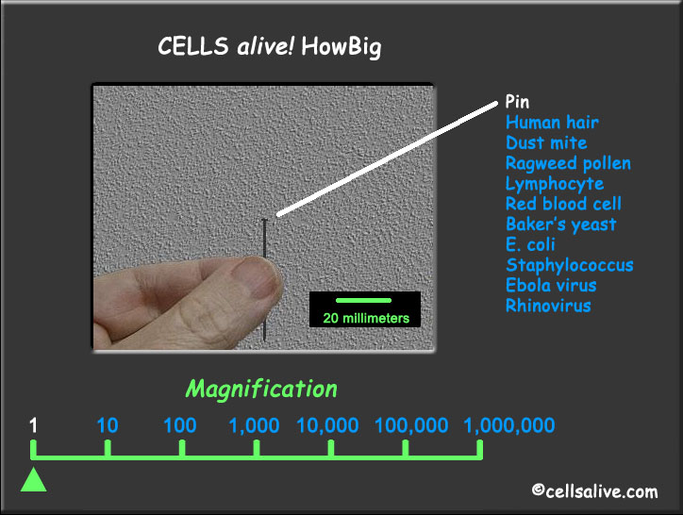
*•PIN • 1x *

Slide 2
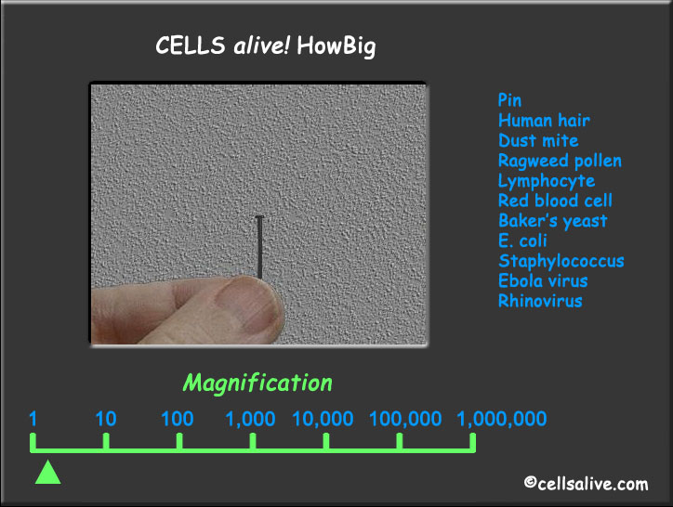
2x

Slide 3
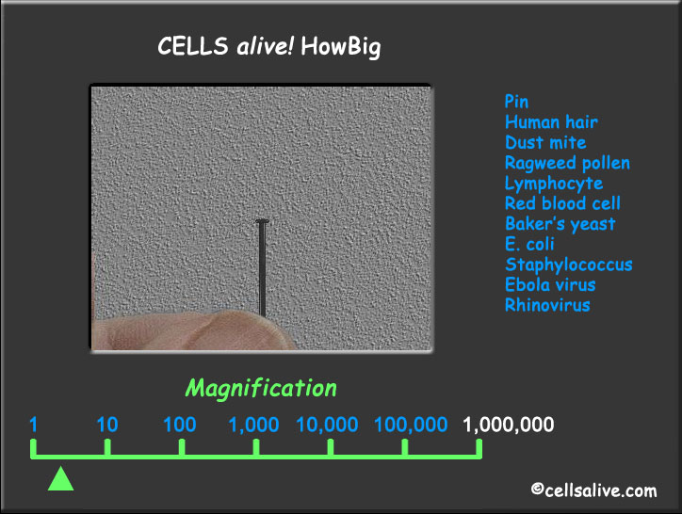
4x

Slide 4
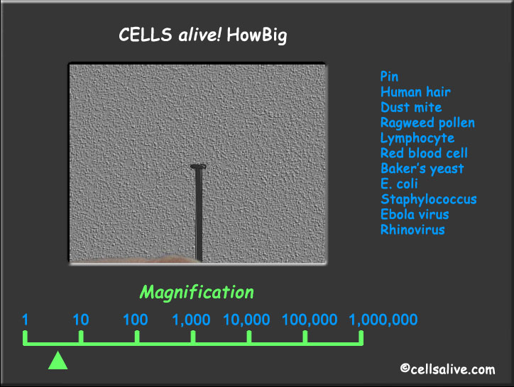
6x

Slide 5
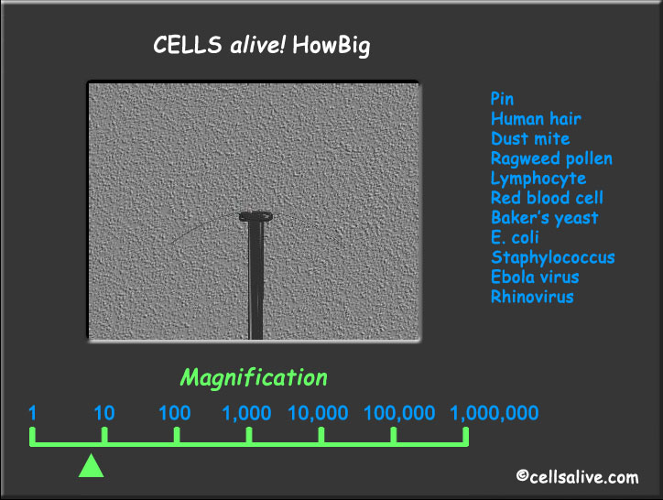
8x

Slide 6
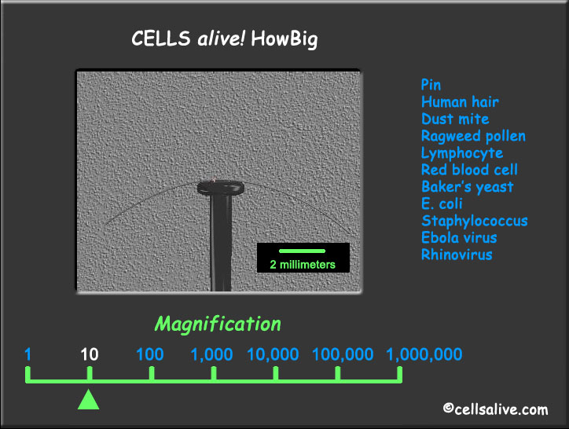
*10x *

Slide 7
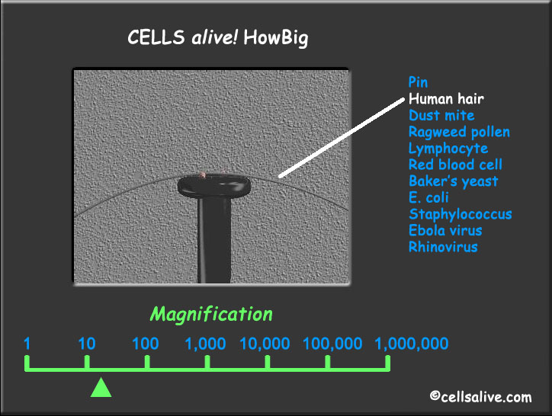
•HAIR • 20x

Slide 8
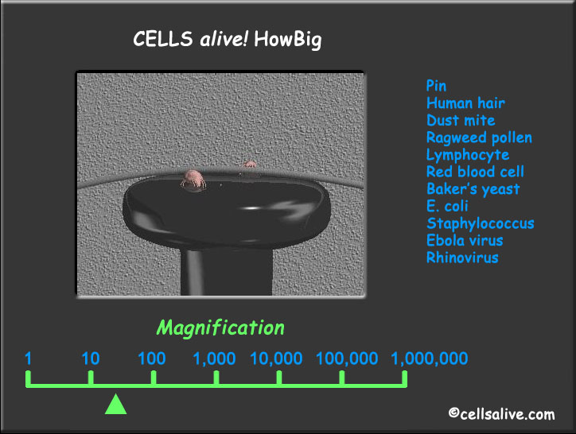
40x

Slide 9
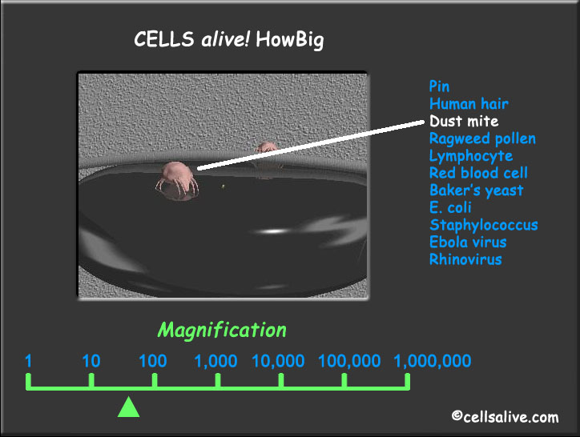
•DUST MITE• 60x

Slide 10
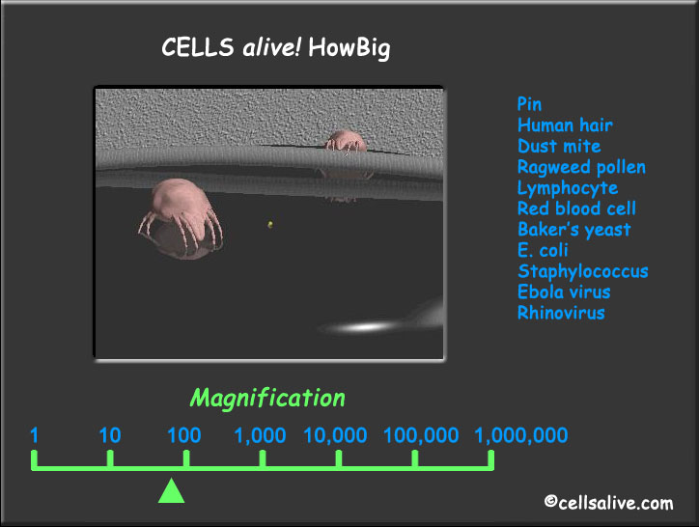
80x

Slide 11
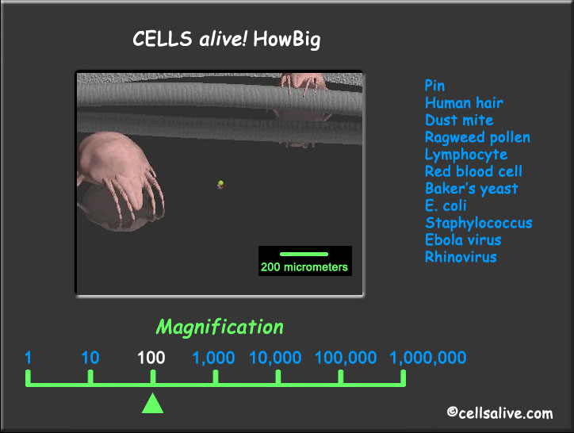
*100x *

Slide 12
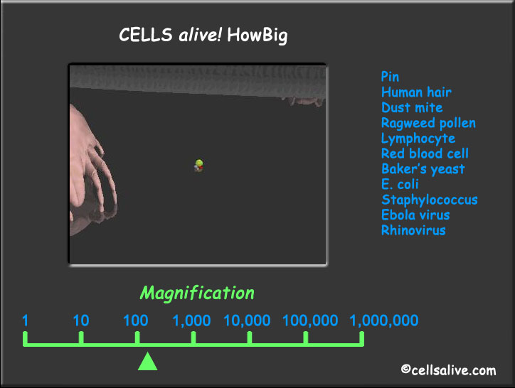
200x

Slide 13
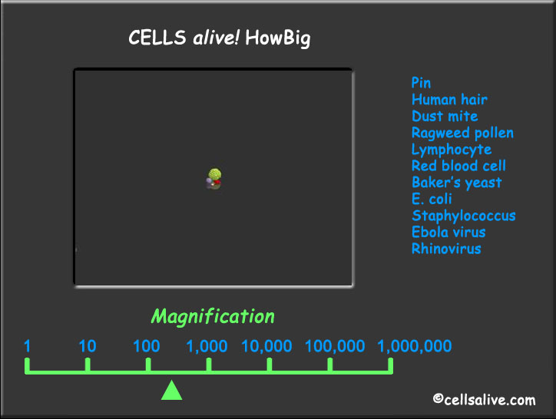
400x

Slide 14

600x

Slide 15
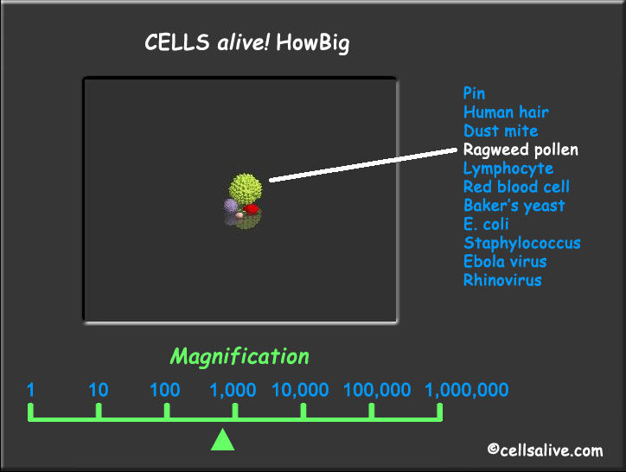
•RAGWEED POLLEN • 800x

Slide 16
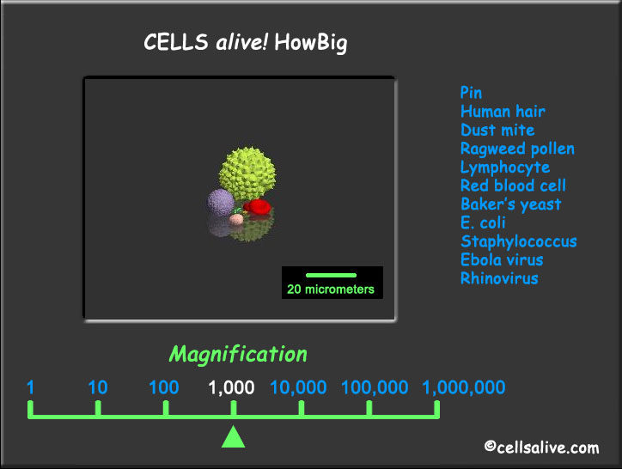
* 1000x *

Slide 17
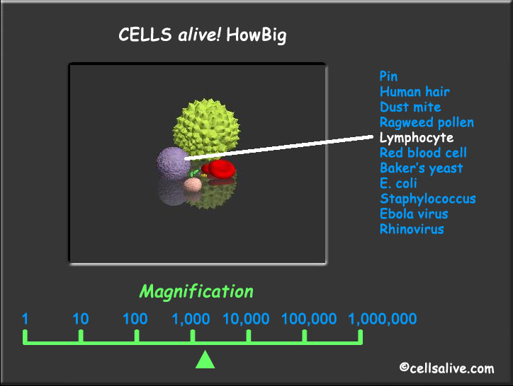
•LYMPHOCYTE • 2000x

Slide 18
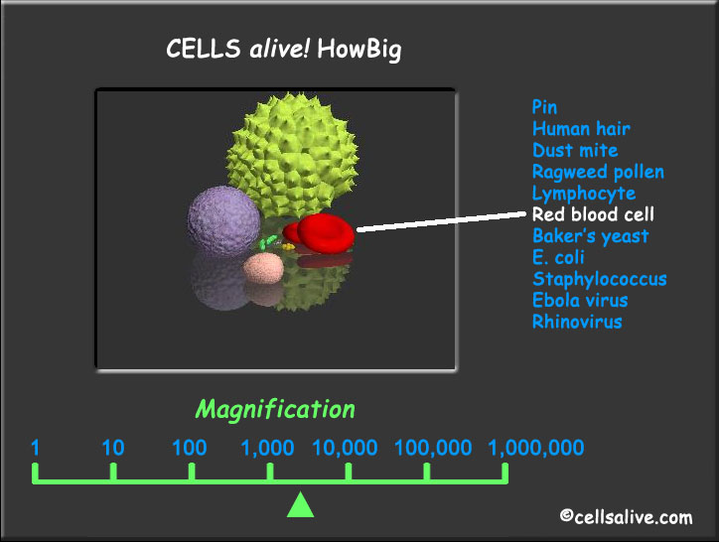
•RED BLOOD CELL • 4000x

Slide 19
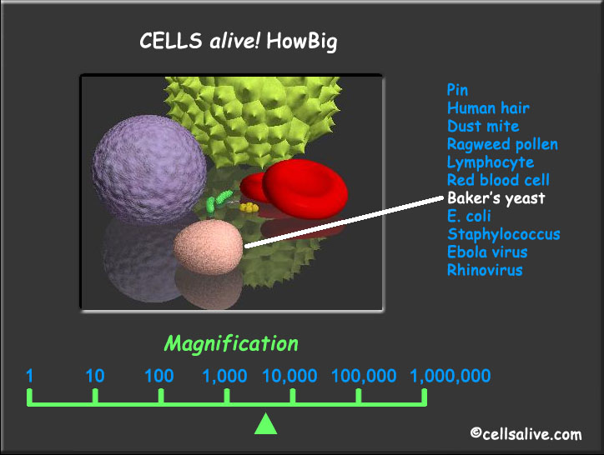
•BAKER’S YEAST • 6000x

Slide 20
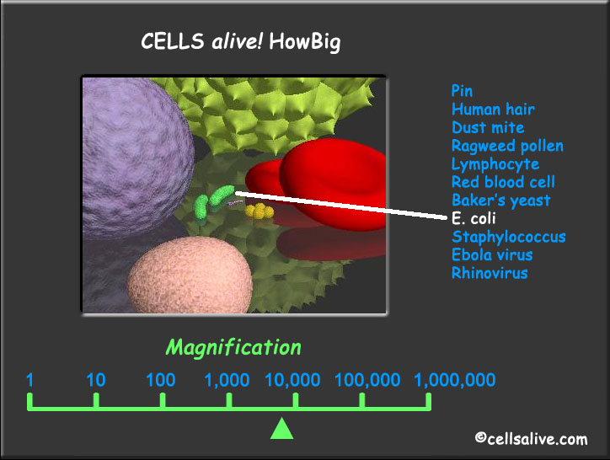
•E. COLI • 8000x

Slide 21
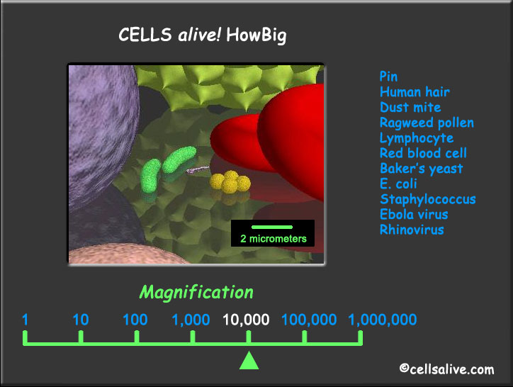
*10,000 X *

Slide 22
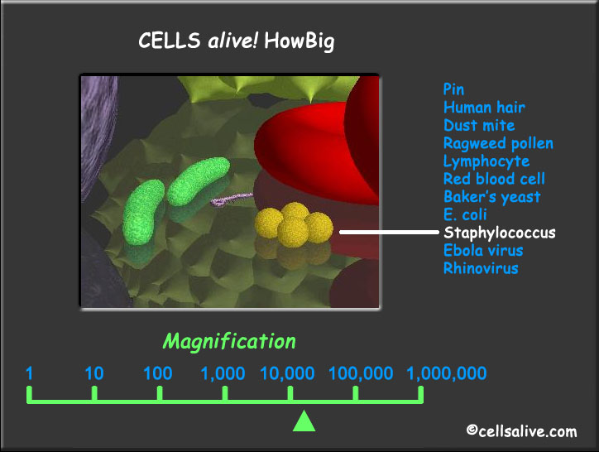
•STAPHYLOCCOUS • 20,000 X

Slide 23
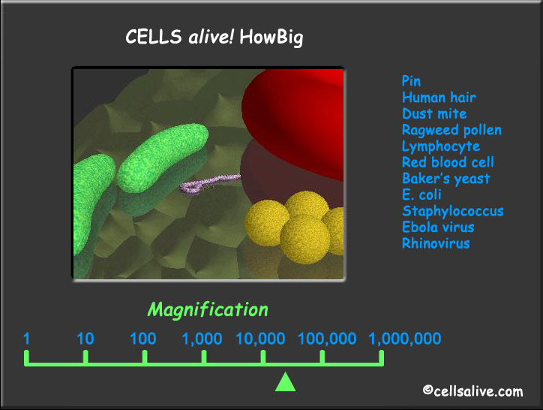
40,000 X

Slide 24
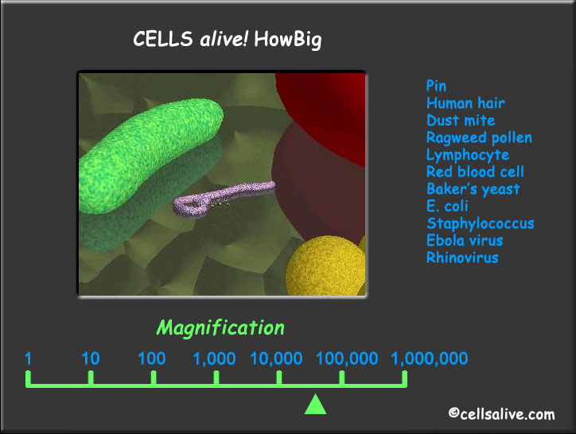
60,000 X

Slide 25
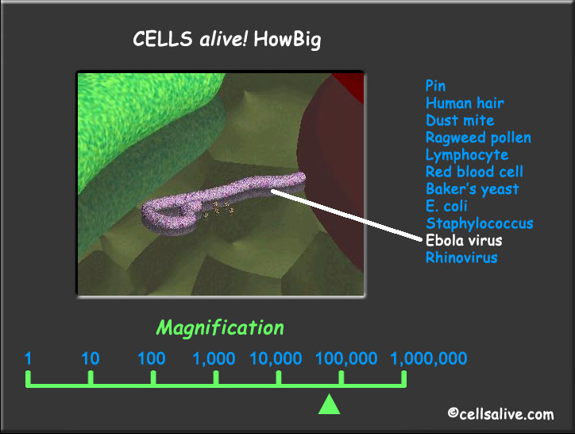
• EBOLA • 80,000 X

Slide 26
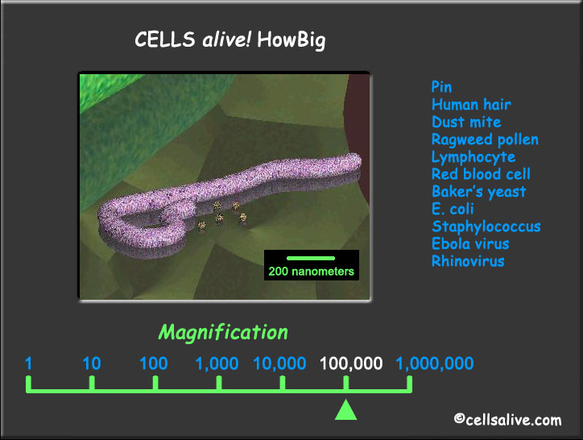
*100,000 X*

Slide 27
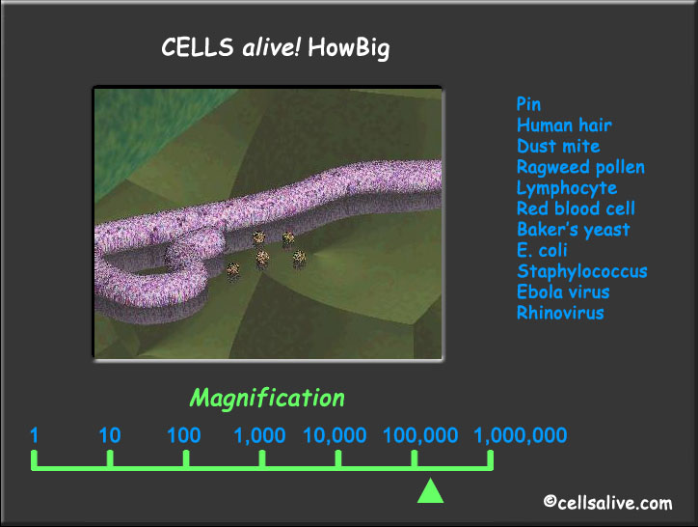
200,000 X

Slide 28
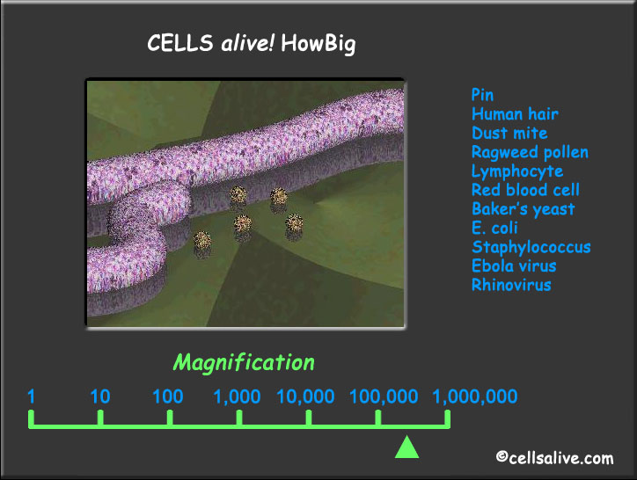
400,000 X

Slide 29
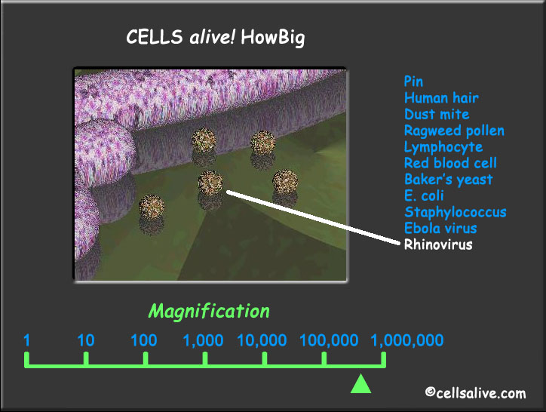
•RHINOVIRUS • 600,000 X

Slide 30
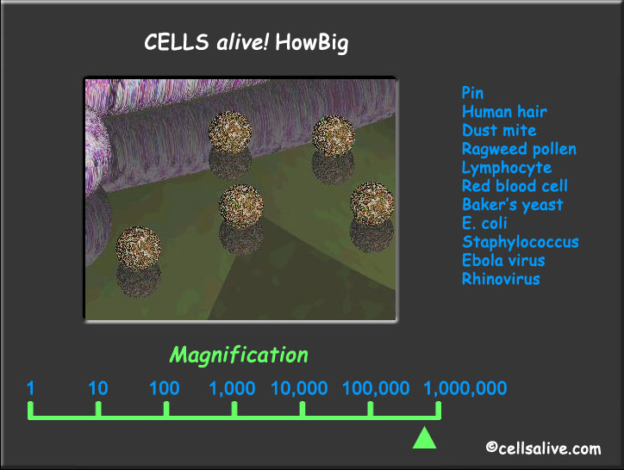
800,000 X

Slide 31
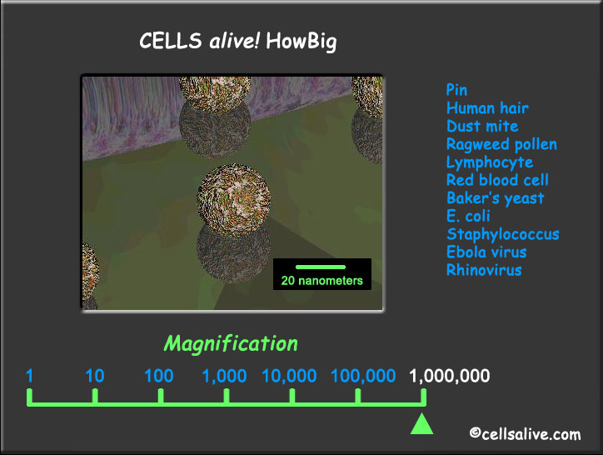
*1,000,000 X*

