Slide 1

Image Processing
Reading A Peak flow meteor
Elizabeth Govan
Michael Kane
David McCahill
Dara Marshall

Slide 2
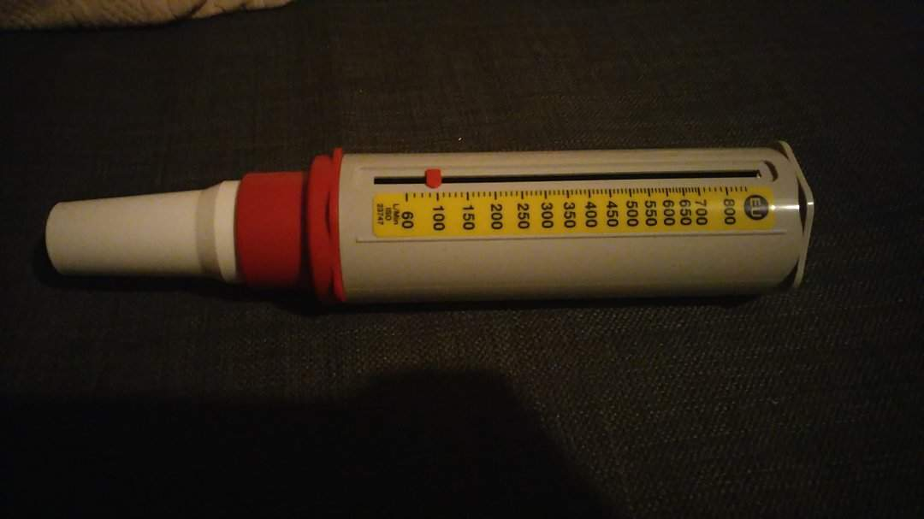
What is a peak flow meteor?
Peak Expiratory Flow (PEF).
A device that gives a reading ,which tells how open your airways are.
The more open the airways the higher the reading.

Slide 3
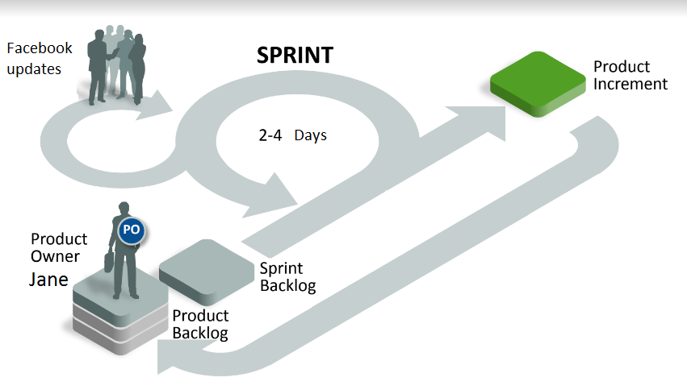
Method - Agile

Slide 4
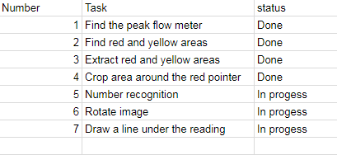
Gantt chart

Slide 5
Research
Segmentation.
Colour spaces.
Image Rotation.
Cropping.
Contouring.
OCR Number recognition.

Slide 6
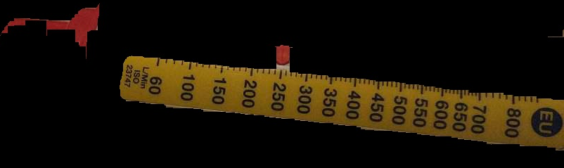
Finding the First ROI
Attempts:
Edge Detection picked up every edge.
Colour space conversions took away the sharpness of the colours
Contouring picked up every object in source image.
Success:
Using the inrange function to find the red and yellow areas

Slide 7
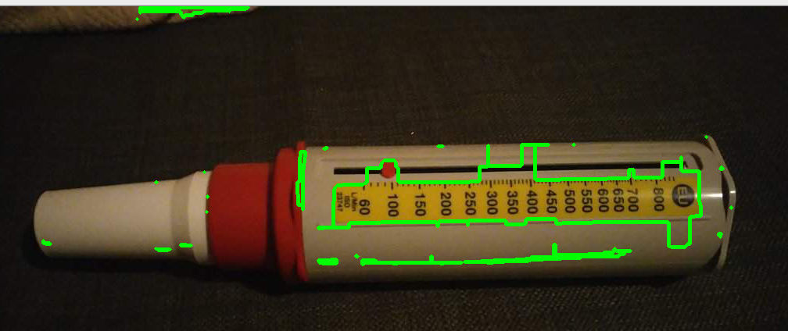
Cropping and contouring
After finding the first ROI, contouring was used to find all the contour in the image
The largest of these contours was then cropped.
Searched for the red pointer.
Cropped the area around the rd pointer and displayed it to the user.

Slide 8
OCR(Optical Character Recognition)
Optical character recognition (OCR) is the mechanical or electronic conversion of images of typed, handwritten or printed text into machine-encoded text.
Done by using pattern recognition and feature detection to compare it character to known examples of each character
In our project its function is to read the digits in order to determine a person peak expiratory flow (PEF)
Other uses include automated passport reading, license plate reading and making electronic version of printed documents

Slide 9
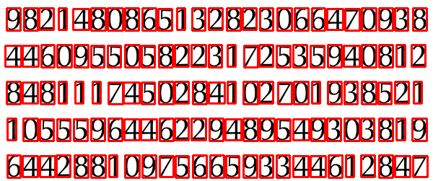
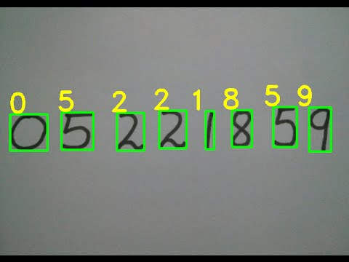
OCR(Optical Character Recognition)

Slide 10

Results and Next Steps
The current results of our work.
Isolated the Region of interest.
Next Steps.
Rotate all sample images to allow OCR to detect the numbers.
Process the colour image and turn it to greyscale.
Use the OCR algorithm to detect the numbers and return it as a value to the user.

Slide 11
Questions?
No Great.

