Slide 1

Image Processing
Reading A Peak flow meteor
Elizabeth Govan
Michael Kane
David Mc Cahill
Dara Marshall

Slide 2
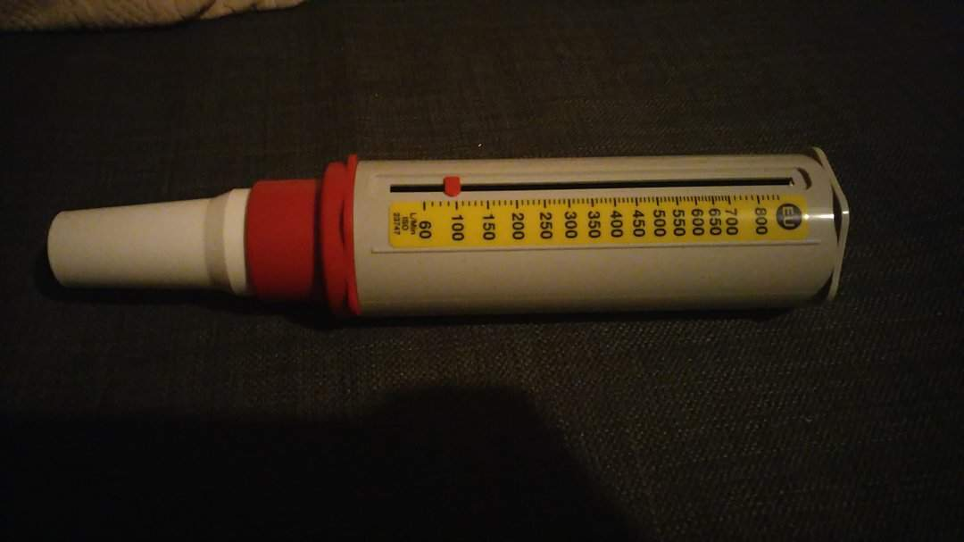
What is a peak flow meteor?
Peak Expiratory Flow (PEF).
A device that gives a reading ,which tells how open your airways are.
The more open the airways the higher the reading.

Slide 3
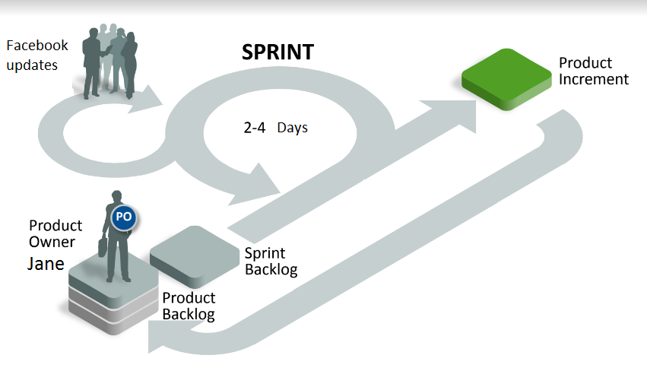
Method - Agile

Slide 4
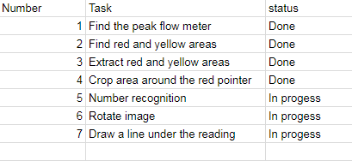
Gantt chart

Slide 5
Research
Segmentation
Contouring
OCR Number recognition

Slide 6
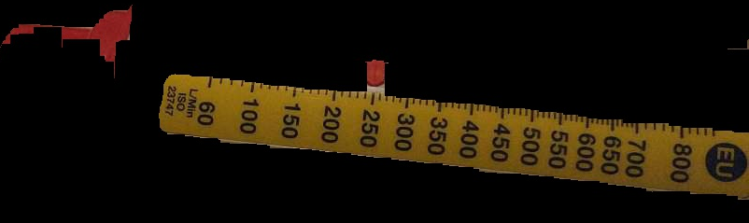
Finding the First ROI
Using the inrange function to find the red and yellow areas

Slide 7
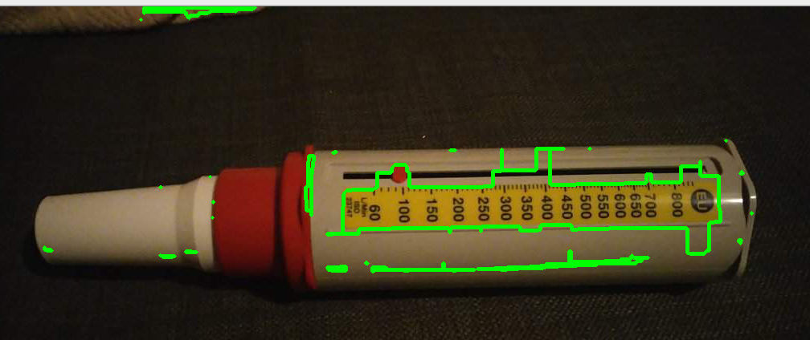
Cropping and contouring
G
G
G
G
G

Slide 8
OCR(Optical Character Recognition)
Optical character recognition (OCR) is the mechanical or electronic conversion of images of typed, handwritten or printed text into machine-encoded text.
Done by using pattern recognition and feature detection to compare it character to known examples of each character
In our project its function is to read the digits in order to determine a person peak expiratory flow (PEF)
Other uses include automated passport reading, license plate reading and making electronic version of printed documents

Slide 9
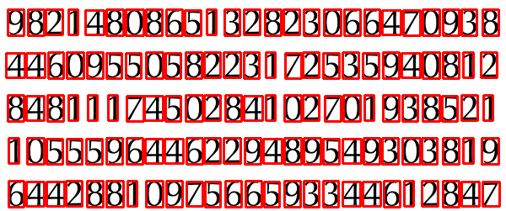
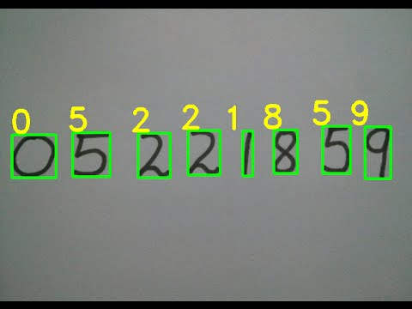
OCR(Optical Character Recognition)

Slide 10

Results and Next Steps
The current results of our work.
Isolated the Region of interest.

