Slide 1

Room Occupancy Measurement Using Image Processing
Michael Kane
C14402048
DT211C/4

Slide 2
Problem and outline of the project
Fall detection in a Patients home or Care home
The use of a infra red camera to identify a person

Slide 3

Solution

Slide 4
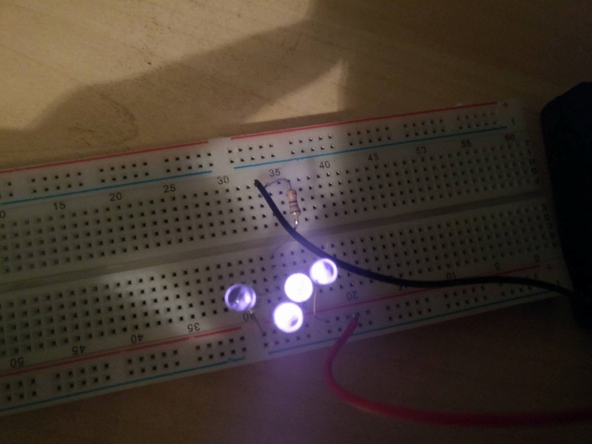
Prototype and Algorithm
Placeholder

Slide 5
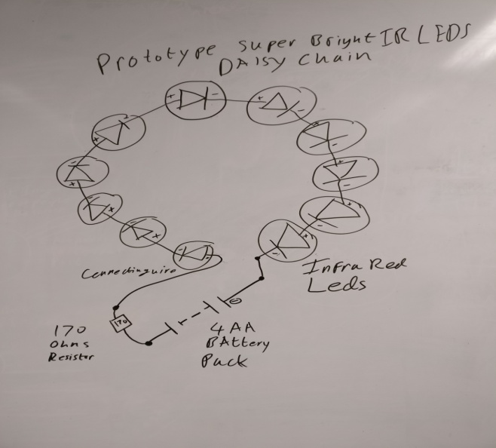
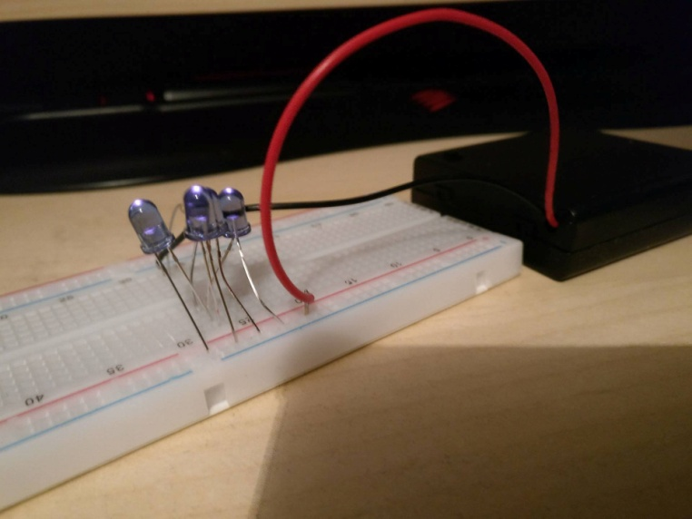
Electronics Background
Current Prototype.
Daisy Chain of super bright LEDS
Issues to overcome.

Slide 6
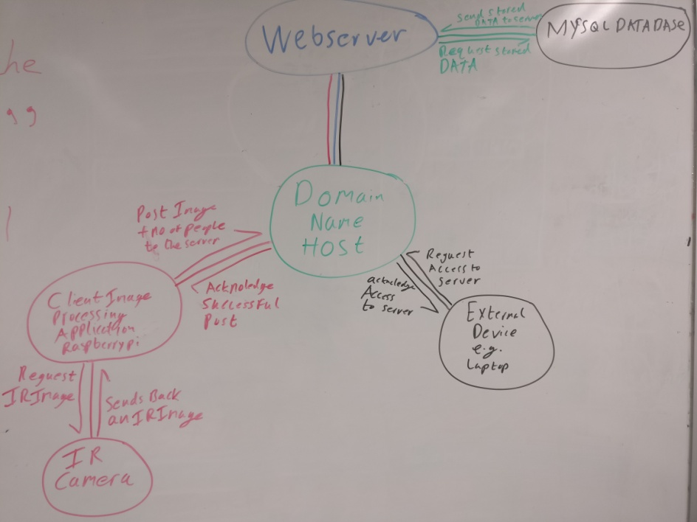
Architecture
Flask Web Server.
MySQL Database.
Raspberry pi + pi noir camera.
DYNU domain hosting service.

Slide 7
Security
Encryption algorithms for the user passwords
Python SHA256
Sessions for the web server

Slide 8
Testing
Usability testing.
Unit tests.
Regular Expressions.

Slide 9
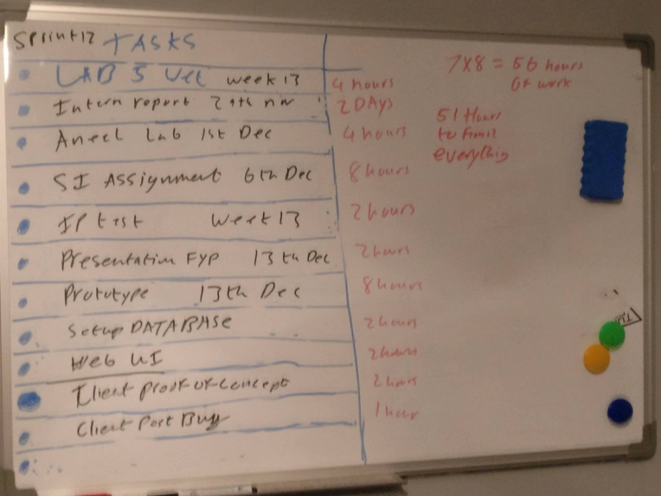
Methodology
Agile Scrum.
Product Owner & Scrum master.
Weekly Sprints

Slide 10
Research
Fall detector
Human skin detection

Slide 11
Future work
Finish the IR prototype.
Implement machine learning on the current IP program.
Increase the efficiency of the algorithm.
S
S
Stronger Encryption Algorithm for user password
Raspberry Pi Client post Bug
Port Number Authentication issue.

Slide 12
DEMO
Moving onto the demo.
Demonstrate a connection to the server.
Showing the login/register system.
Demonstrate posting an image.
Demonstrate that the image has successfully been posted.
Demonstrate the output of the image processing program.

Slide 13
Questions
Any Questions on the project.

