Slide 1

Room Occupancy Measurement Using Image Processing
Michael Kane
C14402048
DT211C/4

Slide 2
Problem and outline of the project
Fall detection in a Patients home or Care home.
Checking room occupancy around the college.
The use of a infra red camera to identify a person

Slide 3

Solution
Image Processing to identify and count people
Track Movements.
Displaying output to the user

Slide 4
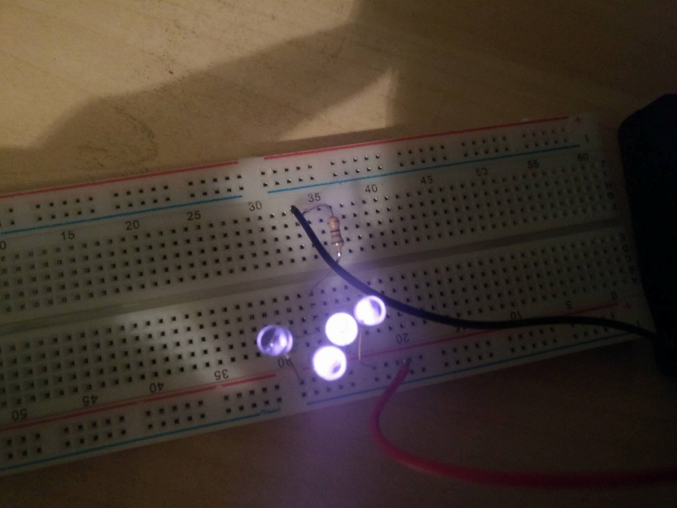
Prototype and Algorithm
Using the NOIR camera with the super bright led’s to make a prototype camera.
Thresholding
Skin detection

Slide 5
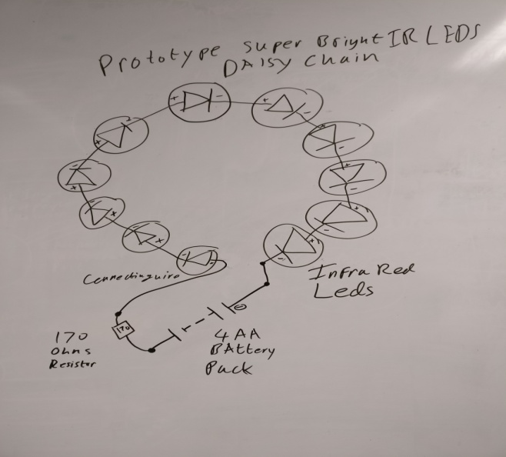
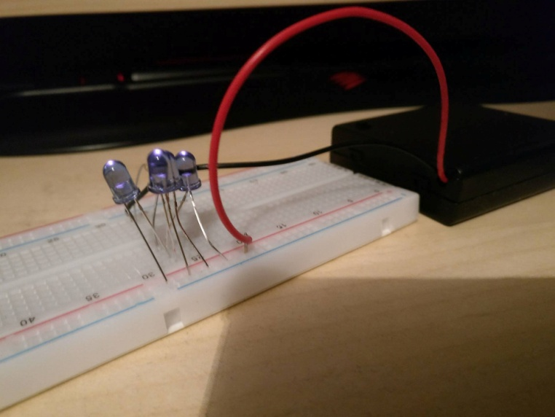
Electronics Background
Current Prototype.
Daisy Chain of super bright LEDS
Issues to overcome.

Slide 6
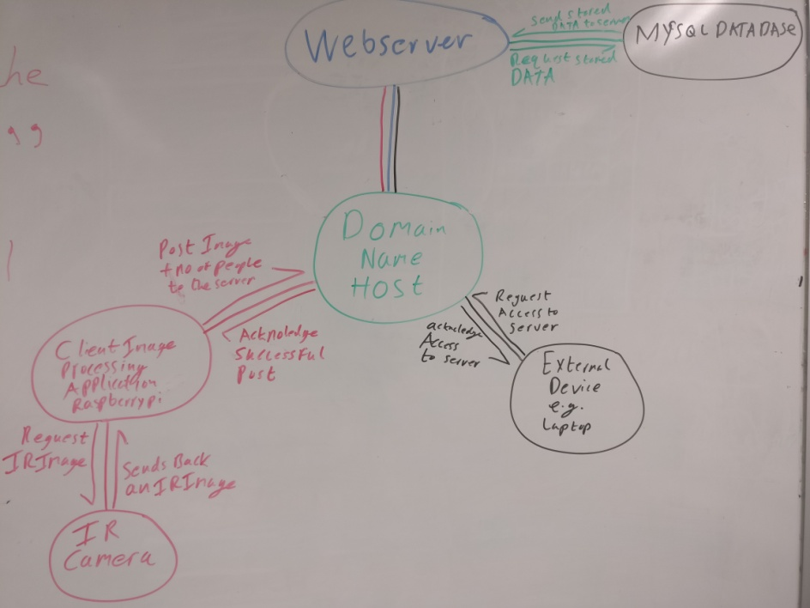
Architecture
Flask Web Server.
MySQL Database.
Raspberry pi + pi noir camera.
DYNU domain hosting service.

Slide 7
Security
Encryption algorithms for the user passwords
Sessions for the web server
Regular expressions to prevent SQL injections.
Public private keys for Remote connection to server or raspberry pi.

Slide 8
Testing
Usability testing.
Unit tests.
Regular Expressions.

Slide 9
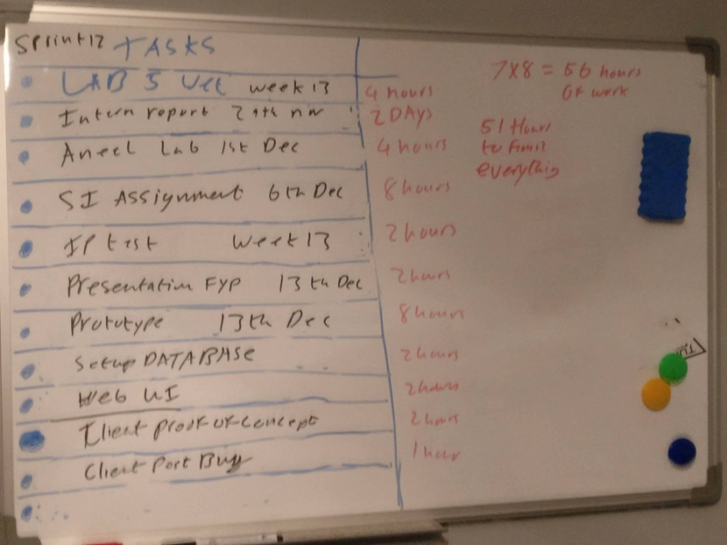
Methodology
Agile Scrum.
Product Owner & Scrum master.
Weekly Sprints

Slide 10
Research
Fall detector
Human skin detection
Flask
MySQL
Image Processing Techniques

Slide 11
Future work
Finish the IR prototype.
Implement machine learning on the current IP program.
Improve the website in general.
Website sessions.
Store images in the database.
Stronger Encryption Algorithm for user password.
Raspberry Pi Client post Bug.
Port Number Authentication issue.

Slide 12
DEMO
Moving onto the demo.
Demonstrate a connection to the server.
Showing the login/register system.
Demonstrate posting an image.
Demonstrate that the image has successfully been posted.
Demonstrate the output of the image processing program.

Slide 13
Questions
Any Questions on the project.

Slide 14
References
citeseerx, CE. (2017)Human Skin Detection by Visible and Near-infrared Imaging Available at: http://citeseerx.ist.psu.edu/viewdoc/download?doi=10.1.1.389.6745&rep=rep1&type=pdf (13/12/2017)
https://pdfs.semanticscholar.org/508d/d39be48aba01ed45c11b14b931d4f9a48629.pdf

