Slide 1
Object-Oriented Essentials

Slide 2
Learning Objectives
Understand motivations for object-oriented languages
Interpret relationships between classes
Use inheritance hierarchy
Use interface hierarchy
Apply polymorphism
Apply downcasting
Distinguish concrete classes from abstract classes
Contrast abstract classes vs interfaces
Use the Comparable interface

Slide 3
Motivations For Object-Orientation
Encapsulation
Every data item is owned by an object
Objects are decoupled and communicate with external interfaces
Internal data manipulation is hidden
Abstraction
Intent is separated from implementation
Problems are solved the way humans think
Modularity
The application is divided into loosely coupled, logical modules

Slide 4
Motivations For Object-Orientation
Inheritance
Objects extend other objects
Polymorphism
One name, many forms
Behavior has one name but behaves differently according to the relevant object
Code Reuse
Unnecessary rewriting is avoided
Rewriting of very similar code is avoided

Slide 5
What is a Class?
A class is the blueprint from which individual objects are created.
A class defines the names, datatypes, visibility, and other properties of all attributes and methods.
Attributes represent and object’s data, and methods represent an object’s behavior.

Slide 6
What is an Object?
An object is an instance or occurrence of a class.
An object has its own values for the attributes.
Typically an object’s behavior is the same as all other objects’ for the same class.

Slide 7
Car Inheritance Example
class Car
{
private String model;
private int milesDriven;
public Car(String model, int miles)
{
this.model = model;
this.milesDriven = miles;
}
public int findPrice()
{
if (milesDriven < 50000)
return 20000;
else
return 10000;
}
}

Slide 8
Car Inheritance Example
class ElectricCar extends Car
{
private int energyEfficiency;
public ElectricCar(String model, int miles, int eff)
{
super(model, miles);
energyEfficiency = eff;
}
public int findPrice()
// POSTCONDITION: energyEfficiency < 3 AND super.findPrice() + $2,000 was returned
// -OR- energyEfficiency >= 3 AND super.findPrice() + $2,500 was returned
{
int temp = super.findPrice();
if (energyEfficiency < 3)
return temp + 20000;
else
return temp + 25000;
}
}
Notes:
Notice that ElectricCar redefines findPrice().

Slide 9
Car Inheritance Output
public class Main
{
public static void main(String[] args)
/*
* Postcondition 1: price of Camry with 48,000 miles is on the console
* Postcondition 2: price of Camry electric with 4,000 miles is on the console
*/
{
Car c = new Car("Camry", 48000);
System.out.println(c.findPrice());
ElectricCar ec = new ElectricCar("Camryel", 4000, 5);
System.out.println(ec.findPrice());
}
}
Output
20000
45000111.

Slide 10
Superclass Constructor Example
class Base
{
public Base() {
System.out.println("Base's no-arg constructor invoked.");
}
public Base(int n) {
System.out.println("Base's constructor invoked with int param");
}
protected String getObjectDescription() {
return "Object of class Base";
}
}
public class Derived extends Base {
public int derivedAttribute;
public Derived(int aBAttributeValue) {
System.out.println("Derived's constructor invoked with int parameter.");
derivedAttribute = aBAttributeValue;
}
}
Notes:
In class Derived’s constructor Derived(int n), a programmer-written super() is NOT required because Base already has a no-arg constructor Base() which gets invoked automatically by Derived’s constructor.
If Base(int n) were the ONLY constructor in class Base, a super(int …) would be required in Derived’s constructor.

Slide 11
Superclass Constructor Example
public class Main {
public static void main(String[] args) {
Derived aDerivedInstance = new Derived(111);
System.out.println(aDerivedInstance.getObjectDescription() +
" with derivedAttribute = " + aDerivedInstance.derivedAttribute + ".");
}
}
Output
Base's no-arg constructor invoked.
Derived's constructor invoked with int parameter.
Object of class Base with derivedAttribute = 111. 111.

Slide 12
Student Polymorphism Classes
public class Student {
private int score;
public Student(int aScore)
{
score = aScore;
}
public int getScore()
{
return score;
}
public void setScore(int aScore)
{
score = aScore;
}
public String computeGrade()
// Returns "A"/B/C/D/F according to >= 90/80/70/60/otherwise
{
if (score >= 90) return "A";
else if (score >= 80) return "B";
else if (score >= 70) return "C";
else if (score >= 60) return "D";
else return "F";
}
}

Slide 13
Student Polymorphism Classes
public class GradStudent extends Student {
private String thesisTitle;
public GradStudent(int aScore, String aTitle)
{
super(aScore);
thesisTitle = aTitle;
}
public String getTitle()
{
return thesisTitle;
}
public void setTitle(String title)
{
thesisTitle = title;
}
public String computeGrade()
// Returns "First/Second Class" according to getScore() >= 95
{
if (getScore() >= 95)
return "First Class";
else
return "Second Class";
}
}

Slide 14
Student Polymorphism Classes
public class NonDegreeStudent extends Student {
public NonDegreeStudent(int aScore) {
super(aScore);
}
public String computeGrade()
{
if (getScore() >= 75) return "Pass";
else return "Fail";
}
}

Slide 15
Student Polymorphism Output
public class Main {
public static void main(String[] args)
{
Student s;
s = new Student(78);
System.out.println("Student's score = " + s.getScore());
System.out.println("Student's grade = " + s.computeGrade());
s = new GradStudent(78, “Computer Science”);
System.out.println("Student's score = " + s.getScore());
System.out.println("Student's grade = " + s.computeGrade());
s = new NonDegreeStudent(78);
System.out.println("Student's score = " + s.getScore());
System.out.println("Student's grade = " + s.computeGrade());
}
}
Output
Student's score = 78
Student's grade = C
Student's score = 78
Student's grade = Second Class
Student's score = 78
Student's grade = Pass
Notes:
The base meaning of Polymorphism is that the type of the object determines which version of the method is called.

Slide 16
Downcasting Example
Student g = new GradStudent();
g.setTitle("My Thesis"); // doesn't compile
System.out.println("Thesis title = " + g.getTitle()); // doesn’t compile
// Explicit downcast (if you are in a code block where it’s already determined it’s a grad student)
((GradStudent)g).setTitle("My Thesis");
// Explicit downcast combined with an instanceof check (where it may not be a grad student instance)
if (g instanceof GradStudent)
((GradStudent)g).setTitle("My Thesis");
Notes:
Downcasting is saying “even though this var s is a type Student, in this moment I’d like to treat is like a GradStudent”
This will temporarily give us access to methods of the child class that do not exist in the parent class.

Slide 17
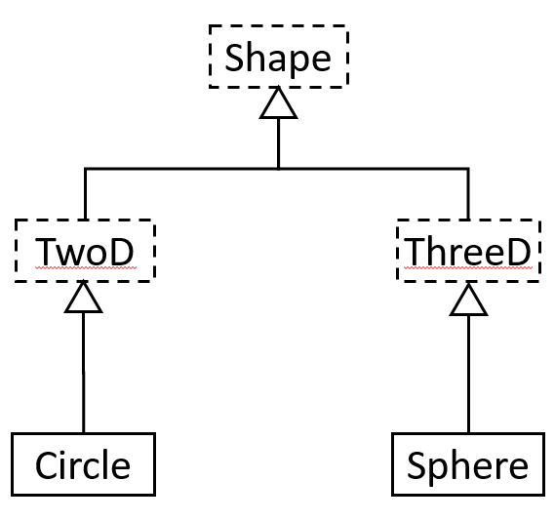
Shapes Diagram (with Abstract)

Slide 18
Shape Classes
abstract class Shape
{
public abstract double getArea();
}
abstract class TwoD extends Shape
{
}
abstract class ThreeD extends Shape
{
public abstract double getVol();
}
class Circle extends TwoD
{
private double radius;
public Circle(double r)
{
radius = r;
}
public double getArea()
{
return Math.PI * radius * radius;
}
}
Notes:
Notice that in the two branches, ThreeD defines another method that must be implemented getVol(), while TwoD does not. All classes must implement getArea since all shapes have an area.

Slide 19
Shape Classes
class Sphere extends ThreeD
{
private double radius;
public Sphere(double r)
{
radius = r;
}
public double getArea()
{
return 4.0 * Math.PI * radius * radius;
}
public double getVol()
{
return (4.0/3.0) * Math.PI * radius * radius * radius;
}
}

Slide 20
Shape Output
public class Main
{
public static void main(String[] args)
{
Shape[] shArr = {new Circle(1.0), new Sphere(1.0), new Sphere(10.0)};
for (Shape elem : shArr)
{
if (elem != null)
{
System.out.println("Area = " + elem.getArea());
if (elem instanceof ThreeD)
System.out.println("Volume = " + ((ThreeD)elem).getVol());
}
}
}
}
Output
Area = 3.141592653589793
Area = 12.566370614359172
Volume = 4.1887902047863905
Area = 1256.6370614359173
Volume = 4188.790204786391
Notes:
This example shows polymorphism AND downcasting

Slide 21
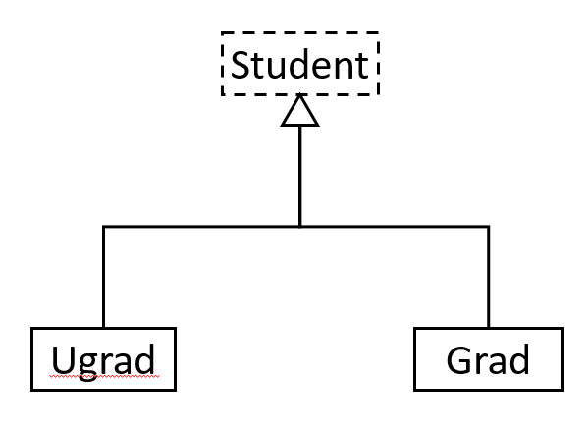
Student Diagram (with Abstract)

Slide 22
Student Classes
abstract class Student
{
public void computeGrade()
{
System.out.println("Student: pass");
}
}
class Ugrad extends Student
{
public void computeGrade()
{
super.computeGrade();
System.out.println("Ugrad: with honors");
}
}
class Grad extends Student
{
public void computeGrade()
{
System.out.println("Grad: with distinction");
}
}
Notes:
Notice that Ugrad calls the super method for its parent type.
Another reason for using an Abstract class is that you might not anyone ever instantiating the class directly.

Slide 23
Student Output
public class Main
{
public static void main(String[] args)
{
Student stuArr[] = {new Ugrad(), new Grad(), new Grad()};
for (Student elem : stuArr)
if (elem != null)
elem.computeGrade();
}
}
Output
Student: pass
Ugrad: with honors
Grad: with distinction
Grad: with distinction

Slide 24
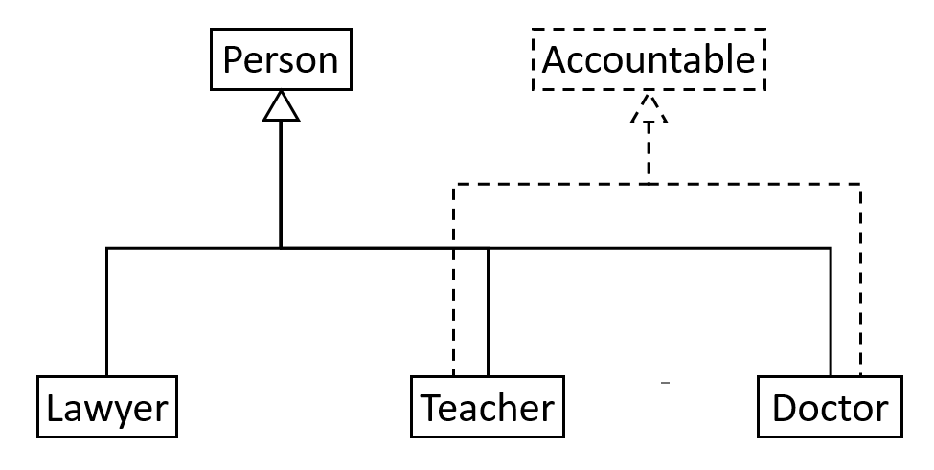
Accountable Interface Diagram

Slide 25
Accountable Classes
interface Accountable
{
public abstract void showAccountability();
}
class Person
{
public void print()
{
System.out.print("I am a Person. ");
}
}
class Teacher extends Person implements Accountable
{
public void showAccountability()
{
System.out.println("I am a Teacher; I am accountable to my students.");
}
}
class Doctor extends Person implements Accountable
{
public void showAccountability()
{
System.out.println("I am a Doctor; I am accountable to my patients.");
}
}
class Lawyer extends Person {}
Notes:
Notice that one object can “be” multiple types with interfaces. For example, a teacher is both a person and is accountable.

Slide 26
Accountable Output
public class Main
{
public static void main(String[] args)
{
Person[] persons = {new Teacher(), new Doctor(), new Lawyer()};
for (Person elem: persons)
elem.print();
if (elem instanceof Accountable)
{
Accountable accountable = (Accountable)elem;
accountable.showAccountability();
}
}
}
Output
I am a person. I am a Teacher; I am accountable to my students.
I am a person. I am a Doctor; I am accountable to my patients.
I am a Person.
Notes:
Notice that objects that are both a Person and also an Accountable have behavior for both.

Slide 27
DriversLicense Class (Comparable Interface)
public class DriversLicense implements Comparable<DriversLicense> {
private String firstName;
private String lastName;
private int licenseID;
public DriversLicense(String first, String last, int licenseID) {
this.firstName = first;
this.lastName = last;
this.licenseID = licenseID;
}
public int compareTo(DriversLicense otherLicense) {
int retVal;
if (licenseID == otherLicense.licenseID)
retVal = 0;
else if (licenseID < otherLicense.licenseID)
retVal = -1;
else
retVal = 1;
return retVal;
}
}
Notes:
Notice that one object can “be” multiple types with interfaces. For example, a teacher is both a person and is accountable.

Slide 28
DriversLicense Output
public class Main {
public static void main(String[] args) {
DriversLicense SallysLicense = new DriversLicense("Sally", "Small", 5);
DriversLicense BobsLicense = new DriversLicense("Bob", "Glass", 2);
DriversLicense ElainasLicense = new DriversLicense("Elaina", "Afilia", 5);
DriversLicense VishnusLicense = new DriversLicense("Vishnu", "Santhana", 10);
System.out.println("Sally's license compared to Bob's license: "
+ SallysLicense.compareTo(BobsLicense));
System.out.println("Sally's license compared to Elaina's license: "
+ SallysLicense.compareTo(ElainasLicense));
System.out.println("Sally's license compared to Vishnu's license: "
+ SallysLicense.compareTo(VishnusLicense));
}
}
Output
Sally's license compared to Bob's license: 1
Sally's license compared to Elaina's license: 0
Sally's license compared to Vishnu's license: -1
Notes:
Notice that the comparable interface returns a negative number, 0, or a positive number depending upon how it compares.
The Collections framework in Java relies on this interface for several operations.

Slide 29

End

