Slide 1
Exception Handling

Slide 2
Terminology
You will hear the terms Exception and Error which are closely related in programming, but carry different implications.
Both terms are used to describe an event that disrupts the normal flow of instruction in an application.
Exception implies that the language has built-in syntax for wrapping errors and separate code paths for handling them.
Error does not carry such an implication, and only suggests that a problem has occurred in the application.
Notes:
Divide by zero
File not found
Invalid input
Etc …

Slide 3
Handling Errors Without Exceptions
int main () {
FILE * pf;
pf = fopen ("unexist.txt", "rb");
if (pf == NULL) {
//handle error here…
}
}
int main () {
int dividend = 20;
int divisor = 0;
int quotient;
if( divisor == 0){
//handle error here…
}
else {
quotient = dividend / divisor;
}
}
Notes:
Traditional error handling requires the programmer to always remember to check return codes and out variables for errors, and to use if conditionals to handle error versus non-error.
Programmers learn to do this implicitly with experience, but clearly this approach can easily lead to uncaught errors.

Slide 4
Exception Advantages
The detection of the error is separated by syntax from the handling of the error.
Detection of the error usually happens in a called method (same as it would with traditional error checking).
Handling of the error happens in a special block just for exceptions (not available with traditional error checking).
Methods can be labeled with the exceptions they throw.
If a language supports it, callers of methods that throw exceptions can be forced to handle the exception.

Slide 5
Example Unhandled Exception
public class UnhandledException {
public static void main(String[] args) {
int dividend = 23;
int divisor = 0;
int result = dividend / divisor;
System.out.printf("Result = %d%n", result);
}
}
Output
Exception in thread "main" java.lang.ArithmeticException: / by zero
at exception_handling.UnhandledException.main(UnhandledException.java:7).
Notes:
Notice that the language did not force the programmer to catch the divide by zero exception. This is termed an unchecked exception.

Slide 6
Example of Handled Exception
public class HandledException {
public static void main(String[] args) {
int dividend = 23;
int divisor = 0;
try {
int result = dividend / divisor;
System.out.printf("Result = %d%n", result);
}
catch (ArithmeticException ex) {
System.out.println("Attempt to divide by zero");
}
System.out.println("This line is reached exception or no exception");
}
}
Output
Attempt to divide by zero
This line is reached exception or no exception
Notes:
Notice that the exception was dealt with, so it printed a message and the program continued executing.
Notice that the exception handling is supported by special syntax and the code is separate from the mainline code.

Slide 7
Throws Declaration
public class ThrowsDeclaration {
public static void main(String[] args) {
int dividend = 23;
int divisor = 0;
try {
int result = quotient(dividend,divisor);
System.out.printf("Result = %d%n", result);
}
catch (ArithmeticException ex) {
System.out.println("Attempt to divide by zero");
}
System.out.println("This line is reached exception or no exception");
}
public static int quotient(int dividend, int divisor) throws ArithmeticException {
return dividend / divisor;
}
}
Output
Attempt to divide by zero
This line is reached exception or no exception
Notes:
Notice the throws declaration next to the quotient declaration.
It’s labeling the method with the possible exception it might produce.
The exception was still dealt with.
Having the called method produce the exception and the calling method handle it is common.

Slide 8
Checked Exceptions
Checked exceptions force the caller to either handle the exception or to propagate the exception to the next caller (unchecked exceptions do not).
The rule of thumb is, if the caller can possibly take some action to correct the issue, then a checked exception can be used.
To say this another way, when a method cannot do what its name says it does, a checked exception can be used.

Slide 9
Checked Exception Compiler Error
public class CheckedException {
public static void main(String[] args) {
throwCheckedException();
}
public static void throwCheckedException() throws DataFormatException {
throw new DataFormatException("Uh Oh!");
}
}
Compiler Error
Unhandled exception type DataFormatException
Notes:
The exception is not caught, and so the compiler complains.
The programmer is forced to catch the exception to compile their code.

Slide 10
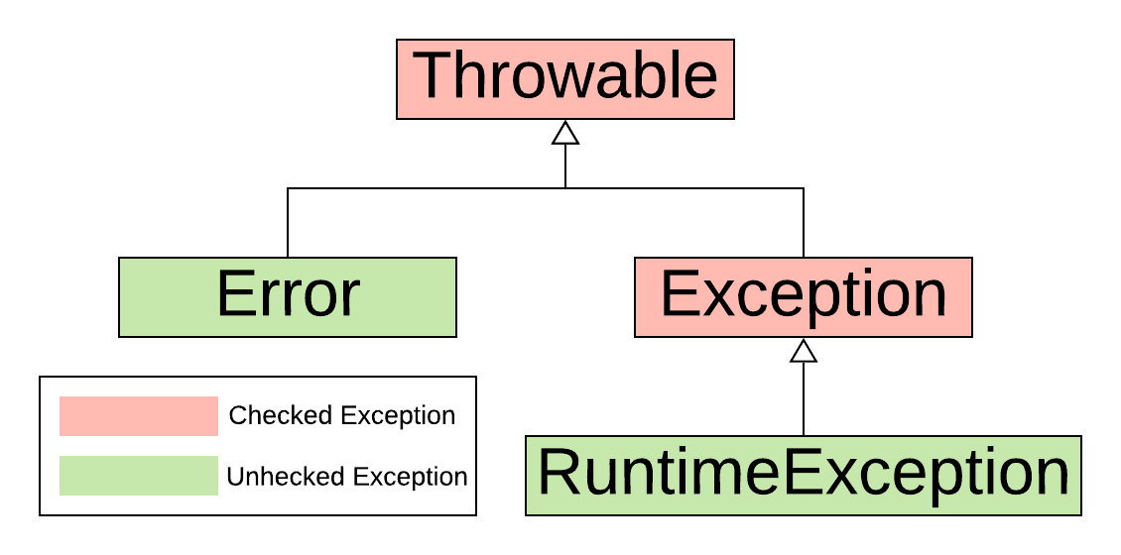
Checked/Unchecked Hierarchy

Slide 11
Checked Exceptions Controversial
Checked exceptions are controversial in the Java world.
Those who support checked exceptions argue that forcing the programmer to handle certain exceptions makes code more robust.
Those who do not support it, in a nutshell, state that they are overkill and cause problems such as:
every method in a call stack is forced to handle an exception instead of the one designated method.
code is often written to catch and swallow exceptions instead of letting the error crash the app as it should.
alternative return values are treated as if they are errors.
abuse of checked exceptions forces programmers to overcatch.

Slide 12
Finally Clause
public class Finally {
public static void main(String[] args) {
Scanner input = new Scanner(System.in);
int dividend = input.nextInt();
int divisor = input.nextInt();
try {
int result = quotient(dividend, divisor);
System.out.printf("Result = %d%n", result);
}
catch (ArithmeticException ex) {
System.out.println("Attempt to divide by zero.");
}
finally {
System.out.println("Finally clause always executed");
input.close();
}
System.out.println("This line reached even when divisor = zero");
}
public static int quotient(int dividend, int divisor) throws ArithmeticException
{
return dividend / divisor;
}
}
Output
Attempt to divide by zero.
Finally clause always executed
This line reached even when divisor = zero
Notes:
The finally block is always executed whether or not the exception is caught, rethrown, or not.

Slide 13
Chained Exceptions
public class ChainedException {
public static void main(String[] args) {
try {
methodCallingMethodThatThrows();
}
catch(Exception ex) {
System.out.println("Exception caught and processed in main().");
ex.printStackTrace();
}
}
public static void methodCallingMethodThatThrows() throws Exception {
try {
methodThatThrows();
}
catch (Exception ex) {
throw new Exception("Exception from methodCallingMethodThatThrows", ex);
}
}
public static void methodThatThrows() throws Exception {
throw new Exception("Exception thrown in methodThatThrows");
}
}
Output
Exception caught and processed in main().
java.lang.Exception: Exception from methodCallingMethodThatThrows
at exception_handling.ChainedException.methodCallingMethodThatThrows(ChainedException.java:19)
at exception_handling.ChainedException.main(ChainedException.java:7)
Caused by: java.lang.Exception: Exception thrown in methodThatThrows
at exception_handling.ChainedException.methodThatThrows(ChainedException.java:23)
at exception_handling.ChainedException.methodCallingMethodThatThrows(ChainedException.java:16)
Notes:
When one exception is the caused for another, it can be passed into the constructor of Exception as a chained exception.

Slide 14
Summary
Exceptions provide a syntax to separate error handling from mainline code.
Methods can be labeled with the exceptions they throw.
Unhandled exceptions bubble up the call stack and cause the program to exit.
Checked exceptions force the caller to either handle the exception or to propagate the exception to the next caller.
Any exception extending Error or RuntimeException are is an unchecked exception.

Slide 15
Summary
Code in a finally clause is always executed whether or not an exception is handled or propagated.
Exceptions can be chained so that the cause of one exception can be explained by another exception.

Slide 16

End

