Slide 1

Project Management
In Software Development
By Georgi Getsov, Stefan Stoev & Michael Kubovic

Slide 2
Presentation overview
Identifying requirements
Choosing a topic
Development processes
Workload distribution
Gant chart & Task sheet
Individual research
Website development

Slide 3
Identifying requirements
Practice project management method
Improve communication skills in a team environment
Plan the project to meet the deadline
Produce fully working software product
Use software collaboration tools

Slide 4


Choosing a topic
Initial idea: Programming languages
Final idea: Bulgaria & Slovakia: General & Travel Info
Pros & Cons
Notes:
(Use objective 2 to explain). Programming languages had more cons than pros, for example: topic was too generic for the deadline.
Pros: we are familiar with topic, easy to gather information (knowledge of language), interesting topic audience
Cons: There is not any we are aware of

Slide 5
Development processes
Compared models: Waterfall, Spiral, Agile, RAD
Chosen model: Rapid Application Development
Minimal planning in favor of rapid prototyping
The lack of extensive pre-planning allows much faster development

Slide 6
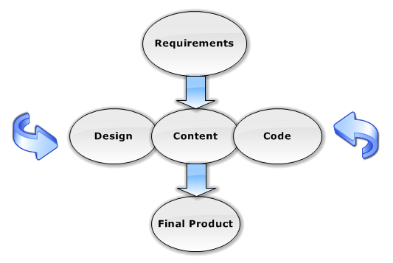
Rapid Application Diagram

Slide 7
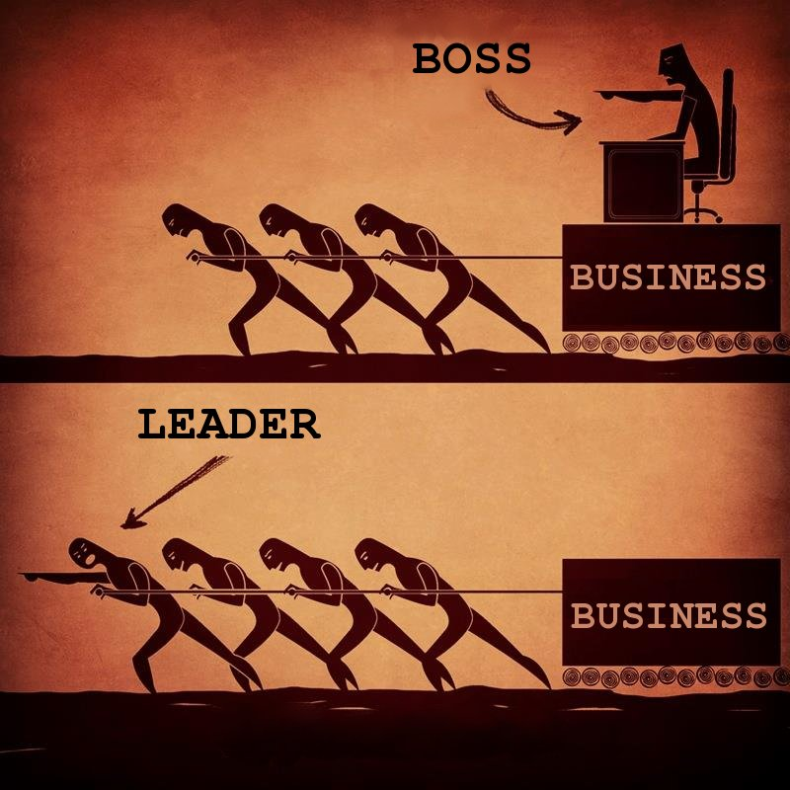
Workload distribution
Content about Bulgaria – Stefan, Georgi
Content about Slovakia – Michael
Website Development: team work
No leader
Notes:
RAD doesn’t require a leader, rather depends on strong cohesive team and individual commitment.

Slide 8
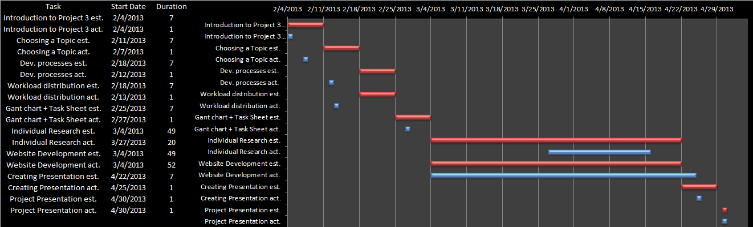
Planning & Tracking
Notes:
We have regularly updated Gantt chart and task sheet to reflect ongoing work.
Gantt chart shows the expectation vs. reality.
Task sheet shows actual hours for each task.

Slide 9
Individual research
Bulgaria
Martenitsa
Epiphany
Gergjovden
Rose festival
Kukeri
Tourism in Bulgaria
Sunny beach
Bansko
Slovakia
Modern history
Bratislava
Košice
Tatras Mountains
Countryside
Slovak Cusine

Slide 10
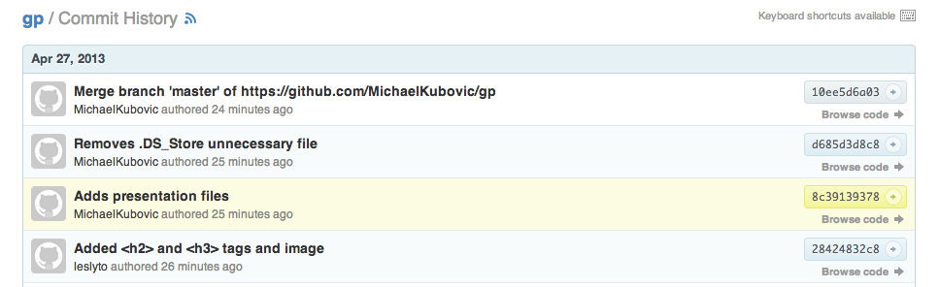
Website development
Tools: GitHub, Sublime Text, Adobe Photoshop
Languages: HTML, CSS, JavaScript

Slide 11
Final product
Screenshot comes here with link to gp.michaelkubovic.com

