Slide 1
Reimplementing STRUCUTRE Algorithm with Linked Loci
Michael Li

Slide 2
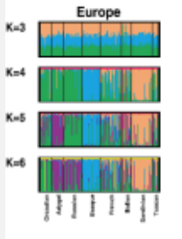
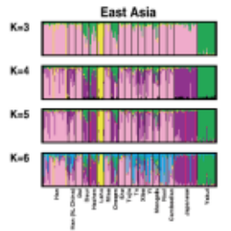
Project Goals
STRUCTURE is an algorithm for multi locus genotype data that assigns individuals to distinct populations. It can be used further for studying hybrid zones, identifying admixed individuals, and estimating population allele frequencies in the case where there is a significant number of migrant or admixed individuals.

Slide 3
Project Plan
Find original paper and developments of STRUCUTRE
Understand the basic algorithm and plan/design code
Acquire original data used
Write code to parse data
Implement most basic version
Test on original data and more if able to find
Improve basic algorithm by adding Linked Loci extension

Slide 4
Ideas/Methods Used in STRUCTURE
STRUCUTRE uses the idea of MCMC convergence with Gibbs Sampling.
Sampling is from the Dirichlet Distribution
Considering the possibility of linkage between loci and the correlations with admixed populations improves the model:
Improved population inference
Detection of admixture events farther in past
More accurate estimates of uncertainty

Slide 5
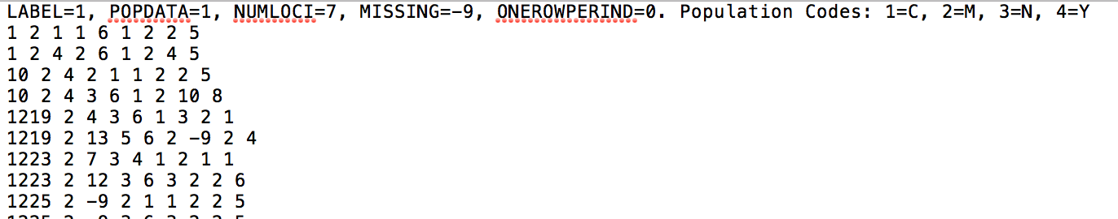
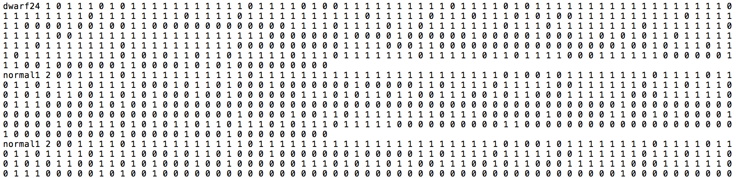
Data
Was able to find the data from the original STRUCTURE paper and more from later studies, but the data was from microsatellites.
Found another paper on STRUCUTRE using allele data that is equivalent to biallelic SNPs

