Slide 1
CMC SAP SOP May 13, 2020 Rain.Yang

Slide 2
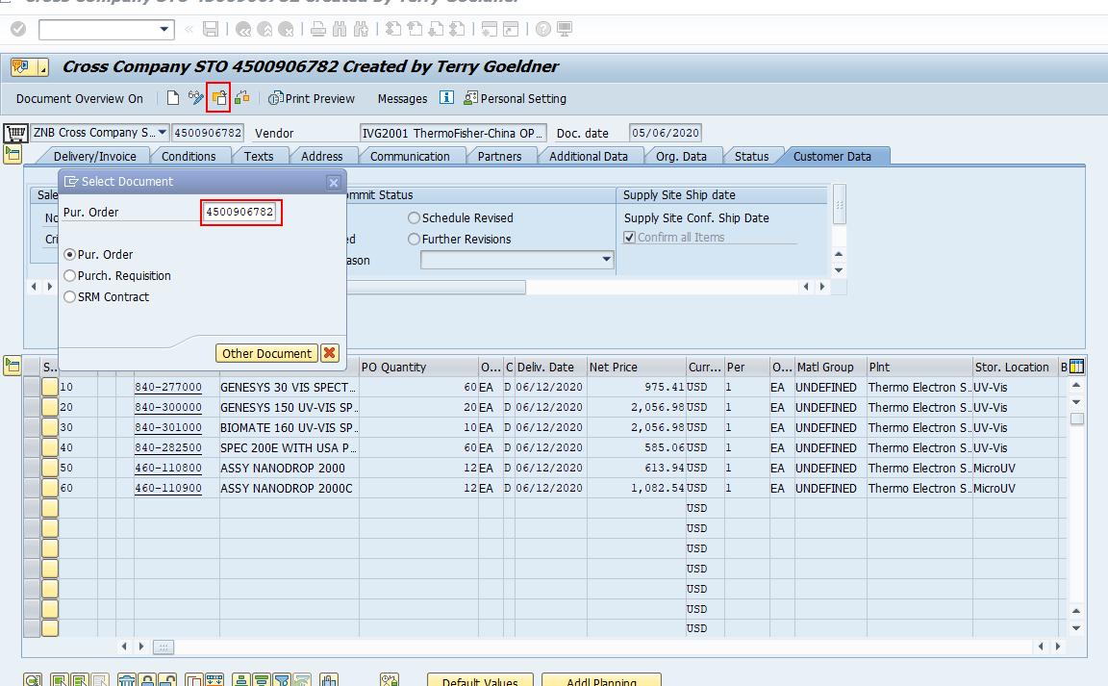
STO-schedule
ME22N, Enter STO number，then Click “Enter” into your keyboard

Slide 3
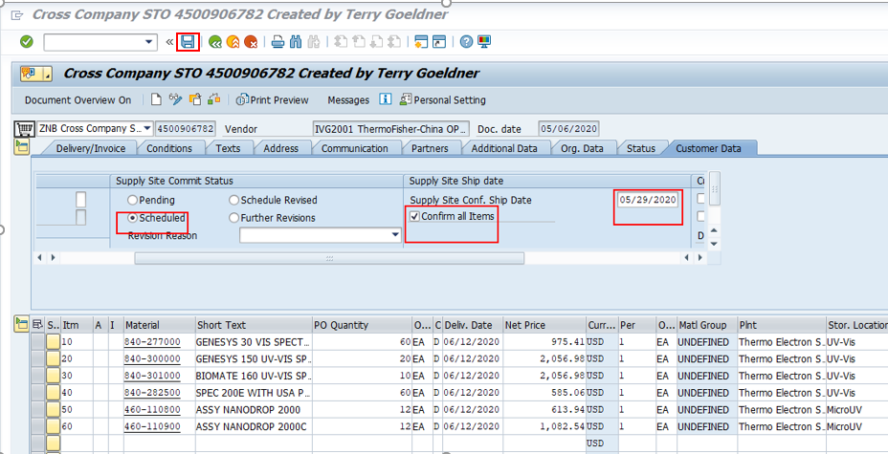
STO-schedule
For STO order, if ETD for whole order is the same, confirm as below:
Fill in the ship date as below .

Slide 4
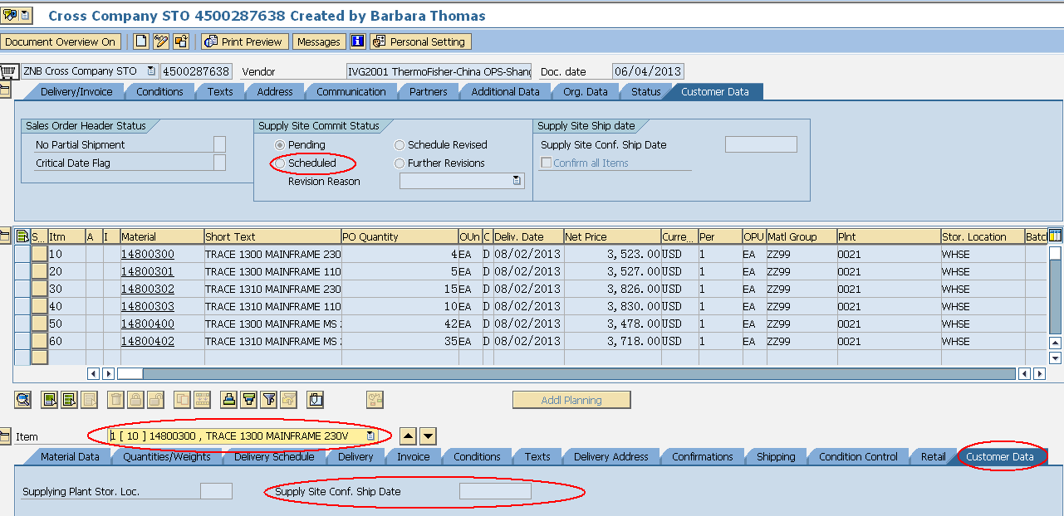
STO-schedule
For STO order, if ETD for each order line is different, confirm as below
Put the ship date by item level and saved.

Slide 5
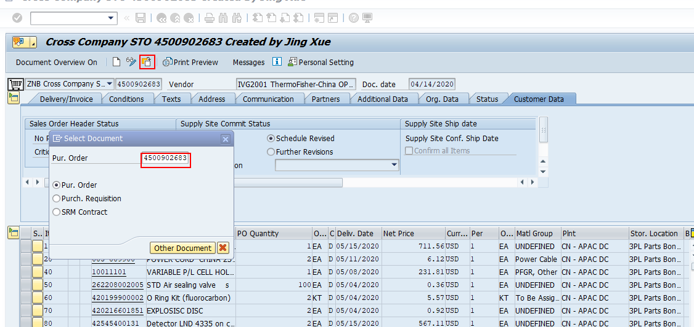
STO reschedule
For STO reschedule , ME22N, Fill into STO number first and click Enter in your keyboard.

Slide 6
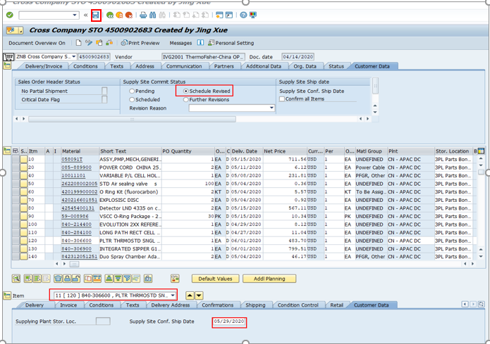
STO reschedule
For STO order reschedule, if ETD for each order line is different, confirm as below:
Update the ship date by item level , then move the button from Schedule to Reschedule Revised and saved.

Slide 7
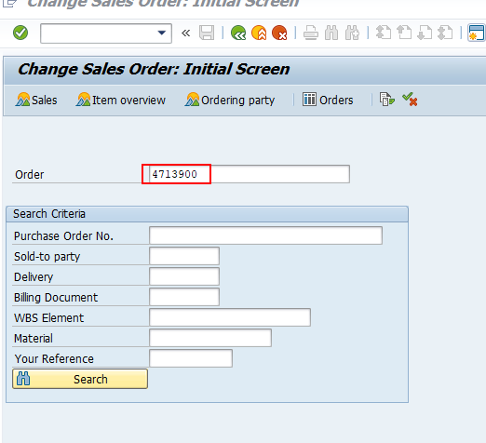
SO schedule
VA02，Enter SO number into it and click the “Enter” in your keyboard

Slide 8
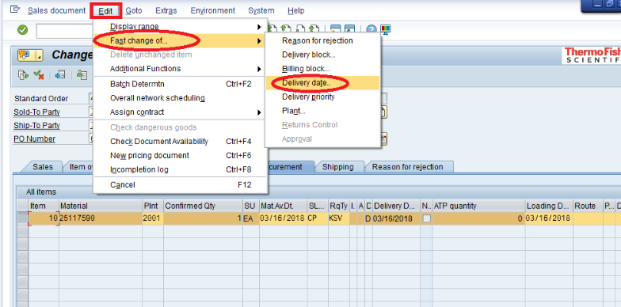
SO schedule
if ETD differs from CRD, confirm as below:

Slide 9
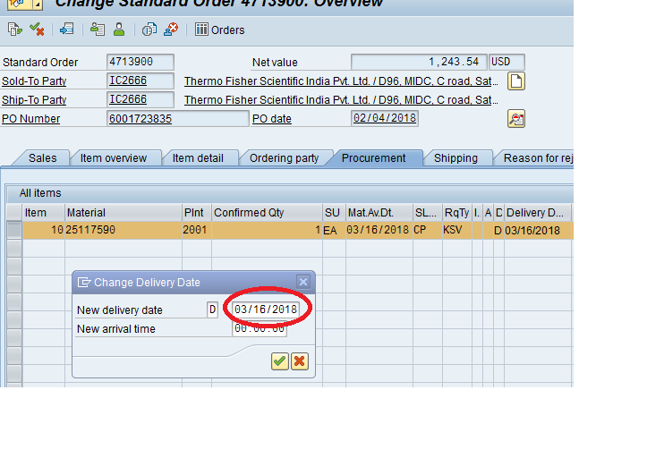
SO schedule
Fill in ETD here.

Slide 10
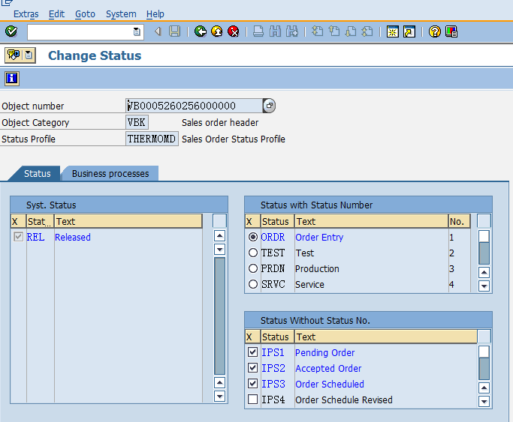

SO schedule –change status
Tick IP2 Accepted Order & IP3 Order Scheduled:
Go back and save the SO.

Slide 11
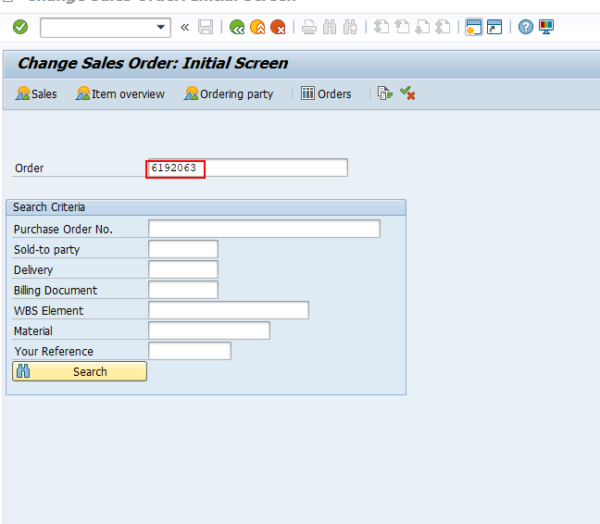
SO Reschedule
VA02，Enter SO number into it .

Slide 12
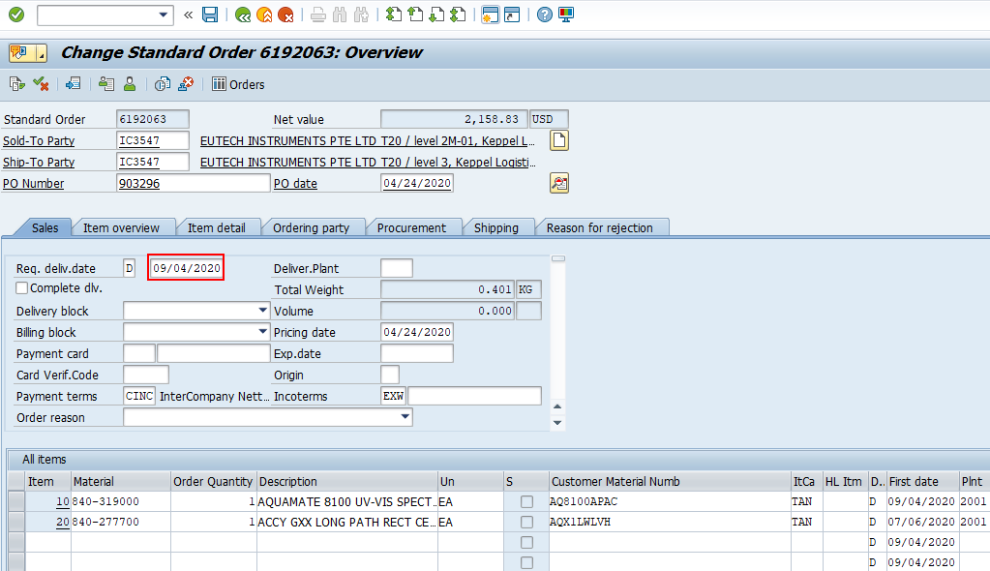
SO Reschedule
If customer reason to pull in /push out , We need to update the CRD :

Slide 13
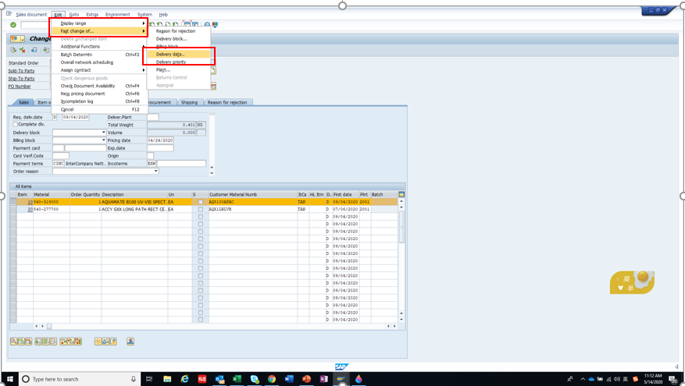
SO Reschedule
Then we will adjust the ship date
Select the item and click the edit as below

Slide 14
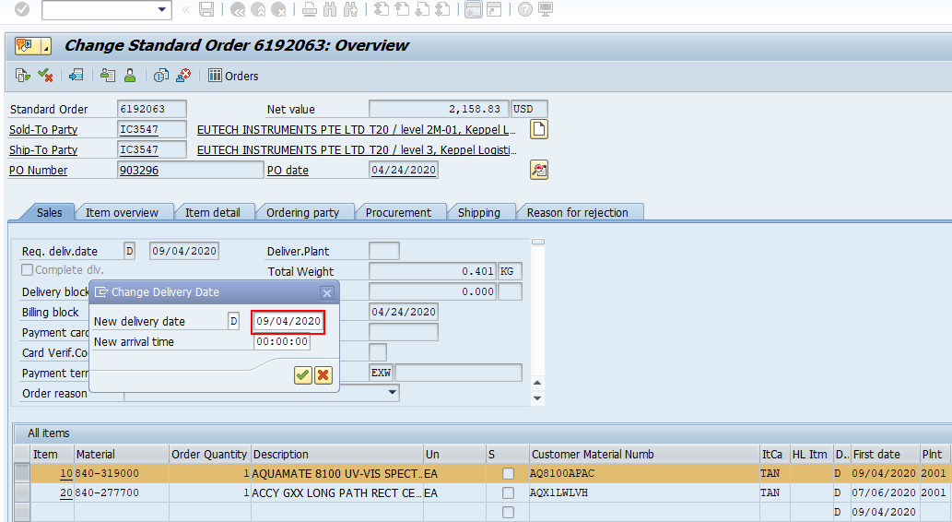
SO Reschedule
Update the delivery date as you want

Slide 15
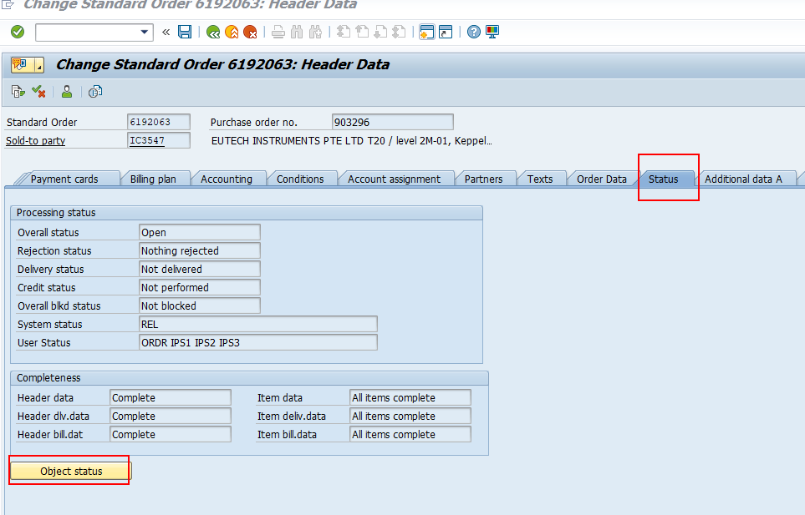
SO Reschedule
Click here

Slide 16
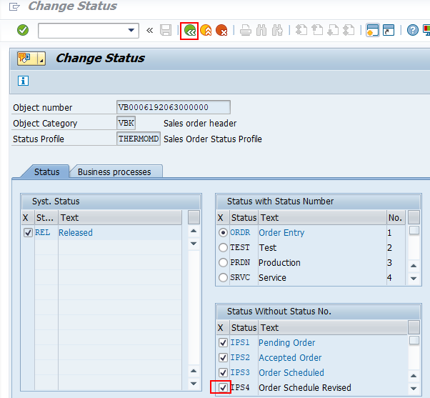

SO Reschedule
Tick IP3 Order Schedule Revised:
Go back and save the SO.

Slide 17
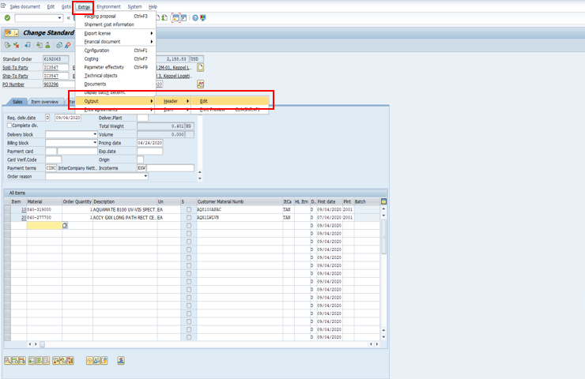
OA print
VA02-输入订单号，回车
输入Key Code :ZCNO
After we create the OA we need to print it as below :

Slide 18
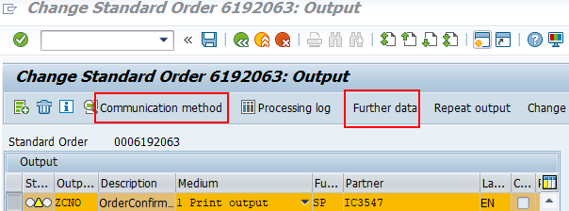
OA print

Slide 19
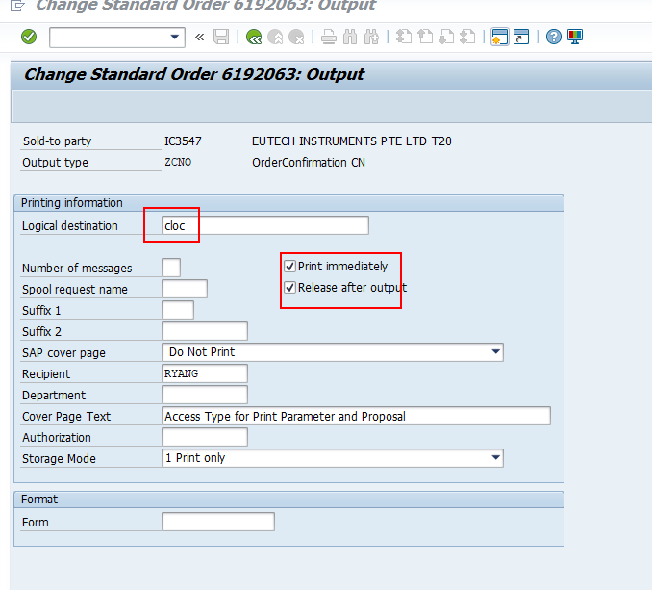
OA print
Input CLOC and click these two buttons

Slide 20
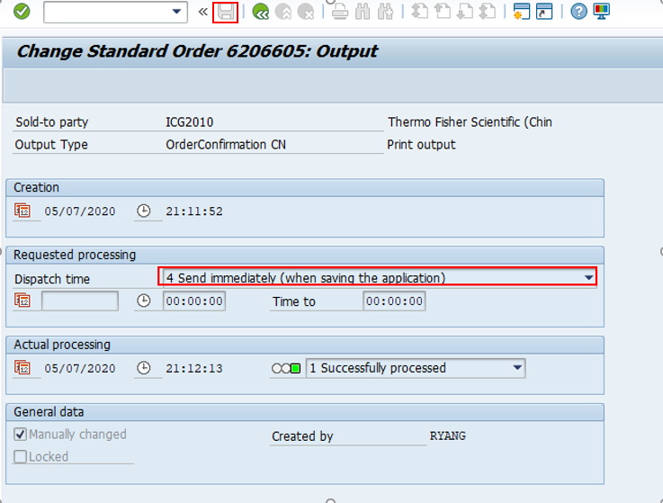
OA print
Select No.4 and Saved

Slide 21
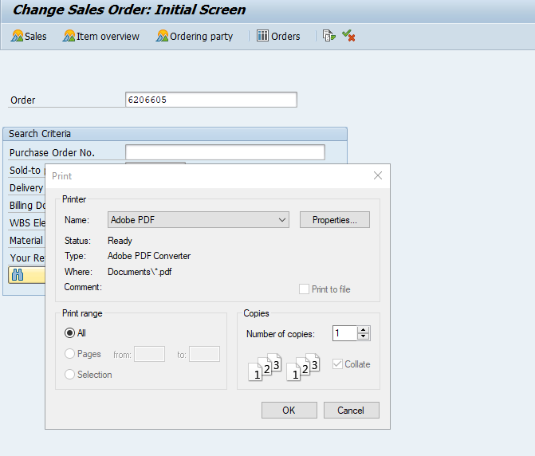
OA print
Saved and print as a PDF

Slide 22
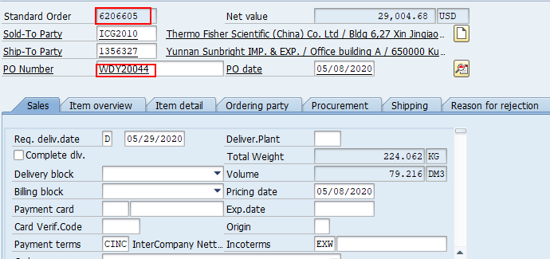
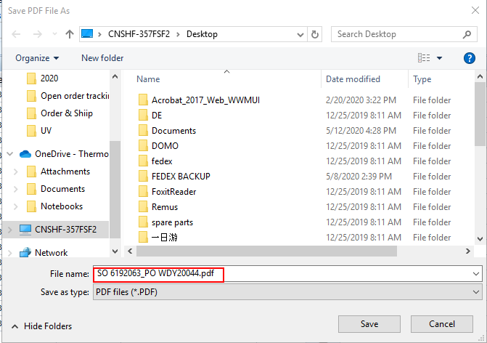
OA print
OA PDF file name with SO_PO number

