Slide 1
Event-Driven Microservices
Michael Lifshits

Slide 2
Agenda
Monolith
SOA & SOA Microservices
EDA Microservices
Kafka
Event Messaging
State Transfer
CQRS
Event Sourcing
Event Storming

Slide 3
Monolith
DB
Order
Shipping
Inventory
Customer
Notes:
Pros:
Code reuse for Domain, utility functions
Stable, fast, tightly-coupled, synchronous inter-communication
Global Data Consistency
Highly methodical Waterfall approach
Integration tests cover end-to-end system
Cons:
For big projects with a large teams – orchestration is very difficult. Few releases.
Mergers/Acquisitions – integration of monoliths usually done using ftp file transfer or enterprise integration tools

Slide 4
SOA - loosely coupled pieces of functionality
with orchestration
DB
Order
Shipping
Inventory
Customer
Data
Service Integration / ESB
Notes:
A service-oriented architecture (SOA) is a style of software design where services are provided to the other components by application components, through a communication protocol over a network.
Synchronous approach – REST/SOAP/XML-RPC
Pros:
Loose coupling of Design and Evolution of Implementation
Loose coupling of Service Contract and Data Schema

Slide 5
SOA Microservices – independently deployable
with orchestration
DB
Order
Shipping
Inventory
Customer
Data
Service Integration / ESB

Slide 6
SOA Microservices – choreography
Order
Shipping
Inventory
Customer
Notes:
Distributed Transaction supporting ACID – Atomicity, Consistency, Isolation, Durability (rollback or compensation)

Slide 7
Buying an item on Amazon
Request/Response
Order
Reserve
Order
Submit
Order
WEB
Server
Inventory
Get
Customer
Ship
Order
Update
Inventory
Sign Up
Shipping
Customer
Get
Customer
Notes:
SOA came with set of technologies for Orchestration and Choreography – BPEL, BPMN
But thinks grew out of control…

Slide 8
Real-time graph of microservice dependencies at amazon.com in 2008.
per Werner Vogels‏ tweet

Slide 9
Apache Kafka
Apache Kafka is a distributed, partitioned, replicated commit log service. It provides the functionality of a messaging system, but with a unique design.
Notes:
Having Kafka base SDP with

Slide 10
Kafka Brokers/Topics/Partitions
Broker 1
Broker 2
Broker 3
Topic A
Topic A
Topic A
Partition 0
Partition 0
Partition 0
Partition 1
Partition 1
Partition 1
Partition 2
Partition 2
Partition 2
* Leader and replicas
Notes:
Kafka is deployed as cluster of Kafka brokers.
AWS cross-region deployment of two clusters of Kafka with replication index of 3 achieving durability comparable to S3 (99.999999999%)

Slide 11
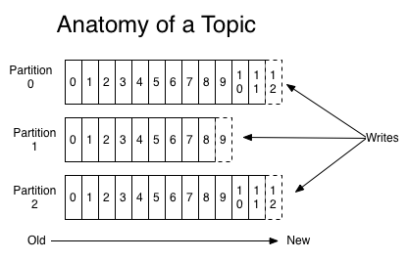
Kafka Topics

Slide 12
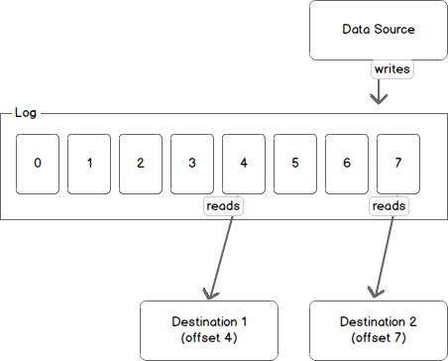
Kafka Partition

Slide 13
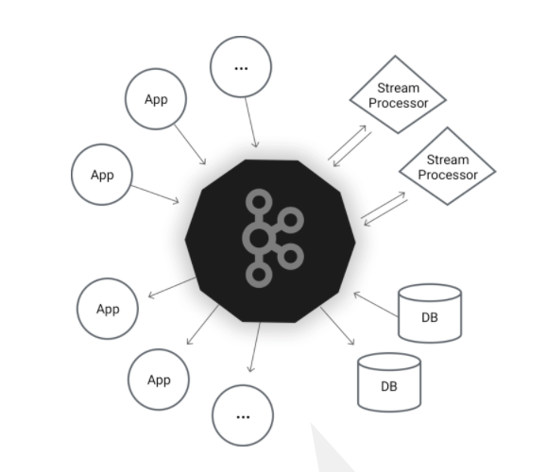
Kafka API
API
Producer
Consumer
Streams
Connect
Notes:
The Producer API allows an application to publish a stream of records to one or more Kafka topics.
The Consumer API allows an application to subscribe to one or more topics and process the stream of records produced to them.
The Streams API allows an application to act as a stream processor, consuming an input stream from one or more topics and producing an output stream to one or more output topics, effectively transforming the input streams to output streams.
The Connector API allows building and running reusable producers or consumers that connect Kafka topics to existing applications or data systems. For example, a connector to a relational database might capture every change to a table.

Slide 14
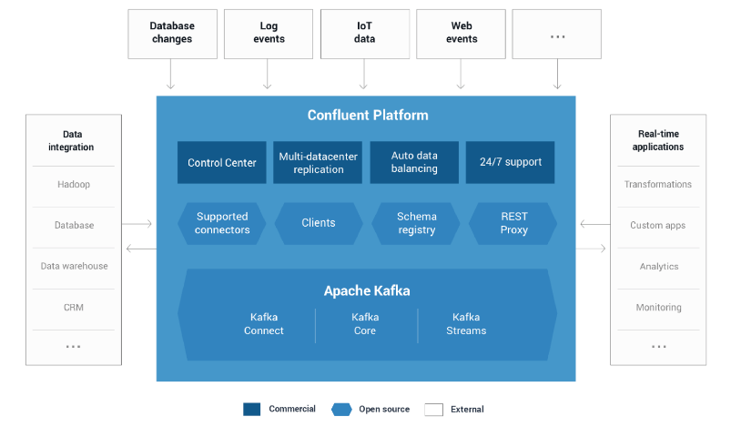
Confluent

Slide 15
Buying an item on Amazon
EDA (Notification Only)
Kafka
Order
Order
Submitted
Submit
Order
WEB
Server
Inventory
Order
Validated
Get
Customer
Login
Shipping
Order
Shipped
Customer
Get
Customer

Slide 16
Buying an item on Amazon
EDA (Notification + State Transfer)
Kafka
Order
Order
Submitted
Submit
Order
WEB
Server
Inventory
Order
Reserved
Signup
Shipping
Order
Shipped
Customer
Customer
Created

Slide 17
Buying an item on Amazon
(Shipping Service on maintenance)
Kafka
Order
Order
Submitted
Submit
Order
WEB
Server
Inventory
Order
Reserved
Signup
Shipping
Order
Shipped
Customer
Customer
Created

Slide 18
Command Query Responsibility Segregation (CQRS)
Kafka
Order
Command
Resource
Producer
WEB
Server
Submit
Order
Consumer
Get
Order
Query
Resource
Service
DB

Slide 19
Event Sourcing
Kafka
Order
Command
Resource
Producer
Consumer
Query
Resource
Service
DB

Slide 20
Event Storming
Customer
Sign Up
Customer
Created
Inventory
Inventory
Updated
Employee
Update
Inventory
Customer
Order
Shipping
Submit
Order
Order
Submitted
Order
Reserved
Customer not Created
Order
Shipped
Customer
Notes:
How to break monolith into a set of cohesive and loosely coupled aggregates
An AGGREGATE is a cluster of associated objects that we treat as a unit for the purpose of data changes. External references are restricted to one member of the Aggregate, designated as the root. A set of consistency rules applies within the Aggregate's boundaries. Eric Evans 2003 DDD
Alberto Brandolini - It started like a tool for discovering Aggregates, then became a teaching tool for the DDD-illiterates.
Prerequisite
Invite the right people – business, IT, UX
Provide unlimited modeling space – surface, markers, stickies
Model a whole business line with domain events
- Establish Timeline
Domain events (verb at past tense)
Commands
Actors
Hot Spots
Aggregates
Bounded Context

Slide 21
Q?
Thank You!

