Slide 1
Co-EmP: Context-aware Emotion and Personality Alignment
Michael Lin · Senior Project Presentation
Advisor: Mr. Benjamin Newton

Slide 2

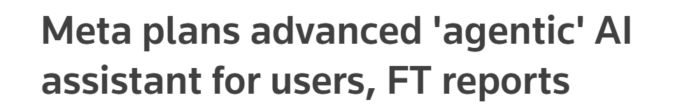
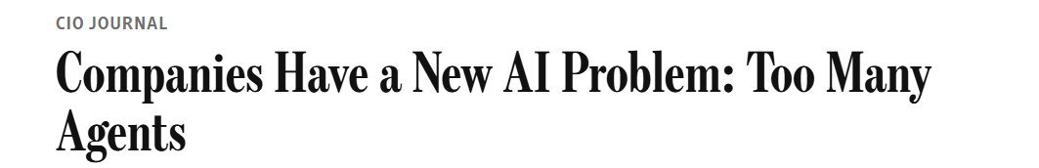
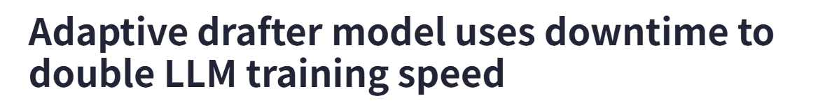


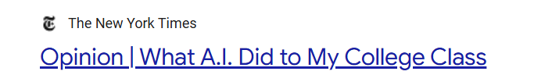
o
LLM

Slide 3
What is Large Language Model?
A type of Artificial Intelligence that encodes natural language into numbers and decodes these numbers into another response in natural language.
How are you today?
AI
I’m fine thank you.
Why is the answer to the universe “42”?
AI
…

Slide 4
o
What is Large Language Model?
Why is the answer to the universe “42”?
Encode
Transformer
Tokens
Next-token-prediction
Decode
is | 0.94
has | 0.03
comes | 0.02
… | …
a | 0.57
not | 0.34
what | 0.09
… | …
joke | 0.33
story | 0.24
classic | 0.08
… | …
from | 0.45
made | 0.27
told | 0.11
… | …
This
is
a
joke
from
Douglas Adams’
The HitchHiker’s Guide to the Galaxy

Slide 5
How do we understand LLM?
Natrual Language
Human Intelligence
Context
Reasoning
Affect
Memory
Logic
emotion

Slide 6

o
Differences between LLM
Number of parameters and number of training text matters.
“Oh great, another meeting added to my calendar.”
Chat-GPT 5.5 - 9.7Trillons
Qwen3.5 - 4Billion

Slide 7
Project Goal
Investigate the feasibility of modeling emotion dynamics and personality for dialogue-based generation in low-resource scenarios.
Notes:
Also mention why project

Slide 8
o
Overall Road Map
Raw Text
?
Emotion
?
Emotional State
LLM
New Raw Text
Prompt

Slide 9
o
Text-to-Emotion – VAD Model
Albert Mehrabian and James A. Russell
A metric that projects any emotion into a 3D vector space
- Valence (Pleasure): The pleasantness of the emotion (ranging from unhappy/negative to extreme happiness/positive).
- Arousal: The intensity of the emotion (ranging from calm/sleep to excited/high-energy).
- Dominance (Control): The degree of control or power the person feels over the situation (ranging from feeling submissive/powerless to feeling in control).

Slide 10
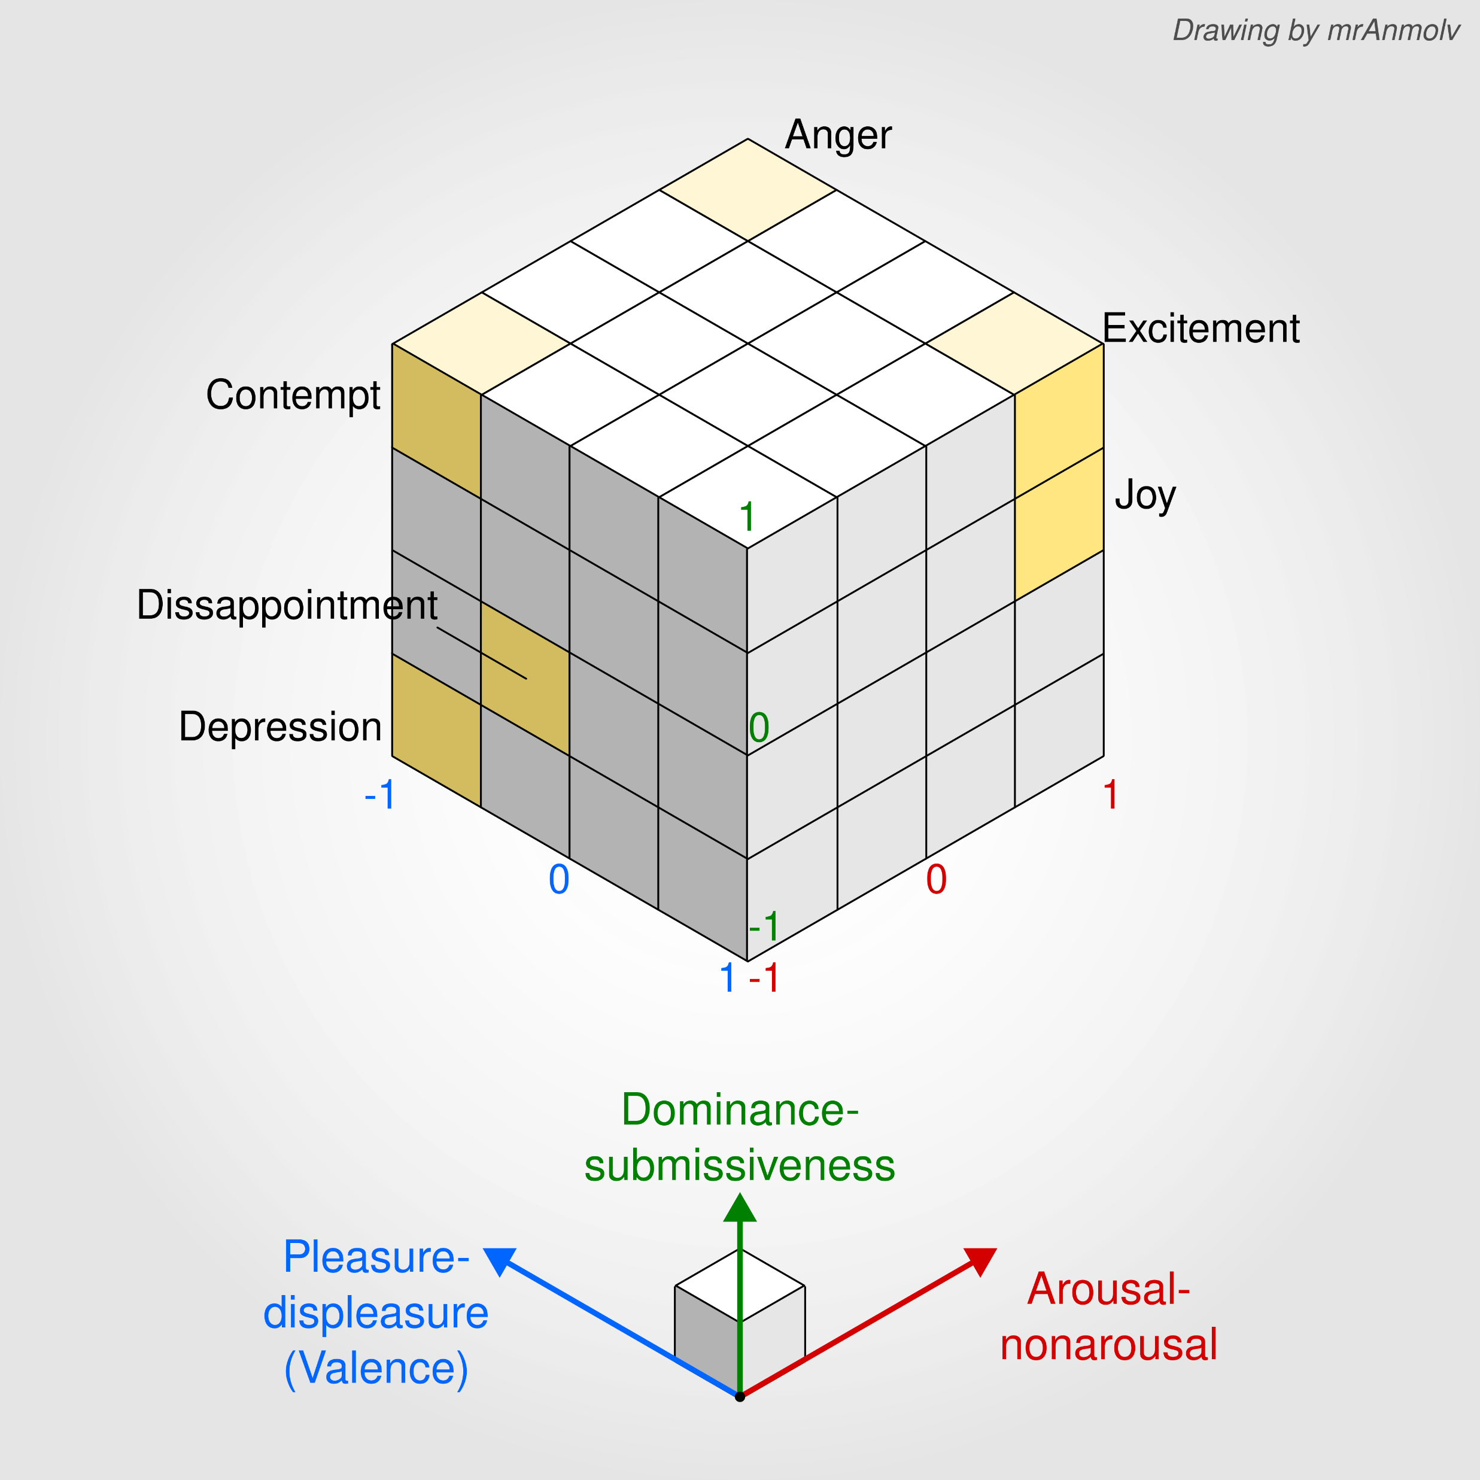
o

Slide 11
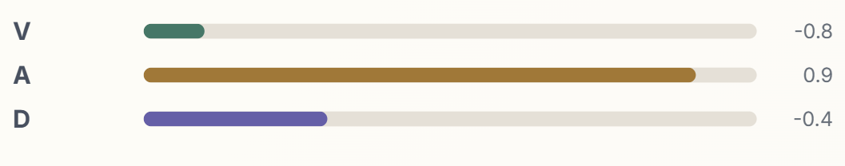
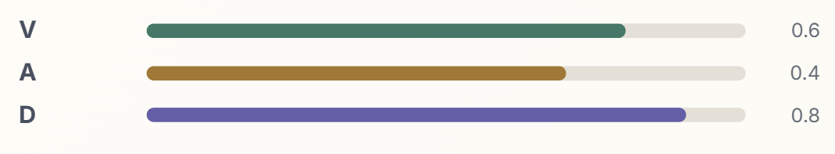
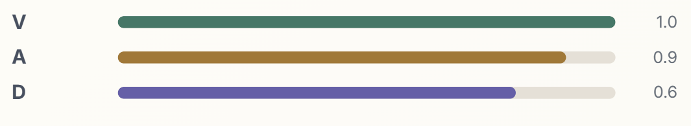
o
Text-to-Emotion – VAD Model
Alright, I'm watching. Nice aim! You did it.
You did it! I knew you would...
And don't pretend you did it out of kindness...

Slide 12
o
Text-to-Emotion – Training
train
?
Emotion
predicted
Emotion
real
Raw Text
deBERTa V3
compare
Datasets
-DailyDialogue
-EmpatheticDialogue
-EmoBank
-EmoDynamic (custom AI generated)
deBERTa V3
Transformer

Slide 13
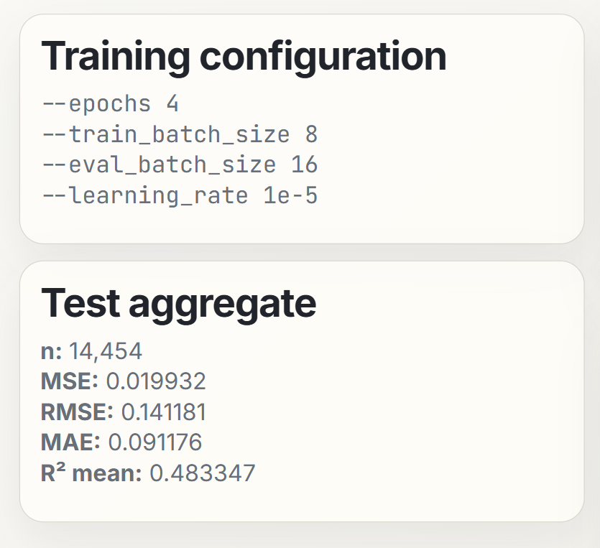
o
Text-to-Emotion – Results

Slide 14
o
Overall Road Map
Raw Text
?
?
Emotion Dynamic
deBERTa V3
Emotion
LLM
New Raw Text
Prompt

Slide 15
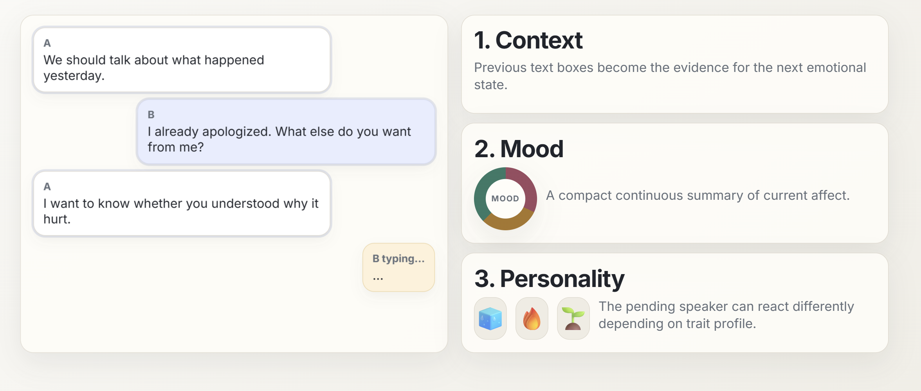
o
Emotion-to-Dynamic – thoughts

Slide 16
o
Emotion-to-Dynamic – Personality
Big Five Personality Traits (OCEAN)
O - Openness to Experience: Describes a person’s willingness to think abstractly, engage with new ideas, appreciate art, and seek novel adventures.
C - Conscientiousness: Reflects a person's level of self-discipline, goal-driven behavior, and adherence to rules and duty.
E - Extraversion: Measures where individuals draw their energy and how they engage with the social world.
A - Agreeableness: Represents one's prosocial tendencies, empathy, and desire to help others.
N - Neuroticism (or Emotional Stability): Gauges an individual's vulnerability to stress and tendency to experience negative emotions.

Slide 17
o
Emotion-to-Dynamic – Gated Recurrent Unit
Gated Recurrent Unit (GRU) model is a traditional AI model that specializes in processing sequential data
emotion states
Emotion
at turn t-1
Emotion
at turn t
Raw Text
at turn t
Personality

Slide 18
o
Emotion-to-Dynamic – Training
Emotion Dynamic
Emotion
initial
Emotion
t1
…
?
Emotion
t1 predicted
Emotion
t2 predicted
…
GRU
train
compare
Datasets
Emotion
t1 real
Emotion
t2 real
…
-EmoDynamic (custom AI generated)

Slide 19
o
Emotion-to-Dynamic – Results
GRU train
Loaded data:
raw dialogues: 4225
train dialogues: 3591
val dialogues: 634
train sequences: 6033
val sequences: 1051
chunk_len: None
include_first_turn:True
device: cuda
val_mse=0.00445 val_rmse=0.06567 val_mae=0.04572

Slide 20
o
Overall Road Map
Raw Text
deBERTa V3
Emotion
?
Emotion Dynamic
GRU
LLM
New Raw Text
Prompt

Slide 21
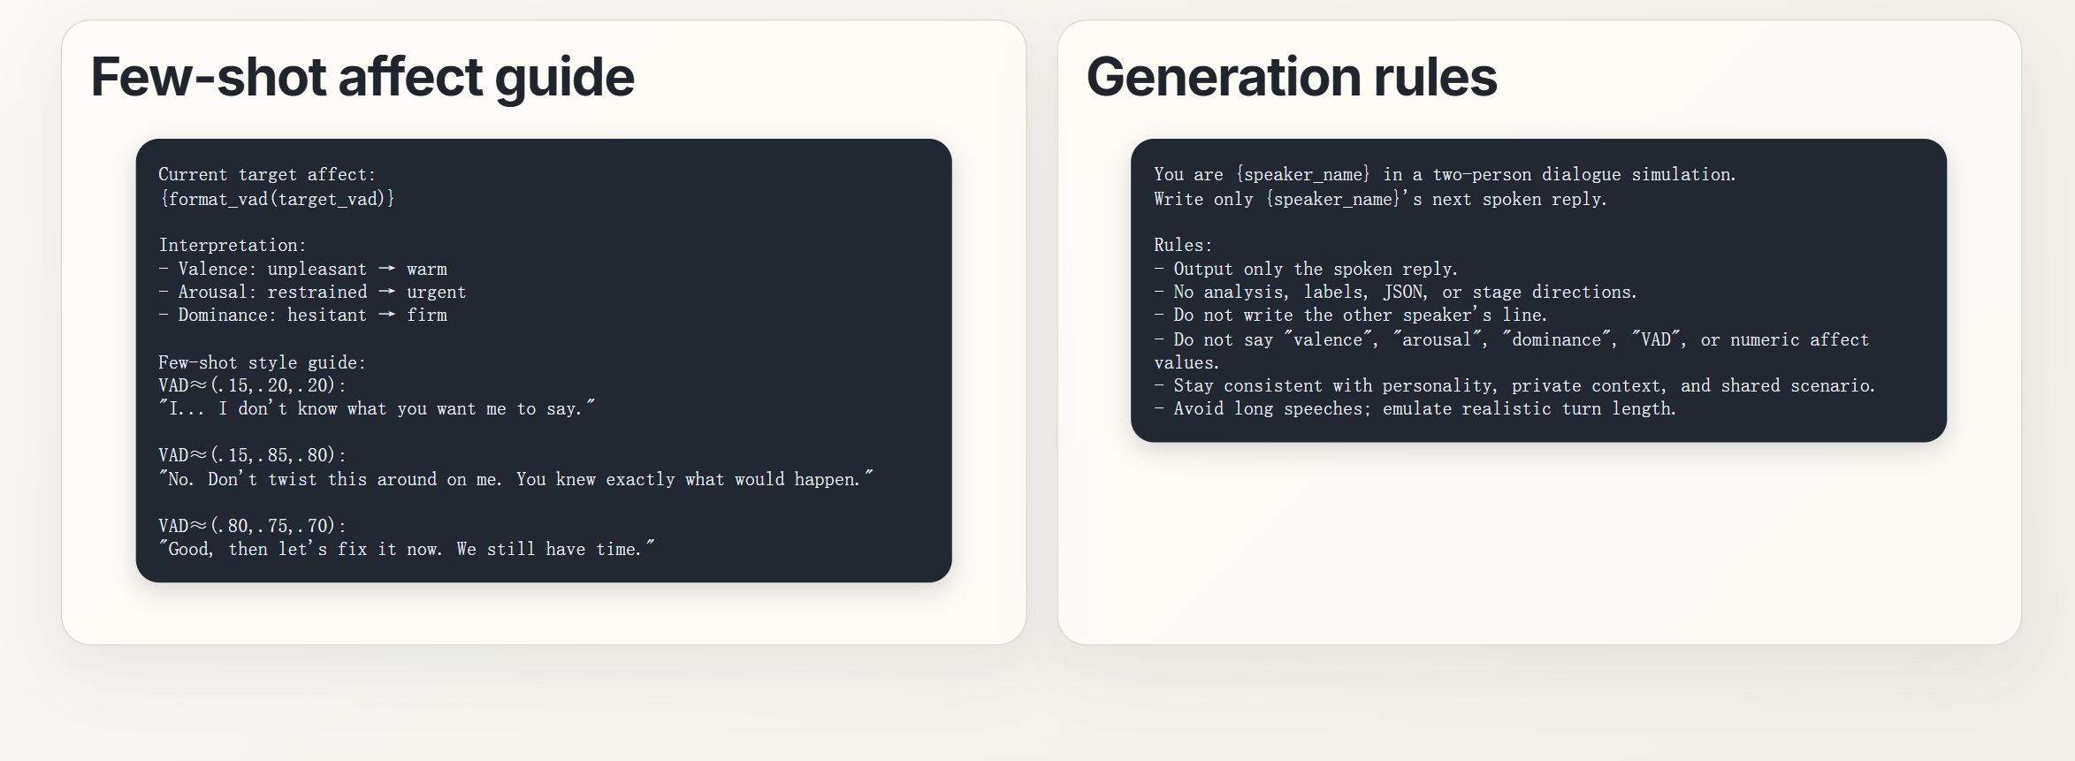
o
Prompt Engineering

Slide 22
o
Demo
https://github.com/MichaelLin3333/Co-EmP

Slide 23
o
Conclusion
We mainly worked on three different parts to achieve emotion dynamic modeling aligning with contextual evidence and personality:
VAD encoder: Converts raw natural language into Valence, Arousal, and Dominance metric.
GRU: Predict the VAD metric for the next upcoming text based on contextual emotional states from the past.
LLM: generate text that are emotionally aligned with what GRU had instructed it.

Slide 24
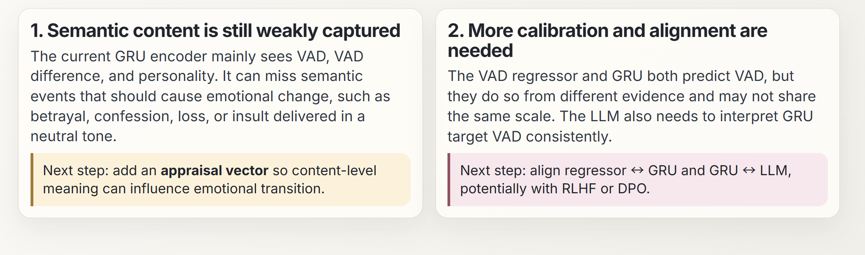
o
Limitations

Slide 25
o
Important References
Russell, J. A. & Mehrabian, A. (1977). “Evidence for a three-factor theory of emotions.”
Goldberg, L. R. (1990). “An alternative description of personality: The Big-Five factor structure.”
Kshirsagar, S. & Magnenat-Thalmann, N. (2002). “A Multilayer Personality Model.”
Egges, A., Kshirsagar, S., & Magnenat-Thalmann, N. (2003). “A Model for Personality and Emotion Simulation.”
Buechel, S. & Hahn, U. (2017). “EmoBank: Studying the Impact of Annotation Perspective and Representation Format on Dimensional Emotion Analysis.”
Li, Y. et al. (2017). “DailyDialog: A Manually Labelled Multi-turn Dialogue Dataset.”
Rashkin, H. et al. (2019). “Towards Empathetic Open-domain Conversation Models.”
He, P., Gao, J. & Chen, W. (2021). “DeBERTaV3: Improving DeBERTa using ELECTRA-style Pre-training with Gradient-disentangled Embedding Sharing.”
Cho, K. et al. (2014). “Learning Phrase Representations using RNN Encoder-Decoder for Statistical Machine Translation.”
Schuller, B. et al. (2024/2026). “Affective Computing Has Changed: The Foundation Model Disruption.”
Gandhi, K. et al. (2024). “Human-like Affective Cognition in Foundation Models.”
Ishikawa, S. & Yoshino, A. (2025). “AI with Emotions: Exploring Emotional Expressions in Large Language Models.”
Abid, A. et al. (2019). “Gradio: Hassle-Free Sharing and Testing of ML Models in the Wild.”

