Slide 1
Flight Dataset
Data Cleaning, Visualization and Regression

Slide 2
Team Members
ID | Name
20191700488 | مايكل مدحت منير لوكا
20191700476 | ماريو ممدوح رضا رزق
20191700444 | فيليب وجيه جورج حنا
20191700462 | كيرمينا اشرف ميخائيل ميخائيل
20191700486 | مايكل فريد فؤاد حنين

Slide 3
Dataset Description
Flight Dataset

Slide 4
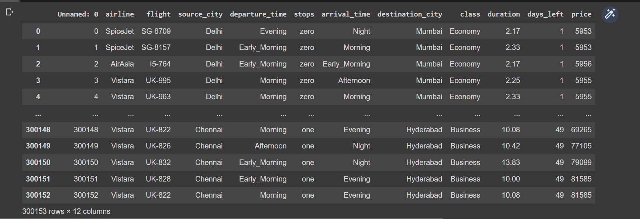
Dataset Description
The Dataset contains 12 columns and 300152 rows.
It describes the departure time, arrival time, source city, destination city, flight number, name of airline, class, duration, days left and price of each flight.

Slide 5
Data Visualization
5 Charts

Slide 6
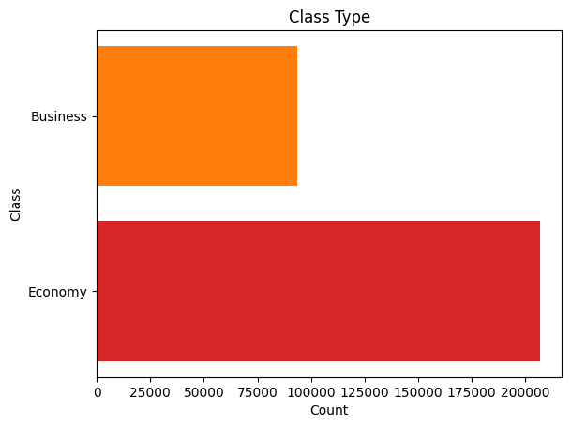
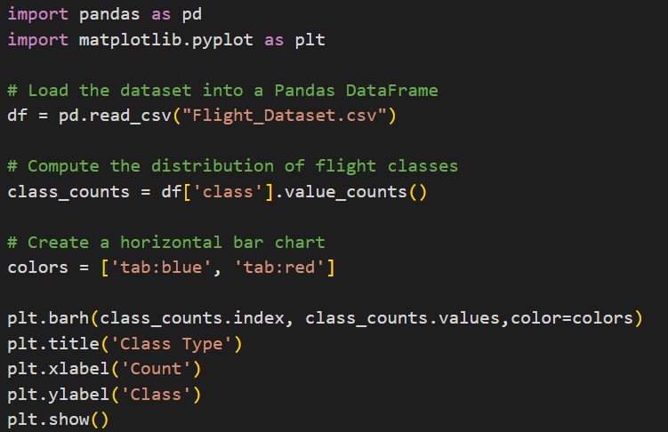
Data Visualization
Horizontal Bar Chart

Slide 7
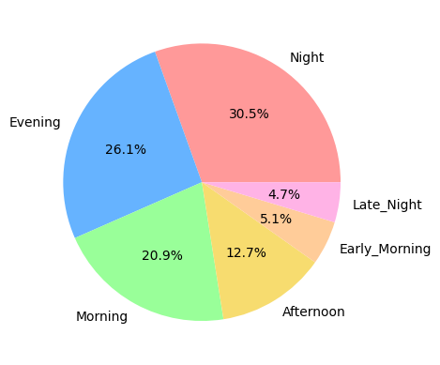
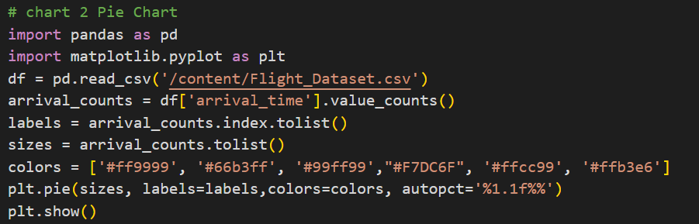
Data Visualization
Pie Chart

Slide 8
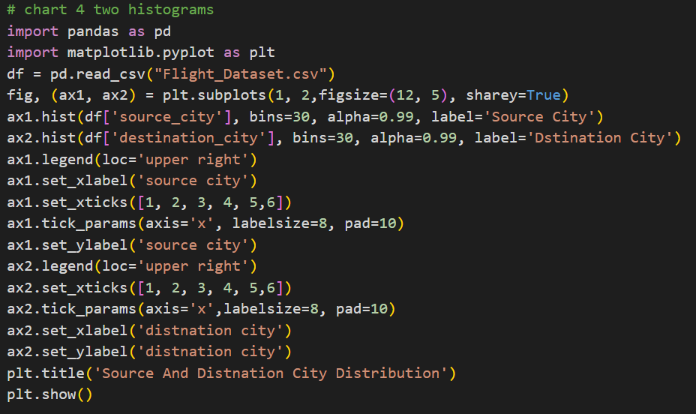
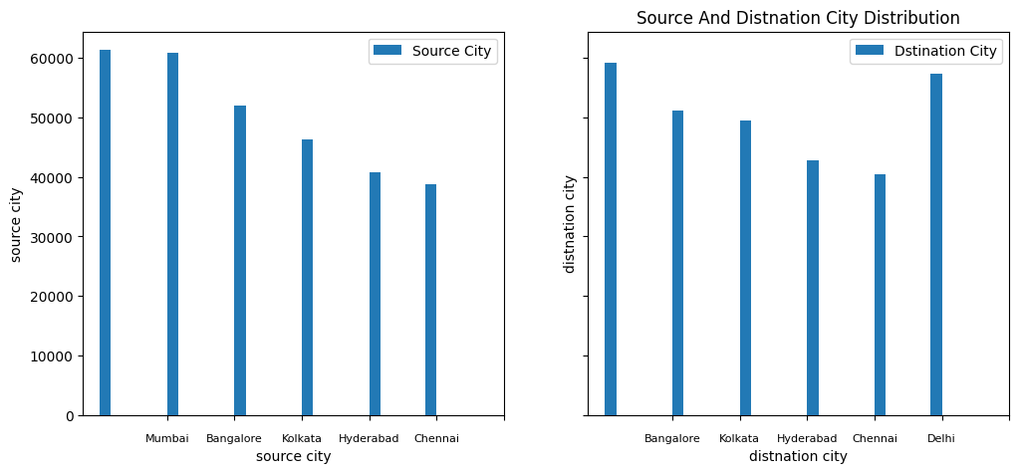
Data Visualization - Two Histograms

Slide 9
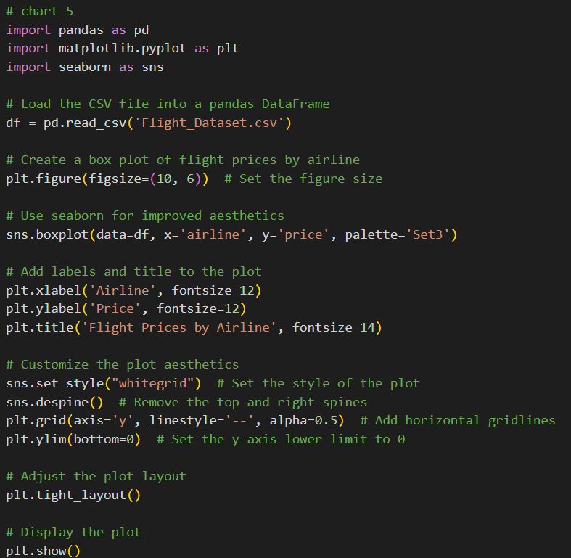
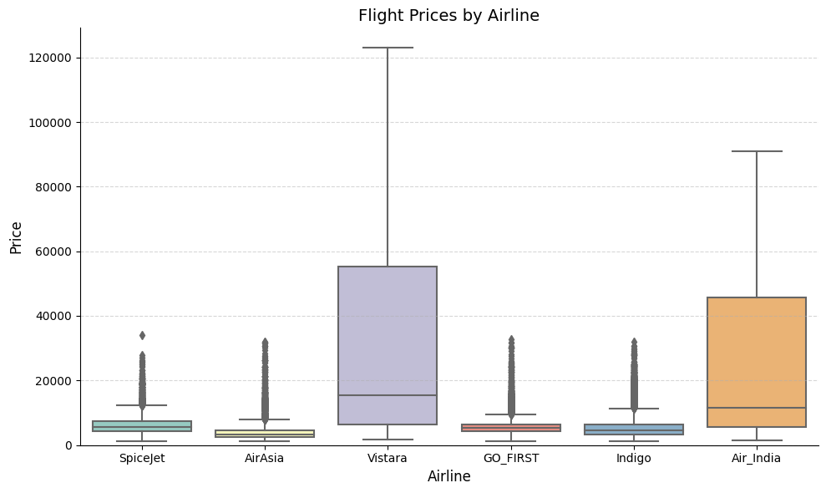
Data Visualization - Box Plot

Slide 10
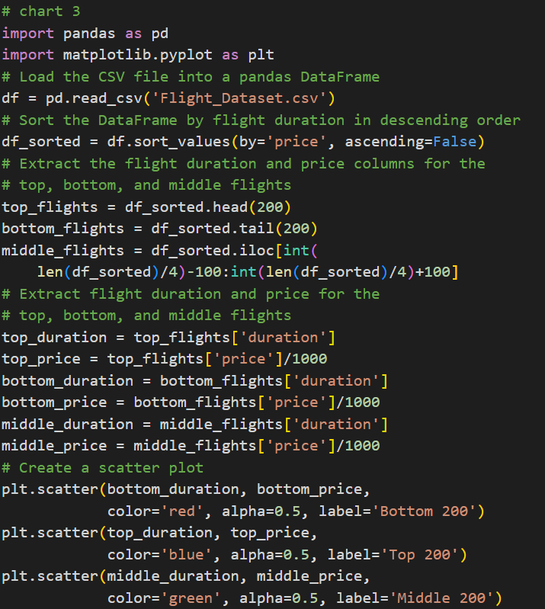
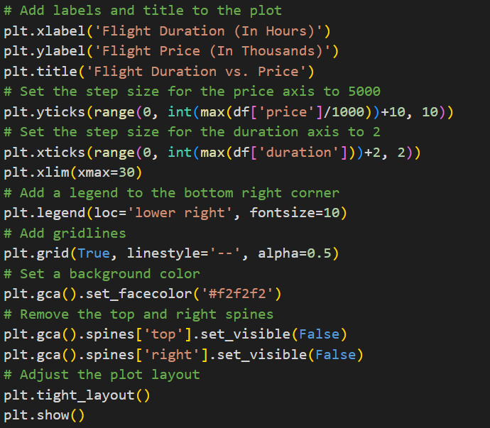
Data Visualization - Scatter Plot

Slide 11
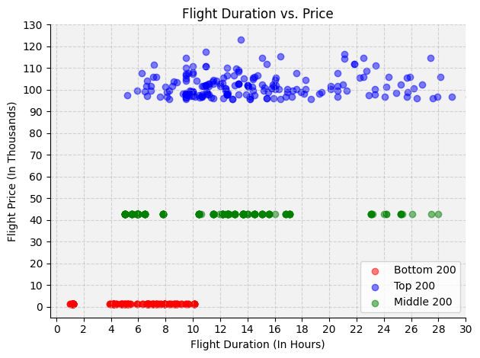
Data Visualization - Scatter Plot

Slide 12
Data Preprocessing
Encoding, Categorical conversion, Correlation matrix

Slide 13
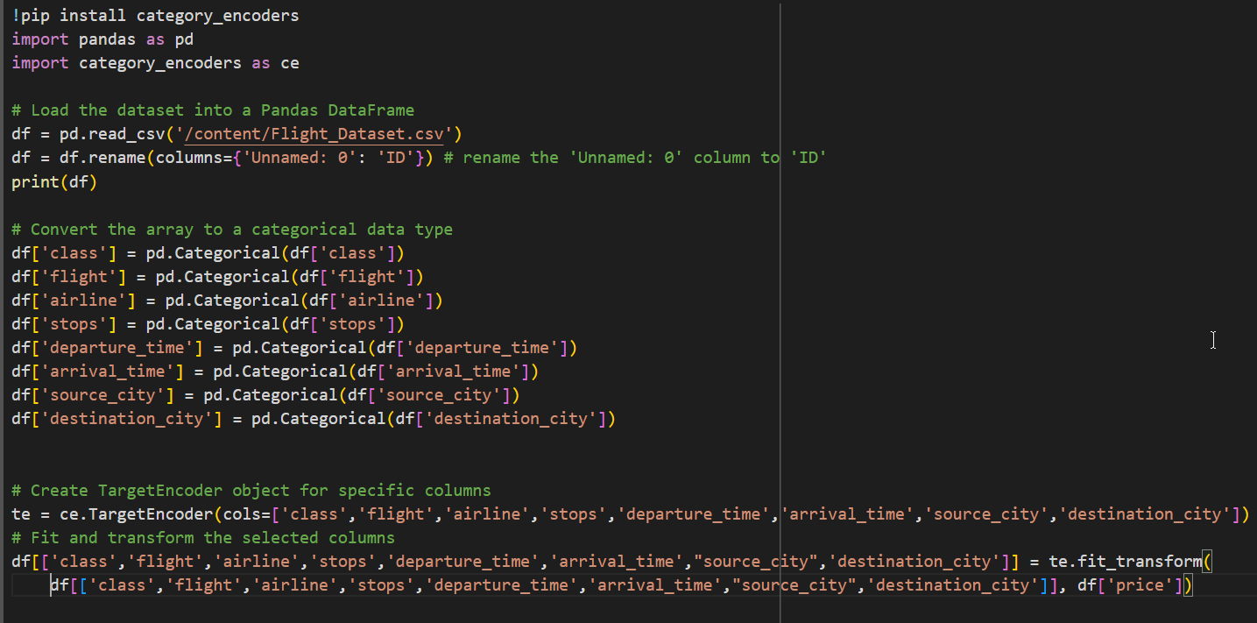
Data Preprocessing
Rename the unnamed column to ID
Covert all the Arrays to Categorical Data type
Encode Specific columns with Target Encoder

Slide 14
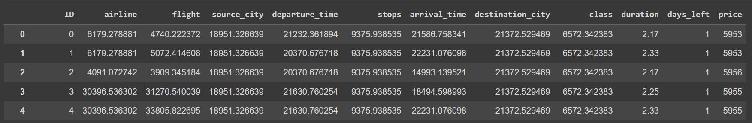
Data Preprocessing
After Encoding

Slide 15
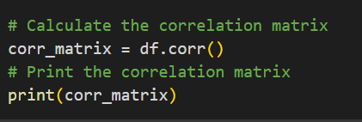
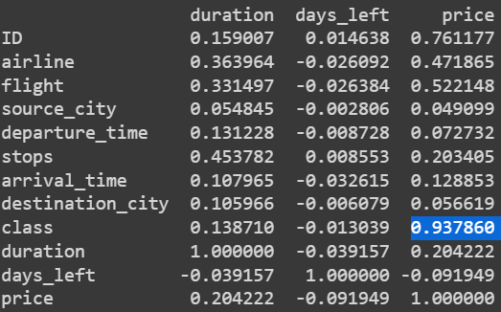
Data Preprocessing
Calculates the correlation matrix that shows the correlation coefficient between a set of variables.
This shows the strength of a relationship between two variables.

Slide 16
Regression
Gradient Descent

Slide 17
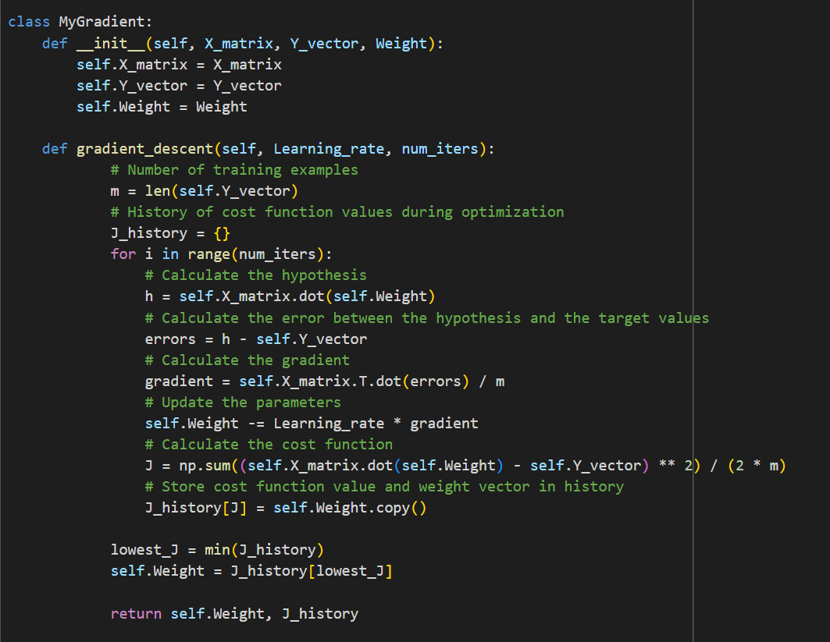
Regression Using Gradient Descent
Implemented Gradient Descent
Parameters: X Train Data, Y Train Data, Initial weight value, Learning Rate, Number Of Iterations.
Returns the best weight vector and Cost Function Dictionary.
Calculates the weight vector and the cost function, insert into “J_history” dictionary: Cost function for the key and Weights vector for the values.

Slide 18
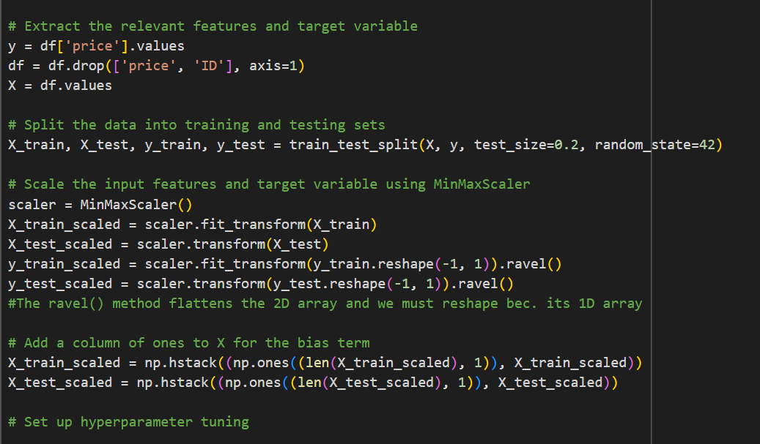
Regression Using Gradient Descent
Data Preparation
Use the Price as Target variable
Remove “Price” and “ID” columns from the Data Frame and use all the Data frame to predict the price
Split the data into training and testing sets
Scale the input features and target variable using MinMaxScaler
Add a column for the bias term

Slide 19
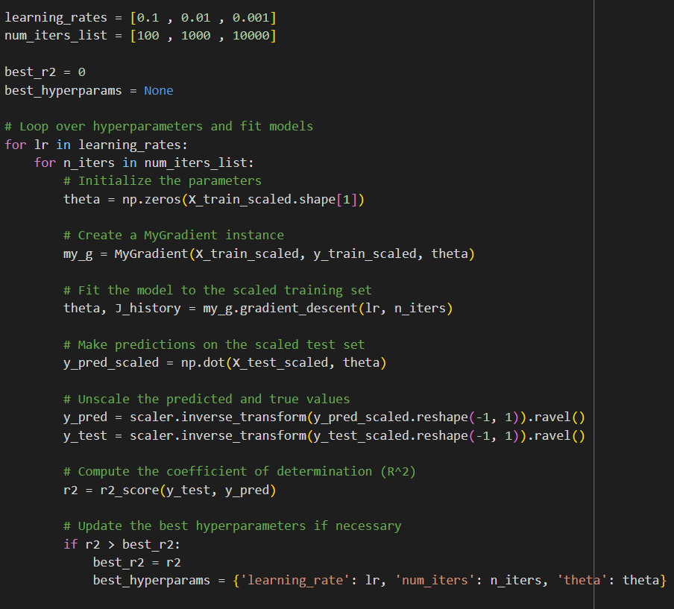
Regression Using Gradient Descent
Find the best Hyperparameter
Set up hyperparameter tuning
Loop over hyperparameters and fit models

Slide 20
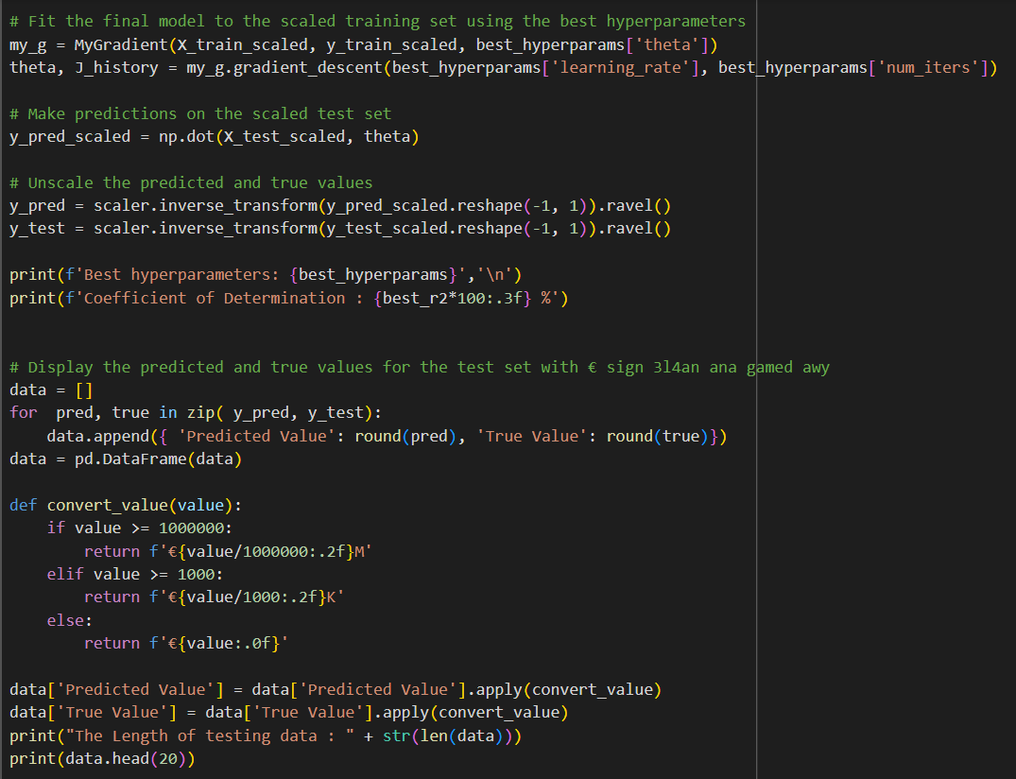
Regression Using Gradient Descent
Model fitting and prediction
Fit the final model to the scaled training set using the best hyperparameters
Make predictions on the scaled test set
Unscale the predicted and true values
Display the predicted and true values for the test set with “€” sign

Slide 21
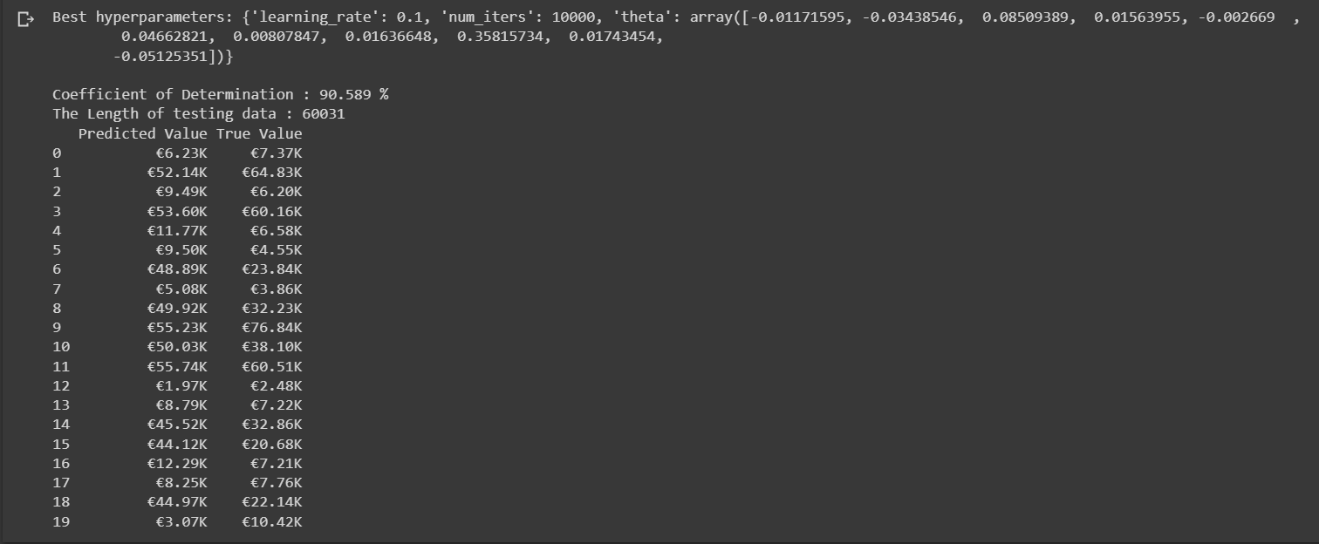
Regression Using Gradient Descent
The model prints the best:
Learning Rate
No. of iterations
Theta values
Print The Predicted Value vs. Actual Value
R2 Score = 90.5%
Length of testing data: 60K

Slide 22
Thank You

