Slide 1
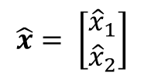
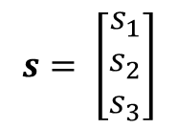


$$s= \left[\begin{aligned}s_{1} \\ s_{2} \\ s_{3}\end{aligned}\right]$$
$$\hat{x}= \left[\begin{aligned}{\hat{x}}_{1} \\ {\hat{x}}_{2}\end{aligned}\right]$$
$$x= \left[\begin{aligned}x_{1} \\ x_{2}\end{aligned}\right]$$
$$u$$
Sensorik
Zustands-
schätzung
Filter
Regler
Stellglied

