Slide 1



Security Solution Justification
A Comprehensive Security Architecture for Business Expansion
Grow Management Consultants
Grow Management Consultants
1

Slide 2







Business Context
Company Profile
Business Expansion
Established 5 years ago, Grow Management Consultants specializes in leadership performance improvement services.
Establishing two new offices in capital cities, requiring robust enterprise architecture.
Current IT Environment
Core Services
Head office with 6 workstations, consultants using own laptops, Office 365 for communication, OneDrive for data storage.
Mentoring, training, coaching, management consultation, and program evaluation.
Core Values
Security Need
Quality, Innovation, Respect, and Reliability.
Comprehensive security solution to protect assets, maintain client trust, and support business growth.
Grow Management Consultants
2

Slide 3







Security Requirements
Clear Security Strategy
Well-defined security strategy and IT Security Policy to guide security practices and ensure consistency across all locations.
Strong Security Controls
Robust security controls to protect systems, data, and infrastructure from potential threats and vulnerabilities.
Risk-Based Security Architecture
Security architecture designed based on identified business risks to ensure security investments align with the organization's risk profile.
Multilevel Security Model
A multilevel security model ensuring appropriate access permissions, with specific access controls for different types of data.
Comprehensive Data Protection
Protection for all types of data, including both data at rest and data in transit, across all business locations.
Measurable Security Effectiveness
Testing methods and metrics to measure security effectiveness and demonstrate value to the business.
Grow Management Consultants
3

Slide 4







Risk Assessment
Data Breach Risk
High
Malware and Ransomware Risk
High
Potential loss of client trust, regulatory penalties, reputational damage, and financial loss.
Data loss, system downtime, and financial extortion.
Third-Party Risk
Medium
Business Continuity Risk
High
Security vulnerabilities introduced by vendors and compliance issues.
Disruption to service delivery, financial loss, and client dissatisfaction.
Infrastructure Risk
High
Unauthorized Access Risk
High
Vulnerabilities in expanding network infrastructure across multiple locations.
Data theft, system compromise, and unauthorized modifications.
Risk Assessment Methodology
Our structured approach includes asset identification, threat identification, vulnerability assessment, impact analysis, likelihood assessment, risk evaluation, and risk treatment planning.
Grow Management Consultants
4

Slide 5








Proposed Security Solution
Identity and Access Management
Security Monitoring
Multi-factor authentication, role-based access control, privileged access management, and regular access reviews.
Security information and event management, user behavior analytics, vulnerability scanning, and security metrics.
Network Security
Security Policies
Next-generation firewalls, intrusion detection/prevention, secure VPN, and network segmentation.
Information Security Policy, Acceptable Use Policy, Data Classification Policy, and Incident Response Policy.
Data Protection
Security Awareness
Encryption for data at rest and in transit, data loss prevention, secure file sharing, and database monitoring.
Regular security awareness training, phishing simulations, and security communications.
Endpoint Security
Physical Security
Endpoint detection and response, anti-malware protection, host-based firewalls, and device encryption.
Access control systems, surveillance, visitor management, and environmental controls.
Multilevel Security Model
Our solution implements a defense-in-depth strategy with multiple security layers. Access controls are based on the principle of least privilege, and data protection measures are implemented for both data at rest and in transit.
Grow Management Consultants
5

Slide 6

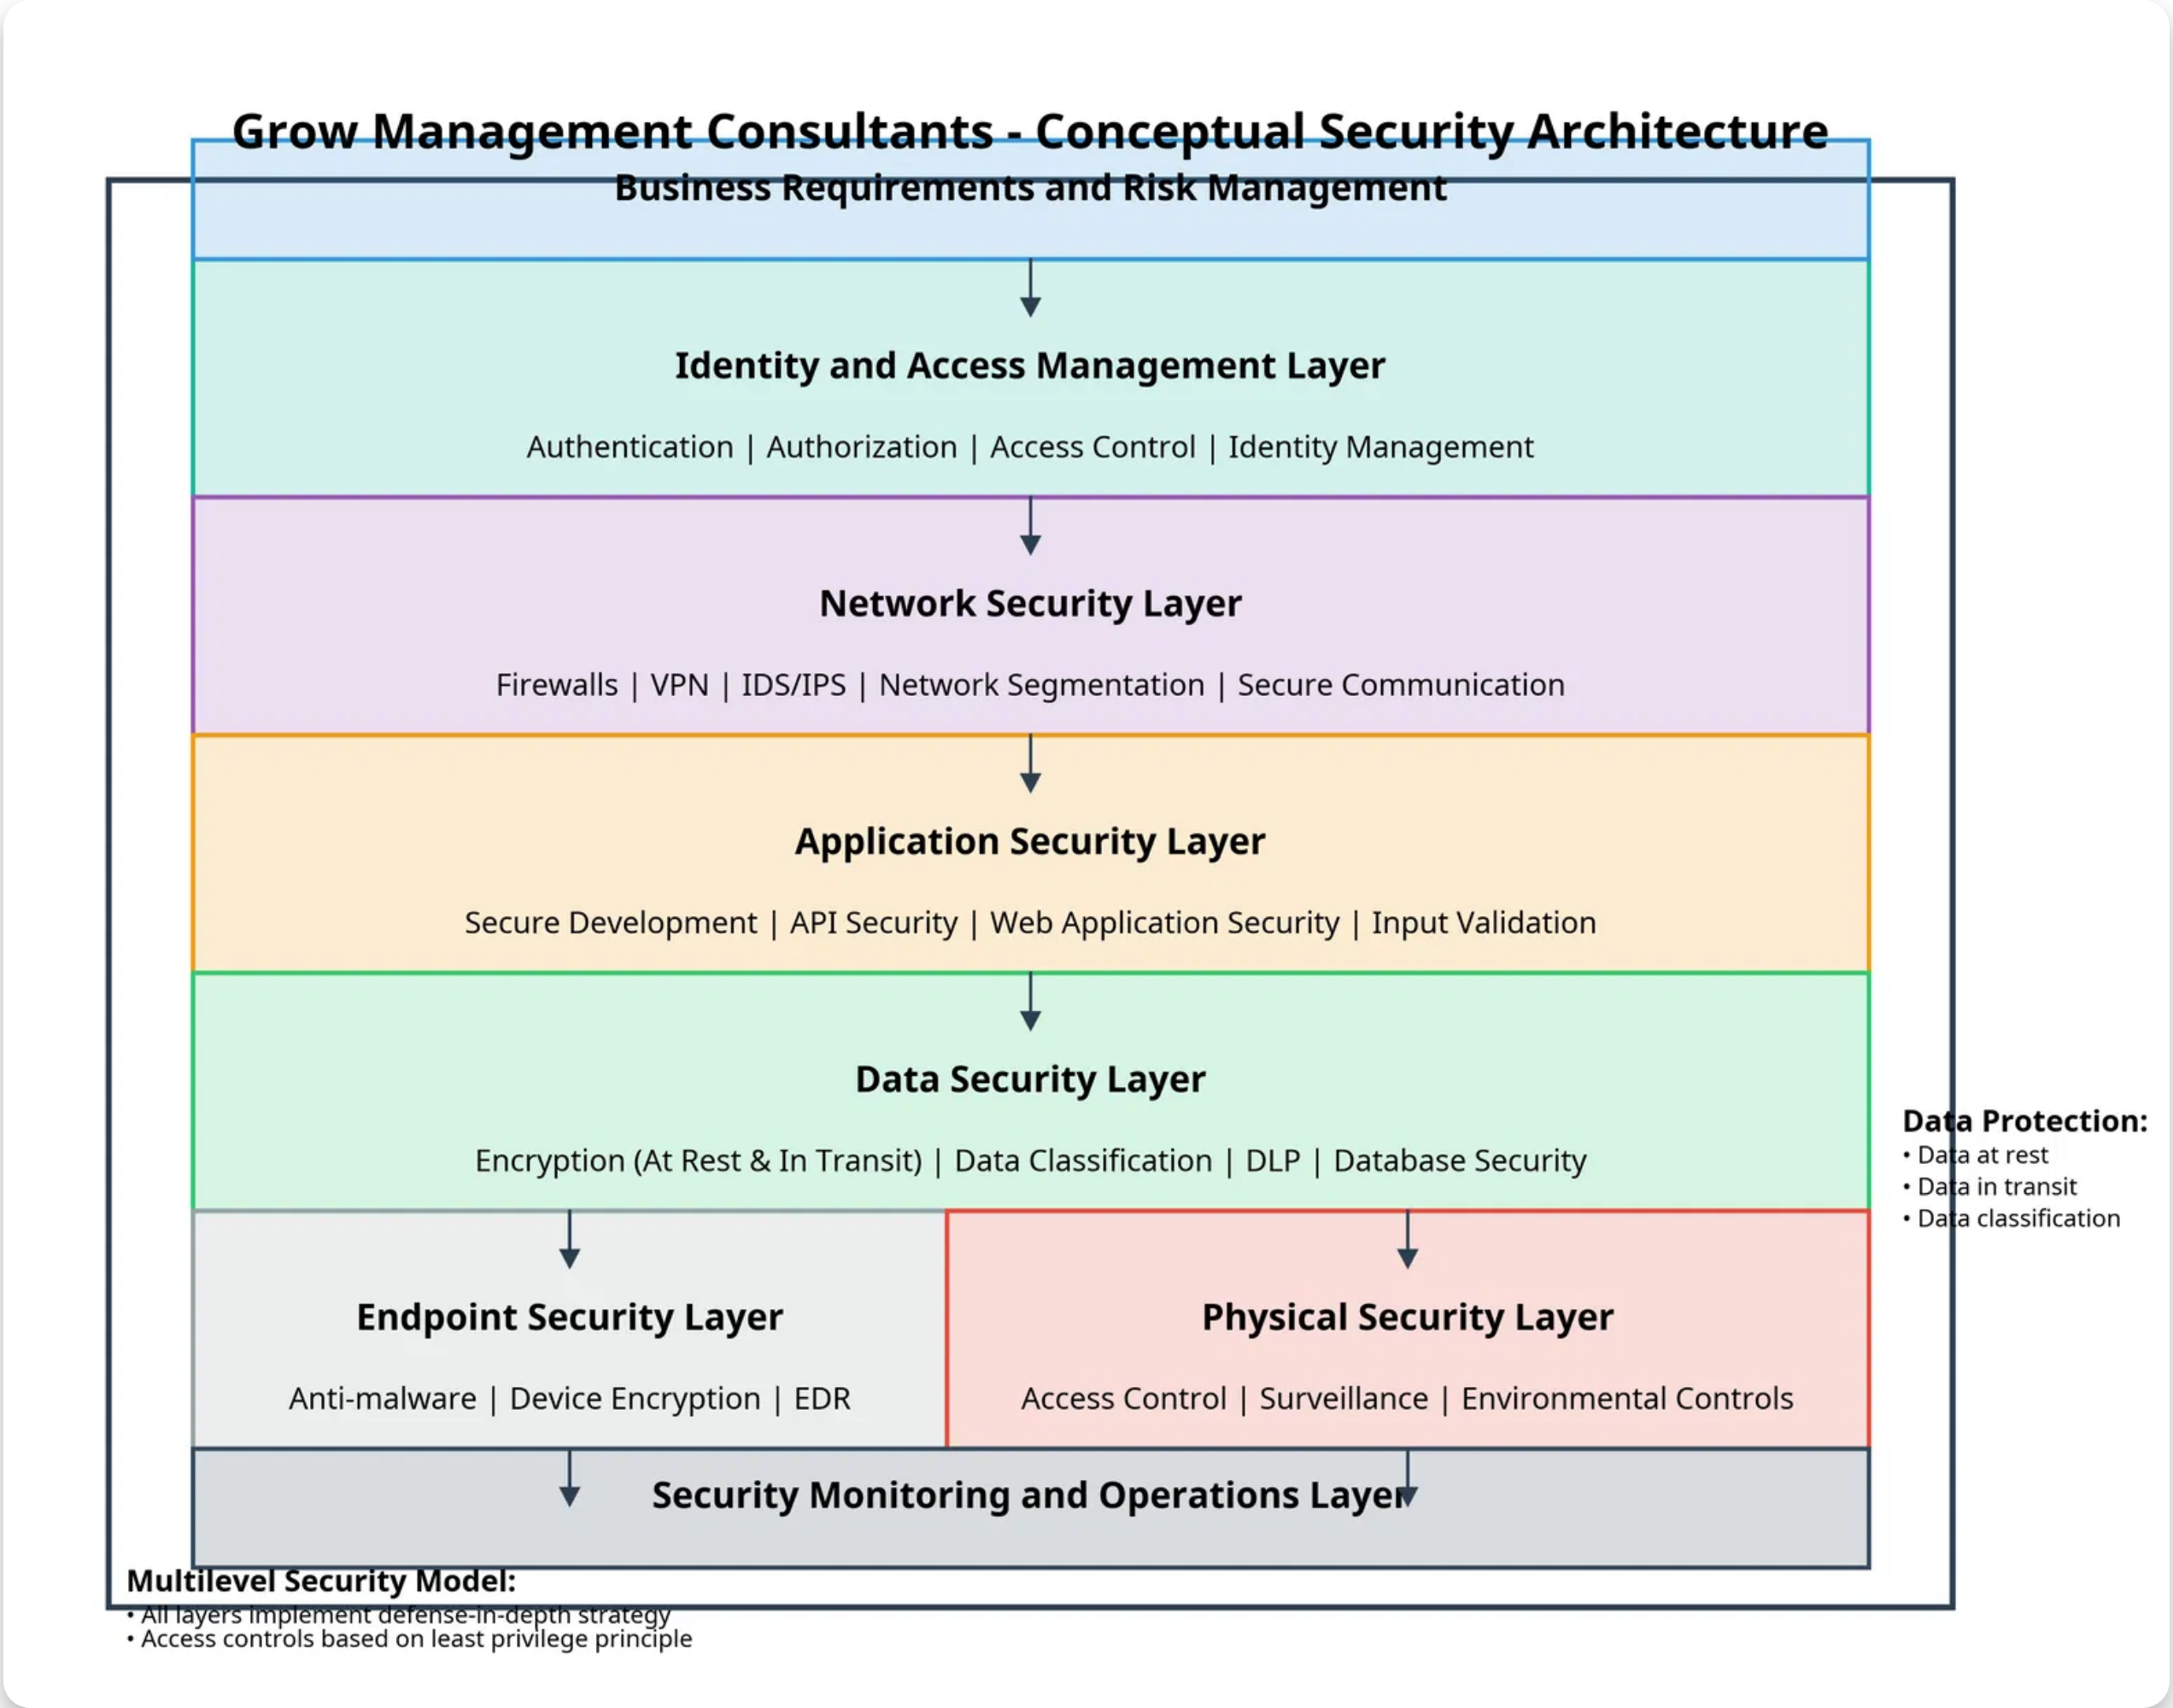
Conceptual Architecture
Multilevel security model with defense-in-depth strategy across all security domains
The conceptual architecture illustrates the high-level security components and their relationships, organized in layers from business requirements to security monitoring. Each layer implements specific security controls to protect the organization's assets while supporting business objectives.
Grow Management Consultants
6

Slide 7
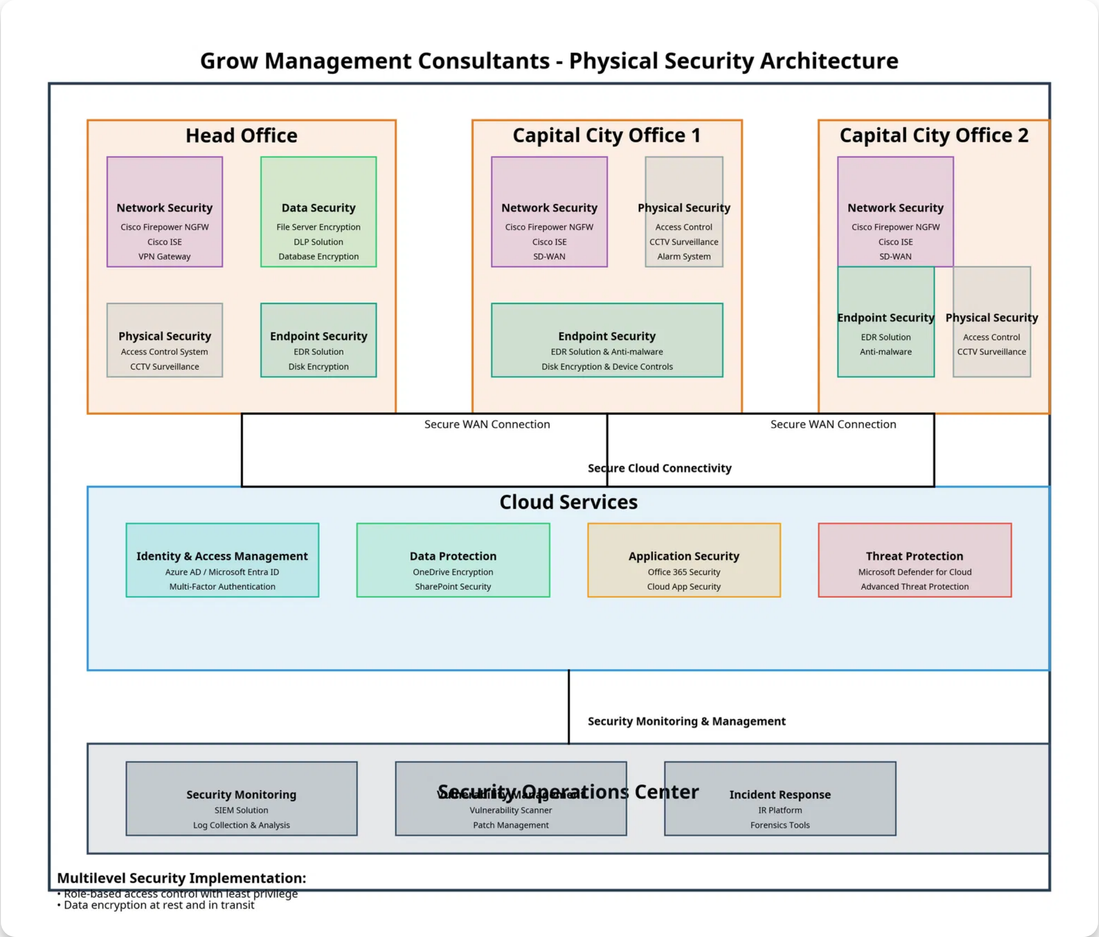
Physical Architecture
Detailed implementation of security components across all office locations
The physical architecture diagram shows the specific technologies and implementations that will secure the organization's assets across the head office and two new capital city offices, including cloud services and the Security Operations Center.
Grow Management Consultants
7

Slide 8

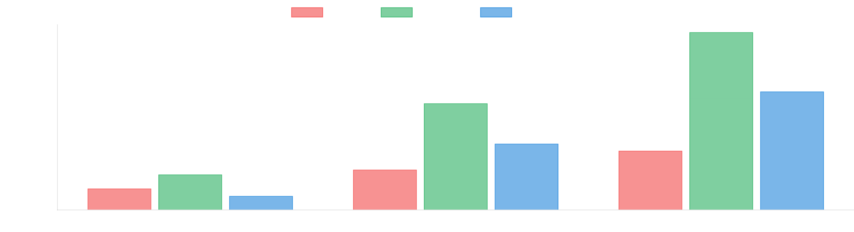









Cost-Benefit Analysis
Costs
Benefits
Initial Implementation
Risk Reduction
Hardware, software, professional services: $130,000 - $195,000
Reduced incidents and impact: $150,000 - $250,000 annually
Annual Operations
Operational Improvements
Maintenance, monitoring, assessments: $100,000 - $155,000
Improved availability and efficiency: $50,000 - $100,000 annually
Training & Awareness
Business Advantages
Initial and ongoing security training: $15,000 - $25,000
Enhanced client trust and growth: $100,000 - $200,000 annually
Compliance Benefits
Reduced compliance costs: $30,000 - $80,000 annually
Grow Management Consultants
8

Slide 9

Implementation Approach
Phase 1: Foundation
0-3 months
Develop and approve security policies and procedures
Implement basic access controls and authentication mechanisms
Deploy endpoint protection solutions
Establish security awareness training program
Conduct initial risk assessment
Phase 2: Enhancement
3-6 months
Implement network security controls and segmentation
Deploy data encryption for sensitive information
Establish security monitoring capabilities
Develop incident response procedures
Implement vulnerability management program
Phase 3: Optimization
6-12 months
Enhance security monitoring and analytics
Implement advanced access controls
Establish security metrics and reporting
Conduct security testing and assessments
Integrate security into business processes
Phase 4: Maturity
12-18 months
Implement advanced security capabilities
Establish continuous improvement processes
Integrate with enterprise risk management
Develop security innovation program
Achieve target security maturity level
Grow Management Consultants
9

Slide 10











Testing Methods & Effectiveness Metrics
Testing Methods
The following methods will be used to evaluate the effectiveness of the security solution:
Vulnerability Assessments
Penetration Testing
Security Control Assessments
Incident Response Exercises
Security Awareness Assessments
Risk Management Metrics
Compliance Metrics
Number of high-risk vulnerabilities identified and remediated
Policy compliance rate across the organization
Risk reduction percentage over time
Audit findings by severity and remediation status
Risk treatment completion rate
Security training completion rate
Risk acceptance decisions monitoring
Compliance with regulatory requirements
Operational Metrics
Business Impact Metrics
Security incident count by severity
Financial impact of security incidents
Mean time to detect (MTTD) security incidents
Downtime due to security incidents
Mean time to respond (MTTR) to security incidents
Client satisfaction with security measures
Patch compliance rate within defined timeframes
Security investment return on investment (ROI)
Grow Management Consultants
10

Slide 11










Conclusion & Recommendations
Key Conclusions
The proposed security solution addresses all identified risks and meets business requirements.
The multilevel security model provides comprehensive protection for all data types and locations.
The cost-benefit analysis demonstrates a positive ROI with significant benefits over time.
The phased implementation approach ensures critical security controls are prioritized.
Recommendations
Approve the Proposed Solution
Develop Detailed Implementation Plan
Proceed with implementation of the security solution as outlined.
Create specific timelines, responsibilities, and success criteria.
Allocate Necessary Resources
Monitor and Measure Effectiveness
Provide required budget, personnel, and time to support implementation.
Implement testing methods and metrics to evaluate performance.
Foster Security Culture
Establish Governance Structure
Promote security awareness through leadership and training.
Create security governance to oversee implementation and management.
Grow Management Consultants
11

