Slide 1
FritoLay Employee Analysis
By Michael Mazel
https://youtu.be/-m5uULvHq5o

Slide 2
Exploring Variable Relationships
Very Strong Relationships:
Monthly Income and Job Level (.95 correlation)
Moderately Strong Relationships
Percent Salary Hike and Performance Rating (.78 correlation)
Job Level and Total Working Years (.78 correlation)
Monthly Income and Total Working Years (.78 correlation)
Years at the Company and Years in Current Role (.78 correlation)
Years at the Company and Years with Current Manager (.77 correlation)

Slide 3
Attrition Frequency
Attrition Status | Count | Percentage
No | 730 | 84%
Yes | 140 | 16%

Slide 4
Attrition Frequency
Attri-tion Status | Healthcare Rep | HR | Lab Tech | Manu-fact Dir. | Rsrch Dir. | Mgr. | Rsrch. Sci. | Sales Exec | Sales Rep
No | 90% | 78% | 80% | 98% | 98% | 92% | 82% | 84% | 55%
Yes | 10% | 22% | 20% | 2% | 2% | 8% | 18% | 16% | 45%

Slide 5
Predicting Attrition
7 Total Models Combined
Total Accuracy: 87.6%
Accuracy for “No”: 88.2%
Accuracy for “Yes”: 85%

Slide 6
Most Important Variables
Job is a Director
Job is Sales Rep
Divorce
Job Involvement
Overtime

Slide 7
Remember!
Correlation not causation
Personal categories like divorce or gender shouldn’t be used for promotion or hiring decisions

Slide 8
Males vs. Females in Leadership Roles
Females: 91
Males: 98
Monthly Incomes:
Females: $11,993
Males: $12,672
Across leadership roles, there is not enough evidence to suggest male incomes are significantly different than female incomes (p-value .37)

Slide 9
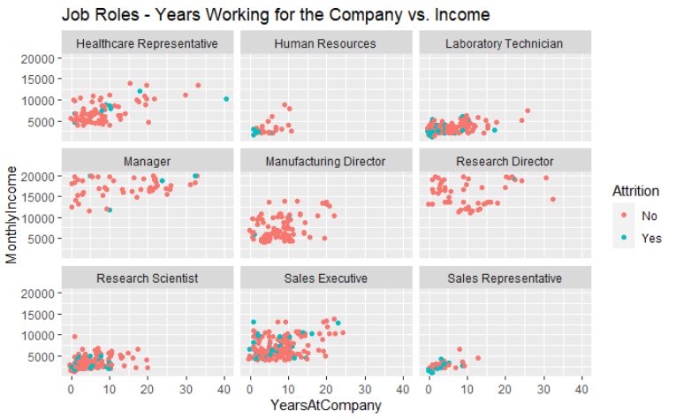
Job Roles - Additional Results

Slide 10
Predicting Incomes
Method: Linear Regression
Variables used:
Job Level
Total Working Years
Job Involvement
87.3% of the variation in employee monthly incomes can be explained by these three variables

Slide 11
Thank You

