Slide 1
SVA Advanced Topics: SVAUnit and Assertions for Formal

Slide 2

SystemVerilog Assertions Verification with SVAUnit
Andra Radu Ionuț Ciocîrlan

Slide 3
Tutorial topics
Introduction to SystemVerilog Assertions (SVAs)
Planning SVA development
Implementation
SVA verification using SVAUnit
SVA test patterns

Slide 4
Introduction to SystemVerilog Assertions (SVAs)

Slide 5
Assertions and properties
What is an assertion?
What is a property?
assert (a |-> b)
else $error("Assertion failed!")
property p_example;
a |-> b
endproperty

Slide 6
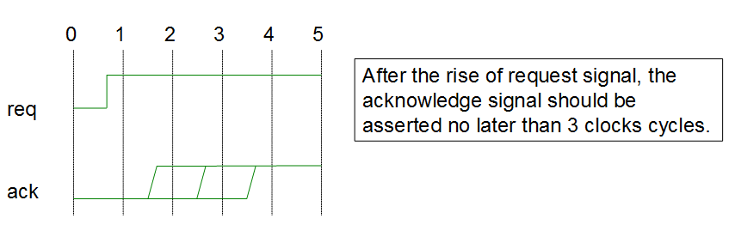
Simple assertion example
property req_to_rise_p;
@(posedge clk) $rose(req) |-> ##[1:3] $rose(ack);
endproperty
ASSERT_LABEL: assert property (req_to_rise_p)
else `uvm_error(“ERR", "Assertion failed")

Slide 7
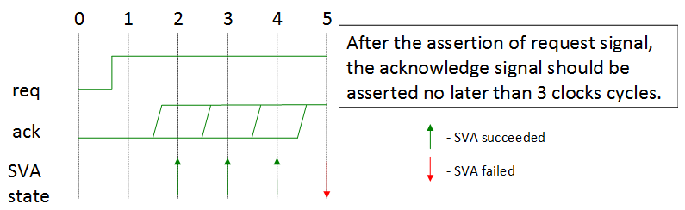
Types of SystemVerilog Assertions
Immediate
Concurrent
assert (expression) pass_statement
[else fail_statement]

Slide 8
Assertions are used
In a verification component
In a formal proof kit
In RTL generation
“Revisiting Regular Expressions in SyntHorus2: from PSL SEREs to Hardware” (Fatemeh (Negin) Javaheri, Katell Morin-Allory, Dominique Borrione)
For test patterns generation
“Towards a Toolchain for Assertion-Driven Test Sequence Generation” (Laurence PIERRE)

Slide 9
SVAs advantages
Fast
Non-instrusive
Flexible
Coverable

Slide 10
Planning SVA development

Slide 11
Identify design characteristics
Defined in a document (design specification)
Known or specified by the designer
The most common format is of the form cause and effect: antecedent |-> consequent
Antecedent:
Consequent:
$rose(req)
##[1:3] $rose(ack)

Slide 12
Keep it simple. Partition!
Complex assertions are typically constructed from complex sequences and properties.
a ##1 b[*1:2] |=> c ##1 d[*1:2] |=> $fell(a)
sequence seq(arg1, arg2);
arg1 ##1 arg2[*1:2];
endsequence
seq(a, b) |=> seq(c, d) |=> $fell(a)

Slide 13
Implementation

Slide 14
Coding guidelines
Avoid duplicating design logic in assertions
Avoid infinite assertions
Reset considerations
Mind the sampling clock

Slide 15
Coding guidelines (contd.)
Always check for unknown condition (‘X’)
Assertion naming
Detailed assertion messages
Assertion encapsulation

Slide 16
Best practices
Review the SVA with the designer to avoid DS misinterpretation
Use strong in assertions that may never complete:
Properties should not hold under certain conditions (reset, enable switch)
assert property ( req |-> strong(##[1:$] ack));
assert property (
@(posedge clk) disable iff (!setup || !rst_n)
req |-> strong(##[1:$] ack)
);

Slide 17
Best practices (contd.)
Avoid overlapping assertions that contradict each other
CPU_0:
CPU_1:
assert property (WRITE |=> ERROR);
assert property (WRITE |=> !ERROR);
assert property (WRITE and CPU==0 |=> ERROR);
assert property (WRITE and CPU==1 |=> !ERROR);

Slide 18
Best practices (contd.)
Use the $sampled() function in action blocks
Previous timeslot
Preponed
Active
Inactive
assert property ( @(posedge clk) ack == 0 )
else
`uvm_error("ERROR", $sformatf("Assertion
failed. ack is %d", $sampled(ack)));
NBA
Observed
Re-active
Re-inactive
Postponed
Next timeslot

Slide 19
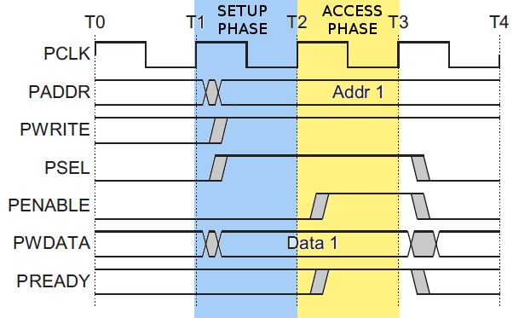
Assertion example
AMBA APB protocol specification:
The bus only remains in the SETUP state for one clock cycle and always moves to the ACCESS state on the next rising edge of the clock.

Slide 20
Assertion example (contd.)
Antecedent (the SETUP phase)
Consequent (the ACCESS phase)
sequence setup_phase_s;
$rose(psel) and $rose(pwrite)
and (!penable) and (!pready);
endsequence
sequence access_phase_s;
$rose(penable) and $rose(pready) and
$stable(pwrite) and $stable(pwdata)and $stable(paddr) and $stable(psel);
endsequence

Slide 21
Assertion example (contd.)
The property can be expressed as:
The assertion will look like:
property access_to_setup_p;
@(posedge clk) disable iff (reset)
setup_phase_s |=> access_phase_s;
endproperty
assert property (access_to_setup_p)
else `uvm_error("ERR", "Assertion failed")

Slide 22
Does it work as intended?

Slide 23
SVA Verification with SVAUnit

Slide 24
SVA Verification Challenges
Easy to:
Update
Enhance
Disable
Clear separation between validation and SVA definition code
Adaptable
Self-contained
Predictable
Results should be:
- Deterministic
Repeatable

Slide 25
Introducing SVAUnit
Structured framework for Unit Testing for SVAs
Allows the user to decouple the SVA definition from its validation code
UVM compliant package written in SystemVerilog
Encapsulate each SVA testing scenario inside an unit test
Easily controlled and supervised using a simple API

Slide 26
SVAUnit Infrastructure
SVAUnit Testbench
SVAUnit Testbench
Enables SVAUnit
Instantiates SVA interface
Starts test
SVAUnit Test Suite
SVAUnit Unit Test
SVAUnit Test
SVAUnit Test
SVAUnit Test Suite
SVA interface handle
SVAUnit Test
Contains the SVA scenario
Interface containing SVA
test()
Interface containing SVA
Reports
Reports
Reports
SVAUnit Test Suite
Test and test suite container
Reports

Slide 27
Example specification
AMBA APB protocol specification:
The bus only remains in the SETUP state for one clock cycle and always moves to the ACCESS state on the next rising edge of the clock.

Slide 28
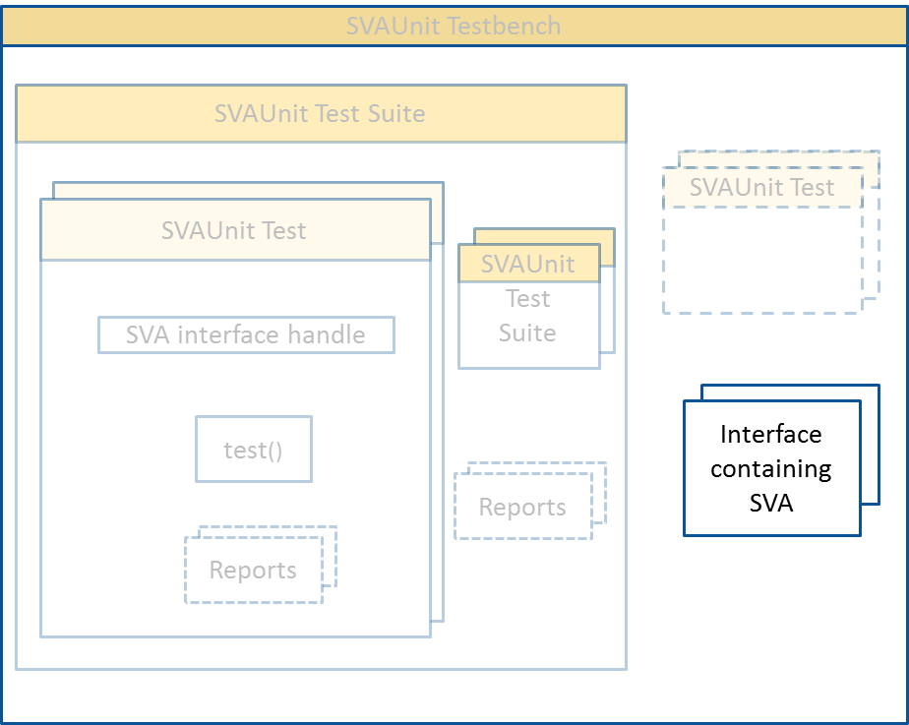
Example APB interface
interface apb_if (input pclk);
logic psel;
logic pwrite;
logic penable;
logic pready;
logic [`ADDR_WIDTH-1 :0] paddr;
logic [`WDATA_WIDTH-1:0] pwdata;
endinterface
APB sequences definitions
APB property definition
APB assertion definition

Slide 29
APB sequences definitions
Antecedent (the SETUP phase)
Consequent (the ACCESS phase)
sequence setup_phase_s;
$rose(psel) and $rose(pwrite)
and (!penable) and (!pready);
endsequence
sequence access_phase_s;
$rose(penable) and $rose(pready) and
$stable(pwrite) and $stable(pwdata)and $stable(paddr) and $stable(psel);
endsequence

Slide 30
APB property & assertion definitions
The property can be expressed as:
The assertion will look like:
property access_to_setup_p;
@(posedge clk) disable iff (reset)
setup_phase_s |=> access_phase_s;
endproperty
assert property (access_to_setup_p)
else `uvm_error("ERR", "Assertion failed")

Slide 31

Example of SVAUnit Testbench
module top;
// Instantiate the SVAUnit framework
`SVAUNIT_UTILS
...
// APB interface with the SVA we want to test
apb_if an_apb_if(.clk(clock));
initial begin
// Register interface with the uvm_config_db
uvm_config_db#(virtual an_if)::
set(uvm_root::get(), "*", “VIF", an_apb_if);
// Start the scenarios
run_test();
end
...
endmodule

Slide 32
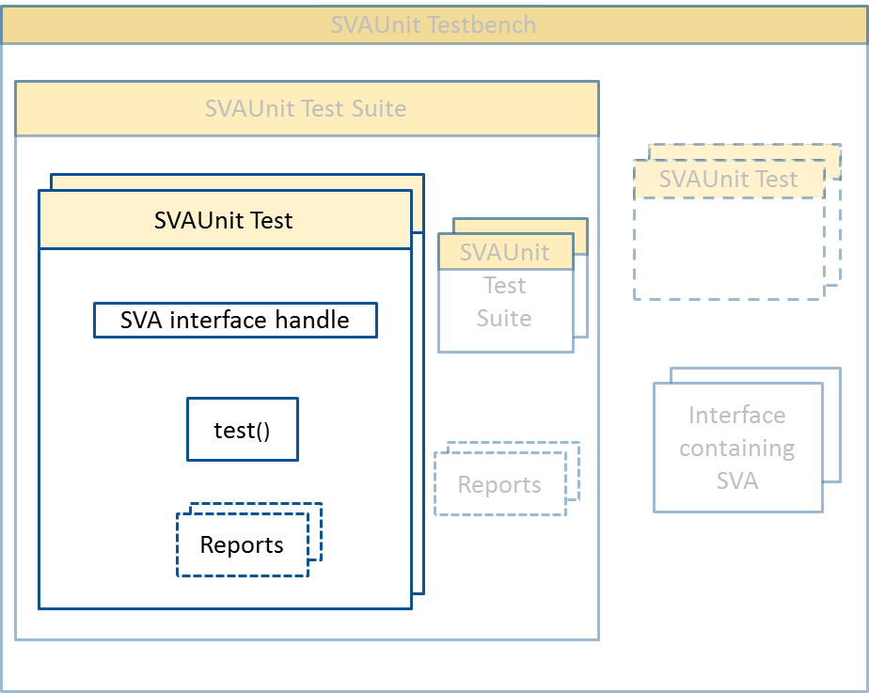
Example of SVAUnit Test
class ut1 extends svaunit_test;
// The virtual interface used to drive the signals
virtual apb_if apb_vif;
function void build_phase(input uvm_phase phase);
// Retrieve the interface handle from the uvm_config_db
if (!uvm_config_db#(virtual an_if)::get(this, "", “VIF", apb_vif))
`uvm_fatal(“UT1_NO_VIF_ERR", "SVA interface is not set!")
// Test will run by default;
disable_test();
endfunction
task test();
// Initialize signals
// Create scenarios for SVA verification
endtask
endclass

Slide 33
APB – SVAUnit test steps
Enable the APB SVA
Initialize the interface signals
Generate setup phase stimuli
Generate access phase stimuli
SVA checks based on generated stimuli

Slide 34
Enable SVA and initialize signals
...
// Enable the APB SVA
vpiw.disable_all_assertions();
vpiw.enable_assertion("APB_PHASES");
// Initialize signals
task initialize_signals();
apb_vif.paddr <= 32'b0;
apb_vif.pwdata <= 32'b0;
apb_vif.pwrite <= 1'b0;
apb_vif.penable <= 1'b0;
apb_vif.psel <= 1'b0;
endtask
...

Slide 35
Generate setup phase stimuli
...
task generate_setup_phase_stimuli(bit valid);
...
// Stimuli for valid SVA scenario valid == 1 ->
pwrite == 1 && psel == 1 && penable == 0 && pready == 0;
// Stimuli for invalid SVA scenario valid == 0 -> pwrite != 1 || psel != 1 || penable != 0 || pready != 0;
...
endtask
...

Slide 36
Generate access phase stimuli
...
task generate_access_phase_stimuli(bit valid);
...
// Constrained stimuli for valid SVA scenario valid == 1 ->
pwdata == apb_vif.pwdata && paddr == apb_vif.paddr &&
pwrite == 1 && psel == 1 && penable == 1 && pready == 1;
// Constrained stimuli for invalid SVA scenario valid == 0 ->
pwdata != apb_vif.pwdata || paddr != apb_vif.paddr ||
pwrite != 1 || psel != 1 || penable != 1 || pready != 1;
...
endtask
...

Slide 37
SVA state checking
...
if (valid_setup_phase)
if (valid_access_phase)
vpiw.fail_if_sva_not_succeeded("APB_PHASES",
"The assertion should have succeeded!");
else
vpiw.fail_if_sva_succeeded("APB_PHASES",
"The assertion should have failed!");
else
vpiw.pass_if_sva_not_started("APB_PHASES",
"The assertion should not have started!");
...

Slide 38
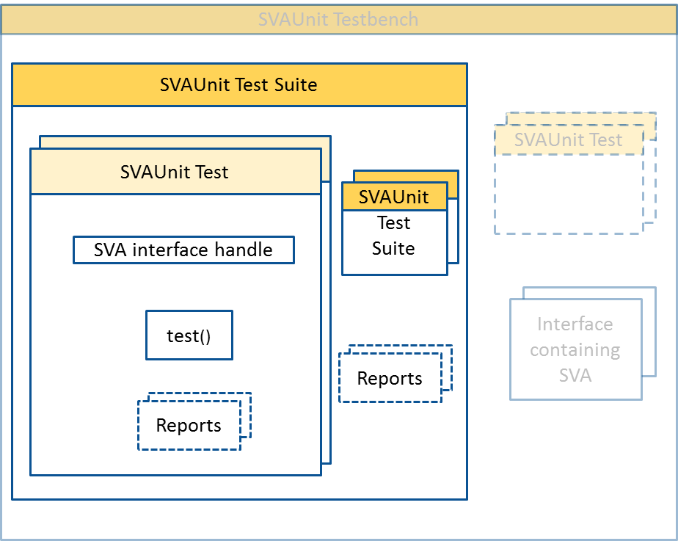
Example of SVAUnit Test Suite
class uts extends svaunit_test_suite;
// Instantiate the SVAUnit tests
ut1 ut1;
...
ut10 ut10;
function void build_phase(input uvm_phase phase);
// Create the tests using UVM factory
ut1 = ut1::type_id::create("ut1", this);
...
ut10 = ut10::type_id::create("ut10", this);
// Register tests in suite
`add_test(ut1);
...
`add_test(ut10);
endfunction
endclass

Slide 39
SVAUnit Test API
CONTROL
disable_all_assertions();
CHECK
fail_if_sva_does_not_exists(sva_name, error_msg);
REPORT
print_status();
enable_assertion(sva_name);
enable_all_assertions(); . . .
pass_if_sva_not_succeeded(sva_name, error_msg);
pass/fail_if(expression, error_msg); . . .
print_sva();
print_report(); . . .

Slide 40
SVAUnit Flow
Create SVAUnit Testbench
Create an SVAUnit Test Suite
Simulate
Create an SVAUnit Test
Instantiate test in Test Suite
Scan report
Implement test() task
Register tests in test suite

Slide 41
Error reporting
Name of SVAUnit check
SVAUnit test path
Name of SVA under test
Custom error message

Slide 42
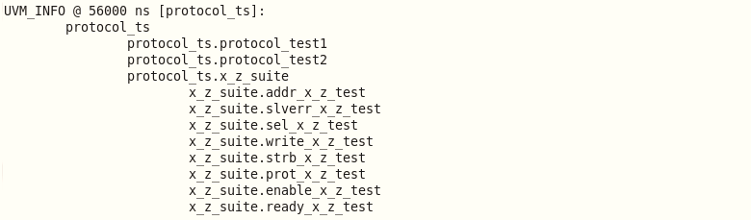
Hierarchy report

Slide 43
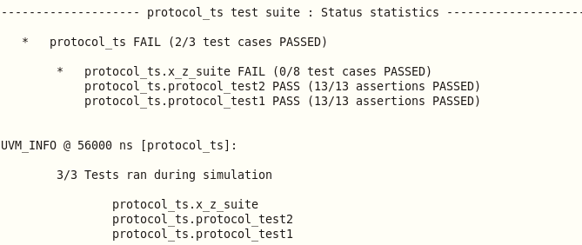
Test scenarios exercised

Slide 44
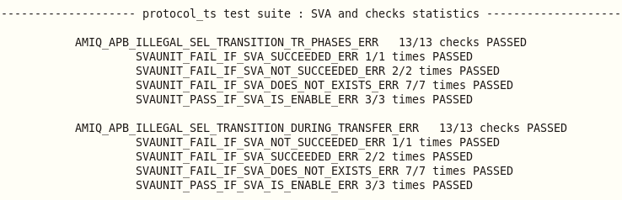
SVAs and checks exercised

Slide 45
SVA test patterns

Slide 46
Simple implication test
a and b |=> c
repeat (test_loop_count) begin
randomize(stimuli_for_a, stimuli_for_b, stimuli_for_c);
interface.a <= stimuli_for_a;
interface.b <= stimuli_for_b;
@(posedge an_vif.clk);
interface.c <= stimuli_for_c;
@(posedge interface.clk);
@(posedge interface.clk);
if (stimuli_for_a == 1 && stimuli_for_b == 1)
if (stimuli_for_c == 1)
vpiw.fail_if_sva_not_succeeded("IMPLICATION_ASSERT",
"The assertion should have succeeded!");
else
vpiw.fail_if_sva_succeeded("IMPLICATION_ASSERT",
"The assertion should have failed!");
else
vpiw.pass_if_sva_not_started("IMPLICATION_ASSERT",
"The assertion should not have started!");
end

Slide 47
Multi-thread antecedent/consequent
$rose(a) ##[1:4] b |-> ##[1:3] c
repeat (test_loop_count) begin
// Generate valid delays for asserting b and c signals
randomize(delay_for_b inside {[1:4]}, delay_for_c inside {[1:3]});
interface.a <= 1;
repeat (delay_for_b)
@(posedge interface.clk);
interface.b <= 1;
vpiw.pass_if_sva_started_but_not_finished("MULTITHREAD_ASSERT",
"The assertion should have started but not finished!");
repeat (delay_for_c)
@(posedge interface.clk);
interface.c <= 1;
vpiw.pass_if_sva_succeeded("MULTITHREAD_ASSERT",
"The assertion should have succeeded!");
end

Slide 48
Multi-thread antecedent/consequent (contd.)
$rose(a) ##[1:4] b |-> ##[1:3] c
repeat (test_loop_count) begin
// Generate invalid delays for asserting b and c signals
randomize(delay_for_b inside {[0:10]}, delay_for_c inside {0,[4:10]});
interface.a <= 1;
repeat (delay_for_b)
@(posedge interface.clk);
interface.b <= 1;
vpiw.pass_if_sva_not_succeeded("MULTITHREAD_ASSERT",
"The assertion should have failed!");
repeat (delay_for_c)
@(posedge interface.clk);
interface.c <= 1;
if (delay_for_b < 5)
vpiw.fail_if_sva_succeeded("MULTITHREAD_ASSERT",
"The assertion should have failed!");
end

Slide 49
Consecutive repetition
a |-> b[*1:2] ##1 c
repeat (test_loop_count) begin
randomize(stimuli_for_a, stimuli_for_c, number_of_b_cycles <= 2);
interface.a <= stimuli_for_a;
repeat (number_of_b_cycles) begin
randomize(stimuli_for_b)
interface.b <= stimuli_for_b;
if (stimuli_for_b == 1) number_of_b_assertions += 1;
@(posedge interface.clk);
end
if (stimuli_for_a == 1 && number_of_b_assertions == number_of_b_cycles &&
number_of_b_assertions > 0)
vpiw.pass_if_sva_started_but_not_finished("IMPLICATION_ASSERT",
"The assertion should have started but not finished!");
@(posedge interface.clk);
... // (continued on the next slide)

Slide 50
Consecutive repetition (contd.)
a |-> b[*1:2] ##1 c
...
// (continued from previous slide)
interface.c <= stimuli_for_c;
@(posedge interface.clk);
if (stimuli_for_a == 1)
if (number_of_b_assertions != number_of_b_cycles ||
number_of_b_assertions == 0 ||
stimuli_for_c == 0)
vpiw.fail_if_sva_succeeded("IMPLICATION_ASSERT",
"The assertion should have failed!");
else
vpiw.fail_if_sva_not_succeeded("IMPLICATION_ASSERT",
"The assertion should have succeeded!");
end // end of test repeat loop

Slide 51
Repetition range with zero
a |-> b[*0:2] ##1 c
repeat (test_loop_count) begin
randomize(stimuli_for_a, stimuli_for_c, number_of_b_cycles <= 2);
interface.a <= stimuli_for_a;
repeat (number_of_b_cycles) begin
randomize(stimuli_for_b)
interface.b <= stimuli_for_b;
if (stimuli_for_b == 1) number_of_b_assertions += 1;
@(posedge interface.clk);
end
if (stimuli_for_a == 1 && number_of_b_assertions == number_of_b_cycles)
&& number_of_b_assertions > 0)
vpiw.pass_if_sva_started_but_not_finished("IMPLICATION_ASSERT",
"The assertion should have started but not finished!");
@(posedge interface.clk);
... // (continued on the next slide)

Slide 52
Repetition range with zero (contd.)
a |-> b[*0:2] ##1 c
...
// (continued from previous slide)
interface.c <= stimuli_for_c;
@(posedge interface.clk);
if (stimuli_for_a == 1)
if (number_of_b_assertions != number_of_b_cycles ||
number_of_b_assertions == 0 ||
stimuli_for_c == 0)
vpiw.fail_if_sva_succeeded("REPETITION_RANGE0_ASSERT",
"The assertion should have failed!");
else
vpiw.fail_if_sva_not_succeeded("REPETITION_RANGE0_ASSERT",
"The assertion should have succeeded!");
end // end of test repeat loop

Slide 53
Sequence disjunction
a |=> (b ##1 c) or (d ##1 e)
repeat (test_loop_count) begin
randomize(stimuli_for_a, stimuli_for_b, stimuli_for_c, stimuli_for_d, stimuli_for_e);
interface.a <= stimuli_for_a;
@(posedge interface.clk);
fork
begin
end
begin
end
join
end
Stimuli for branch: (b ##1 c)
SVA state check based on branch stimuli
Stimuli for branch: (c ##1 d)
SVA state check based on branch stimuli

Slide 54
Sequence disjunction (contd.)
a |=> (b ##1 c) or (d ##1 e)
...
// Stimuli for branch (b ##1 c)
fork
begin
interface.b <= stimuli_for_b;
@(posedge interface.clk);
interface.c <= stimuli_for_c;
@(posedge interface.clk);
@(posedge interface.clk);
// SVA state check based on branch stimuli
sva_check_phase(interface.a, interface.b, interface.c);
end
join

Slide 55
Sequence disjunction (contd.)
a |=> (b ##1 c) or (d ##1 e)
...
// Stimuli for branch (d ##1 e)
fork
begin
interface.b <= stimuli_for_d;
@(posedge interface.clk);
interface.c <= stimuli_for_e;
@(posedge interface.clk);
@(posedge interface.clk);
// SVA state check based on branch stimuli
sva_check_phase(interface.a, interface.d, interface.e);
end
join

Slide 56
Sequence disjunction (contd.)
a |=> (b ##1 c) or (d ##1 e)
// SVA state checking task used in each fork branch
task sva_check_phase(bit stimuli_a, bit stimuli_b, bit stimuli_c);
if (stimuli_a)
if (stimuli_b && stimuli_c)
vpiw.pass_if_sva_succeeded("DISJUNCTION_ASSERT",
"The assertion should have succeeded");
else
vpiw.fail_if_sva_succeeded("DISJUNCTION_ASSERT",
"The assertion should have failed");
endtask

Slide 57
Tools integration
Simulator independent!

Slide 58
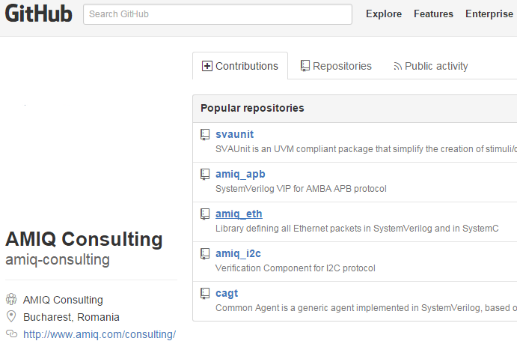
Availability
SVAUnit is an open-source package released by AMIQ Consulting
We provide:
SystemVerilog and simulator integration codes
AMBA-APB assertion package
Code templates and examples
HTML documentation for API
https://github.com/amiq-consulting/svaunit

Slide 59
Conclusions
SVAUnit decouples the checking logic from SVA definition code
Safety net for eventual code refactoring
Can also be used as self-checking documentation on how SVAs work
Quick learning curve
Easy-to-use and flexible API
Speed up verification closure
Boost verification quality

Slide 60
Q & A
?

Slide 61
Thank you!

