Slide 1


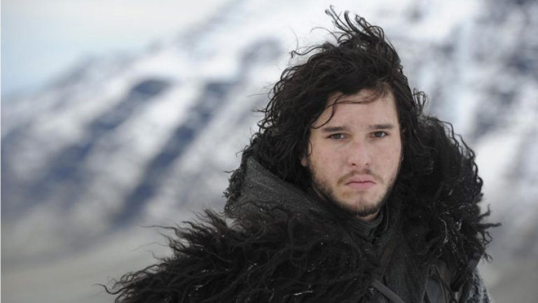
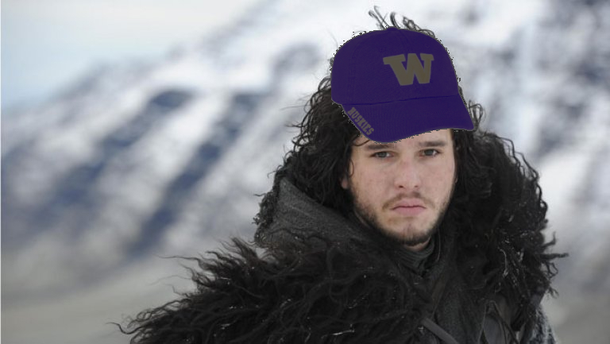
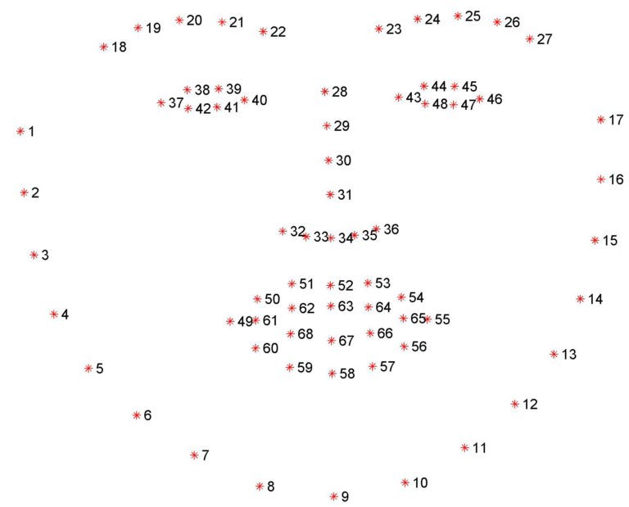






MemeDub
Matt Xu, Michael Fang, Andrew Wei | Computer Vision CSE455 Autumn 2018 | University of Washington
Abstract
Model
Results
We put UW hats on faces for both images and videos in real time like a “Snapchat” filter
We did this using a mix of facial feature recognition and math
We’re using a pre-trained model that was trained on the iBUG300-W dataset
W opted to use a pre-trained model because we have finals and couldn’t find the time to train the model ourselves
Before
Images
After
Process
We first looked at OpenPose to get an understanding of what features were available/landmarked as features people have used for similar facial recognition/detection projects in the past
We were able to run OpenPose after reinstalling CUDA 3 times, installing VisualStudio, then reinstalling Python twice
We decided not to use OpenPose because the library was more complex than we needed it to be to accomplish what we wanted to do
General:
We used OpenCV, dlib, and the model to detect and obtain the features of faces
Image:
We calculated [MATT SHOULD DO THIS]
Video:
We used our webcam and detected faces from each frame and overlaid a hat where the faces were. [MICHAEL DESCRIBE THIS A BIT MORE]
Video
[PUT SCREENSHOTS HERE]
[ALSO READ OVER THINGS]
Inspiration
References
Facial mapping (landmarks) with Dlib + python by Italo José
[FILL THIS PART OUT]

