Slide 1
PYTORCH COMMUNITY MEETUP / MBARARA
Image classification
with PyTorch
01 Clothing classification with Fashion-MNIST
02 Bean leaf classification with ResNet18
01
Notes:
Use the two workshop notebooks for the live exercises. Open the notebook links ahead of time and cache the data and ResNet weights before the session.
Workshop notebooks — https://github.com/MichaelMukiibi/pytorch-meetup-mbra/tree/dev/notebooks

Slide 2
WORKSHOP 01 / FUNDAMENTALS
AI, machine learning and deep learning
01 Artificial intelligence
The broad field of building systems that perform tasks such as recognizing images or planning a route.
02 Machine learning
Models learn patterns from examples. In supervised learning, each training image comes with a label.
03 Deep learning
A branch of machine learning that uses neural networks with multiple layers to learn representations.
Both workshops use supervised image classification.
02
Notes:
Explain the nesting out loud: deep learning is one approach within machine learning, which sits within AI. The notebooks both use labeled examples for image classification.
Google, Introduction to Machine Learning — https://developers.google.com/machine-learning/intro-to-ml/what-is-ml

Slide 3
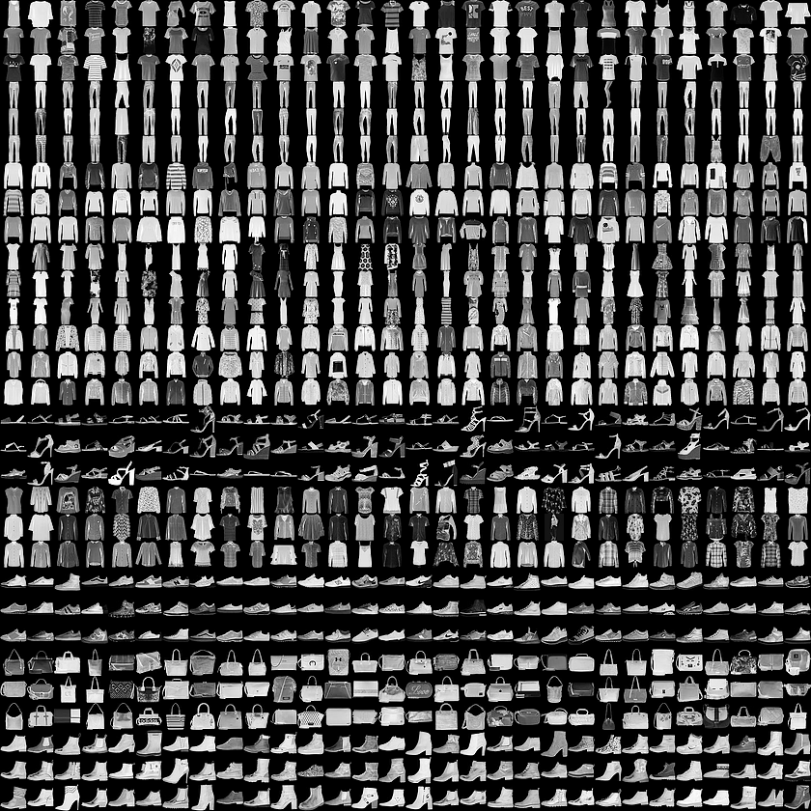
WORKSHOP 01 / FUNDAMENTALS
Fashion-MNIST
Input
A 28 × 28 grayscale image.
Target
One of 10 labels, such as shirt, sneaker or bag.
Workshop split
6,000 images for training and 1,000 separate images for testing.
Fashion-MNIST examples / Zalando Research
03
Notes:
Point out that garments can be difficult to distinguish at 28 × 28 pixels. The workshop uses a randomly selected training subset and the first 1,000 examples of the official test split.
Zalando Research, dataset and MIT license — https://github.com/zalandoresearch/fashion-mnist
Graphic by Zalando Research, Fashion-MNIST sprite — https://github.com/zalandoresearch/fashion-mnist/blob/master/doc/img/fashion-mnist-sprite.png
Workshop notebook — https://github.com/MichaelMukiibi/pytorch-meetup-mbra/tree/dev/notebooks

Slide 4
WORKSHOP 01 / FUNDAMENTALS
Preprocessing and tensor shapes
One image / [1, 28, 28]
ToTensor converts pixels to floats in [0, 1]. The first dimension is the grayscale channel.
One batch / [B, 1, 28, 28]
DataLoader groups images and their labels. B is the number of images in the batch.
Flattened input / [B, 784]
Flatten reshapes the image dimensions into 784 values per image.
In the notebook, print images.shape and labels.shape.
04
Notes:
The notebook's ToTensor scales the uint8 values. Read dimensions from left to right and distinguish one image, a batch, and the flattened input. B is the number of images in a batch.
Torchvision, ToTensor — https://docs.pytorch.org/vision/stable/generated/torchvision.transforms.ToTensor.html
Workshop notebook — https://github.com/MichaelMukiibi/pytorch-meetup-mbra/tree/dev/notebooks

Slide 5
WORKSHOP 01 / FUNDAMENTALS
Class scores and cross-entropy
Forward pass
The network maps 784 pixel values through a 128-unit hidden layer to 10 raw class scores (logits).
Prediction
argmax picks the class with the highest score for each image.
Training loss
Cross-entropy uses the raw scores and the correct class label. It decreases as the model assigns more probability to the correct class.
Predict the output shape for two images, then check it.
05
Notes:
The Fashion-MNIST model uses Flatten, Linear(784, 128), ReLU, then Linear(128, 10). CrossEntropyLoss expects raw logits and integer labels for this task. Argmax picks the largest score.
PyTorch, CrossEntropyLoss — https://docs.pytorch.org/docs/stable/generated/torch.nn.CrossEntropyLoss.html
Workshop notebook — https://github.com/MichaelMukiibi/pytorch-meetup-mbra/tree/dev/notebooks

Slide 6
WORKSHOP 01 / FUNDAMENTALS
The PyTorch training loop
01
Clear old gradients
optimizer.zero_grad()
02
Run the model on a batch
logits = model(x)
03
Compare scores with labels
loss = loss_fn(logits, y)
04
Compute gradients
loss.backward()
05
Update the weights
optimizer.step()
One epoch is one pass through the training subset.
06
Notes:
Point to each line in the notebook. In PyTorch gradients accumulate unless cleared. The notebook logs average loss across all examples in the epoch, weighting each batch mean by its batch size.
PyTorch, Optimizing Model Parameters — https://docs.pytorch.org/tutorials/beginner/basics/optimization_tutorial.html
Workshop notebook — https://github.com/MichaelMukiibi/pytorch-meetup-mbra/tree/dev/notebooks

Slide 7
WORKSHOP 01 / FUNDAMENTALS
Accuracy on held-out images
Accuracy = correct predictions ÷ total examples
Illustrative result
820 correct out of 1,000 images gives 82% accuracy.
Evaluation in PyTorch
Use model.eval() and torch.inference_mode(). Compare the predicted labels with the true labels.
Record your test accuracy and inspect one wrong prediction.
07
Notes:
The figures are illustrative. The notebook reports held-out test accuracy after two epochs. For systematic hyperparameter tuning, make a validation split from the training set and reserve the test split for a final check.
PyTorch, evaluation loop — https://docs.pytorch.org/tutorials/beginner/basics/optimization_tutorial.html
Google, classification metrics — https://developers.google.com/machine-learning/crash-course/classification/accuracy-precision-recall
Workshop notebook — https://github.com/MichaelMukiibi/pytorch-meetup-mbra/tree/dev/notebooks

Slide 8
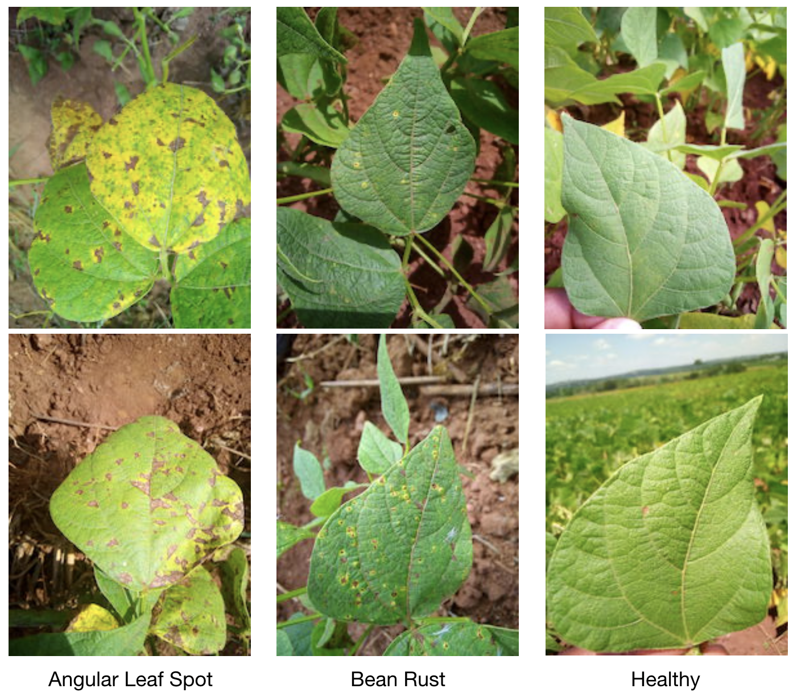
WORKSHOP 02 / TRANSFER LEARNING
Bean leaf
classification
Angular leaf spot
Bean rust
Healthy
Beans dataset examples / Makerere AI Lab
08
Notes:
The photos come from the dataset creators. The notebook trains on 300 examples from the official training split and evaluates on the separate validation split. This is a teaching exercise.
Makerere AI Lab, Beans dataset — https://huggingface.co/datasets/AI-Lab-Makerere/beans
Graphic by Makerere AI Lab, sample image montage — https://github.com/AI-Lab-Makerere/ibean/blob/master/bean-example-data.png
Workshop notebook — https://github.com/MichaelMukiibi/pytorch-meetup-mbra/tree/dev/notebooks

Slide 9
WORKSHOP 02 / TRANSFER LEARNING
Preprocessing for ResNet18
01 Convert to RGB
Use three channels for each leaf photo.
02 Apply weights.transforms()
Resize the shorter edge to 256, then take a 224 × 224 center crop.
03 Scale and normalize
The same transform scales pixels to [0, 1] and normalizes each channel using the ImageNet statistics.
Check the shape of one transformed image [3, 224, 224].
09
Notes:
DEFAULT resolves to IMAGENET1K_V1. The transform resizes the shorter edge to 256, center crops to 224 × 224, rescales to [0, 1], then normalizes using ImageNet channel means and standard deviations.
Torchvision, ResNet18 weights and transforms — https://docs.pytorch.org/vision/stable/models/generated/torchvision.models.resnet18.html
Workshop notebook — https://github.com/MichaelMukiibi/pytorch-meetup-mbra/tree/dev/notebooks

Slide 10
WORKSHOP 02 / TRANSFER LEARNING
A frozen backbone and a new head
Reuse pretrained features
Load ResNet18 with ImageNet weights. Freeze the existing parameters.
Replace the classifier
Set model.fc to a new linear layer with three outputs, one per bean leaf class.
Train only the new layer
Use the same loss and optimizer steps. Keep the backbone in evaluation mode to preserve BatchNorm statistics.
List the trainable parameters. Expect fc.weight and fc.bias.
10
Notes:
The backbone learned useful features during ImageNet pretraining. Freezing the parameters prevents gradient updates. Calling model.eval() also keeps BatchNorm running statistics fixed. The notebook optimizes model.fc.parameters() only.
PyTorch, Transfer Learning for Computer Vision — https://docs.pytorch.org/tutorials/beginner/transfer_learning_tutorial.html
Torchvision, ResNet18 — https://docs.pytorch.org/vision/stable/models/generated/torchvision.models.resnet18.html
Workshop notebook — https://github.com/MichaelMukiibi/pytorch-meetup-mbra/tree/dev/notebooks

Slide 11
WORKSHOP 02 / TRANSFER LEARNING
Validation metrics for Beans
Accuracy
What fraction of all validation images did the model classify correctly?
Precision for bean rust
Of the images predicted as rust, what fraction actually showed rust?
Recall for bean rust
Of the images that actually showed rust, what fraction did the model identify as rust?
In a confusion matrix, look across the true-rust row to see where rust cases went.
11
Notes:
The notebook reports accuracy on the 133-example validation split. Precision, recall, and a confusion matrix are optional follow-up analyses. For rust, treat all other classes as negatives when calculating precision and recall.
Google, classification metrics — https://developers.google.com/machine-learning/crash-course/classification/accuracy-precision-recall
Makerere AI Lab, Beans dataset splits — https://huggingface.co/datasets/AI-Lab-Makerere/beans
Workshop notebook — https://github.com/MichaelMukiibi/pytorch-meetup-mbra/tree/dev/notebooks

Slide 12
WORKSHOP 02 / TRANSFER LEARNING
A worked example of missed rust cases
ILLUSTRATIVE COUNTS
90 of 100 leaves are classified correctly.
Of 10 true rust cases, the model catches 6.
Of 9 rust predictions, 6 are correct.
90%
67%
60%
Overall accuracy
Rust precision
Rust recall
How many rust cases did the model miss? Compare your answer with a partner.
12
Notes:
All numbers on this slide are hypothetical. In the example, four rust cases are missed and three non-rust cases are predicted as rust. Show why overall accuracy and rust recall answer different questions.
Google, classification metrics — https://developers.google.com/machine-learning/crash-course/classification/accuracy-precision-recall

Slide 13
MEETUP LAB
Two notebook experiments
Fashion-MNIST
Change the hidden layer from 128 to 64 units. Keep the epoch count fixed and compare held-out accuracy.
Beans
Train a fresh classifier head for three epochs. Compare validation accuracy and inspect a missed case.
For each run, record the change, the metric and one example prediction.
13
Notes:
In each experiment, hold the data split constant and record the initial result. Restart from a fresh model when comparing runs. A fixed random seed can reduce variability. The Beans model is for learning, and field performance would require representative data and independent validation.
Workshop notebooks — https://github.com/MichaelMukiibi/pytorch-meetup-mbra/tree/dev/notebooks

