Slide 1

Modeling Nutrient Concentrations in Urban Stormwater Runoff
Michael Neman

Slide 2




Urbanization increases nutrient levels in runoff, negatively impacting aquatic ecosystems
Urbanization
Increased Runoff
Increased Contaminants
Eutrophication
Notes:
Urbanization
Increase in impervious surfaces
Change hydrological conditions – prevent infiltration
Higher volume during storm events increasing nutrient and contaminant loads
Urban drainage systems / retention often have higher levels of contaminants.
Vehicles
Oil and grease
Fertilizer
Eutrophication
Nitrogen and Phosphorus main drivers
Increased plant life
Depleted oxygen
Dead animal life
TSS
Increased turbidity – reduction in sunlight
Affects aquatic plant life
Carrier of contaminants, phos, heavy metals

Slide 3

Problem Statement
Increased nutrient loads in runoff due to urbanization has resulted in a need for accurate and timely estimates of nutrient loads to make informed decisions in stormwater management.
I address this challenge by developing predictive models to estimate stormwater concentrations of Nitrate, Phosphorus and Total Suspended Solids.

Slide 4

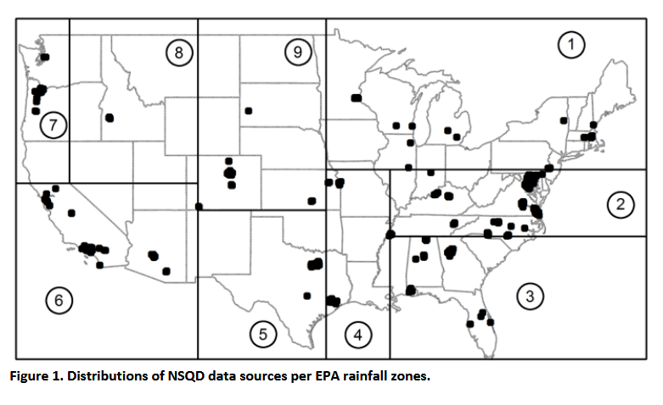
Dr. Pitt with support from EPA developed the National Stormwater Database
National Stormwater Quality Database
NPDES monitoring programs
200 municipalities
9,000 runoff events
Notes:
2001 – 2015
NPDES – National Pollutant Discharge Elimination System
200 municipalities
9,000 events
9 epa rain zones
Data collected
Lat and long
Drainage area
Principle land use
Percentage industrial, residential, commercial
Percent impervious

Slide 5





Libraries / Packages

Slide 6
Pipeline
Original Data
Pre-processing
Training Data
Validation
Test Data
Train
Evaluate
Predict

Slide 7
Cleaning the data by handling missing values non-numeric values and categorical data.
NA | 1.006 | 2.586 | < 2.0 | SU
26.22 | < 2.0 | 15.56 | NA | WI
< 2.0 | 3.45 | NA | 4.56 | FA
Notes:
9052 observations
259 parameters
Non-numeric values
< X, non-detect converted to 0
> x, missed dilution no result, dropped
Missing values
Missing values were dropped
Data collected at several locations, tend to not record the same data
Mean imputation not appropriate – different regions
QC results
< or > for micro wrong dilution, could not be quantified
ND converted to 0
> dropped
Categorical variables
One-hot encoding
Nrow – 884

Slide 8
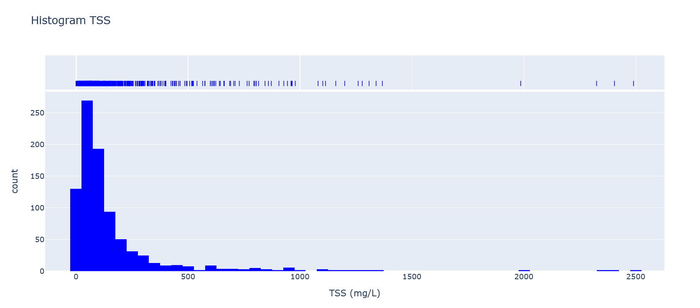
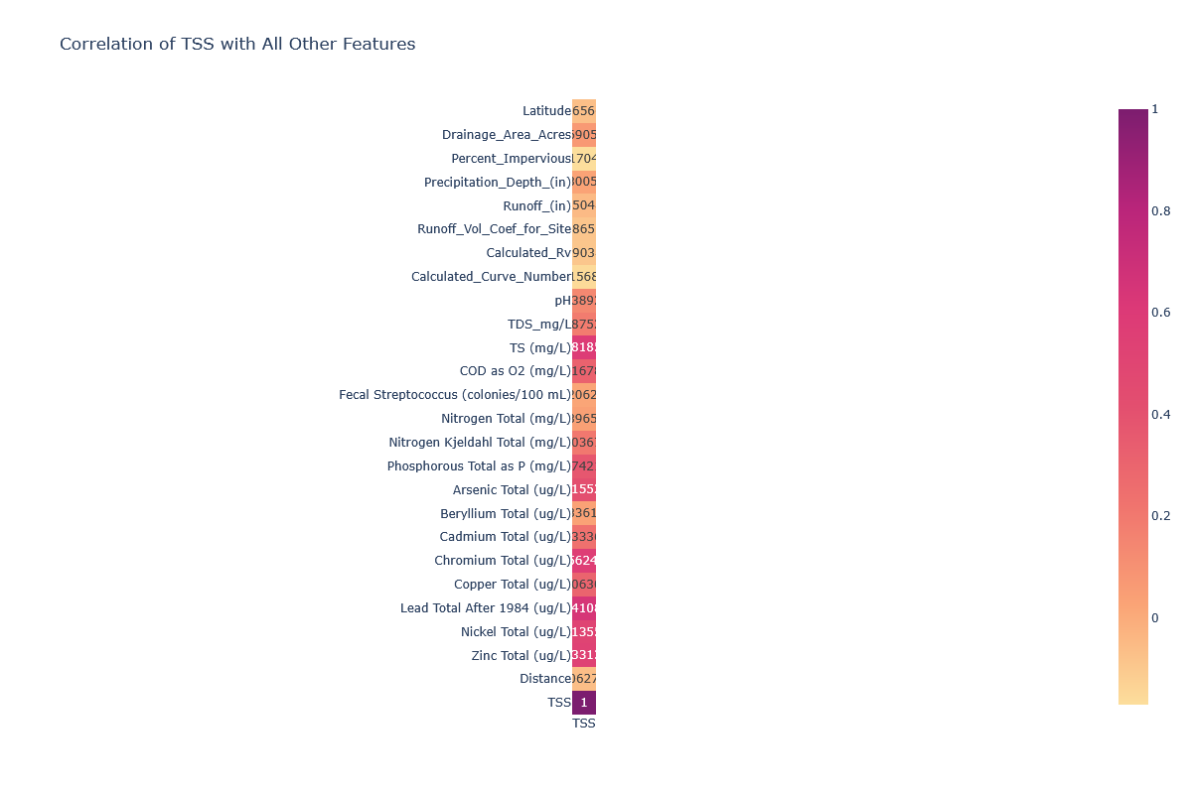
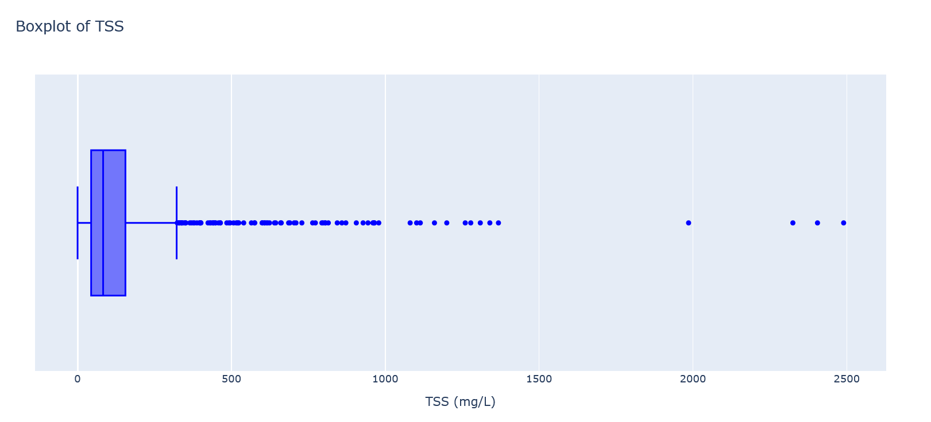
Total suspended solids data is right skewed with numerous outliers

Slide 9
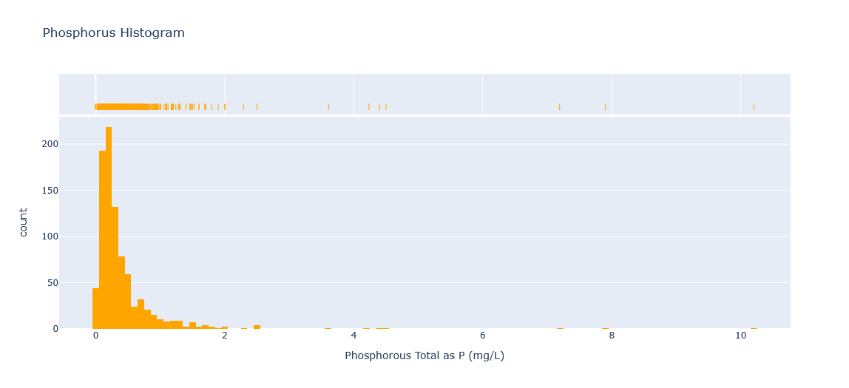
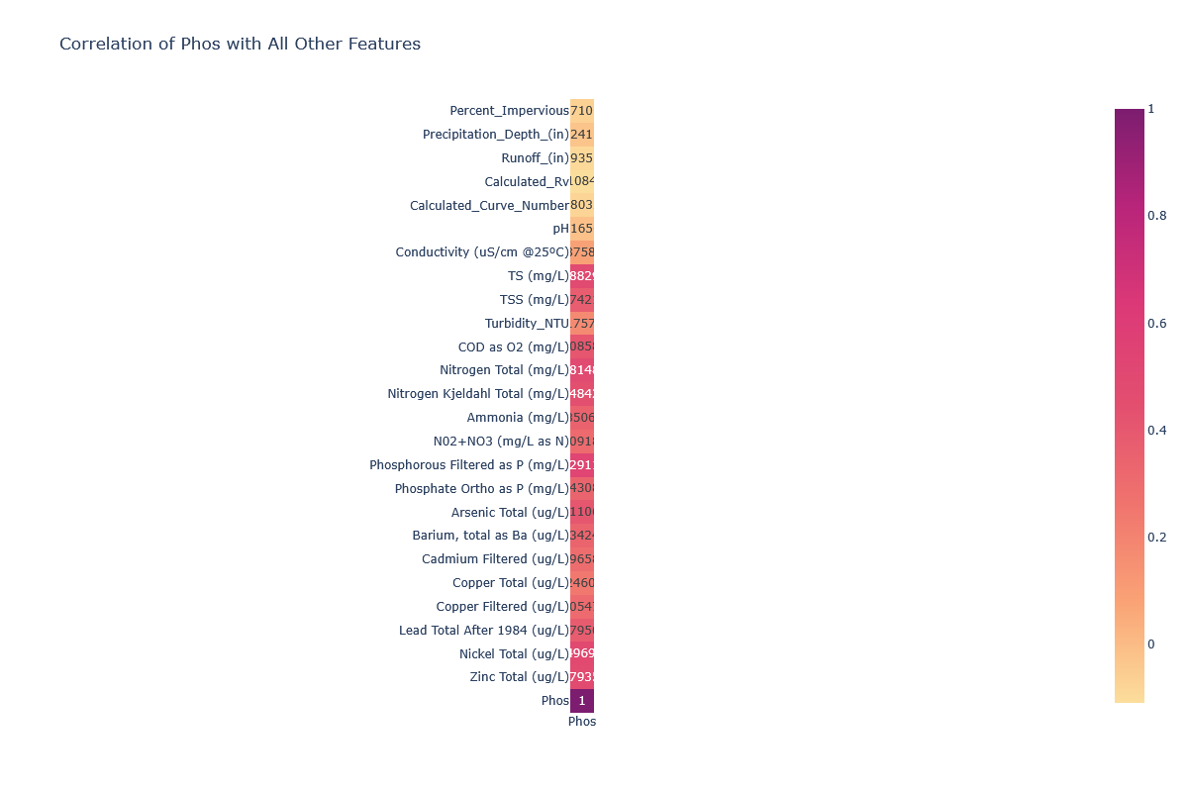
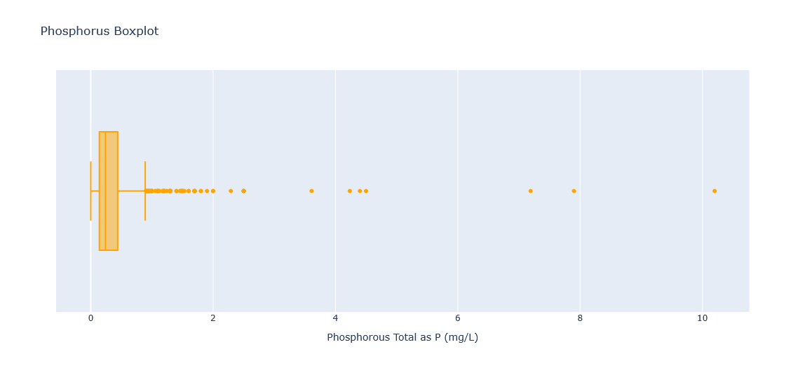
Phosphorus data is right skewed with numerous outliers

Slide 10
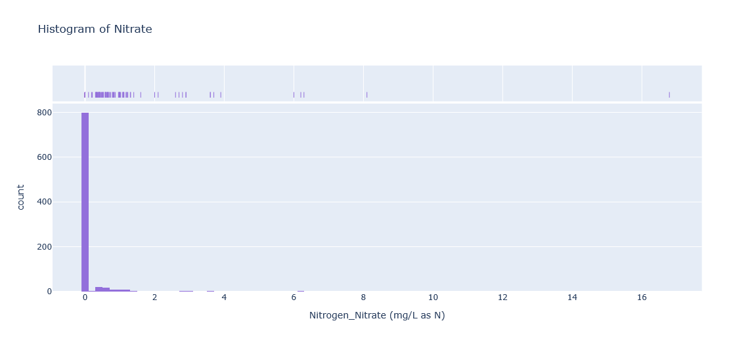
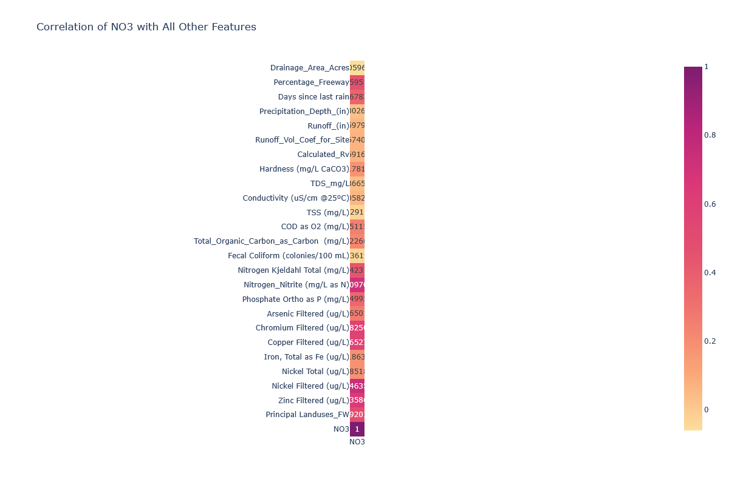
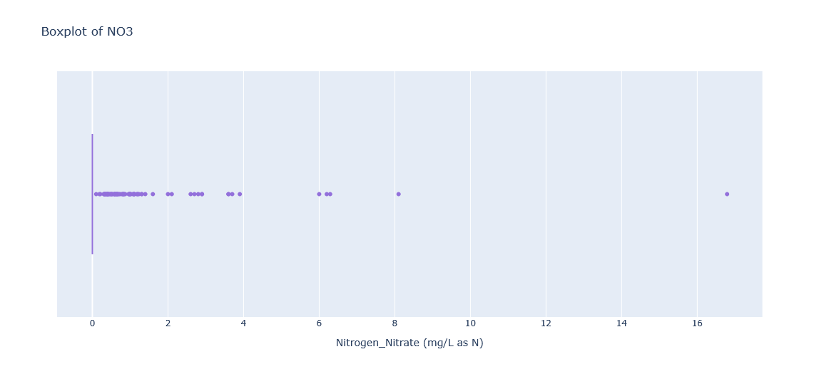
Nitrate data is right skewed High number of value 0.

Slide 11


Feature Engineering
Raw Data
Transformation
New Feature
Runoff coefficient = Runoff (in) / Precipitation Depth (in)
Notes:
Features
Distance – Latitude and longitude from Omaha
Runoff coefficient
Calculated RV = percent impervious * 0.9 + 0.05

Slide 12
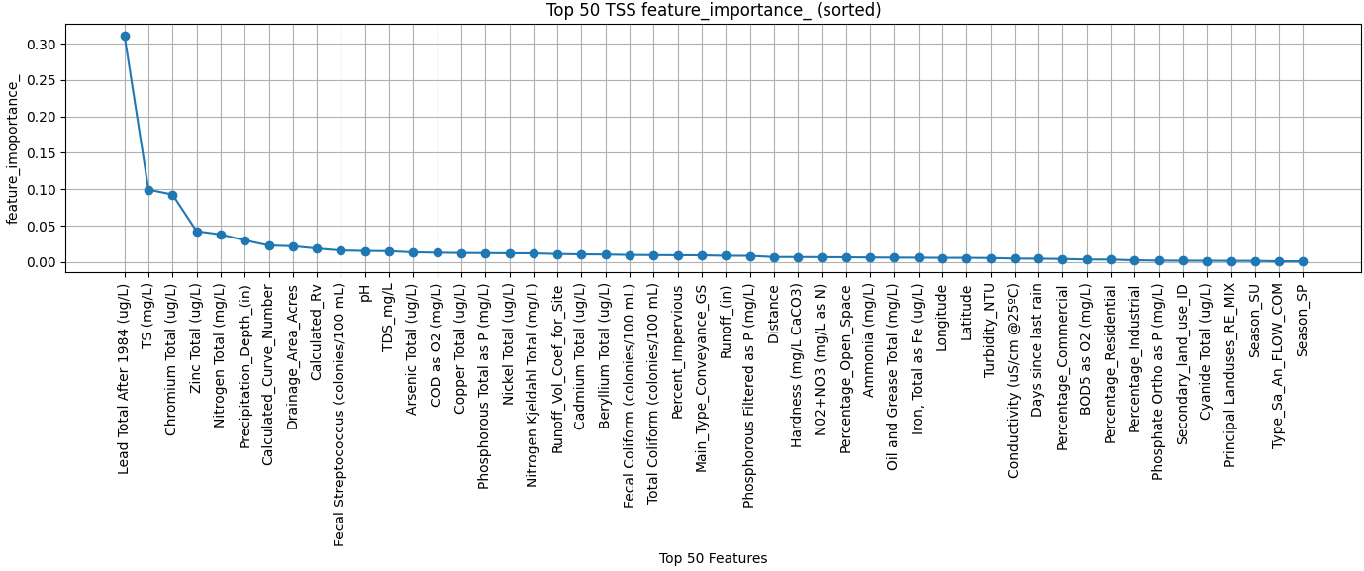
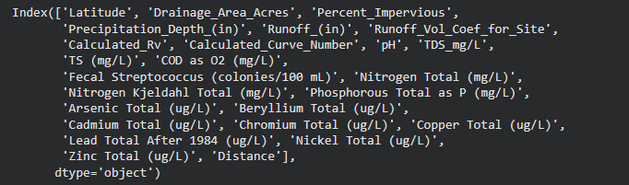
Feature Selection – Total Suspended Solids
Random Forest Feature Selection
Recursive Feature Elimination
Notes:
Random Forest Feature Importance
Subset of features considered at each split
Minimize variance (residual sum of squares) sum(y – yhat)^2
Each time feature is used for a split, rss is calculated
Decreases are weighted by the number samples that reach that node, summed over all trees in the forest
Score per feature calculated, determining importance
Recursive
Train on full set of features
Remove features step = 1
Repeat with reduced data set,
Continue until features = 50

Slide 13
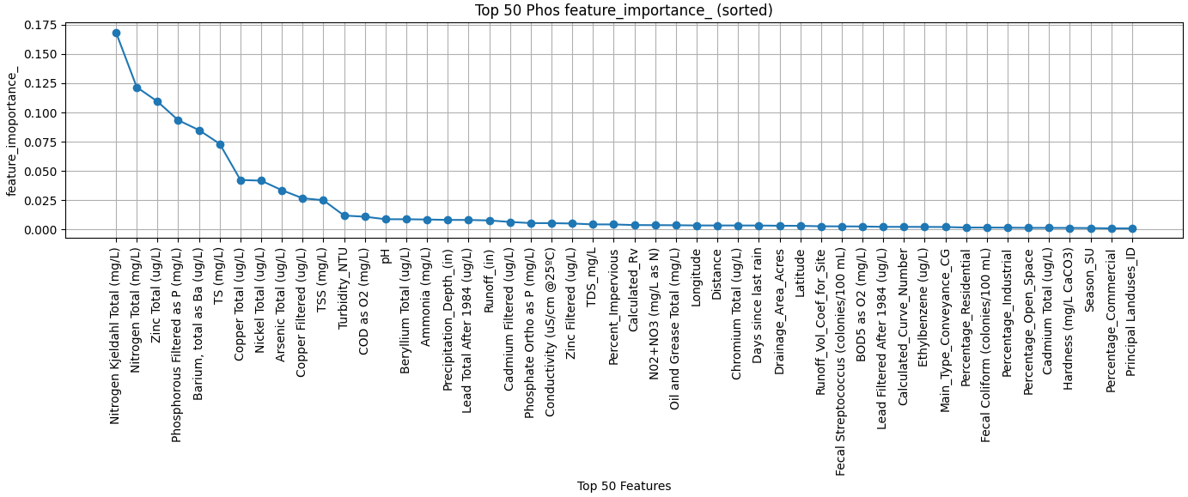
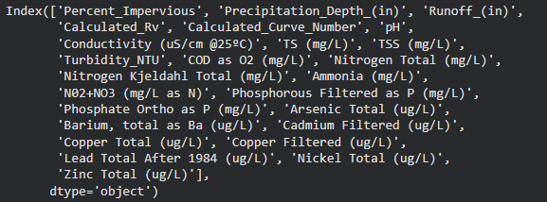
Feature Selection - Phosphorus
Random Forest Feature Selection
Recursive Feature Elimination

Slide 14
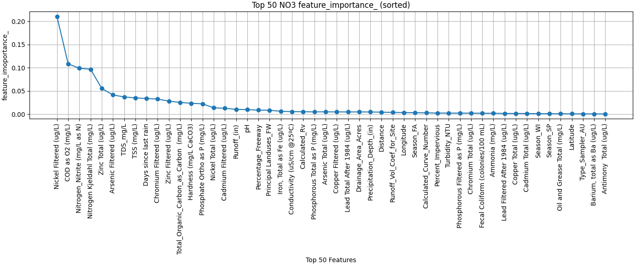
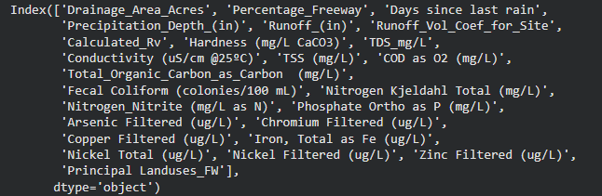
Feature Selection - Nitrate
Random Forest Feature Selection
Recursive Feature Elimination

Slide 15


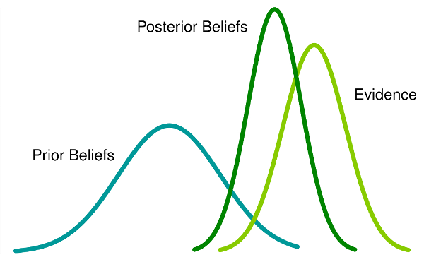
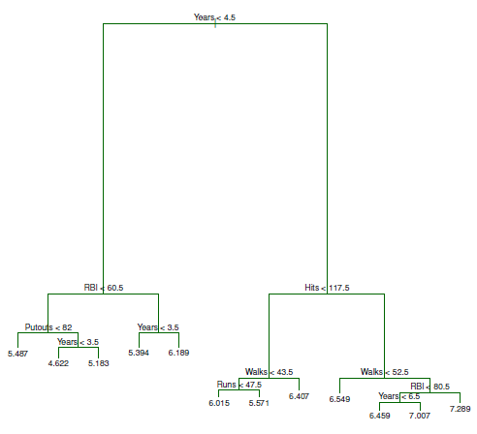

Random Forest Regression, Gradient Boosted Regression and BART
P1 | P2 | P3 | P4 | P5 | P6 | P7 | P8 | P9 | P10
P1 | P3 | P4 | P7 | P10
Random Forest Feature Regression
Gradient Boosted Regression
BART
Notes:
Ensemble methods
Random Forest Regression
Fits number of decision tree regressors on various sub samples of the dataset
Bagging (bootstrap aggregation)
Each tree trained on a bootstrap of the sample
At each node, random subset of features is selected and the best split is found amongst the subset
De-correlates the trees because each tree sees a different subset
Squared error – split that maximizes the decrease
All trees are trained, averaging the predictions of all individual trees.
Gradient Boosted Regression
Additive model, sequential, each stage is a decision tree fitted to the negative gradient of the loss function
At each stage, algorithm fits a new tree to approximate the negative gradient of the loss function (squared error)
What does that mean?
Think of it as gradient descent, but in the space of a function.
Each base learner (tree) is trying to move the model in the direction of deepest descent.
After fitting each tree, the predictions are multiplied by the learning rate before being added to the existing model.
BART
Bayesian sum of trees. Model the response as the sum of many regression trees, subject to priors that shrink each tree to be a weak learner
Prior – tree structure to regularize trees so it’s weak, penalty for deeper trees.
Prior for node being terminal = a * (1 + d)^-b
A = prior_terminal_node_coef
D = depth
B = prio_terminal_node_expo
Residual prio – chi-squared distribution
Markov Chain Monte Carlo to sample from the posterior
Proposes changes to individual trees. Typical moves include, birth/death, change and swap of nodes.
MCMC
Gibbs sampler
Multivariate distributions, thetas
Conditional probability thetas
Creates a markov chain with the correct stationary probabilities

Slide 16

Cross-Validation / Hyperparameter Tuning
Notes:
Random forest parameters
N_estimator – number of individual trees in the forest 100
Max_depth – maximum depth, smaller trees prevents overfitting 15
Min_sample_split – min number of samples to split a node 2
Max_features – number (or fraction) of features to consider when looking for the best split at each node none
Max_leaf_nodes – max = number of samples, max leads to overfitting none
Min_impurity_decrease – node will split if doing so improves the criterion this much 0.0
Gradient boosted regression
Loss – squared error
Learning rate – shrinkage of each trees contribution
BART
Trees
Prior_terminal_node_coefficient

Slide 17
Total Suspended Solids Results
*Models evaluated using Root Mean Square Error
Random Forest | Gradient Boosted | BART
154.28 | 142.33 | 141.685
Notes:
RMSE = sqrt(1/n * sum(yhat-y)^2)

Slide 18
Phosphorus Results
Random Forest | Gradient Boosted | BART
0.78 | 0.78 | 0.81

Slide 19
Nitrate Results
Random Forest | Gradient Boosted | BART
0.13 | 0.40 | 0.45

Slide 20

Future Work
Notes:
Multivariate Analysis
Data-transformation – log
Aggregate additional data
Antecedent dry period - NOAA
Precipitation duration
Precipitation intensity mm/min
Imperviousness – National Landuse landcover database
Available water capacity – Web soil survey geographic database - U.S Department of Ag
Saturated hydraulic conductivity – dept of ag

Slide 21
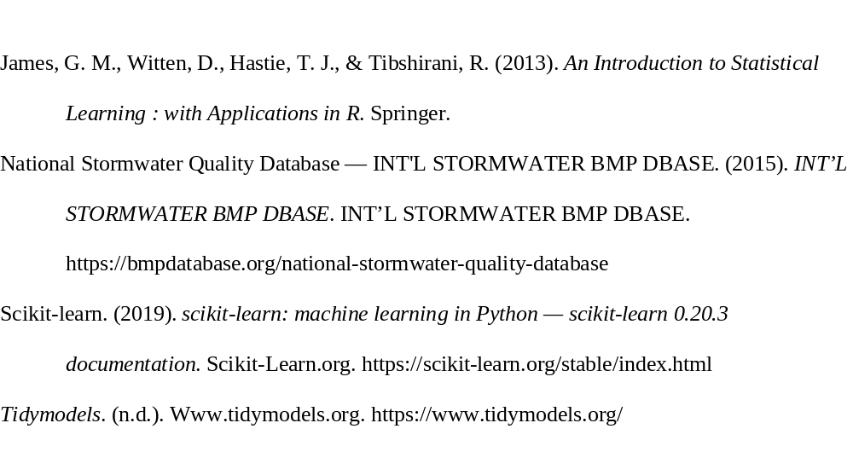
References

