Slide 1

STARK HEALTH CLINIC - DIABETES PREDICTION PROJECT
Leveraging machine learning to predict diabetes onset and empower proactive healthcare interventions.

Slide 2
STARK HEALTH CLINIC – Diabetes Prediction Machine Learning Model
Presented By
Nwako Chukwunonye Michael
Cohort C24-09 FSDS EU
FINAL CAPTONE PROJECT
PREDICTIVE ANALYTICS USING PATIENTS DATA TO DETECT DIABETES TOWARDS PREVENTIVE MEASURES AND OPTIMISING PATIENTS CARE - 10ALYTICS NIGERIA
FEBRUARY 2025

Slide 3
AGENDA
PROJECT INTRODUCTION
TERMINOLOGIES
PROBLEM STATEMENT
PROJECT RATIONALE
METHODOLOGY
EXPLORATORY DATA ANALYSIS (EDA)
RESULTS
FEATURE IMPORTANCES
MODEL EVALUATION
CONCLUSIONS & RECOMMENDATIONS

Slide 4


PROJECT INTRODUCTION
Stark Health Clinic seeks to explore
machine learning algorithms (Logistic Regression, Random Forest, Adaboost, Random Forest, etc.) for accurate diabetes incidence prediction, utilizing comprehensive patients' clinical data towards early detection, supporting timely interventions, taking preventive measures and advancing predictive healthcare analytics.

Slide 5
Terminologies
Target Variable: This is the dependent or output variable the model predicts (e.g. diabetes presence)
Features: Other (independent) variables or predictors the model uses for predictions e.g. blood glucose level, age, BMI, etc.
Hemoglobin A1C (HbA1c) Level: measures average blood glucose level within several months. This metric predicts microvascular problems associated with diabetes (Chehregosha, et al., 2019).
Body Mass Index (BMI): human body weight (in kilogrammes) divided by height. If BMI > 30kg/m², implies Obesity (Apovian, 2016).
Blood Glucose Level: This is the amount of blood sugar. Normal fasting blood glucose level between 70–105 mg/dL, while 126 mg/dL or higher indicates diabetes.
Accuracy: number of correct predictions out of the total correct and incorrect model predictions
Precision: number of positive predictions of the model that are truly/actually positive or correct
Recall: amount of the actual positive cases (e.g. diabetic patients) correctly identified by the model
F1-score: shows the balance between recall and precision as the harmonic of both.

Slide 6

PROBLEM STATEMENT
Stark Health Clinic requires accurate detection techniques using supervised machine learning unlike conventional methods for early diabetes detection and management for its patients.

Slide 7


PROJECT RATIONALE
By accurately predicting diabetes risk through advanced machine learning, Stark Health Clinic can improve patient care, reduce long-term costs, and take a proactive role in combating diabetes.

Slide 8
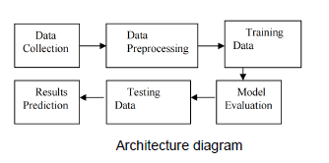
METHODOLOGY
Data Preprocessing:
Data cleaning e.g. handling missing, duplicates, outlier values, etc.
Features scaling
Data splitting
Correcting minority class (non-diabetic patients) imbalance -SMOTE
Source: Rasheed et. al. (2024)

Slide 9

Exploratory Data Analysis (EDA) Target Feature (Diabetes Variable) vs. Other Features
Patient’s Target Feature | Other Features | Category/Comments
Diabetes | Gender | Male, Female, Other
 | Age | All Age groups
 | Hypertension | Presence(1) or Absence(0)
 | Heart disease | Presence(1) or Absence(0)
 | Smoking History | Current, Former, Never, etc.
 | BMI | Random Value
 | HbA1c Level | Random Value
 | Blood Glucose Level | Random Value

Slide 10
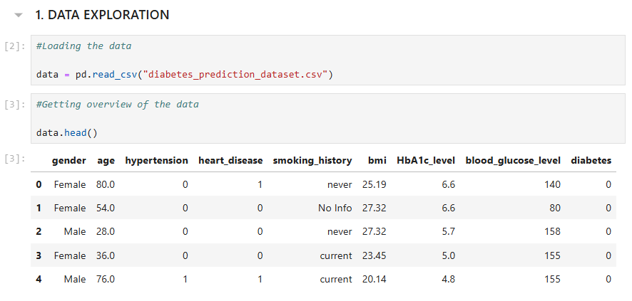
RESULTS – Exploratory Data Analysis (EDA) Target Variable/Other Features Relationships
Univariate analysis: distribution/spread of 1 single variable/column feature and its occurrence e.g. risks factors of high glucose level, age group, etc. among patients
Bivariate Analysis: shows relationships and correlations among 2 identified features e.g. the target variable (diabetes) and another feature (blood glucose level) to ascertain each factor’s influence.
Multivariate Analysis: summarise more than 2 relationships among features, informing targeted interventions for high potential (risk) factors groups e.g. age, smoking history and BMI.

Slide 11
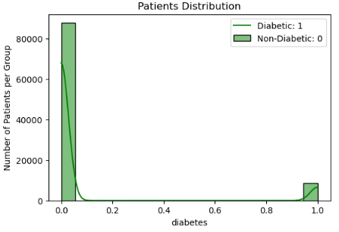
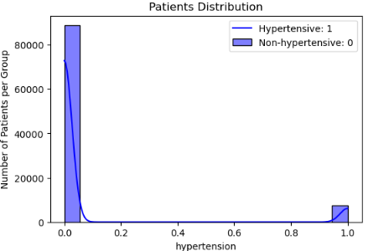
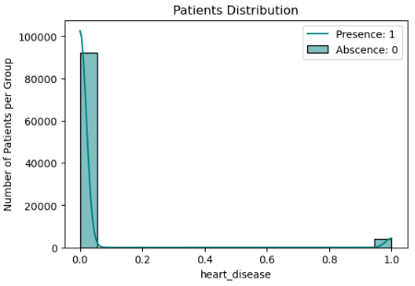
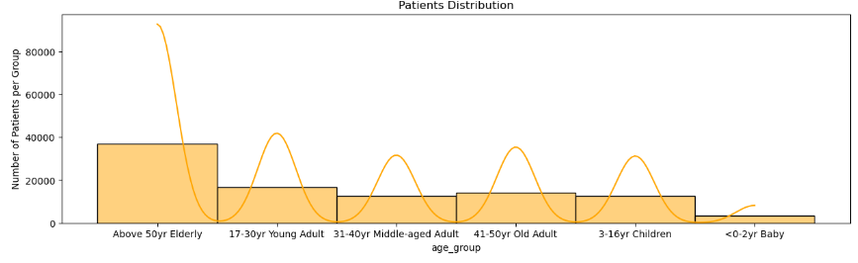
RESULTS – Exploratory Data Analysis (EDA) Target Variable vs. Other Features Relationships Graphs
Data Analysis Insights:
>80k non-diabetic patients (class -0) compared to diabetic ( class - 1), imbalanced dataset.
Similar trend for patients with and without hypertension and heart disease >80k respectively.
Above 50 years Elderly, Young adult 17-30 years and 41-50 years patients dominating total patient number, can imply diabetes predominating with higher age values.

Slide 12
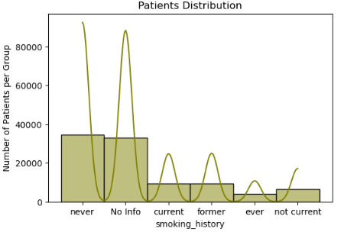
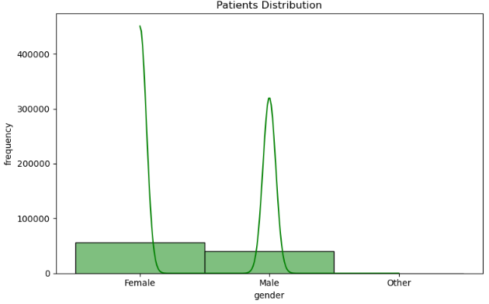
RESULTS – Exploratory Data Analysis (EDA) Target Variable vs. Other Features Relationships Graphs
Data Analysis Insights:
More “never” smokers' patients suggesting smoking unlikely diabetic causative factor.
Slightly more Female Patients >50k than Male distribution.
Data Analysis Insights:

Slide 13
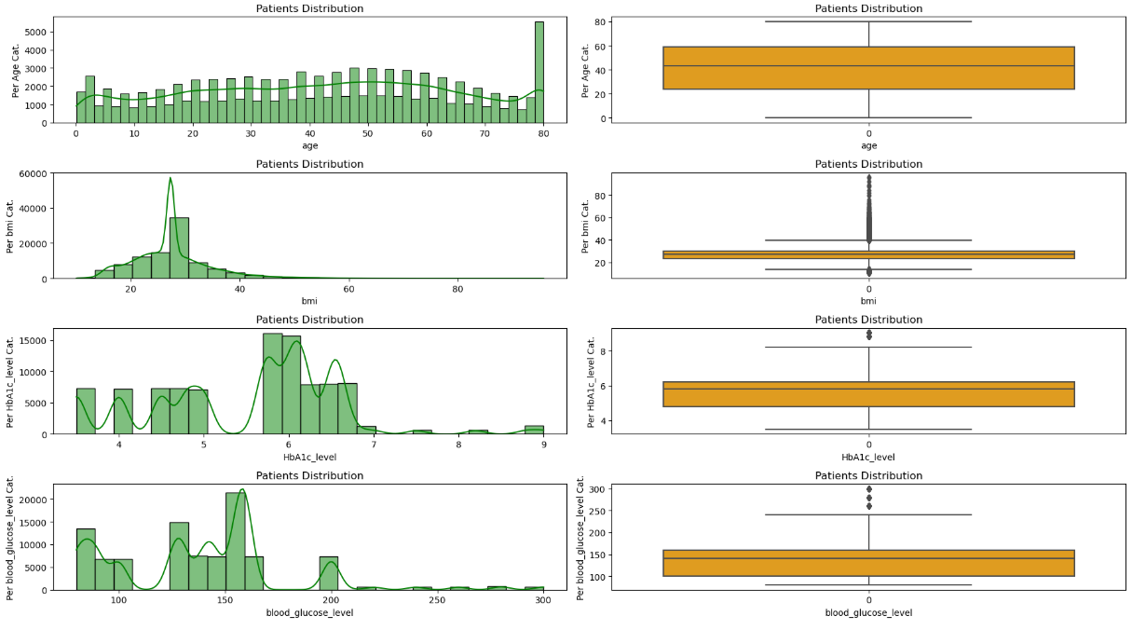
RESULTS – Exploratory Data Analysis (EDA) Numerical Features Relationships Graphs
Data Analysis Insights:
More “80years” patients >5k total suggesting age indicative factor for diabetes.
Majority of BMI, HbA1C and blood glucose levels of patients data between 25-40 units, 5.5-7.0 units, and around 120-160 units respectively for blood glucose level from distribution.

Slide 14
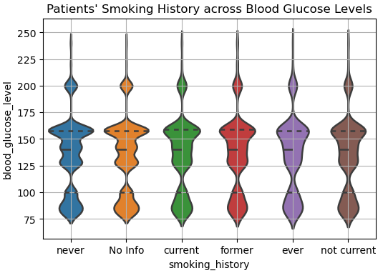
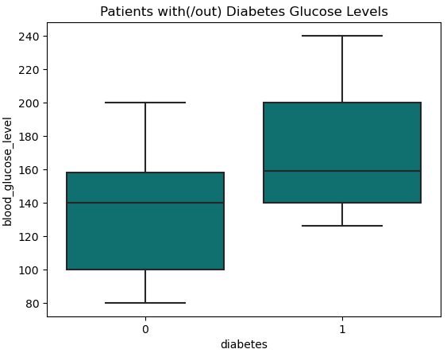
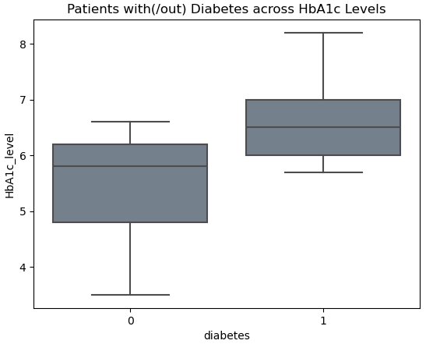
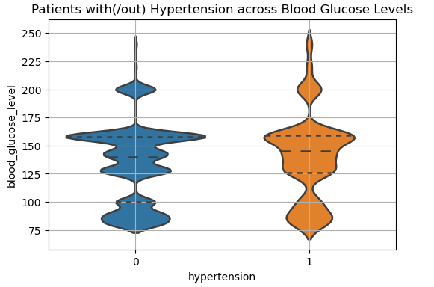
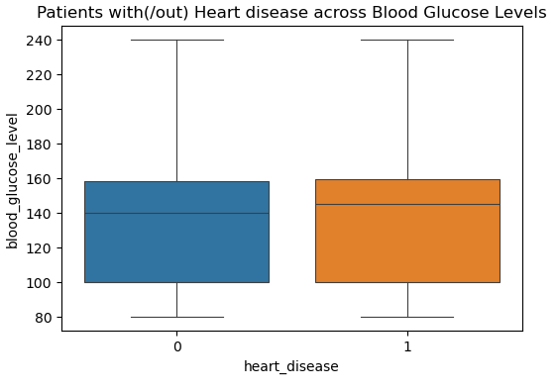
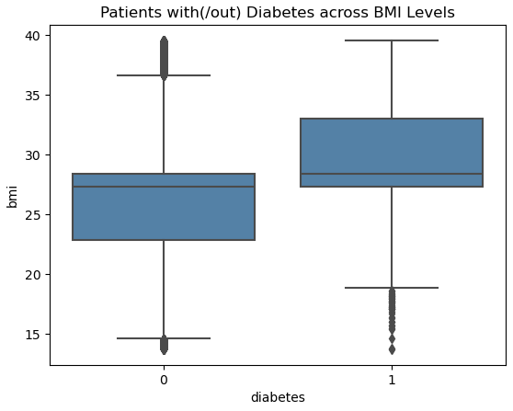
RESULTS – Exploratory Data Analysis (EDA) Features Inter-relationships Graphs (2 Variables)
Data Analysis Insights:

Slide 15
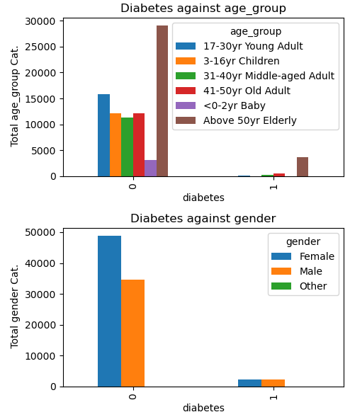
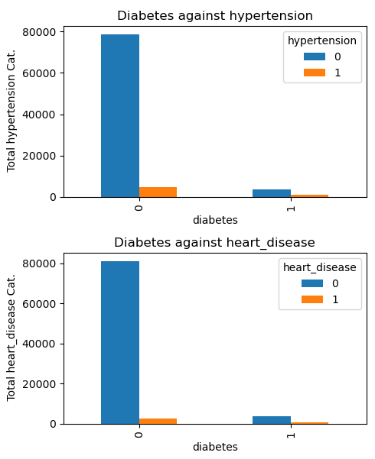
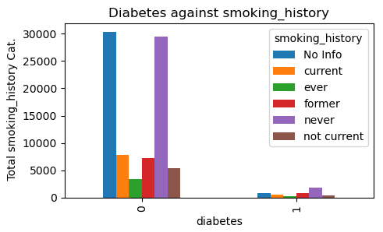
RESULTS – Exploratory Data Analysis (EDA) Features Inter-relationships Graphs (2 Variables)
Data Analysis Insights:

Slide 16
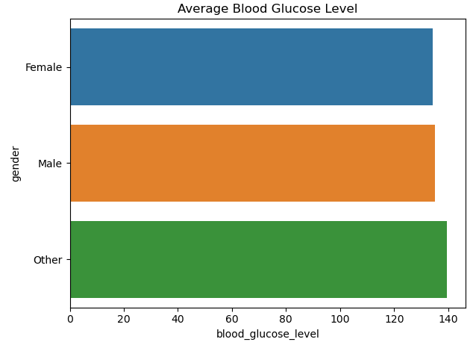
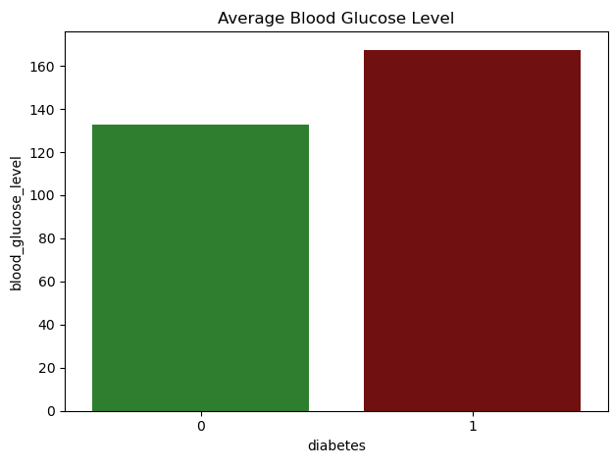
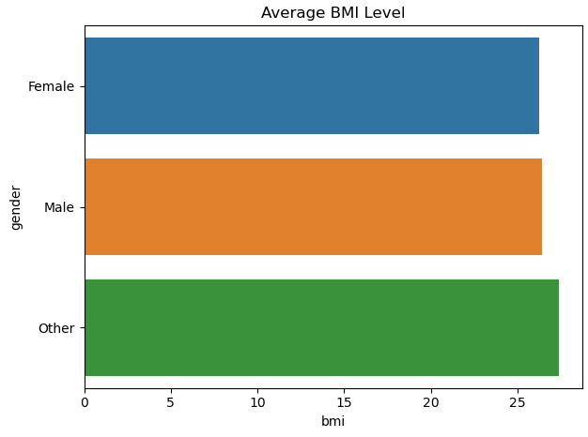
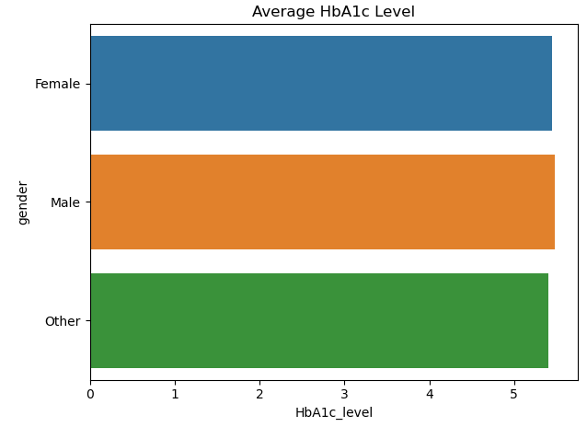
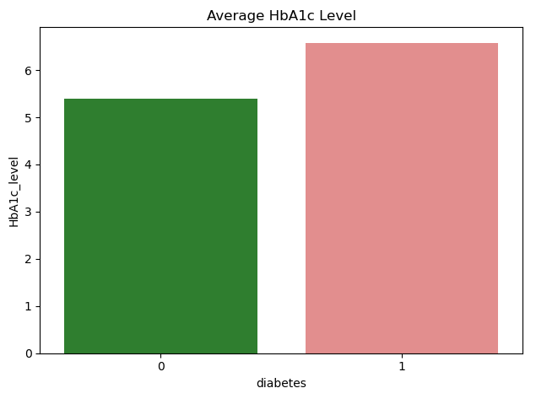
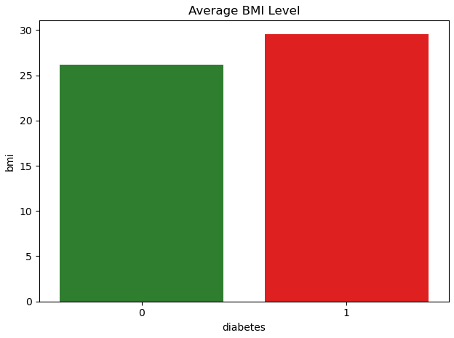
RESULTS – Exploratory Data Analysis (EDA) Features Inter-relationships Graphs (2 Variables)
Data Analysis Insights:
Average BMI, blood glucose and HbA1c levels of diabetic patients (class -1) higher overall than non-diabetic ( class - 0)
Average blood glucose level > Typical Fasting blood glucose level 100 mg/dL (American Diabetes Association, 2021)
Equivalent Male & Female gender average BMI, blood glucose and HbA1c levels – balanced

Slide 17
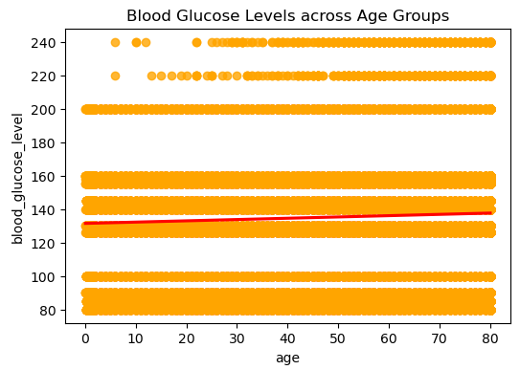
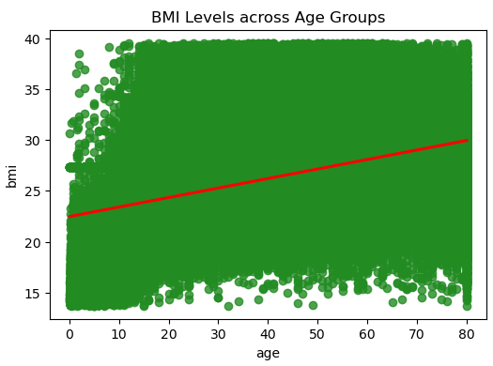
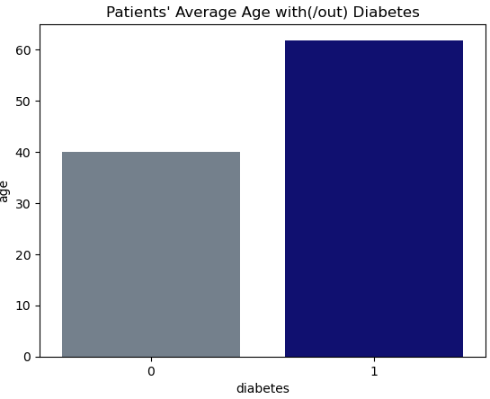
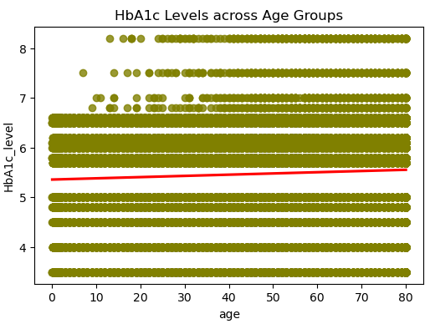
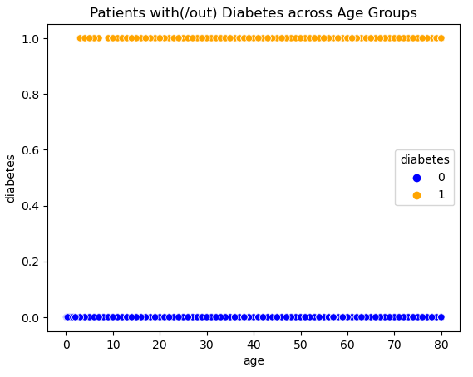
RESULTS – Exploratory Data Analysis (EDA) Target Variable vs. Other Features Relationships Graphs
Data Analysis Insights:
Slightly positive correlation between blood glucose levels, HbA1c and age.
Strong positive correlation between BMI and age.
Diabetes spread across age groups except baby (<0-2 years).
Data Analysis Insights:

Slide 18
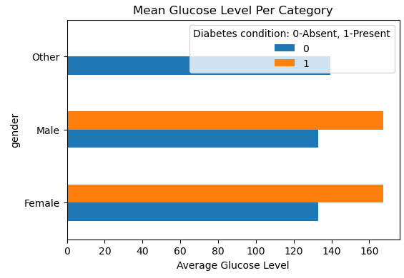
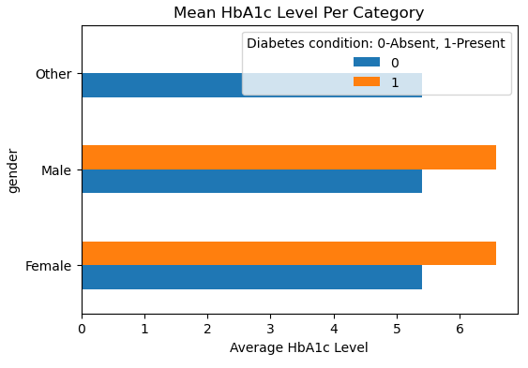
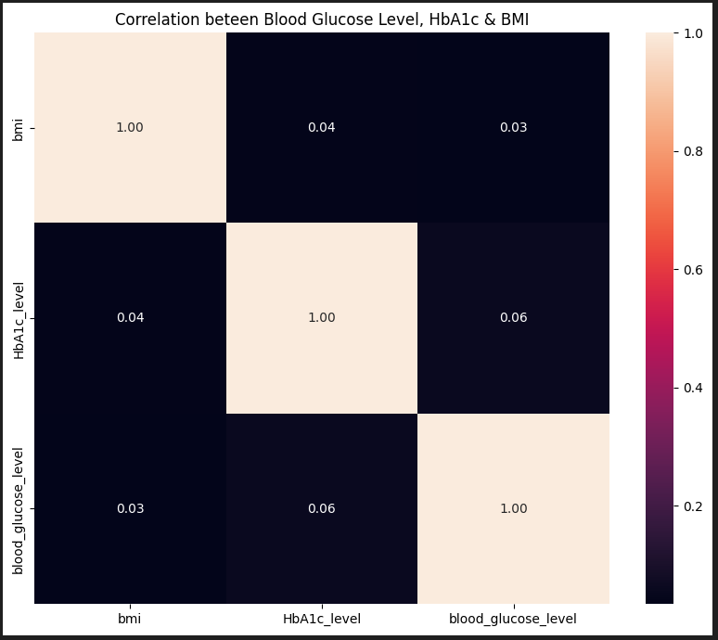
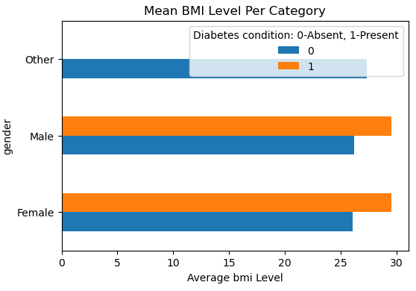
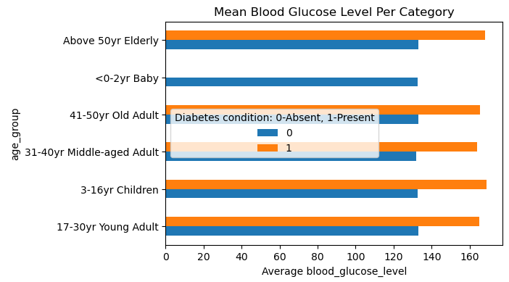
RESULTS – Exploratory Data Analysis (EDA) Target Variable/Other Features Relationships Plots

Slide 19
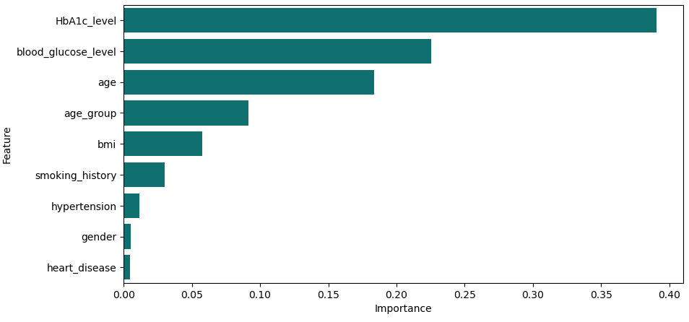
FEATURES IMPORTANCES - Results Key Diabetes Predominant Factors Relationships
Classification Analysis Conclusions:
HbA1c, blood glucose levels, ages are key predominant factors to diabetes onset.
Smoking history, hypertension and heart disease are less risk factors to diabetes in patients

Slide 20
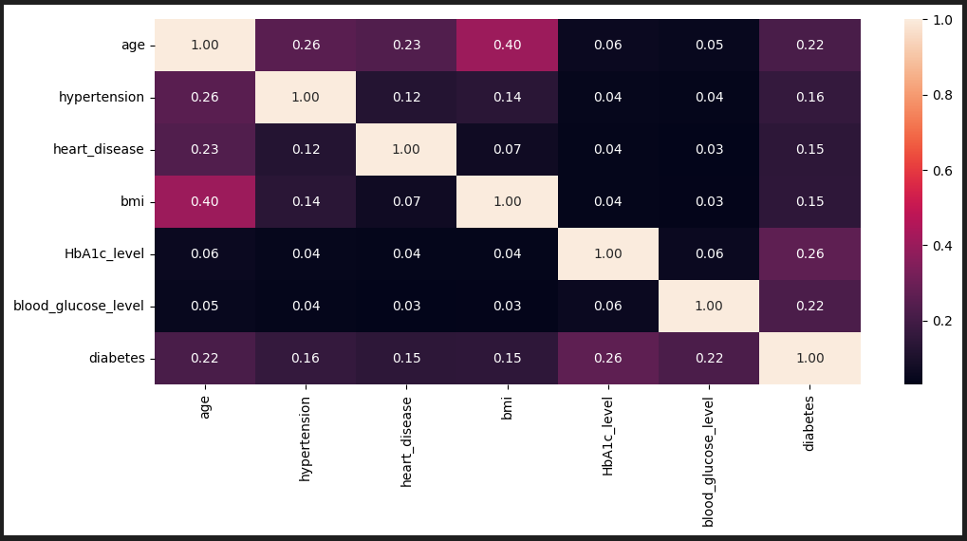
FEATURES IMPORTANCES - Results (cont’d) Key Diabetes Causative Factors Relationships (Machine Learning)
Classification Analysis Conclusions:

Slide 21
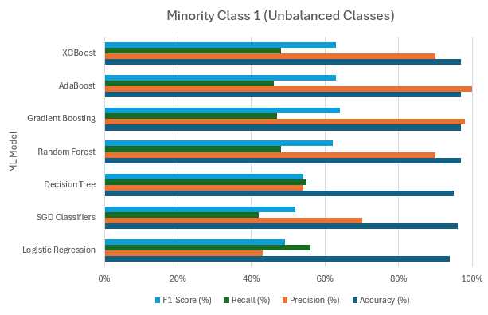
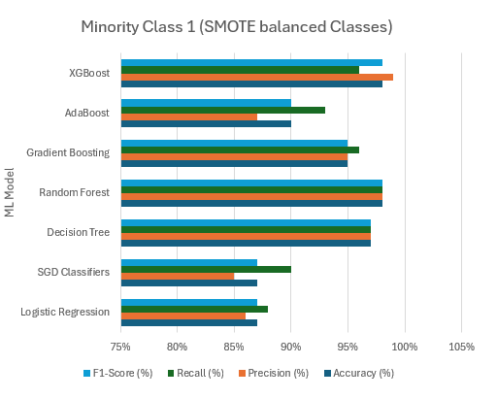
MODEL EVALUATION Key Metrics – Accuracy, Precision, Recall & F-1 score
- Above results show, Random Forest Model gives overall better performance in terms of 98% Recall (False Negatives – useful for Diabetes detection), Precision and F1-score overall compared to other models for the balanced classes. Recall metrics is used here as missing a diabetes diagnosis poses high risks to the business.

Slide 22
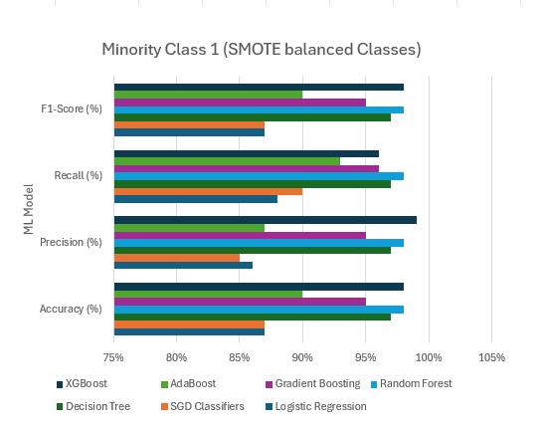
MODEL EVALUATION Key Metrics – Accuracy, Precision, Recall & F-1 score
- Above results show, the business should be more concerned with Random Forest Model Recall (False Negatives metric) results compared to Precision (True Positives metric) and F1-score overall compared to other models for the balanced classes.

Slide 23
CONCLUSIONS & RECOMMENDATIONS
KEY INSIGHTS –
Causative factors: It has been shown high/abnormal HbA1c and blood glucose levels in Elderly and Young/Middle-aged patients are key predominant factors to diabetes onset. Other risk factors such as smoking history, heart disease, hypertension and high BMI are fewer causative factors to diabetes.
Results: The Random Forest model with GridSearchCV achieved 98% recall (and accuracy) in predicting diabetes in patients, demonstrating strong potential for early diagnosis and improved patient care. Further validation is needed for broader application across diverse datasets and clinical settings.
RECOMMENDATIONS –
Biased model results from unbalanced datasets with a class more dominant than the other is addressed by techniques such as SMOTE or under sampling the majority class as the occurrence of diabetes in commonly significantly less frequent. Also, comparison among other baseline ML algorithms with hyperparameter tuning for better model performance should be applied. There should also be clear descriptions or data dictionary for each patient data (e.g., “ever” smoker or “other” gender for proper data pre-processing and sampling. Finally, the patients’ dataset lack units of measure for comparison with normal human values from scientific research.

Slide 24
REFERENCES
Apovian, C. M., 2016. Obesity: Definition, Comorbidities, Causes, and Burden, s.l.: The American Journal of Managed Care.
American Diabetes Association., 2021. Classification and Diagnosis of Diabetes: Standards of Medical Care in Diabetes—2021. Diabetes Care, 44(Supplement 1), S15–S33
Chehregosha, H., Khamseh, M. E. & Malek, M., 2019. A View Beyond HbA1c: Role of Continuous Glucose Monitoring. Diabetes Ther, 26 February, pp. 853-863.
Ramadhan, M. M., Sitanggang, I. S., Nasution, F. R. & Ghifari, A., 2017. Parameter Tuning in Random Forest Based on Grid Search Method for Gender Classification Based on Voice Frequency. s.l., International Conference on Computer, Electronics and Communication Engineering (CECE 2017).
Rasheed, S. et al., 2024. Heart Disease Prediction Using GridSearchCV and Random Forest. EAI Endorsed Transactions on Pervasive Health and Technology, Volume 10, pp. 1-8.

Slide 25
Thank You

