Slide 1
Binary Trees
Investigating the concepts of an commonly used algorithm, and the concepts behind it, along with how to make them work

Slide 2


Why is it called Binary Trees

Slide 3

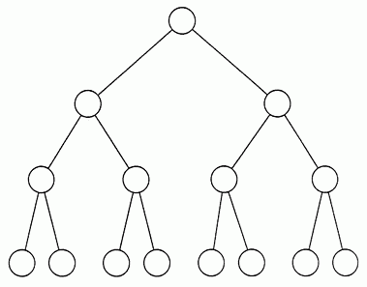
You’re gunna starting think roots are in the sky
Notes:
Have them draw the binary tree

Slide 4

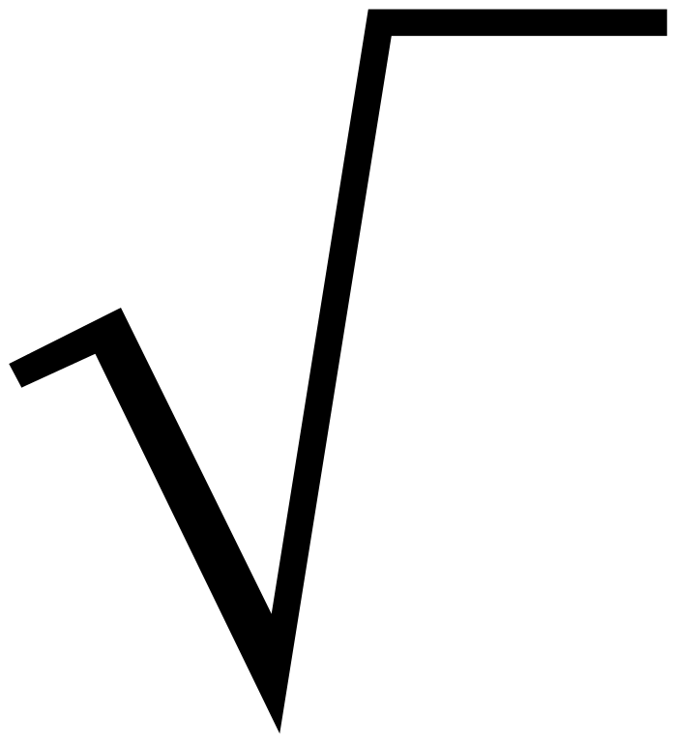
Node – All those circles in the first tree
Root-The top node in a tree.
Child -A node directly connected to another node when moving away from the Root.
Parent- The node that is above the node in question.
Siblings -A group of nodes with the same parent.
Descendant -A node reachable by repeated proceeding from parent to child.
Ancestor - A node reachable by repeated proceeding from child to parent.
Leaf -(less commonly called External node)
A node with no children.
Branch
Internal node- A node with at least one child.
Degree -The number of sub trees of a node.
Edge -The connection between one node and another.
Path -A sequence of nodes and edges connecting a node with a descendant.
Level -The level of a node is defined by 1 + (the number of connections between the node and the root).
Height of node -The height of a node is the number of edges on the longest path between that node and a leaf.
Height of tree -The height of a tree is the height of its root node.
Depth - The depth of a node is the number of edges from the tree's root node to the node.
t

Slide 5

So how do we connect these leaves

Slide 6
Linked Lists!!
Binary trees are based off of linked lists
A linked list is based off a list
The concept of a linked list is that a whole list is held inside one variable
How can we have several items in one variable?

Slide 7
We create a type (please ignore class
In Java we use classes, but they look like structs
Class Leaf
{
Public LinkedList
{
Int value;
}
}
Class Linked List extends Leaf
{
Public LinkedList
{
Leaf next
}
}
In Python We make a class
Class LinkedList:
def __init___(self):
self.value = a
self.next = b
In C we make a struct
Struct Item
{
int value;
} /* or you can use typedef if yr tired of struct */
Typedef Struct LinkedList
{
Sturct Item *next
}

Slide 8




How do we add to a Linked List
We can just keep using next
Or we create a rule to handle this
Conceptually Speaking
If there's nothing in the list, value is me
Try it
Try it

Slide 9
Plus I am providing a different way to understand it too.
But that leads to the question

Slide 10
How do I deleten
Try it!
Notes:
Have them make a function that deletes an object from the node

Slide 11
Searching should be easy
It is commonn
Next next next till I get there
Does everyone understand so far, if they did I am doing my job

Slide 12
SO HOW DOES THIS APPLY TO BINARY TREES
For Those who do not see the connection I expect many

Slide 13



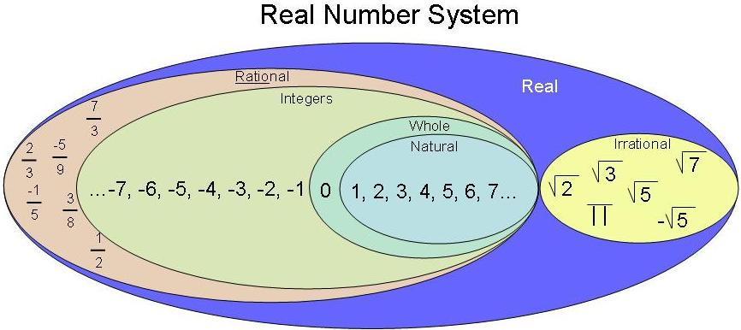

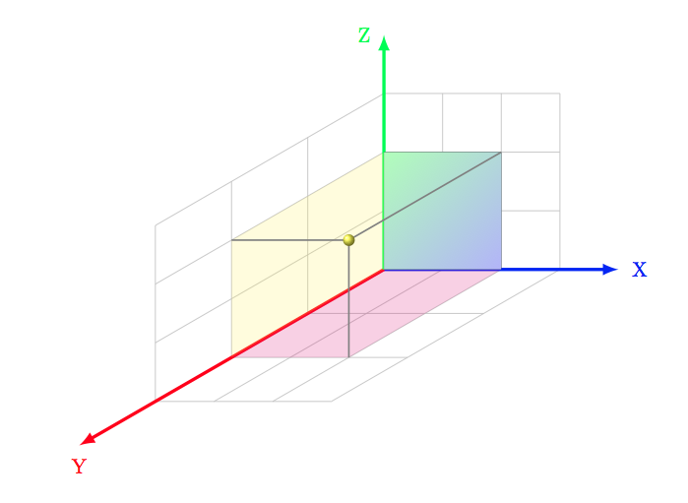
First, there are different ways Binary Trees are made
Z
Y
X
Notes:
Min first, max first, min top, max top, association or scribbily
Mirco-LR,Macro-LR,Micro-TB,Macro-TB, BAT, and scribbly

Slide 14
We will only be working with min arrangement because
There is not enough time
There is too much to cover as you can see
This is the common one
You might get the goal of this workshop, and wont need my workshop

Slide 15
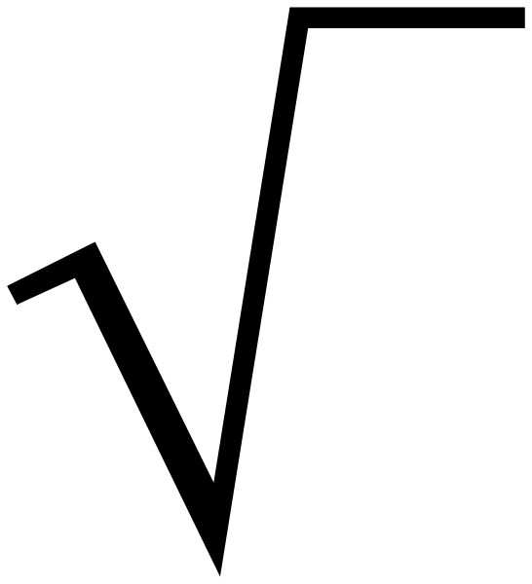
First two concepts
Root
Leaf
Try it
Notes:
Have the students try to implement a class linked list with root and leaf object that make up the list

Slide 16


And two more concepts
Left
Right
Notes:
Instead of next,we have left and right

Slide 17


You should be able to add and search(but ill give you hints)
Adding(parent, node_to_add)
(Look at adding
Make sure it goes in the correct next
Make sure you preseve everything about the parent's leaf
If a new root is added, just make it equal to the root, and make the root the left or the right.
It's just like putting a lego in between two legos
Searching(node_to_find)
Start from the left
You will need just one nested recursion (a call in a call)
Since it is ordered, from the middle, rule is
1. If its less that node go left
2. If its greater than node go right

Slide 18




Getting given value into the tree(min BT)
1. Get the items from your file into your program
2. Reorder the items
3. Find the middle of the items, and make that the root
4. Add as necessary according to algorithm
1 download all items from all the files
2. Follow steps 2-4
1 Reorder your values on a piece of paper
2. Find the middle value
3. For additional values, add as necessary according to algorithm
1. If an item belongs in the head, make it the head and readjust accordingly
2. add according to the algorithm
Notes:
For a file, for several files, for typing in your values, for typing in as teacher instructs,
Point is to start at the middle of the list

Slide 19
Deleting a node(gets confusing)
First you must find the node
If it is a leaf just have its parents child equal none
If its not, everything is relative to the subtree so,
If it less than parent, If its greater than the parent
First make the siblings left First make the siblings left
Or leaf of the siblings leftmost Or leaf of the siblings leftmost
Equal to the nodes left,then equal the nodes right, then make
Make the parents left equal the parents right equal to its
To its sibling, effectively sibling
Removing the node
Notes:
If it’s the head,say hey I know so much, make sure its not the head

