Slide 1
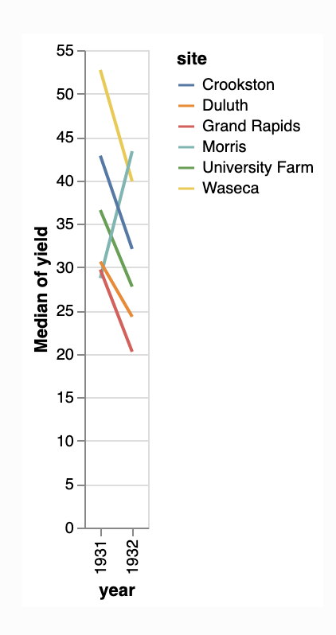
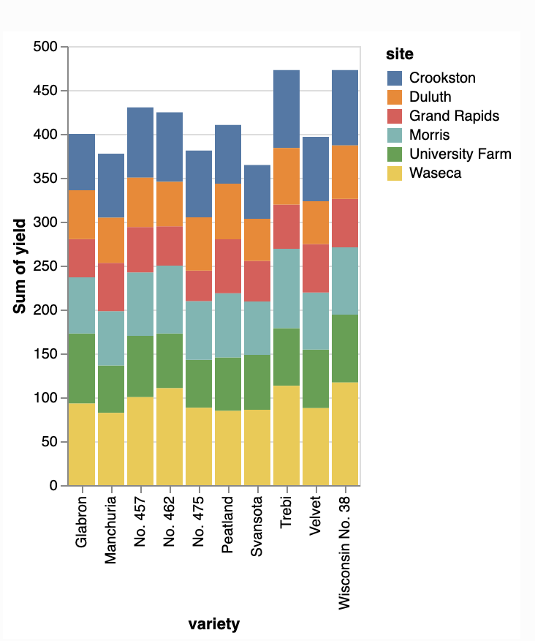
WSP ‘Programmer and visualization specialist’ test task
Please use python and Plotly / Dash (https://plotly.com/dash/), to create a dashboard that visualizes the two graphs below.
The data can be downloaded “from vega_datasets”; “import data source = data.barley()” (the dataset are from the altair library. (Please use the altair library only for downloading the data not for plotting)
When programming the dashboard, please write code that is pep8 compliant (https://www.python.org/dev/peps/pep-0008/)
Please use version controlling (GIT), during the development process
When finished submit your code on github and send link to davoud.taghawi-nejad@whiteshieldpartners.com

Slide 2
The two graphs to be reproduced

