Slide 1
Automatic Parallelisation of Rust Programs at Compile Time

Slide 2
Why?
Processors gain more cores
Writing parallel code is more difficult than sequential code
Already got many sequential programs that we do not want to rewrite.
Want a way to automatically convert a sequential program to take advantage of the additional cores

Slide 3
Why Rust?
Rust has a unique memory management system.
Each variable has ownership information and a lifetime.
Access to the variable can be given by moving or borrowed the variable.
“Guarantees thread safety”

Slide 4
What did I do?
Created two rust compiler plugin
  Linter plugin: Analyses function with macros expanded
  Syntax extension plugin: Modifies function to run parts in parallel
Parallelising Steps
  Deconstruction
  Dependency Analysis
  Scheduling
  Reconstruction
Focused on “safe” statement level parallelisations

Slide 5
Simple Example
fn main() {
let mut a = 4;
let mut b = 3;
a += 1;
b += 1;
println!("{}, {}", a, b);
println!("End of program");
}

Slide 6
Deconstructor
fn main() {
let mut a = 4;
let mut b = 3;
a += 1;
b += 1;
println!("{}, {}", a, b);
println!("End of program");
}
In: {}, Out: {a}
In: {}, Out: {b}
In: {a}, Out: {a}
In: {b}, Out: {b}
In: {a, b}, Out: {a, b}
In: {}, Out: {}

Slide 7
Dependency Analysis
let mut a = 4;
let mut b = 3;
a += 1;
b += 1;
println!("End of program");
println!("{}, {}", a, b);

Slide 8
Scheduler
println!("End of program");
let mut b = 3;
b += 1;
// send b
let mut a = 4;
a += 1;
// wait for b
println!("{}, {}", a, b);

Slide 9
fn main() {
let (syncline_137_144_149_174_b_send,
syncline_137_144_149_174_b_receive) = std::sync::mpsc::channel();
let thread_179_206 =
std::thread::spawn(move || { println!("End of program"); });
let thread_106_120 =
std::thread::spawn(move ||
{
let mut b = 3;
let return_value =
{
b += 1;
syncline_137_144_149_174_b_send.send((b,)).unwrap()
};
return_value
});
let return_value =
{
let mut a = 4;
let return_value =
{
a += 1;
let return_value =
{
let (b,) =
syncline_137_144_149_174_b_receive.recv().unwrap();
println!("{}, {}" , a , b);
};
return_value
};
return_value
};
thread_179_206.join().unwrap();
thread_106_120.join().unwrap();
return_value
}

Slide 10
What could be expanded
Performance analysis
Unsafe blocks
External functions that rely on a global state
Already threaded code
Loops
Limit number of threads
Check for Send Trait

Slide 11
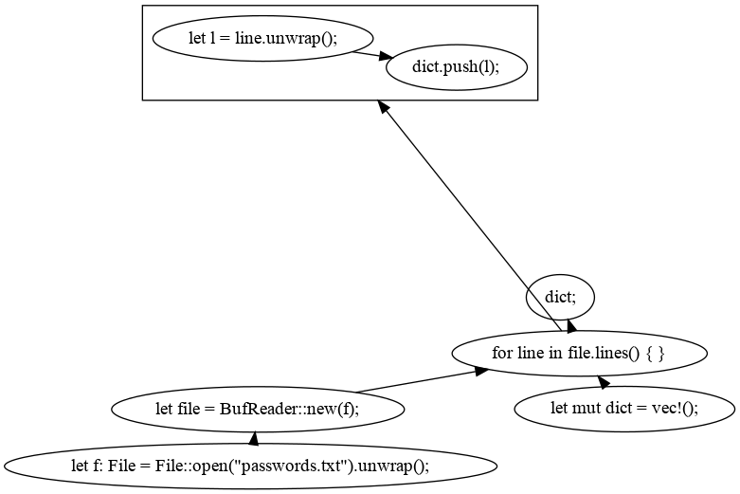
Password Cracker
loadDictionary()

Slide 12
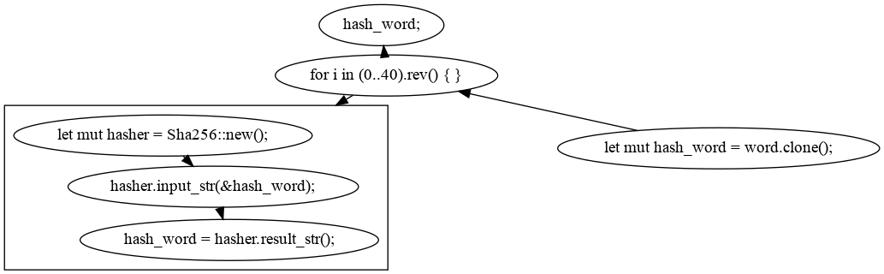
Password Cracker
hash()

Slide 13
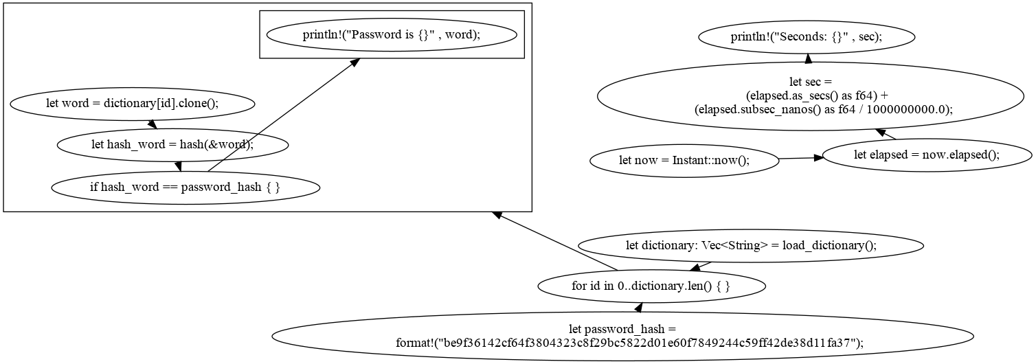
Password Cracker
main()

