Slide 1
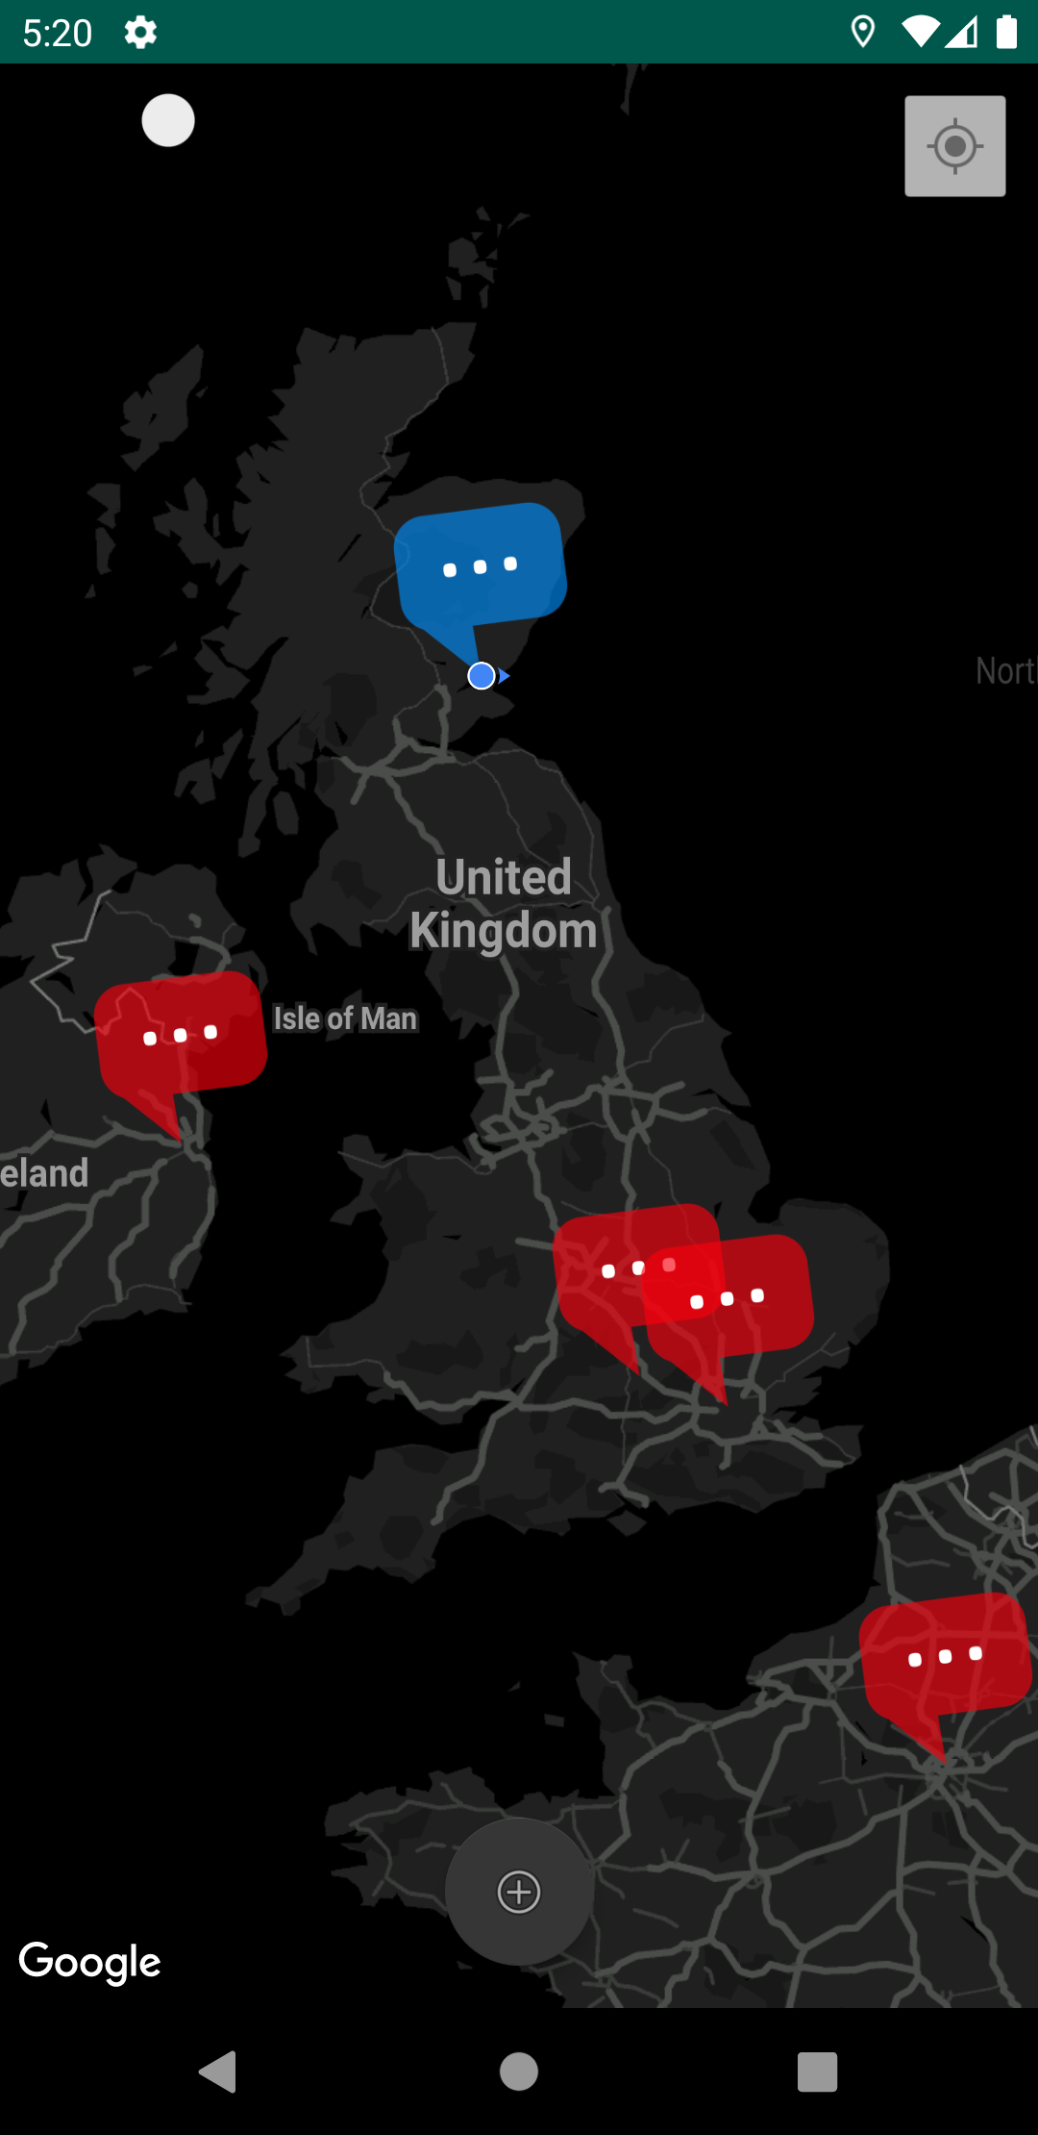

GeoChat
Michael Wilson (1905979)

Slide 2
Purpose
Allows users to post text to a map at their current location.
Posts are visible to everyone.
Users can add comments to posts.
There is no pre-defined purpose of the app, users are free to use it as they please.

Slide 3
APIs, Storage, and Networking Features
APIs
Location Awareness (Google Maps)
Notifications
Storage
Firebase
Shared Preferences
Networking
Firebase Cloud Messaging

Slide 4
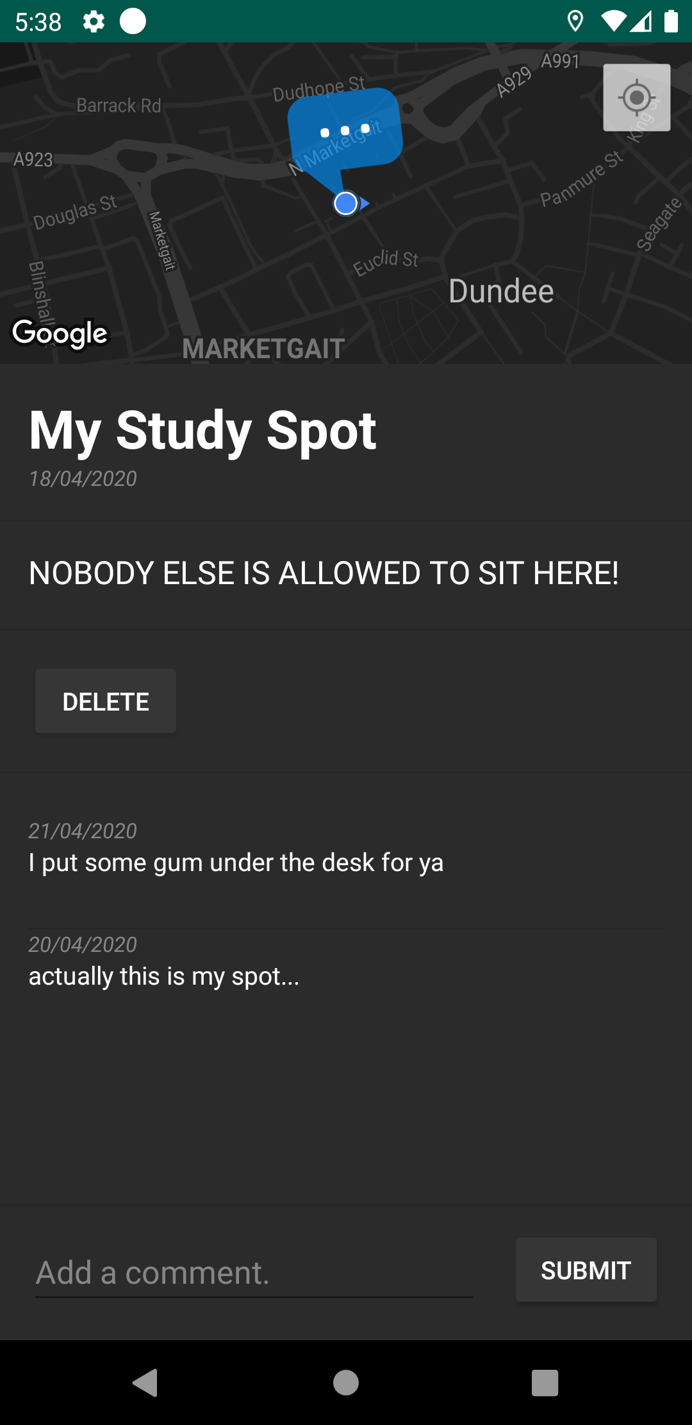
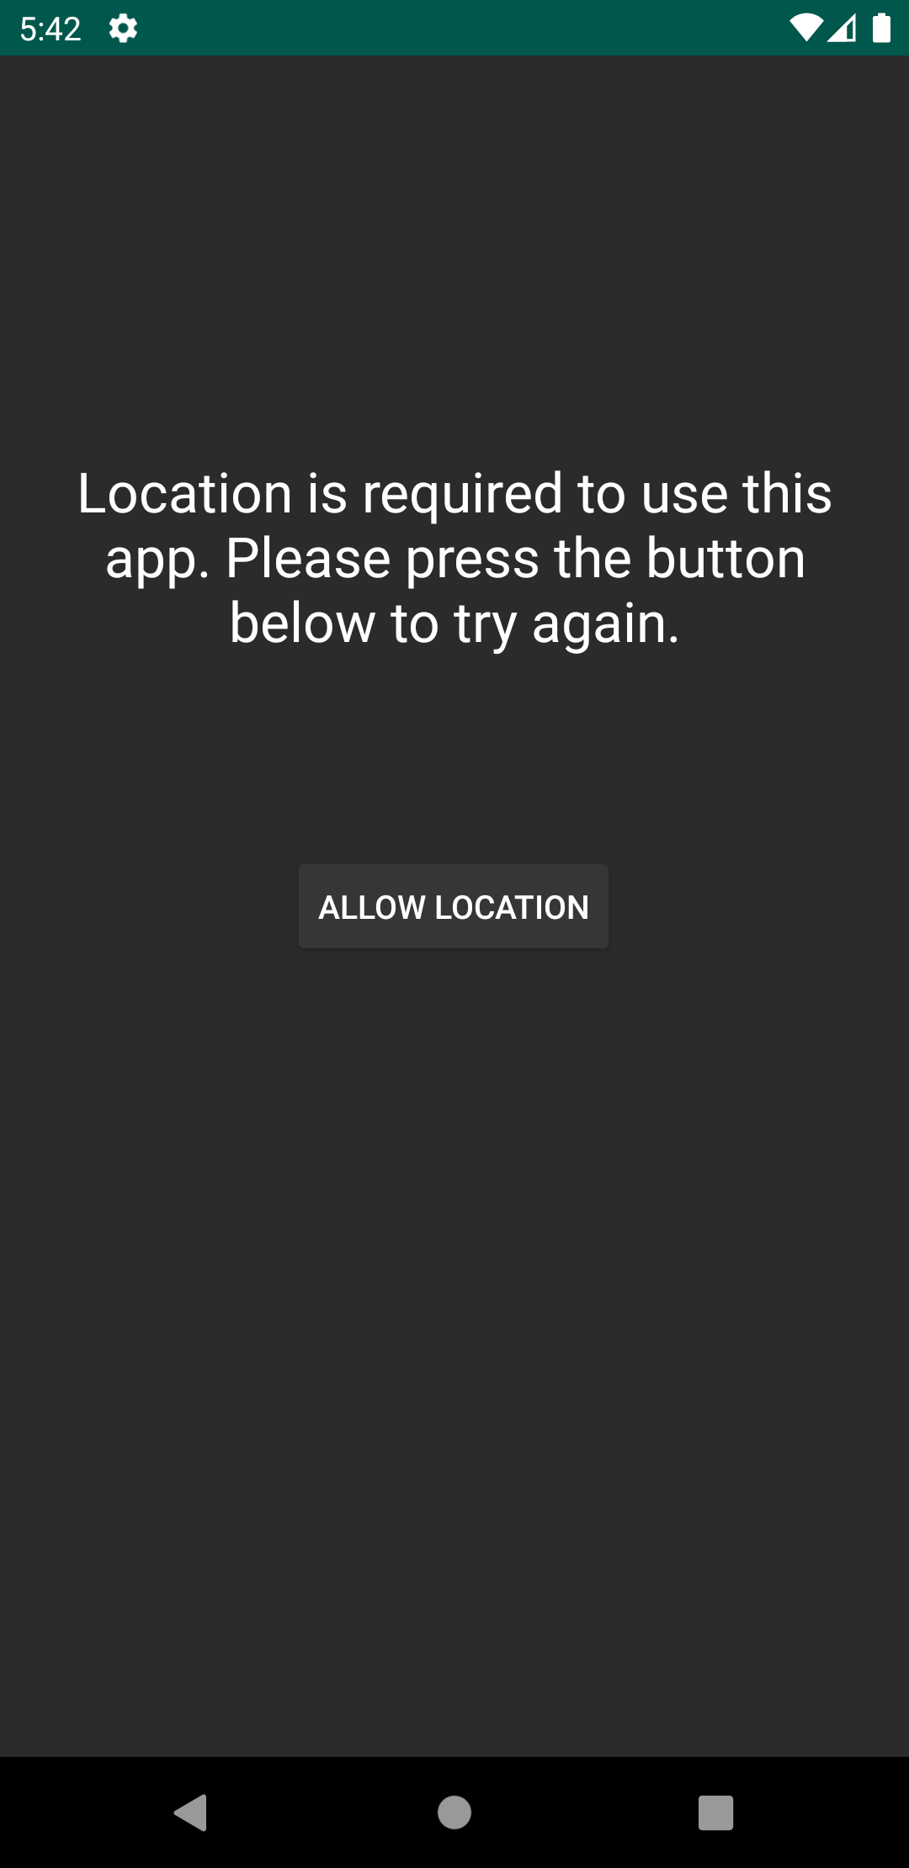
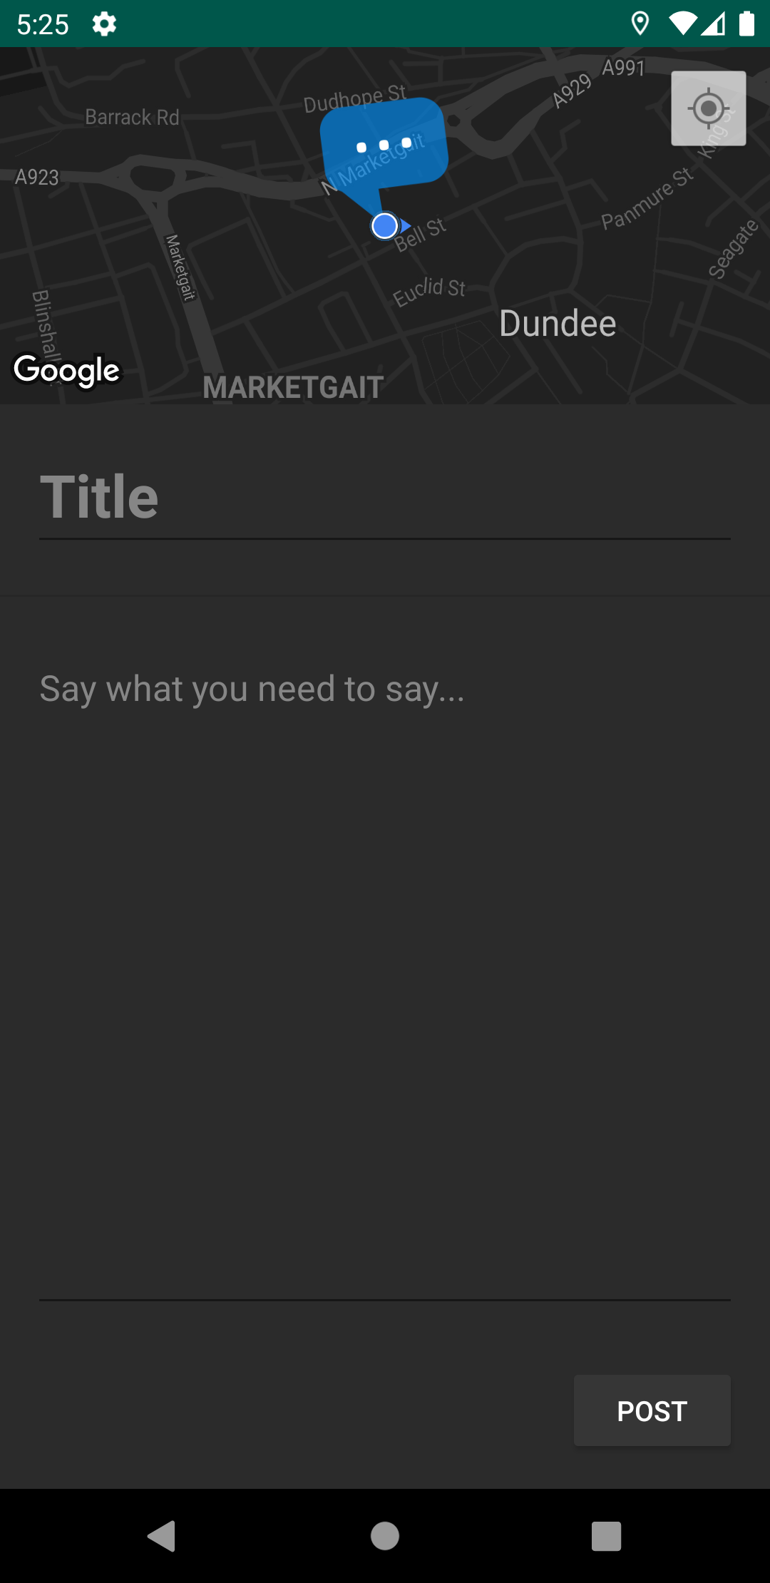
App Structure
Permissions Screen
(LauncherActivity)
Home Screen
(MainActivity)
Post Discussion Screen
(DiscussionActivity)
Back button pressed
User clicks on a post
App launched
Located allowed
‘POST’ button clicked
User clicks on button to add a new post
New Post Screen
(PostActivity)

Slide 5
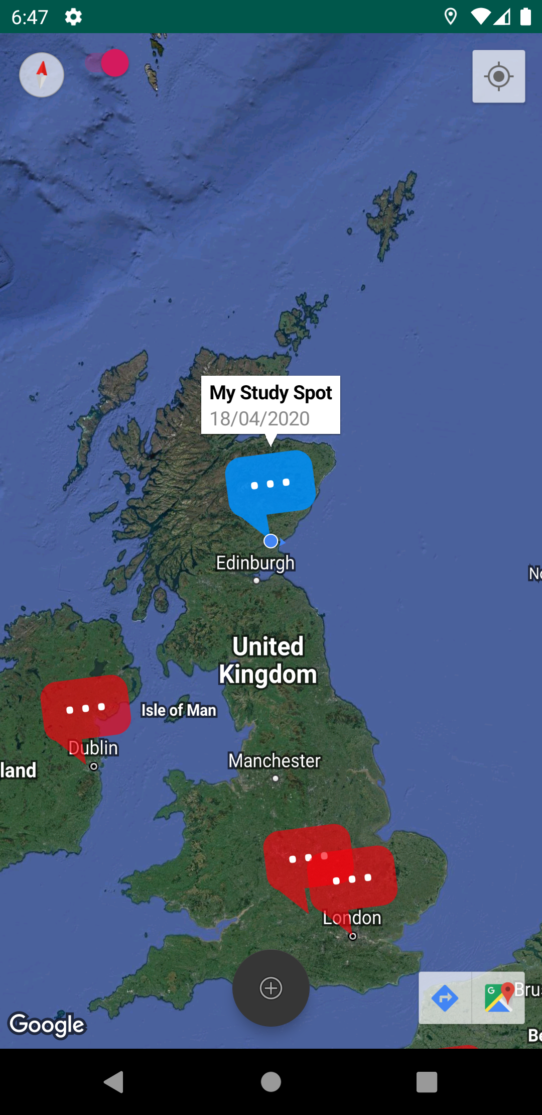
‘Home Screen’ Overview
Toggle satellite mode
Zoom to your location
(A default feature of Google Maps)
Your posts appear blue
Info window appears when a post marker is tapped. Displays the post’s title and creation date. Click on this window to open the discussion screen.
All other posts appear red
Button to add a new post at your current location
(Location must be enabled)
Your current location
(A default feature of Google Maps)

Slide 6
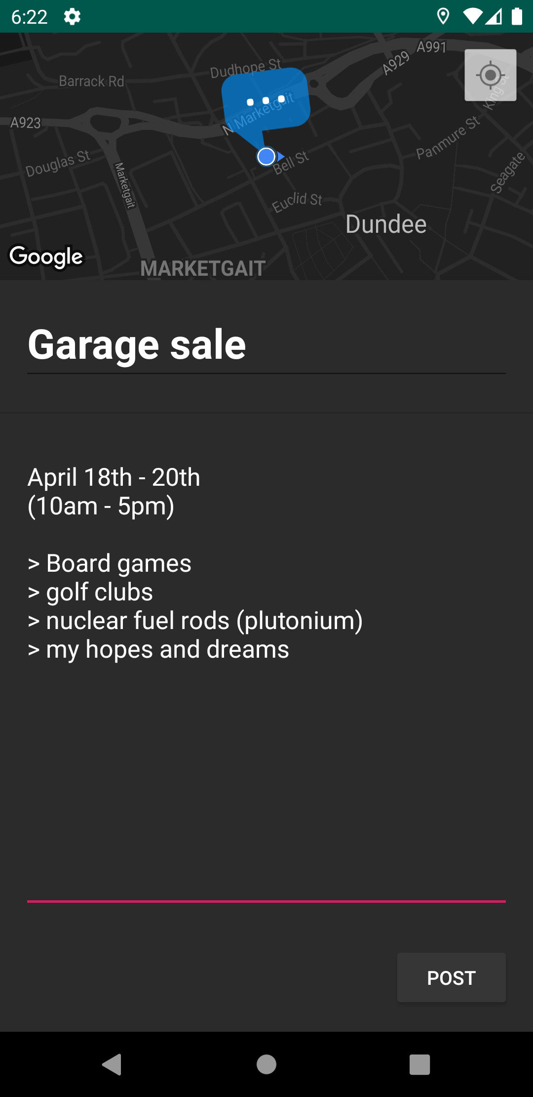
‘New Post’ Overview
Location of the new post
Single-line textbox for the post’s title
Multi-line textbox for the post’s body
Finish the post and add it to global map.

Slide 7
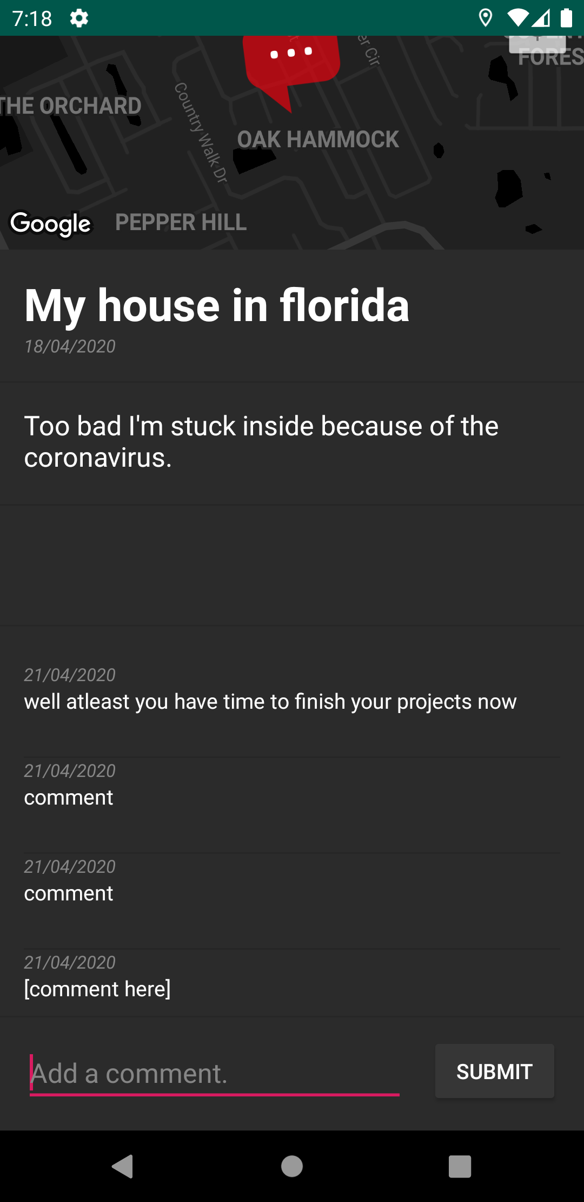
‘Discussion Screen’ Overview
Post title
Post body
Creation date
(day/month/year)
Delete button
(Only visible to the owner of this post)
List of comments
Single-line textbox to write a comment
Button to submit your comment (A notification will be sent to the post’s owner)

Slide 8
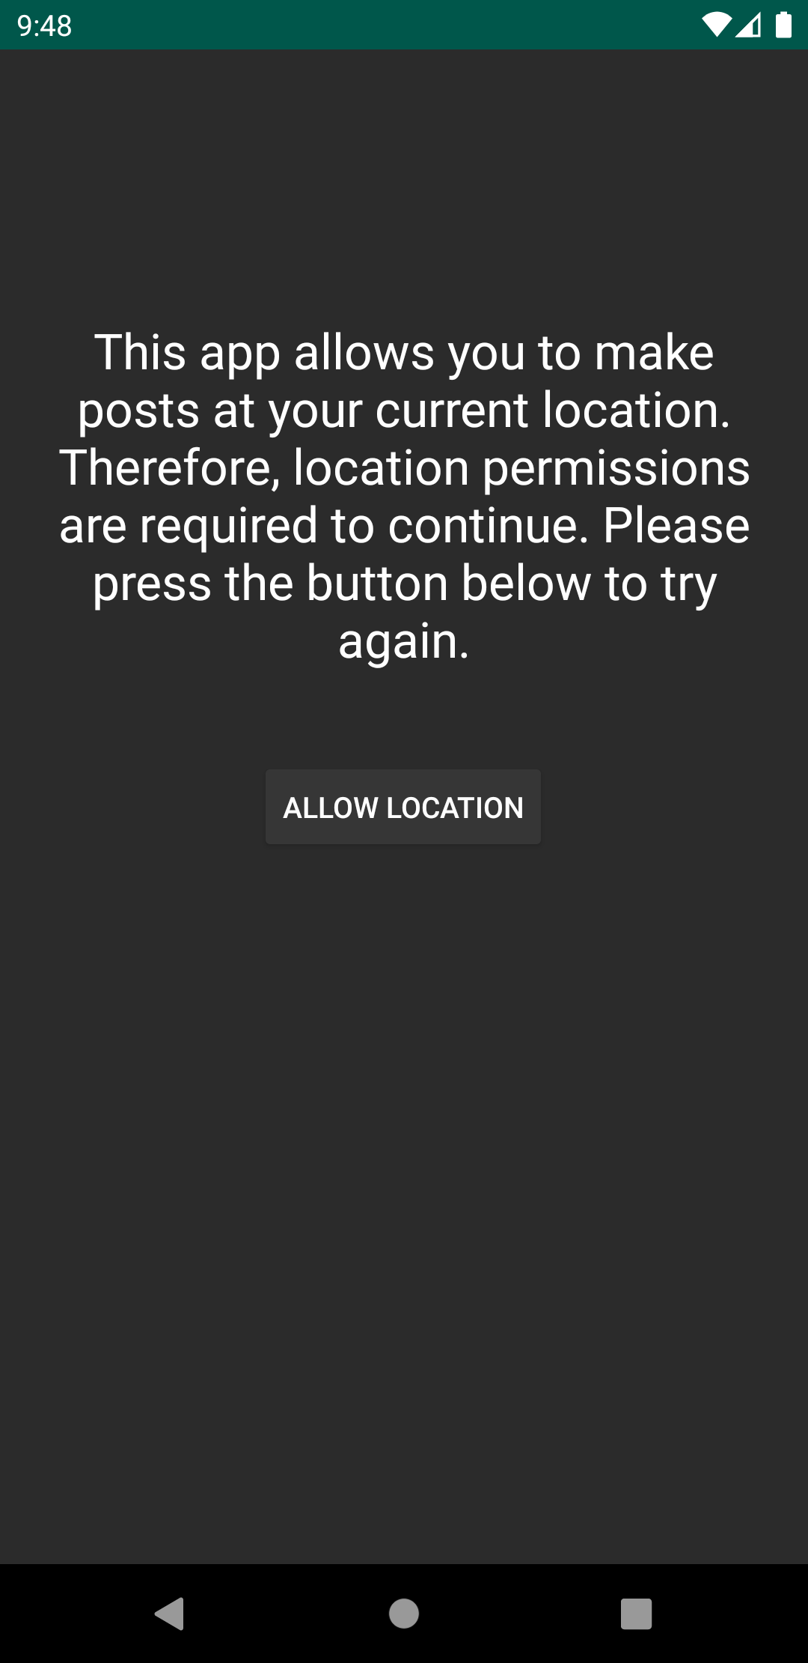
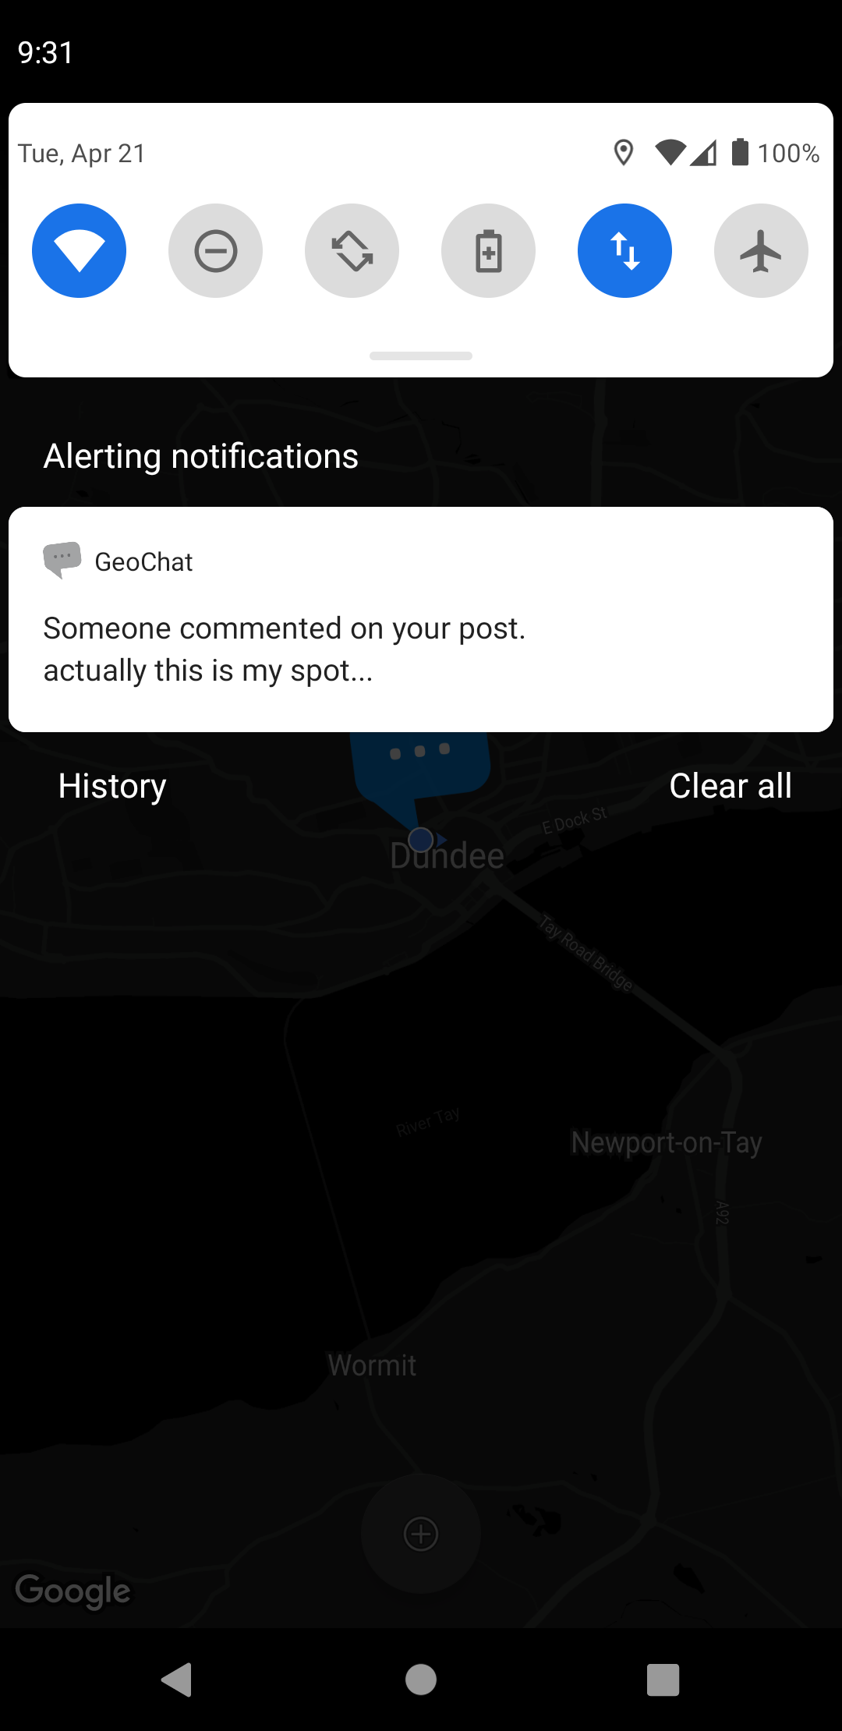
‘Permissions Screen’ & Notifications
When launched, all views in this activity are hidden, and permissions are immediately requested. If denied, this explanation is shown.
When clicked, opens the ‘Discussion Screen’ where the comment was made.
Click to display the permissions request dialog again.

Slide 9
Critical Evaluation: What Worked, What Didn’t?
What Worked
All cloud storage is done seamlessly through Firebase.
Loading times are reasonable.
Simple and easy to use UI.
Notifications sent via Firebase Cloud Messaging without the need for my own external server.
What Didn’t
Purpose of the app isn’t immediately apparent.
Delete button and satellite toggle switch feel awkwardly placed.
GPS location is not as accurate as I would like it.
App will not work without internet connection.
Too many posts in the same spot make them hard to touch.

Slide 10
Critical Evaluation: Future Improvements
Allow users attach images to their posts.
Allow the user to choose from a variety of markers.
Give the user an option to post under an alias instead of all anonymously.
Create a Light/Dark theme which the user can swap between.
Add an “offline-mode” where the user can add posts which as stored locally.
Create “groups” or “categories” which users can post to instead of all posts being visible at all times.

Slide 11
Video Demo: https://www.youtube.com/watch?v=5bu8XsUCrRY

