Slide 1
Airline Passenger Satisfaction
Big Data Computing, a.y. 2021/22, Michele Spina

Slide 2
01
A/D
What are the starting points and objectives of this project?

Slide 3
2.987.240
More than 100.000 rows and 23 columns

Slide 4
What do we know?
Customer information
Flight data
Satisfaction levels by category
Age and gender of the passenger and reason of the travel
Flight distance, class and delay
Satisfaction level (0 to 5) of flight services, like food or cleanliness

Slide 5

Arrival point
The goal of the project is to predict if a passenger it’s satisfied or not

Slide 6
02
Pre- processing
Analyze the distribution and correlation of the data, and apply feature engineering

Slide 7
Pre-processing
A
Analyze dataset
Data encoding
C
B
Drop columns
Normalize
D
Analyze data distribution and correlation
Convert categorical values to numerical values
Drop useless or redundant columns
Normalize the data distribution

Slide 8
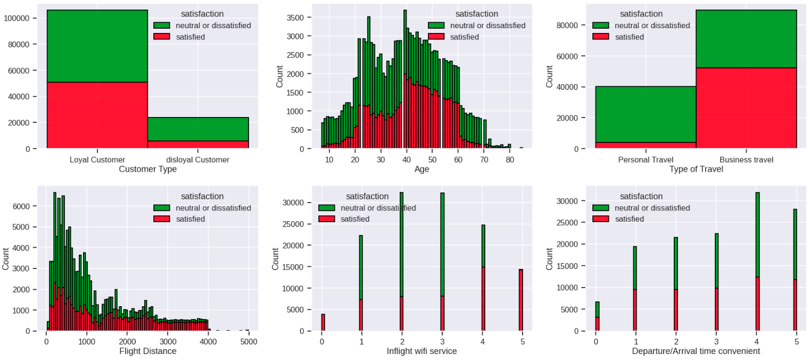
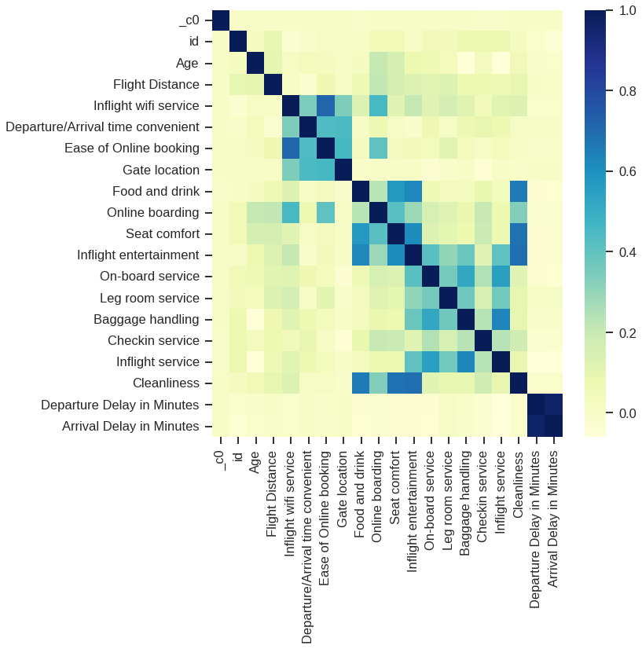
Analyze dataset
Data distribution
Correlation matrix
Data are not normally distributed
High correlation arrival-departure delay

Slide 9
Data encoding pipeline
StringIndexer
OneHotEncoder
VectorAssembler
StandardScaler
it encodes string column of labels to a column of label indices
it maps a categorical feature to a binary vector indicating the presence of a specific feature value
It combines a list of columns into a single vector column;
it normalizes each feature to have unit standard deviation and/or zero mean;

Slide 10
03
Classification models
Logistic Regression, Random Forest and Decision Tree

Slide 11
Classification models
Logistic Regression
Random Forest
Decision Tree
LR
RF
DT

Slide 12
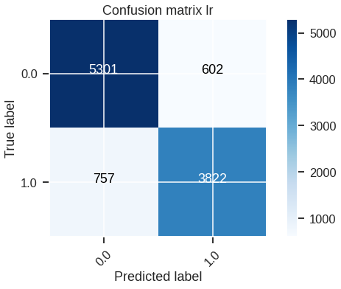
LR results
Precision metric: 0.869
Recall Metric: 0.866
Accuracy Metric: 0.870
F1-score Metric: 0.868 AUROC: 0.925

Slide 13
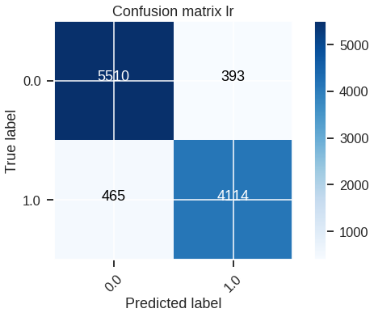
RF results
Precision metric: 0.917
Recall Metric: 0.916
Accuracy Metric: 0.918
F1-score Metric: 0.917
AUROC: 0.972

Slide 14
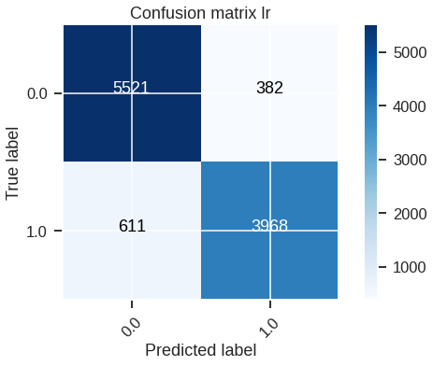
DT results
Precision metric: 0.906
Recall Metric: 0.901
Accuracy Metric: 0.905
F1-score Metric: 0.904
AUROC: 0.752

Slide 15
Models evaluation
 | AUROC | Precision
Logistic Regression | 0.925 | 0.869
Random Forest | 0.972 | 0.917
Decision Tree | 0.752 | 0.906

Slide 16
05
Tuning & K-fold
Tuning hyperparameter and apply k-fold validation

Slide 17
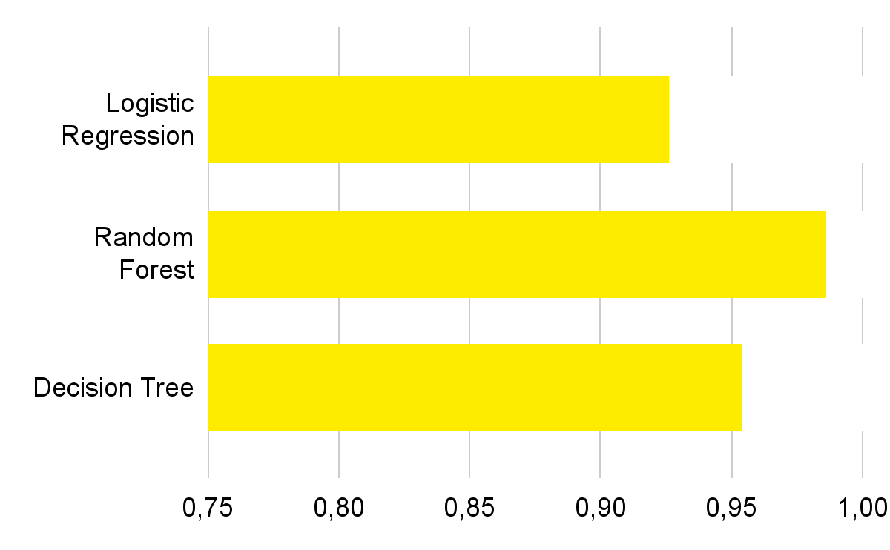
Tuning hyper-
Parameter (AUROC)
Logistic Regression
0.927
Random Forest
0.986
Decision Tree
0.945
lambda= 0 alfa=0 maxiter= 1000
maxDepth = 8 numTrees = 100
maxDepth= 8
impurity= entropy

Slide 18
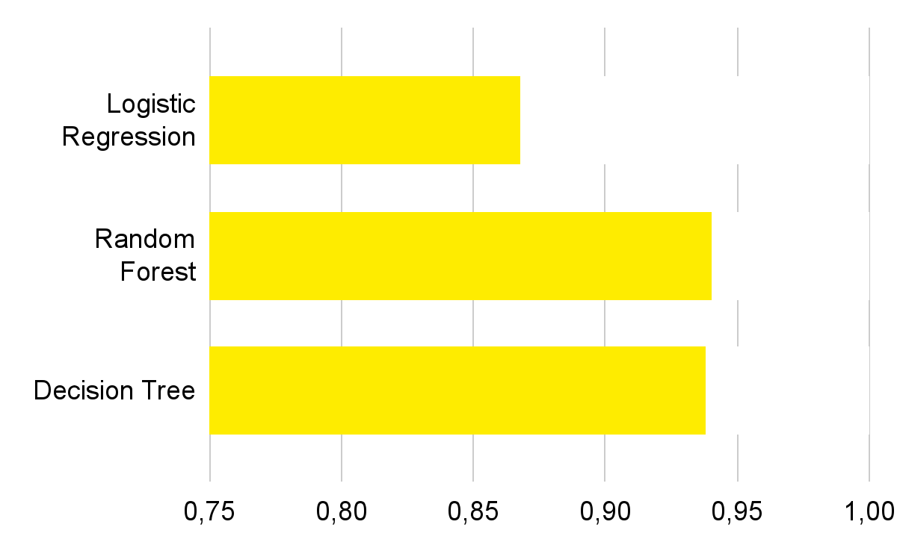
Precision evaluation
Logistic Regression
0.868
Random Forest
0.940
Decision Tree
0.938
lambda= 0 alfa=0 maxiter= 1000
maxDepth = 8 numTrees = 100
maxDepth= 8
impurity= entropy

Slide 19
05
Conclusion
Conclusion and future works

Slide 20
Conclusions
I trained 3 differents model and Random Forest result the best ono, and decision tree is the most improved by tuning
The best results occurs for high number of iterations
It’s probably I initially occurs in underfitting
Overcoming the limits of Google Colab it would be possible to perform the tuning with more interaction or trees or use more dense intervals to tune the parameters

Slide 21
Thanks
Does anyone have any questions?
spina.1711821@studenti.uniroma1.it

