Slide 1
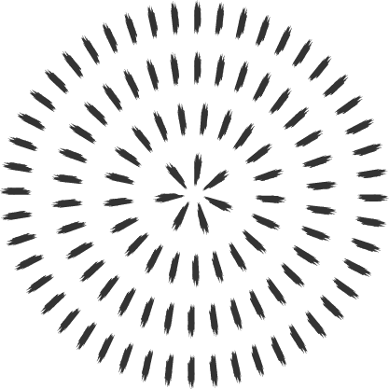

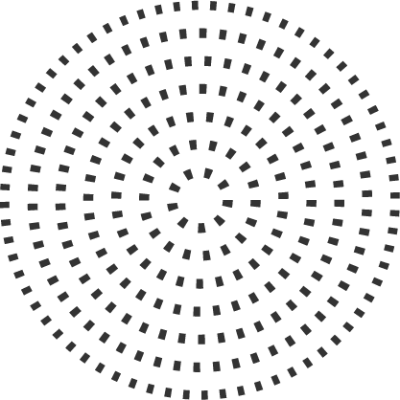
DArt: Blockchain applied to Cultural Heritage
Revisor: Di Ciccio Claudio
Students: Dionisi Giordano and Spina Michele
Notes:
GIORDANO

Slide 2
Let's Start: Who We Are?
Giordano Dionisi
Michele Spina
Notes:
ENTRAMBI

Slide 3
Common Point
BlockChain Interest
Work / Research
Community
Notes:
ENTRAMBI

Slide 4
Responsibilities
Giordano
Logo Design
Presentation
HTML
Use-Cases
Michele
Solidity
Architecture
JavaScript
Conceptual Layer
Notes:
GIORDANO

Slide 5
Responsibilities
Giordano
Logo Design
Presentation
HTML
Use-Cases
Michele
Solidity
Architecture
JavaScript
Conceptual Layer
Notes:
GIORDANO

Slide 6
Responsibilities
Giordano
Logo Design
Presentation
HTML
Use-Cases
Michele
Solidity
Architecture
JavaScript
Conceptual Layer
Notes:
GIORDANO

Slide 7
Responsibilities
Giordano
Logo Design
Presentation
HTML
Use-Cases
Michele
Solidity
Architecture
JavaScript
Conceptual Layer
Notes:
GIORDANO

Slide 8
Responsibilities
Giordano
Logo Design
Presentation
HTML
Use-Cases
Michele
Solidity
Architecture
JavaScript
Conceptual Layer
Notes:
GIORDANO

Slide 9
Responsibilities
Giordano
Logo Design
Presentation
HTML
Use-Cases
Michele
Solidity
Architecture
JavaScript
Conceptual Layer
Notes:
MICHELE

Slide 10
Responsibilities
Giordano
Logo Design
Presentation
HTML
Use-Cases
Michele
Solidity
Architecture
JavaScript
Conceptual Layer
Notes:
MICHELE

Slide 11
Responsibilities
Giordano
Logo Design
Presentation
HTML
Use-Cases
Michele
Solidity
Architecture
JavaScript
Conceptual Layer
Notes:
MICHELE

Slide 12
Responsibilities
Giordano
Logo Design
Presentation
HTML
Use-Cases
Michele
Solidity
Architecture
JavaScript
Conceptual Layer
Notes:
MICHELE

Slide 13
What is DArt?
App
Decentralized
Management
Physical Artworks
Notes:
MICHELE
MAX 1:00 MIN

Slide 14
App Decentralised
Menagment
Artwork

Slide 15
What is DArt?
DArt's a DECENTRALISED APPLICATION
to MANAGE any type of physical ARTWORK
Notes:
MICHELE
MAX 1:00 MIN

Slide 16
The Context
Management Evolution
Third Part controllers
Digitalization Trend
Modern Definition of Museum
Notes:
MICHELE
MAX 1:30 MIN
Modern Definition of Museum: Link Actors with Definition of Museum

Slide 17
One-to-One Keywords
Def. Museum
Def. Blockchain
Notes:
MICHELE
MAX 2:15 MIN

Slide 18
One-to-One Keywords
Def. Museum
Accessible
Def. Blockchain
Notes:
MICHELE
MAX 2:15 MIN

Slide 19
One-to-One Keywords
Def. Museum
Accessible
Knowledge Sharing
Def. Blockchain
Notes:
MICHELE
MAX 2:15 MIN

Slide 20
One-to-One Keywords
Def. Museum
Accessible
Knowledge Sharing
Def. Blockchain
Notes:
MICHELE
MAX 2:15 MIN

Slide 21
One-to-One Keywords
Def. Museum
Accessible
Knowledge Sharing
Def. Blockchain
Transparent
Notes:
MICHELE
MAX 2:15 MIN

Slide 22
One-to-One Keywords
Def. Museum
Accessible
Knowledge Sharing
Open - Public
Def. Blockchain
Transparent
Notes:
MICHELE
MAX 2:15 MIN

Slide 23
One-to-One Keywords
Def. Museum
Accessible
Knowledge Sharing
Open - Public
Def. Blockchain
Transparent
Open
Notes:
MICHELE
MAX 2:15 MIN

Slide 24
One-to-One Keywords
Def. Museum
Accessible
Knowledge Sharing
Open - Public
Permanent Storage
Def. Blockchain
Transparent
Open
Notes:
MICHELE
MAX 2:15 MIN

Slide 25
One-to-One Keywords
Def. Museum
Accessible
Knowledge Sharing
Open - Public
Permanent Storage
Def. Blockchain
Transparent
Open
Permanent
Notes:
MICHELE
MAX 2:15 MIN

Slide 26
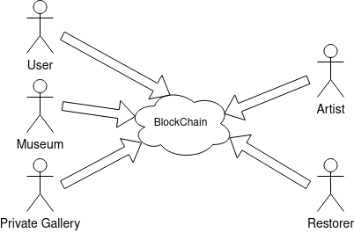
Mhh.. Some Entities ?
Notes:
GIORDANO
MAX 2:40

Slide 27
Blockchain Type
Public-Permissionless
Hierarchy Using Smart-Contracts
Notes:
GIORDANO
MAX 3:05

Slide 28
Use-Cases ?
Registration
Artwork
Restoration
Exhibition
Ownership Transfer
Crowd Founding
Notes:
GIORDANO
MAX 3:30

Slide 29
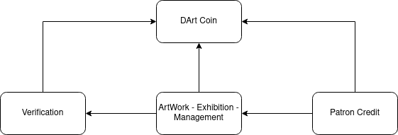
Smart-Contracts Communication
Notes:
GIORDANO
MAX 4:00 MIN
FARE UML TRA COMUNICAZIONE TRA SMART CONTRACTS (L'ALTRO PER L'IDENTIFICAZIONE) COM'è LA COMUNICAZIONE TRA CONTRATTI CON THIS IS DONE AND THIS IS NOT DONE

Slide 30
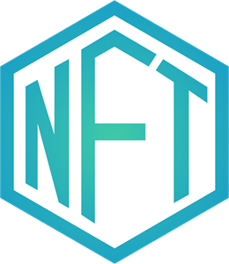

Tokenization (1)
TokenID
hashedName
verified
role
DCoin
Notes:
MICHELE
MAX 4:30
DCoin:
Manage CrowdFounding
Buy / Sell Artworks
Better: No Market's Oscillations

Slide 31

Tokenization (2)
Exhibition
organizer
isOn
Artwork
PatronCredit
Amount
Museum
holder
owner
exhibition
status
DCoin
Notes:
MAX 5:20 MIN
We used another NFT to rapresent Exibions and their main information and also an NFT to represent the artwowrk
We have information about the property and also the possesion, where the artwork is actually exposed and which pretection activity are in progess. In the end it's associed an amout of DCoin raised with crowdfunding that is locked until the artwork will be restored.
In the end any donator have a patronCredit that can give access to some special benefits MICHELE

Slide 32


That's Okay.. But No Logo.. :(
Notes:
GIORDANO

Slide 33
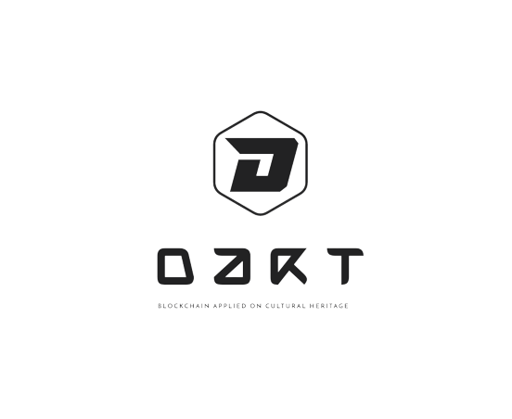
Et Voilaaaa !!
Notes:
GIORDANO

Slide 34


Ideas For GUI..
Complete One
Much Effort On Concept / Functionalities
Notes:
GIORDANO

Slide 35
SURPRISE.. WebSite Readyyy
Notes:
GIORDANO

Slide 36
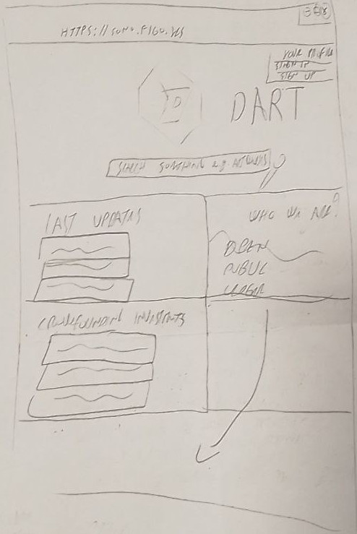
Notes:
GIORDANO

Slide 37
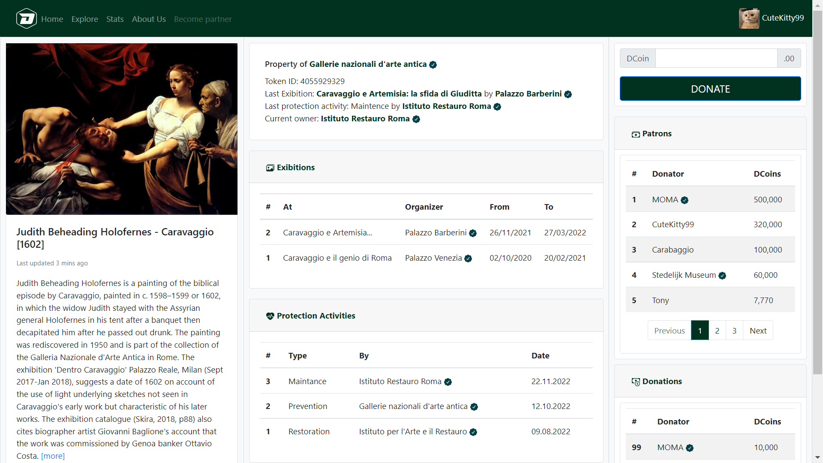
Notes:
GIORDANO

Slide 38

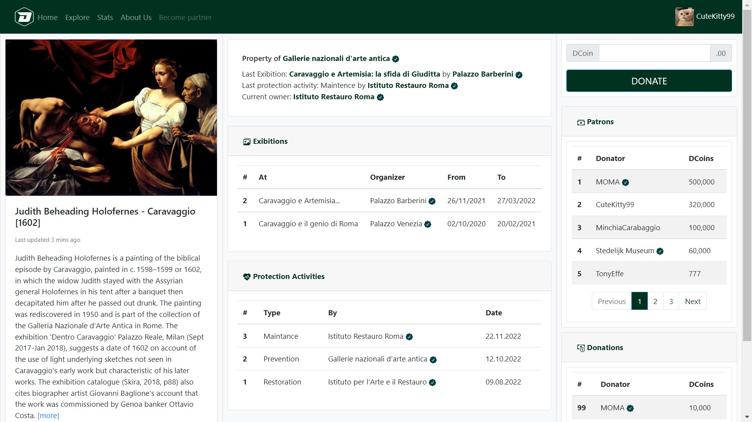
Notes:
GIORDANO

Slide 39
And Stop... :((
No No
But a Little of Suspense
Notes:
GIORDANO

Slide 40
Limitations / Issues
Big Players Difficult To Convince
Consolidated
High Presence Public Entity
Bureaucracy
Difficult Change Actual Things
Notes:
GIORDANO
È difficile muoversi nel mondo dei musei perchè è un ambito con big player, forte burocrazia e ben consolidato e non a caso c'è una forte presenza dell'ente pubblico (difficile lavorare con loro)

Slide 41
Please Don't Sleep !! Remember DArt...
Manage ArtWorks
Ownership Transfer
Crowd-Founding
Restoration
Tokenization
Notes:
GIORDANO

Slide 42
Contacts
dionisi.1834919@studenti.uniroma1.it
spina.1711821@studenti.uniroma1.it
Notes:
GIORDANO
Vote Us
We Will Remember of It :)
Seriously: If You like The Idea, Thanks, Otherwise We Are Here To Accept Suggestions
THANKS !!!

