Slide 1
Mortgage Origination Data Analysis

Slide 2
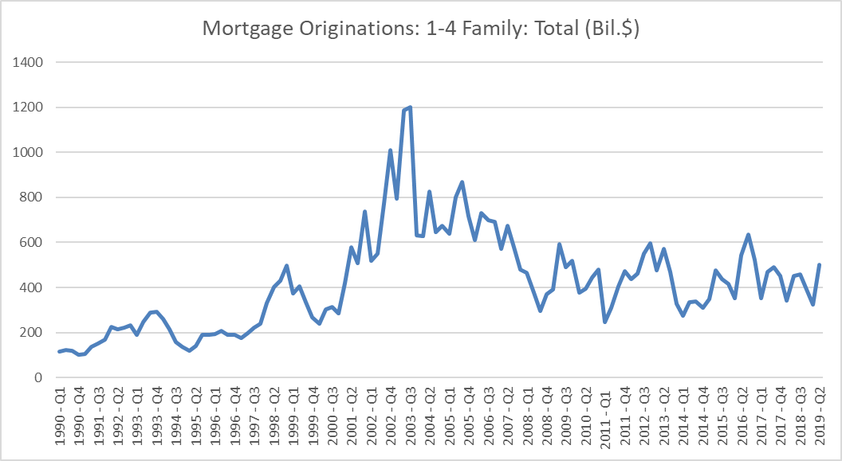
Mortgage originations are cyclical, with Q4 generally lower:

Slide 3
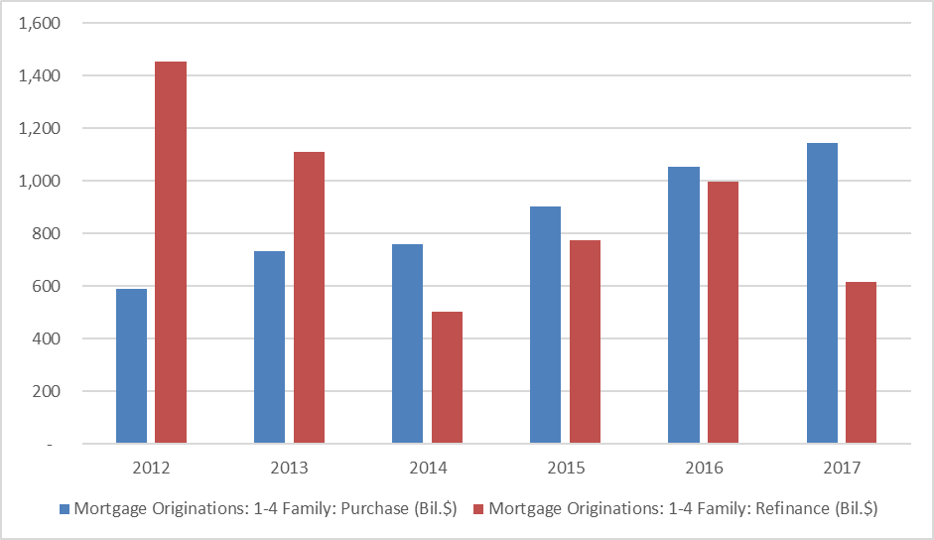
The refinance share is down nearly half from its 2012 high, from 71.2% to 35%

