Slide 1
Digital Logic & Design Final Project
Joanne Yong, Michael Gomez

Slide 2
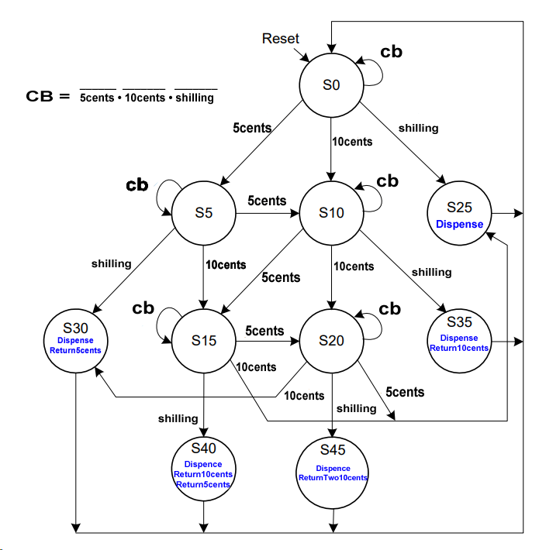
State Transition
Diagram

Slide 3
State Encodings
State | Encoding
S0 | 0000000001
S5 | 0000000010
S10 | 0000000100
S25 | 0000001000
S30 | 0000010000
S15 | 0000100000
State | Encoding
S20 | 0001000000
S35 | 0010000000
S40 | 0100000000
S45 | 1000000000

Slide 4
FSM State Transition Table
Current State | Inputs |  |  | Next State
s | 5 cents | 10 cents | shilling | s’
S0 | 0 | 0 | 0 | S0
S0 | 0 | 0 | 1 | S25
S0 | 0 | 1 | 0 | S10
S0 | 1 | 0 | 0 | S5
S5 | 0 | 0 | 0 | S5
S5 | 0 | 0 | 1 | S30

Slide 5
FSM State Transition Table
Current State | Inputs |  |  | Next State
s | 5 cents | 10 cents | shilling | s’
S5 | 0 | 1 | 0 | S15
S5 | 1 | 0 | 0 | S10
S10 | 0 | 0 | 0 | S10
S10 | 0 | 0 | 1 | S35
S10 | 0 | 1 | 0 | S20
S10 | 1 | 0 | 0 | S15

Slide 6
FSM State Transition Table
Current State | Inputs |  |  | Next State
s | 5 cents | 10 cents | shilling | s’
S25 | X | X | X | S0
S30 | X | X | X | S0
S15 | 0 | 0 | 0 | S15
S15 | 0 | 0 | 1 | S40
S15 | 0 | 1 | 0 | S25
S15 | 1 | 0 | 0 | S20

Slide 7
FSM State Transition Table
Current State | Inputs |  |  | Next State
s | 5 cents | 10 cents | shilling | s’
S20 | 0 | 0 | 0 | S20
S20 | 0 | 0 | 1 | S45
S20 | 0 | 1 | 0 | S30
S20 | 1 | 0 | 0 | S25
S35 | X | X | X | S0
S40 | X | X | X | S0
S45 | X | X | X | S0

Slide 8
FSM Encoded State Transition Table
Current State | Inputs |  |  | Next State
s | 5 cents | 10 cents | shilling | s’
0000000001 | 0 | 0 | 0 | 0000000001
0000000001 | 0 | 0 | 1 | 0000001000
0000000001 | 0 | 1 | 0 | 0000000100
0000000001 | 1 | 0 | 0 | 0000000010
0000000010 | 0 | 0 | 0 | 0000000010
0000000010 | 0 | 0 | 1 | 0000010000
0000000010 | 0 | 1 | 0 | 0000100000

Slide 9
FSM Encoded State Transition Table
Current State | Inputs |  |  | Next State
s | 5 cents | 10 cents | shilling | s’
0000000010 | 1 | 0 | 0 | 0000000100
0000000100 | 0 | 0 | 0 | 0000000100
0000000100 | 0 | 0 | 1 | 0010000000
0000000100 | 0 | 1 | 0 | 0001000000
0000000100 | 1 | 0 | 0 | 0000100000
0000001000 | X | X | X | 0000000001
0000010000 | X | X | X | 0000000001

Slide 10
FSM Encoded State Transition Table
Current State | Inputs |  |  | Next State
s | 5 cents | 10 cents | shilling | s’
0000100000 | 0 | 0 | 0 | 0000100000
0000100000 | 0 | 0 | 1 | 0100000000
0000100000 | 0 | 1 | 0 | 0000001000
0000100000 | 1 | 0 | 0 | 0001000000
0001000000 | 0 | 0 | 0 | 0001000000
0001000000 | 0 | 0 | 1 | 1000000000
0001000000 | 0 | 1 | 0 | 0000010000

Slide 11
FSM Encoded State Transition Table
Current State | Inputs |  |  | Next State
s | 5 cents | 10 cents | shilling | s’
0001000000 | 1 | 0 | 0 | 0000001000
0010000000 | X | X | X | 0000000001
0100000000 | X | X | X | 0000000001
1000000000 | X | X | X | 0000000001

Slide 12
Output Table
Output Result | State Input
ReturnTwo10cents | s45
Return10cents | s35
Return10cents | s40
Returns5cents | s30
Returns5cents | s40
Dispense | s25
Dispense | s30
Dispense | s35
Dispense | s40
Dispense | s45
ReturnTwo10cents = s45
Return10cents = s35 + s40
Return5cents = s30 + s40
Dispense = s25 + s30 + s35 + s40 + s45

Slide 13
Unsimplified Equations
S0' = S0(5c' • 10c' • shilling') + S25 + S30 + S35 +S40 +S45
S5' = S0(5c • 10c' • shilling') + S5(5c' • 10c' • shilling')
S10' = S0(5c' • 10c • shilling') + S5(5c • 10c' • shilling') + S10(5c' • 10c' • shilling')
S15' = S5(5c' • 10c • shilling') + S10(5c • 10c' • shilling') + S15(5c' • 10c' • shilling')
S20' = S10(5c' • 10c • shilling') + S15(5c • 10c' • shilling') + S20(5c' • 10c' • shilling')
S25' = S0(5c' • 10c' • shilling) + S15(5c' • 10c • shilling') + S20(5c • 10c' • shilling')
S30' = S5(5c' • 10c' • shilling) + S20(5c' • 10c • shilling')
S35' = S10(5c' • 10c' • shilling)
S40' = S15(5c' • 10c' • shilling)
S45' = S20(5c' • 10c' • shilling)

Slide 14
Simplification Steps: Equations
S20’ = S10(5c’ • 10c’ • shilling) + S15(5c’ • 10c • shilling’) + S20(5c’ • 10c’ • shilling’)
S20’ = S10(10c) + S15(5c) + S20(5c’ • 10c • shilling’)
S25’ = S0(5c’ • 10c’ • shilling) + S15(5c’ • 10c • shilling’) + S20(5c • 10c’ • shilling’)
S25’ = S0(shilling) + S15(10c) + S20(5c)
S30’ = S5(5c’ • 10c’ • shilling) + S20(5c’ • 10c • shilling’)
S30’ = S5(10c’ • shilling) + S20(10c • shilling’)
S30’ = S5(shilling) + S20(10c)
S35’ = S10(5c’ • 10c’ • shilling)
S35’ = S10(shilling)
S40’ = S15(5c’ • 10c’ • shilling)
S40’ = S15(shilling)
S45’ = S20(5c’ • 10c’ • shilling)
S45’ = S20(shilling)

Slide 15
Simplified Equations
S0' = S0(5c' • 10c' • shilling') + S25 + S30 + S35 + S40 + S45
S5' = S0(5c) + S5'(5c' • 10c' • shilling')
S10' = S0(10c) + S5(5c) + S10(5c' • 10c' • shilling')
S15' = S5(10c) + S10(5c) + S15(5c' • 10c' • shilling)
S20' = S10(10c) + S15(5c) + S20(5c' • 10c' • shilling')
S25' = S0(shilling) + S15(10c) + S20(5c)
S30' = S5(shilling) + S20(10c)
S35' = S10(shilling)
S40' = S15(shilling)
S45' = S20(shilling)

Slide 16
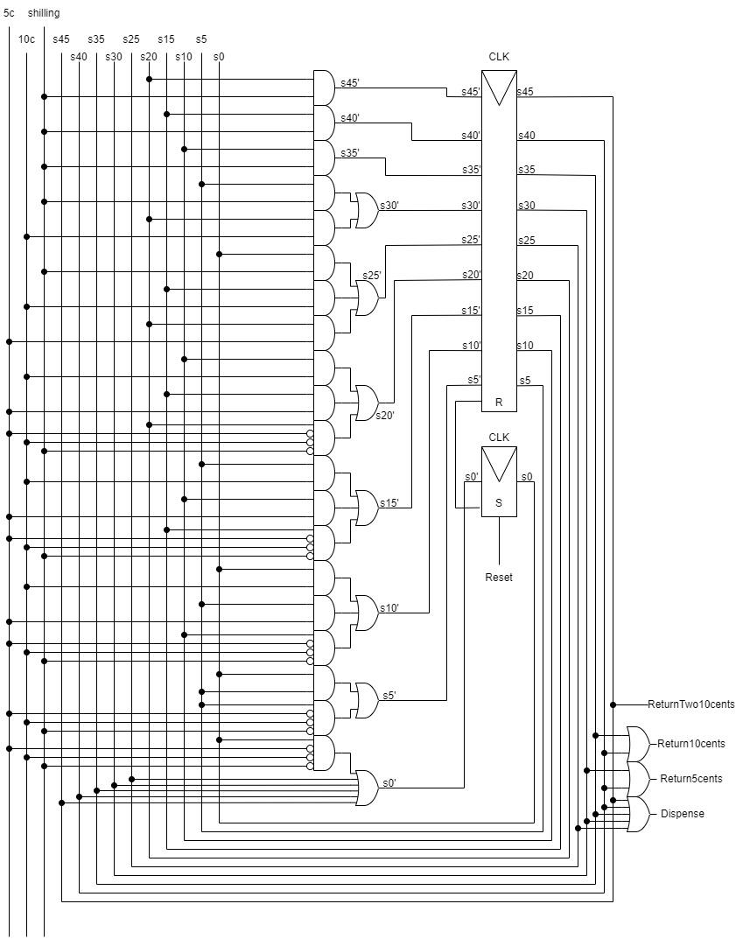
State Machine Circuit

Slide 17
Closing

