Slide 1
HydroSatML
Midterm Check-in
DATA 591
1/31/2018
Notes:
1

Slide 2
Project Motivation
Soil moisture:
Correlates strongly with plant health and crop yields
In-situ measurements are expensive and impractical at scale
Remote sensing:
Low cost, high-coverage, high-granularity measurements
No established method to use remote sensing for soil moisture
Notes:
1 Samir

Slide 3
Proposed Work
GOAL: Develop machine learning model(s) to predict soil moisture based on multi-spectral satellite imagery
Ideally the model(s) would be scalable to locations not used in the model training process
We also plan to write a publication on our work

Slide 4
Data Overview
Soil moisture (response)
Weather
Soil properties
NDRE (Normalized Difference Red Edge) - Satellite Imagery

Slide 5
Data Processing
Soil moisture, weather, soil properties (Excel Spreadsheets)
Cleaning and aggregation
Merging (on primary key = date, farm, sensor)
Satellite imagery
Subset to farm shapefiles
8-pixel fence around each sensor for a total of 9-pixels
Pixel data averaged

Slide 6

Model Development
Linear Regression
Lasso (for parameter selection)
Ridge
Gaussian SVR
XGBoost
Neural networks
Error Metric

Slide 7
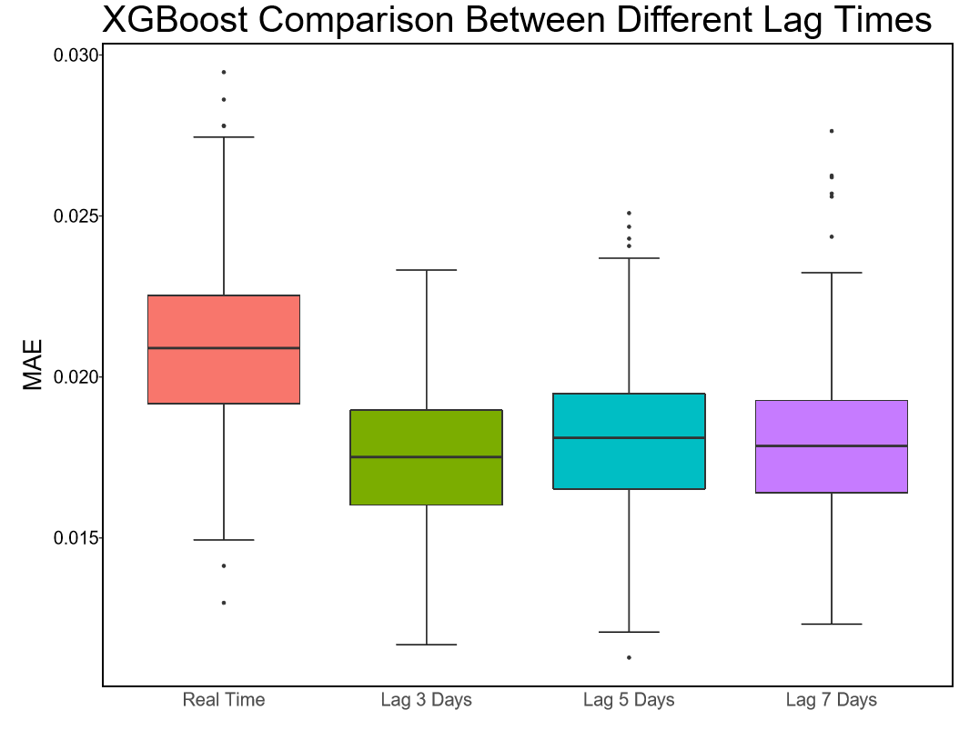
Model Results

Slide 8
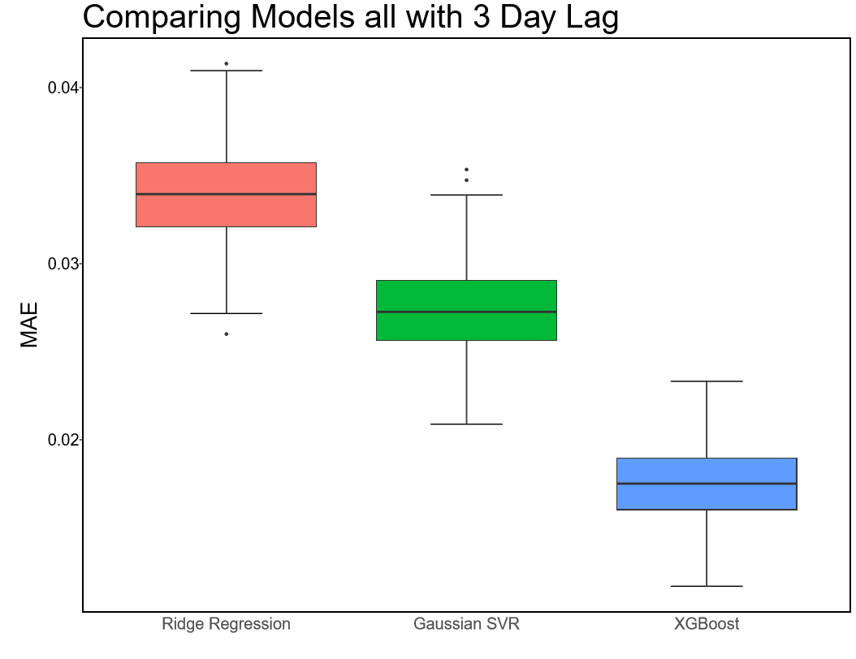
Model Results

Slide 9
Limitations/Challenges
NDRE satellite imagery
Temporally limited (~one image/week)
Requires clear atmosphere (e.g. no cloud cover)
Only useful for soil moisture predictions over vegetation
Accuracy vs. Scalability
Lots of training parameters = accurate model
Lots of training parameters = difficult to duplicate at scale

Slide 10
Soil Moisture Routing (SMR) Model
Physical model that simulates 3D water movement
Potential to solve two problems:
Generate more soil moisture data for model training
Scalability (1D model vs. basic SMR vs. fancy SMR)
But….struggling to get SMR working in GRASS GIS

Slide 11
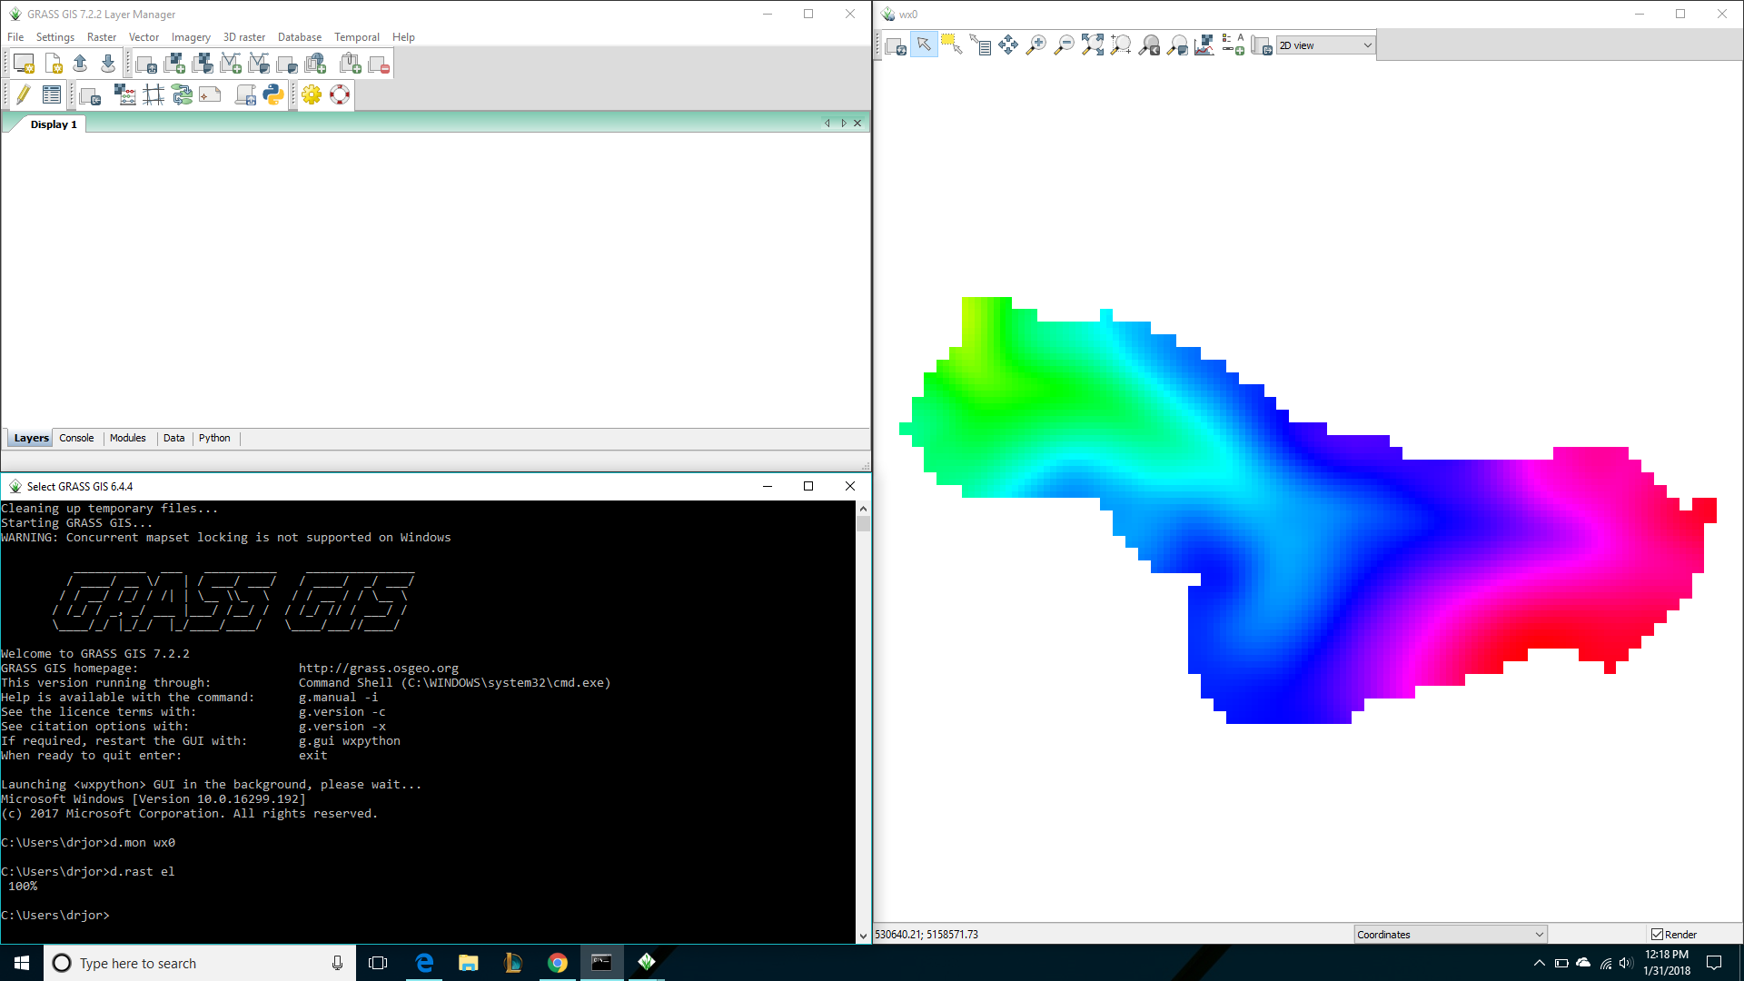
GRASS GIS

Slide 12
Modeling Next Steps
SMR Model
1-D approach
Basic SMR (2-D with publicly-available base maps)
Advanced SMR (w/ root zone depth, fancy maps, etc.)
Cook Farm Data Set
More ML models

Slide 13

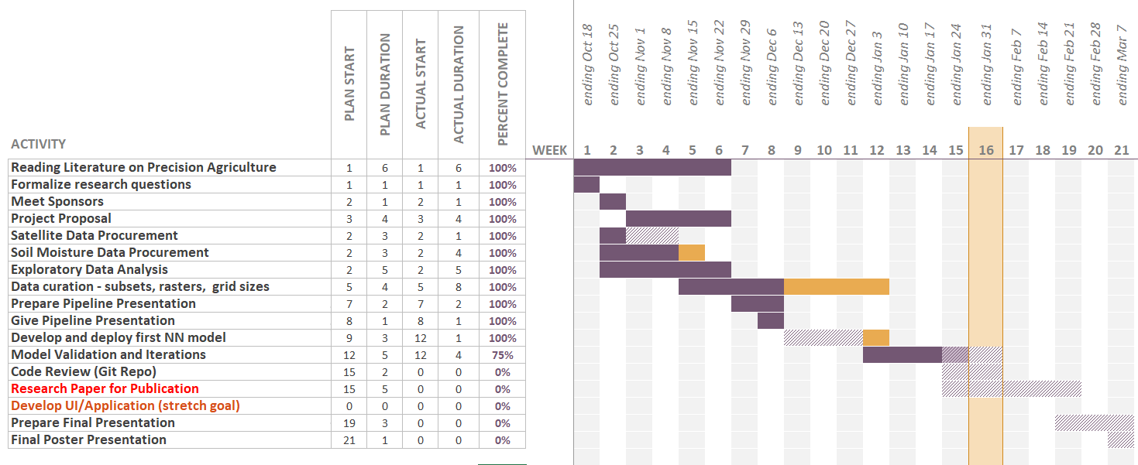
Schedule Review

Slide 14
Schedule Review
Remaining Tasks End of Quarter Model Validation and Iterations - Feb. 14 Code Review (Git Repo) - Feb. 21 Final Poster Presentation - Feb. 28 Beyond Research Paper for Publication Develop UI/Application (stretch goal)

Slide 15
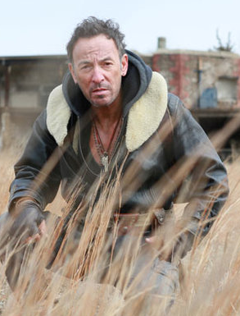
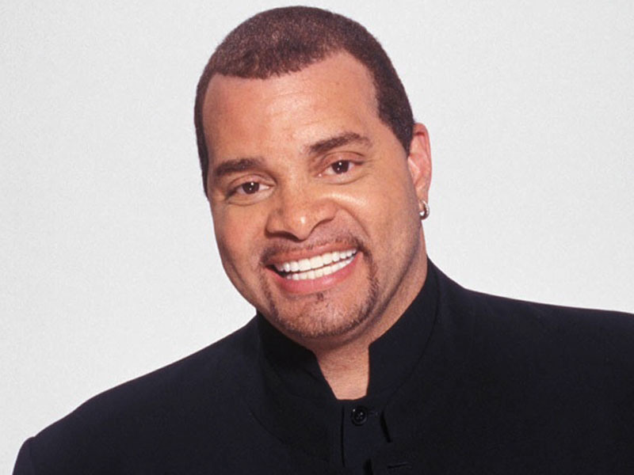
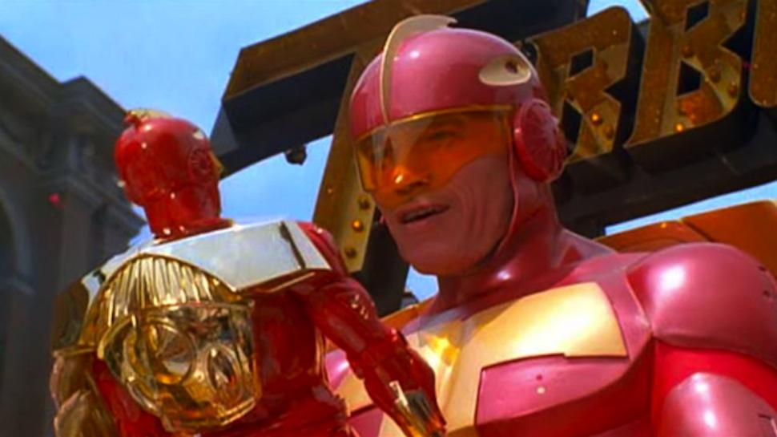
“THANKS Y’ALL!!!”
Bruce Springsteen,
“The Boss”
“ANY QUESTIONS?”
Sinbad,
Performing at
Emerald Queen Casino
On March 24th!

