Slide 1
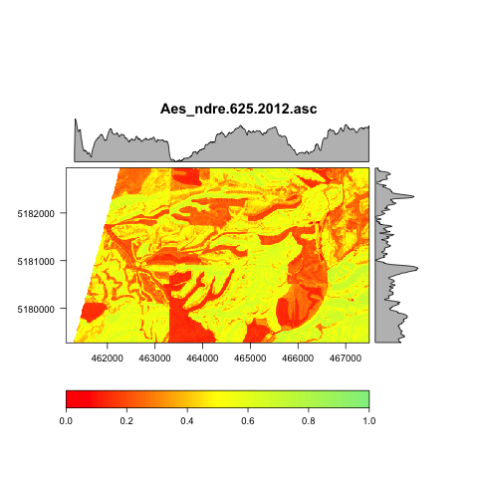
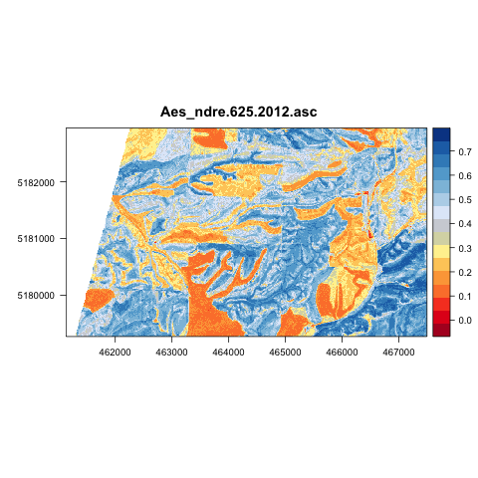

Slide 2
Sites
Colfax: (46.79N, 117.44W)
Gennesee: (46.55N, 116.92W)
Troy: (46.68N, 116.77W)
Leland: (46.58N, 116.60W)
Site description in Matt’s Thesis page 42

