Slide 1
Testing Overview

Slide 2
Agenda
Testing Overview
Testing Pipeline
The Testing Universe
Testing @ JPMC
Unit Tests
Integration Tests
End to End Tests
Appendix

Slide 3
Testing
Provide confidence to you and your team that the code you write is functioning as intended.
As projects expand and create complex interactions between different components of an application, a small error can have a huge impact on the system as a whole.
Increases speed of hotfixes. If there is a problem in your code, tests can tell you where the problem originates.

Slide 4
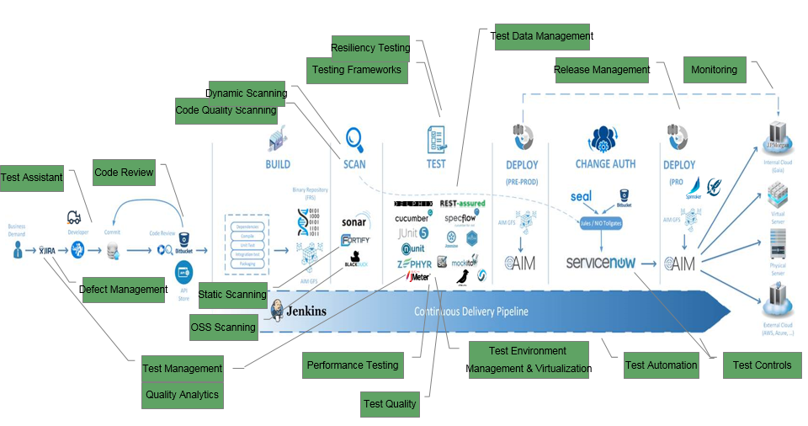
Testing Pipeline

Slide 5
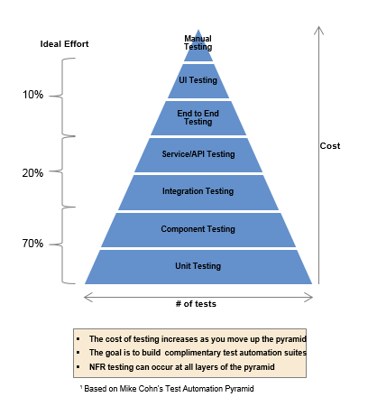
The Testing Universe

Slide 6
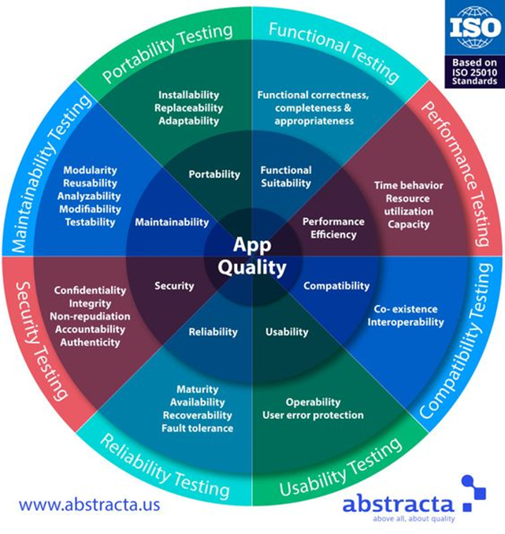
The Testing Universe Cont.

Slide 7
Testing @ JPMC
The industry as a whole is moving away from specialized testing teams and towards T-shaped developers who test their own code
Testing occurs throughout the SDLC in all environments from the IDE -> Production
Proper Testing takes into account happy path as well as negative and limit testing
Regression testing should be highly automated as part of the CI/CD pipeline
Smoke tests are used to validate an environment before using it. (Is it working, is it up)
All tests can’t be automated; effort should be based on the test pyramid using team input

Slide 8
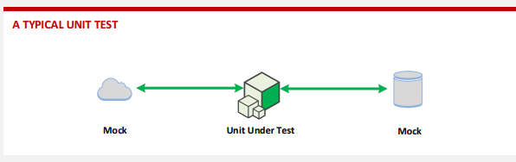
Unit Testing
Unit tests typically test a single method, class, or function in isolation, providing assurance to the developer that their code operates as designed
Click to see how a team at Chase does Unit Testing

Slide 9
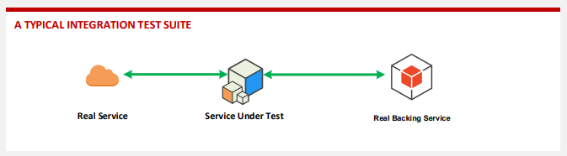
Integration Testing
Integration tests will validate that the different components of your application like a database, restful service, or a message bus, work with each other as expected.
Click to see how a team at Chase does Integration Testing

Slide 10
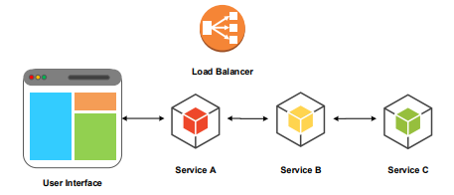
End to End Testing
End to end tests give you the greatest confidence when you need to decide if your software is working or not. For many applications, this means user interface testing.
Click to see how a team at Chase does End to End Testing

Slide 11



















Testing Frameworks
Open source software drives development in JPMC, and testing follows suit. No single or set of solutions will work for everyone. Teams need to spend as much time deciding on their testing frameworks as they do in their application’s.
End-to-End AngularJS testing
Mocking
Look and Feel testing
Performance testing
Unit testing
BDD JavaScript testing
Thick Client testing
Browser testing
JavaScript Test Runner
Mutation testing
JavaScript testing
Service testing
Mobile testing
Acceptance (BDD) testing
Acceptance testing
Note: Not all tools are displayed.

Slide 12
Appendix
Go/techprimers
Go/pluralsight
Go/learning

Slide 13
Facilitator Guide (notes)
Testing Overview Facilitator Guide:
Intro:
Start off by asking the class what testing experience they have and ask a small number of people to elaborate on their experiences.
Agenda:
Go over the course content
Testing:
Practice of validating your source code is working as intended.
With the move to Agile and T-Shaped Developers, dedicated testing teams are starting to dissolve and the responsibility of testing belongs to the App Dev team as a whole. Everyone codes and everyone tests.
Test Coverage is a complicated and big topic. We will not be able to cover the wide scope of testing in this session. You can look forward to an additional Technical Theme Day around testing where you will get a hands-on and in-depth look at testing.

Slide 14
Facilitator Guide (notes)
Testing Pipeline:
Vision: Assemble a cohesive end-to-end set of quality and testing tools along with supporting enablers that optimizes application quality and software delivery efficiency for JPMC Global Technology
Give a high level overview of the build/deploy pipeline so that you can explain how testing fits into that pipeline.
  The order of events is this: Check in Code to Bitbucket -> Test Code -> Build & Package Code -> Deploy Code. Testing can be done at various stages in this pipeline.
Developers should be writing and running unit tests of their code locally before committing the code to bitbucket.
Once those Unit Tests are done, you can run the rest of your automated test suite, like integration tests, UI/End-to-end tests, and acceptance tests.
Regression testing should be highly automated as part of the CI/CD pipeline
Not all tests can be automated to run in the pipeline. Some tests require a human touch to validate input, like Exploratory Tests

Slide 15
Facilitator Guide (notes)
The Testing Universe
Different types of tests provide different benefits, each of these also have their own set of drawbacks.
All tests can be automated however, for certain types of testing, the benefits do not outweigh the effort of creating those tests. As a team you will need to decide what level of effort to put into various tests. The pyramid demonstrates how much effort you should be placing into different types of tests.
As you go up the testing pyramid, the tests become more brittle, or more likely to fail. This is because as you go up the pyramid, the complexity of the higher level tests increases as well.
The Testing Universe 2:
When people think of testing, they are usually thinking about Functional testing, or testing how your application works. However, functional testing is just one slice of the testing pie. There are many other types of testing that are important for your application’s success.
The various functional and non-functional tests can align to the types of tests seen on the pyramid in the previous slide.
Is your application secure and safe from vulnerabilities? Are your application environments running correctly? How will your application run on different types of user devices? These questions may not seem relevant when you’re developing the application, but are every bit of important as functional testing. These types of problems can be devastating to an organization if not caught.
There are so many types of testing and scanning in the software quality universe, how do you make sense of it all? How does everything fit together? How do I know my software has been tested well enough to give me confidence to deploy? How do I know when to stop testing?
Test Coverage and Code Coverage can give you a sense of how much of your application has tests. Test coverage is the percentage of requirements you have covered. Code Coverage is how many lines of code have corresponding tests.

Slide 16
Facilitator Guide (notes)
Testing @ JPMC:
Developers at JPMC are starting to adopt development styles like BDD & TDD. Ask the class if they know what these are and if they know the differences between the two.
The main difference between TDD and BDD is that in BDD you are testing a specific behavior from the end user’s perspective and in TDD you create tests for functionality from a developer’s perspective.
A good test suite will have tests for the happy cases, as well as the un-happy cases.
  Happy cases are tests that are written to test the standard/average input for a certain class or function. If you have a function that adds two numbers together, you would test that providing two numbers returns the correct sum. That is a happy case.
  Un-Happy cases are tests that are written to test irregular inputs. For example, in our addition function, you are expecting two numbers, but what if the User passes in a number and null? You know you can’t have a null value, there usually is no way an input can be null, but you want to make sure this is tested so if it does happen you know how to handle it.
Industry guidelines are that 80% of your code should be covered by tests. At JPMC the targets are 50% overall Unit Test Coverage and 70% Unit Test Coverage for code modified in the past 90 days.

Slide 17
Facilitator Guide (notes)
Integration Tests
The picture now shows data going between the service in question and the connected services & databases.
During an integration test, an application’s resources are used to ensure that the functionality matches what is mocked and that the application works with the environment it is in.
Suppose you have a database, and a web UI that displays database objects. Between those two components sits a controller that will make the calls to the DB, as well as gives DB info to the front end. In an integration tests, you would test that the controller can access the DB correctly, or that the controller is providing the correct information to the front end.
Integration Tests differ from Unit Tests because of:
  Encapsulation – Unit tests are encapsulated and don’t use resources outside the unit in question. Integration tests are not encapsulated, and need the other resources.
  Complexity – Unit tests are supposed to be simple, easy to write, and not complex. Integration tests are complex, they require tooling and setting up different infrastructures.
  Test Failure – When Unit tests fail, you know there is a bug inside the Unit in question. This leads to easy identification. With integration tests, as long as you have good unit test coverage, you don’t need to look at the code that implements the logic. The likely culprit of the error usually has to do with the environment.

Slide 18
Facilitator Guide (notes)
Integration tests can fail even if your source code is built and packaged correctly. To avoid anticipated failures of integration tests (like knowing your database is going to be down), integration tests are best run during IST, UAT, and PROD builds/deploys.
Service Tests are usually discussed in parallel with Integration Tests. Service tests are designed to specifically test that a set of components together actually implement a required feature of the application.
Integration Test Coverage (ITC) is another type of test coverage measurement. It’s also available on Sonar. The only difference to UTC is that the Maven FailSafe plugin is used instead to run the Integration Tests.

Slide 19
Facilitator Guide (notes)
Unit Testing
A unit test tests a single unit of your application in isolation. No other units or components of your application should be used during a unit test.
The picture shows how no inputs go into the Unit Test. Only outputs of the test.
It is common that a Unit in an application is not completely isolated from other Units. Typically you will need some additional information to make your Unit work, however because we only want to test the Unit in question, you need a way to simulate those other components. Mockito Mock Objects allow you to mock an object in your test class that is necessary for the Unit to run but isn’t a complete instance of that object.
Assertion Functions are functions that ensure that tested variables contain the expected value for those variables. If you have a function that adds two numbers together, your test would pass in two numbers and make an assertion on the expected result of that addition. If you pass in 2 and 3 you can expect the result to be 5, if it is anything but 5 then you have a problem in code.

Slide 20
Facilitator Guide (notes)
  Fast – If they’re not fast, developers won’t write or run them.
  Isolated – If your unit test is isolated, you don’t need to concern yourself with validating interactions between units. You can focus solely on how the single unit works.
  Succinct – If you can’t write a unit test easily for your unit, it’s a good sign that the code you’re testing is too complex. Unit tests need to be simple and easy.
  Easy to Comprehend – This is self-explanatory. At a glance you should know what a unit test is testing for. This usually means having the test name be a short description of the test itself.
  Reliable – Unit tests shouldn’t be bound by the environment they’re running in. DEV unit tests should work the same as PROD unit tests. Unit tests should work 100% of the time.
Test behavior, not implementation. If you test for implementation, you will need to edit your tests every time a change is made to the code in question. If your unit is testing behavior, you won’t need to edit a test if the implementation changes.
Don’t put logic in the unit tests. Logic creates complexity. Most unit tests verify that a single, known input, produces a single known output. State the inputs and outputs in the test directly, don’t compute them.
Unit Test Coverage (UTC) is the most common test coverage measurement. The typical way for generating these is by running your unit tests using the Maven SureFire plugin and having the JaCoCo agent instrument the code in order to produce the report.

Slide 21
Facilitator Guide (notes)
End to End Tests
Talk about the integration testing from a service perspective (DBs external stuff) and how it’s different than integration testing of app features.
The picture shows how you will test everything from what the user sees and interacts with, to functionality underneath the hood.
End-to-end tests typically require a dedicated testing environment; examples include SIT, QA, UAT, PERF environments.
End-to-end tests generally require the most maintenance, as a change in any dependency can cause the test’s expectations not to be met.
In order to be cost effective, an end-to-end test should focus on aspects of your system that cannot be reliably evaluated with smaller tests, such as resource allocation, concurrency issues and API compatibility.
End to End tests can be fairly slow so a focused minimal set of tests is often more useful than full breadth. As a guideline, think about high-value interactions that users will have with your application and write end-to-end tests for these interactions.
For each important use case of an application, there should be a corresponding end to end test.

Slide 22
Facilitator Guide (notes)
Focus your efforts on verifying overall system behavior instead of specific implementation details; for example, when testing login behavior, verify that the process succeeds independent of the exact messages or visual layouts, which may change frequently
Not all tests can be automated to run in the pipeline. Some tests require a human touch to validate input, like End to End tests.
Done via a UI interface or a command line interface.
In addition, Service & API Testing is usually talked about with End to End testing. When testing services and APIs you are looking for vulnerabilities and flaws in regards to how your application interacts with services and APIs. You want to make sure the services and APIs are available and not faulty.

Slide 23
Facilitator Guide (notes)
Testing Frameworks:
Open source software drives development in JPMC, and testing follows suit. No single or set of solutions will work for everyone. Teams need to spend as much time deciding on their testing frameworks as they do in their applications.

