Slide 1
Assignment 3b Q&A

Slide 2
Three steps to applying a texture
specify the texture
read image
assign to texture
enable texturing
assign texture coordinates to vertices
specify texture parameters
wrapping, filtering

Slide 3
Download stb_image.h
OpenGL does not have build-in functions to read images
Download stb_image.h from https://github.com/nothings/stb

Slide 4
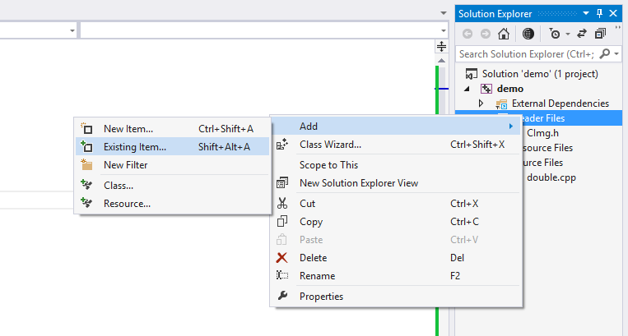
Add stb_image.h to your Project
Copy stb_image.h to your project folder
Right click Header Files under solution explorer
Add -> Existing Item-> select stb_image.h

Slide 5
Use stb_image.h to read image
Include header file
#define STB_IMAGE_IMPLEMENTATION
#include "stb_image.h"
Read the texture image
image_data = stbi_load("checker.jpg", &x, &y, &n, force_channels);
Checker.jpg : texture file
x: width of the image
y: height of the image
force_channels: number of channels of the images

Slide 6
specify texture parameters
static GLuint texName;
glEnable(GL_TEXTURE_2D);
glGenTextures(1, &texName);
glBindTexture(GL_TEXTURE_2D, texName);
glTexParameteri(GL_TEXTURE_2D, GL_TEXTURE_WRAP_S, GL_REPEAT);
glTexParameteri(GL_TEXTURE_2D, GL_TEXTURE_WRAP_T, GL_REPEAT);
glTexParameteri(GL_TEXTURE_2D, GL_TEXTURE_MAG_FILTER,GL_LINEAR);
glTexParameteri(GL_TEXTURE_2D, GL_TEXTURE_MIN_FILTER,GL_LINEAR);
// select modulate to mix texture with color for shading
glTexEnvf( GL_TEXTURE_ENV, GL_TEXTURE_ENV_MODE, GL_MODULATE );
glTexImage2D(GL_TEXTURE_2D, 0, GL_RGBA, x,
y, 0, GL_RGBA, GL_UNSIGNED_BYTE, image_data );

Slide 7
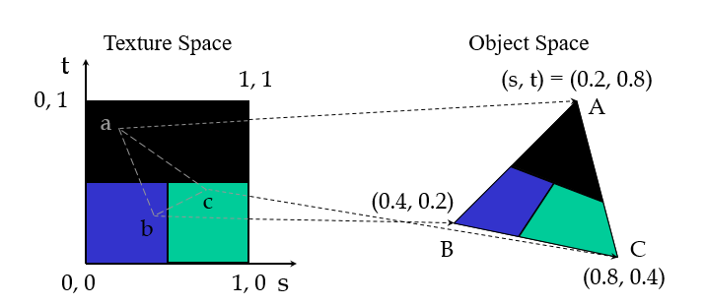
Typical Code
glBegin(GL_POLYGON);
glColor3f(r0, g0, b0); //if no shading used
glNormal3f(u0, v0, w0); // if shading used
glTexCoord2f(s0, t0);
glVertex3f(x0, y0, z0);
glColor3f(r1, g1, b1);
glNormal3f(u1, v1, w1);
glTexCoord2f(s1, t1);
glVertex3f(x1, y1, z1);
.
.
glEnd();

