Slide 1
Assignment 2a Q&A
Xu Wang

Slide 2
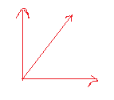
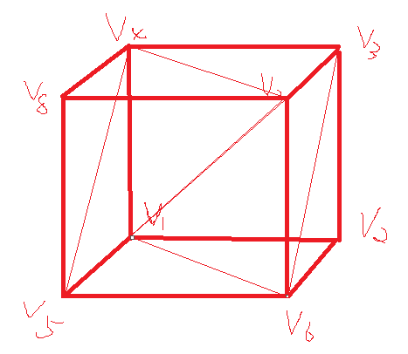
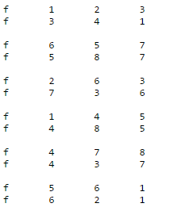
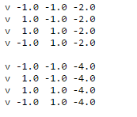
.obj file format
y
z
x
triangle faces
vertices

Slide 3
Parser Demo
Header
#include<vector>
Global variable
vector<GLfloat*> vertices;
vector<GLint*> faces;

Slide 4
Function to load .obj mesh
char *file = “path to obj”;
FILE *input;
char c;
GLfloat f1, f2, f3, *arrayfloat;
GLint d1, d2, d3, *arrayint;
vertices.clear();
faces.clear();
input = fopen(file, "r");
while (!feof(input)){
fscanf(input, "%c", &c);
if (c == 'v') {
arrayfloat = new GLfloat[3];
fscanf(input, "%f %f %f", &f1, &f2, &f3);
arrayfloat[0] = f1;
arrayfloat[1] = f2;
arrayfloat[2] = f3;
vertices.push_back(arrayfloat);
}
else if (c == 'f'){
arrayint = new GLint[3];
fscanf(input, "%d %d %d", &d1, &d2, &d3);
arrayint[0] = d1;
arrayint[1] = d2;
arrayint[2] = d3;
faces.push_back(arrayint);
}
}
fclose(input);

Slide 5
Hints
Project -> property -> C/C++ -> Preprocessor -> Preprocessor Definitions add _CRT_SECURE_NO_DEPRECATE to avoid fopen error
If you use 64 bit machine, it might be useful to include the following in the beginning of the code:
#define WIN32

Slide 6


Where is the pig and teapot?

Slide 7
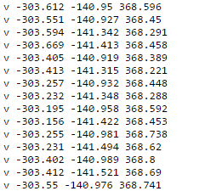
teapot.obj

Slide 8
Normalization
Maxx, maxy,
maxz
Center:
0
0
0
x: [-1, 1]
Y: [-1, 1]
Z: [-1, 1]
Minx, miny,
minz
Center: (maxx+minx)/2
(maxy+miny)/2
(maxz+minz)/2

Slide 9

points
glBegin(GL_POINTS);
for (int i = 0; i<vertices.size(); i++)
{
glVertex3fv(vertices[i]);
}
glEnd();

Slide 10
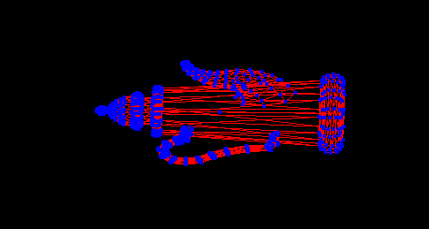
wireframe
glBegin(GL_LINES); // GL_LINE_STRIP
for (int i = 0; i<faces.size(); i++)
{
glVertex3fv(vertices[faces[i][0] - 1]);
glVertex3fv(vertices[faces[i][1] - 1]);
glVertex3fv(vertices[faces[i][1] - 1]);
glVertex3fv(vertices[faces[i][2] - 1]);
glVertex3fv(vertices[faces[i][2] - 1]);
glVertex3fv(vertices[faces[i][0] - 1]);
}
glEnd();

Slide 11
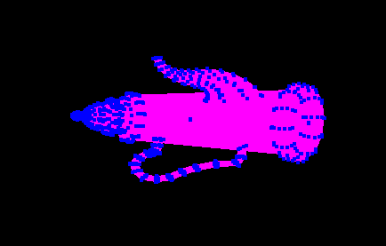
surface
glBegin(GL_TRIANGLES);
for (int i = 0; i<faces.size(); i++)
{
glVertex3fv(vertices[faces[i][0] - 1]);
glVertex3fv(vertices[faces[i][1] - 1]);
glVertex3fv(vertices[faces[i][2] - 1]);
}
glEnd();

Slide 12
Keyboard callback
In main()
glutKeyboardFunc(processKeys);
void processKeys(unsigned char key, int x, int y) {
if (key == ‘a')
// your code here
glutPostRedisplay();
}

