Slide 1
Dynamic Strategy Priority
Michael Rawson, Giles Reger
University of Manchester, UK
Notes:
Introduce self & Giles
I made up the name.
Early work: if choices are arbitrary/misguided, they _are_.
Segue to background

Slide 2
Background
Theorem Provers
Vampire
Algorithms
Notes:
Apologise but insist
Very quick introduction

Slide 3
Automated Theorem Provers
Proposition
Prover
(sorcery)
Proof
Notes:
Mathematicians, scientists, computer scientists, linguists, engineers….

Slide 4
ATP Design & Folklore
Hard problem
Complementary heuristics
Best results require careful engineering
Algorithm either solves a problem quickly, or not at all
Small changes cause huge differences.
Performance matters
Generally care about finding proofs, not time-to-proof
Notes:
Historical slide
Make point about time-to-proof versus finding proof in timeout time.

Slide 5
Vampire
ATP
First-order logic with equality (+ extensions)
Experimental testbed for this project.
Notes:
Vampire facts

Slide 6

Vampire (advertisement)
High-performance
CASC veteran
State-of-the-art proof technology
Well-engineered
Decades of experience
Large database of problems and proofs
http://vprover.github.io
No longer hard to obtain!
Get Vampire!
Notes:
Vampire commercial
Charisma possibly acceptable here

Slide 7
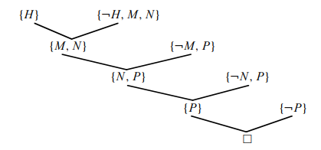
Algorithm
Pre-process (“clausify”) your problem, negated
Obtain set of clauses
Resolve clauses according to rules
Iterate
Produce the empty clause
QED
Notes:
Be brief.
Iteration is the important point.

Slide 8
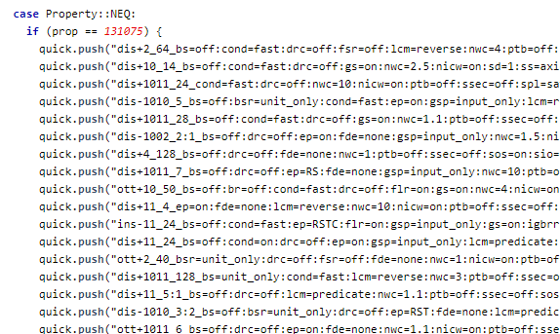
Strategies
What are they?
Why does Vampire need them?
Notes:
Work is about strategies

Slide 9
Strategies in Vampire
Algorithm
Parameters
Time to run
dis+1011_24_cond=fast:drc=off:nwc=10:nicw=on:ptb=off:ssec=off:spl=sat_14

Slide 10
Strategies in Vampire
Strategy | Success?
1 | No
2 | No
3 | Yes!
4 | …
Run several short strategies
Better than one long strategy
Execute strategy schedules
Find schedules experimentally
Problem solved?
Notes:
Vampire implementation of strategy scheduling

Slide 11
Strategy schedules are great!
Much better than using just one strategy
Minimal overhead
Engineering opportunity
Parallelism

Slide 12

Unfortunately…
Computationally difficult to find “best” strategy schedules
Engineering: schedules.cpp unreasonable
Brittle and rigid
Frequently slow due to ordering
Notes:
Talk about time limit again here.

Slide 13

Possible fix: round-robin scheduling
Turns this
Into this
Doesn’t fix other issues, context-switching overheads
Not particularly “smart”
Notes:
Length of time slice

Slide 14
Possible fix: “static” priority
Try and guess which strategy will work first
Based on features of the input problem
Vampire attempts some version of this when selecting schedules
Little runtime overhead
Overly ambitious?
Notes:
Should be extremely hard as an AI problem.

Slide 15

Proposal: “dynamic” strategy priority
Run a standard or existing schedule, but…
Regularly stop and check running strategies
Look for strategies which look like they’re succeeding or failing (how?)
Prioritise succeeding strategies
Turn this:
Into this:
Notes:
“stretching” strategy #4

Slide 16
Machine Learning
Data collection & preparation
Classifier training
Evaluation
Notes:
Bandwagon!

Slide 17
Data collection
We want to find “something” to identify strategies
Not sure what
Available features: properties, statistics, options
Report ALL the features (376 of them)
Report a real-valued feature vector every k resolution steps
Decently-large dataset of execution traces
Tag traces with success or failure
Notes:
Trying to be agnostic about features since no intuition for what is good.

Slide 18
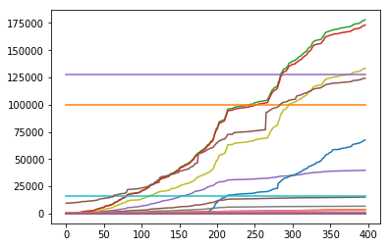
Example trace
Notes:
Doesn’t matter what is what.

Slide 19
Data ideals
Real values
Zero mean, unit variance
Fixed input size
Not too voluminous
Preferably matrix-like
Balanced dataset
Notes:
Possibly opinionated

Slide 20
Problems and “Solutions”
Problem: far more failing than successful traces
“Solution”: randomly select enough failures to match successes
Problem: traces are of wildly differing lengths
“Solution”: bucket-averaging to the same size
Problem: want to predict based on running (not complete) strategies
“Solution”: chop up traces to yield several traces at different stages
Problem: traces contain high-variance data
Solution: feature scaling!
Notes:
Reasonable choices, but not solutions

Slide 21

Example trace (after pre-processing)
Notes:
Remember to mention colour!

Slide 22


Classifiers
Several off-the-shelf technologies:
“Vanilla” neural network
Convolutional neural network
Gated Recurrent Unit (a recurrent neural network)
All neural networks, 1 hidden layer. Other suggestions welcome!
Thanks to Keras and Scikit-learn.
Notes:
I’d be interested in a classical/Bayesian approach.

Slide 23
Results (5-fold cross-validation)
Method | Mean accuracy (%) | Standard deviation (%)
Simple NN | 81.5 | 2.0
Convolutional NN | 82.4 | 3.1
Recurrent NN | 83.9 | 1.9
Notes:
…huh

Slide 24
Results
High accuracy (?!)
Surprisingly little difference between NN methods
Reasonably consistent across a dataset of around 10,000 traces
Little tweaking required
Notes:
Surprising!

Slide 25
Selection
Despite expectation: simple NN suffices
Much more performant than other classifiers
Simple to implement!
Notes:
Minimal overhead

Slide 26
Implementation
Integrating classifier
Scheduling modifications
Benchmark
Notes:
Hardest part!

Slide 27
Integrating classifiers
Challenging for more-sophisticated classifiers
Not too bad for the simple classifier chosen
Train network in Python
Generate C(++) code
No dependencies
Notes:
Bit of a hack, but performant.

Slide 28
Scheduling issues
Ideally, run all strategies simultaneously. But…
Memory pressure
Start-up time
Less good for the common case: short strategies
If we don’t have all strategies running at once, what’s the point?
Notes:
Scheduling problem slide.

Slide 29
Compromise
Pool of running processes
Queue of paused (or non-started) processes
When the pool needs filling, take processes from queue
Regularly remove processes from the run-pool and re-evaluate them
Still partially sequential, avoids some issues
Only has all strategies running simultaneously in a corner case
Notes:
Do an A/B comparison to lead audience

Slide 30
System overview
Queued
Running
Wake Up
Give up/Proof
Time Ends
Prediction
Predictor
Notes:
Talk through the architecture in order a few times.

Slide 31
Benchmarks
Thanks to StarExec, TPTP
Compared to baseline without modification on around 20k problems
Not good for solving theorems: 585 vs 111 distinct proofs found
Better for speed: 10.5s/proof vs 8.7s/proof!
Also compared to round-robin: better in both aspects
Notes:
Kind-of a success.

Slide 32
Wrap Up

Slide 33
Conclusions
Very early work
Classifier performance is pleasantly surprising
Implementation issues
Perhaps an unfair comparison with baseline Vampire?
Plenty of room for improvement and future exploration
Notes:
Unfair: schedules already try to produce shorter runs. Vampire has no overhead.
Surprisingly easy to classify, hard to implement.
Fix any of the previously-made decisions.

Slide 34
Questions

