Slide 1




Who am I ?
new PnPDemoPresenter
{
Name = "Adam Wójcik",
Description = @"Standard dev that loves coding with headphones🎧 on
and coffee☕ next to the keyboard👨‍💻",
Position = ".NET/FullStack/SharePoint/Microsoft 365 Developer/Consultant 🤔",
Location = Country.Poland,
Social = new List<SocialType>()
{
SocialType.LinkedIn,
SocialType.Twitter
},
IsFirstTimePresenter = true
};
Like what I do? 👍
yes
no
That’s ok 😉
Want to buy me coffee? 🍵
no
yes
Please don’t, my work is for free 😊 Instead please support the ones in need 🙏💙💛
Thanks,
You Rock

Slide 2

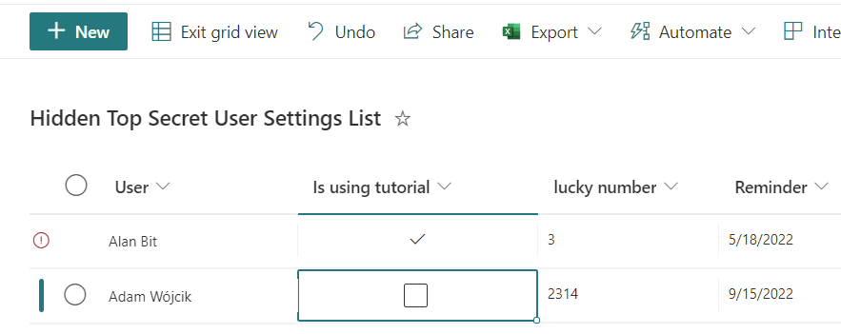


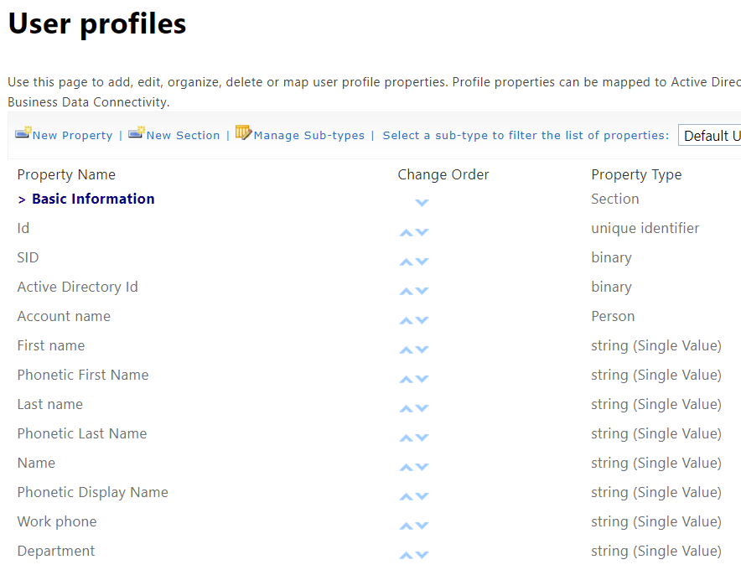










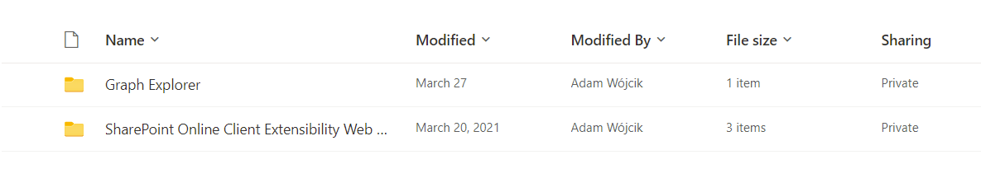


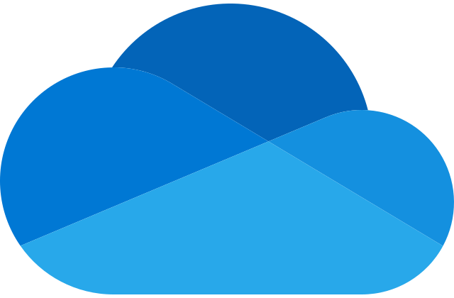

What’s it all about ?
Cool SPFx app 😎
User personal data 🤯
Save? But where?🤔

Slide 3

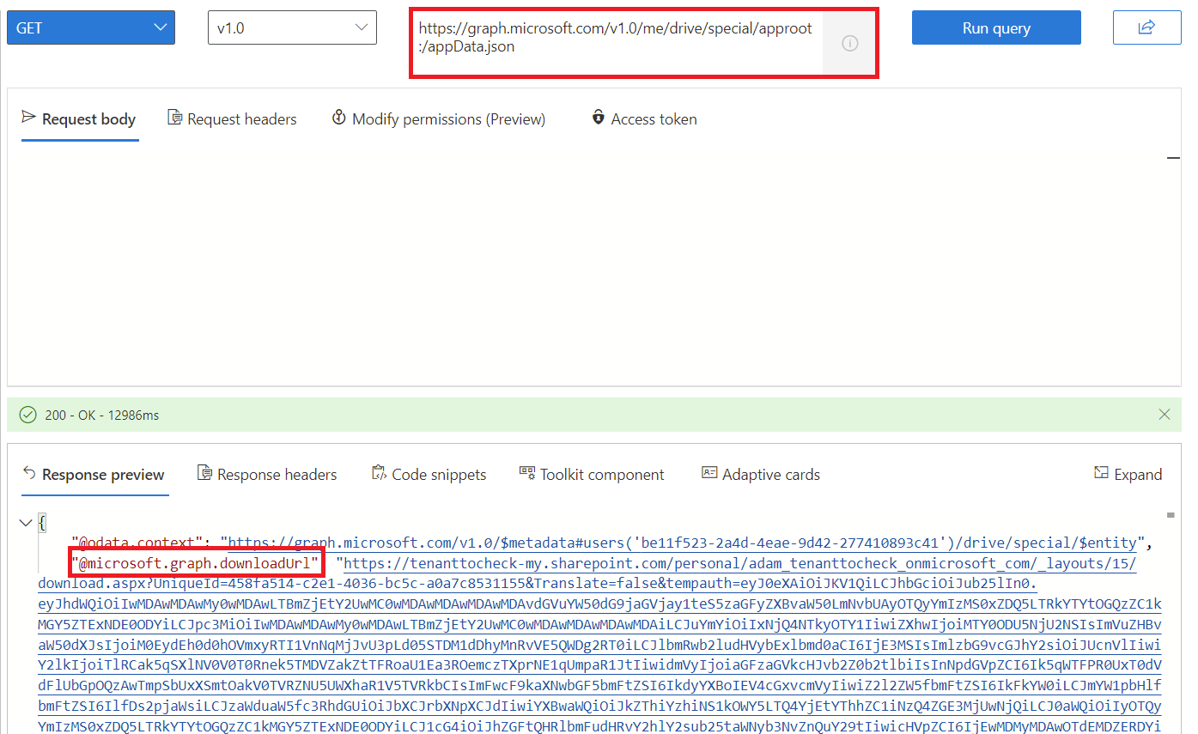
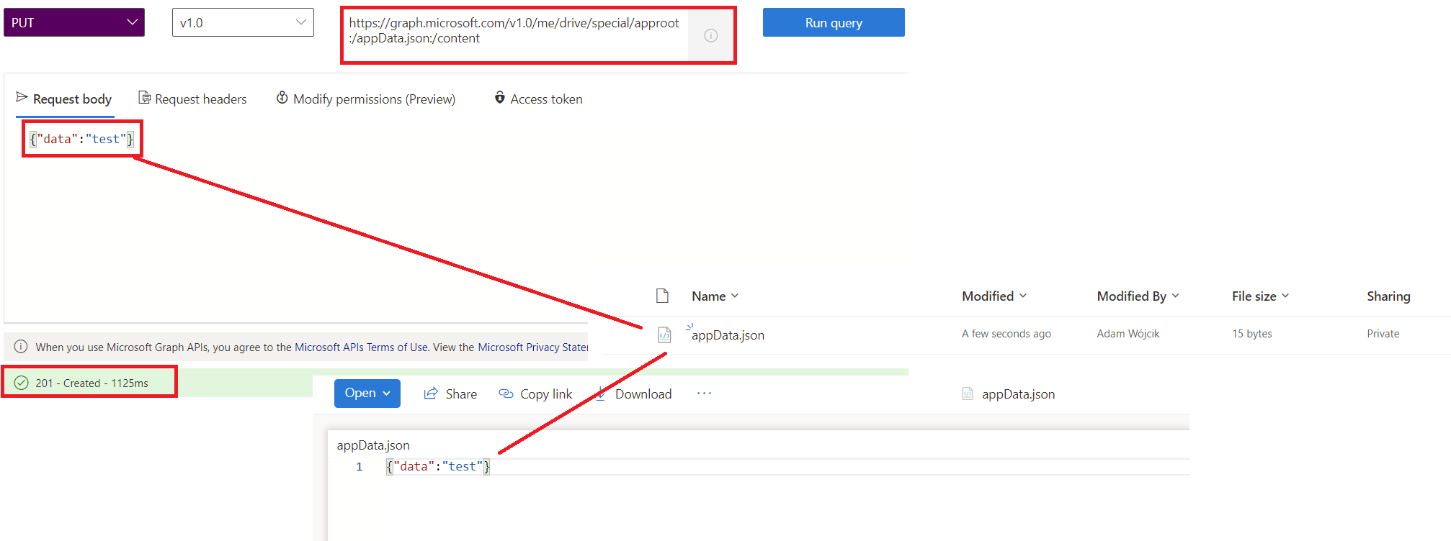
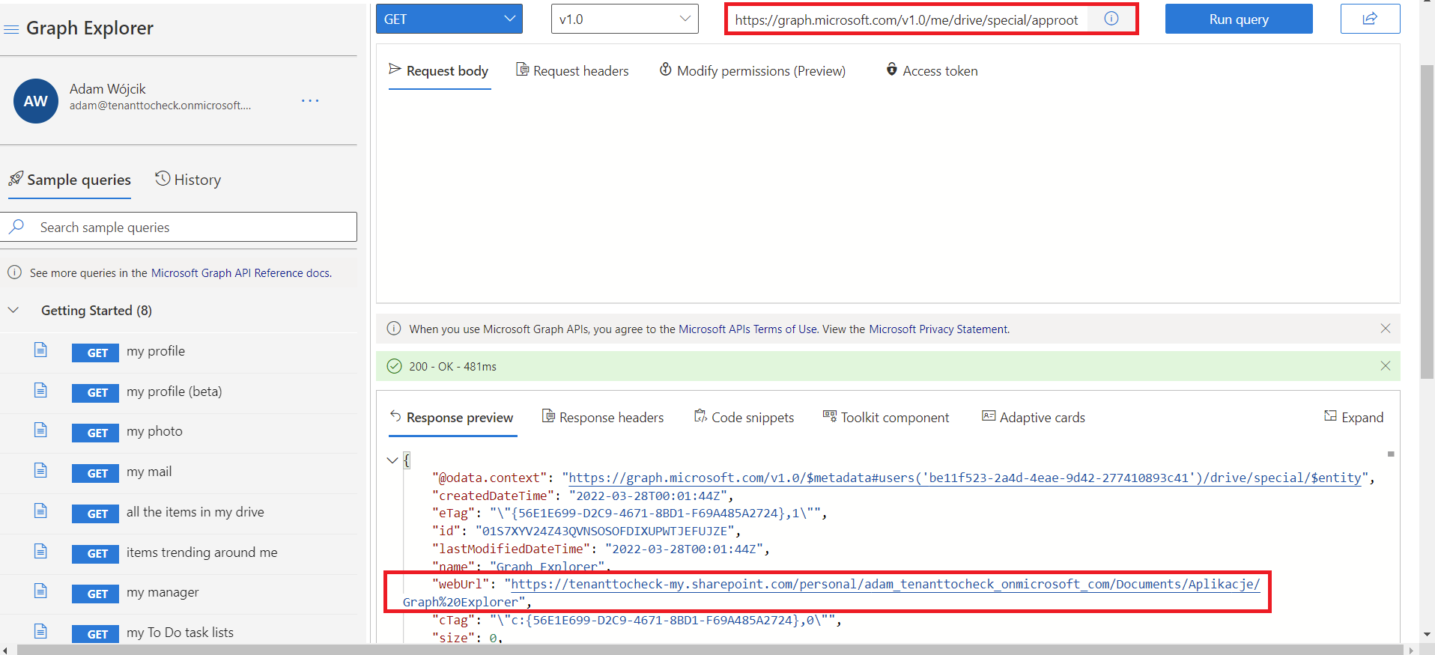
How ?
&
JSON
GET: https://graph.microsoft.com/v1.0/me/drive/special/approot
PUT: https://graph.microsoft.com/v1.0/me/drive/special/approot:/{YOURFILENAMEHERE}.json:/content
GET: https://graph.microsoft.com/v1.0/me/drive/special/approot:/{YOURFILENAMEHERE}.json
body { }
download
@microsoft.graph.downloadUrl

Slide 4
DEMO 🍿

Slide 5
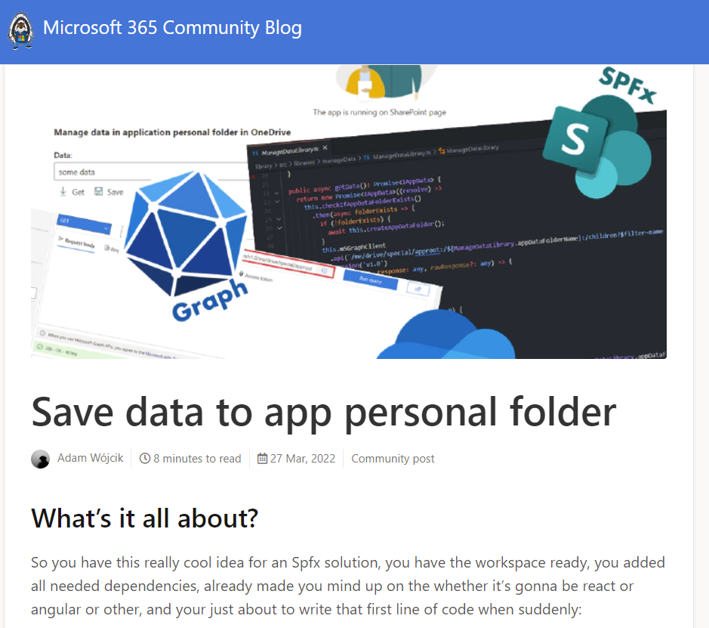
Thanks for watching 👍
You missed it 😯? No problem I guess it’s recorded 😉, but in case you do prefer to read 📖 there is a blog post about it on pnp.github.io/blog as well 👍

