Slide 1
Confusion Matrix
Accuracy you can cite
A demo segment. The repository is currently private, so this is shown live rather than installed by attendees.
michaelsnelson.github.io/BINA-I2K-2026-QuPath-Extensions
1

Slide 2
You trained a classifier. How good, exactly?
You mark a sample of cells with their correct class; the extension compares that to the classifier.
It looks good in the viewer. That is an impression, not a result.
How accurate -- and measured on how many cells? 95% from 40 cells and 95% from 4000 are not the same claim.
Which classes get confused with which, and is it the classifier or the ground truth that is wrong?
A classifier accuracy without a confidence interval, and without a look at what is being confused, is not yet a result.
2

Slide 3
What it gives you
Per-class precision, recall, specificity and F1, plus overall accuracy -- each with a bootstrap 95% confidence interval.
An N x N confusion matrix for any number of classes, including composite classes like "Macrophage: FoxP3".
Interactive: click any matrix cell to highlight exactly those cells in the QuPath viewer.
CSV export of the matrix and every metric, for downstream figures.
Probability metrics for OpenCV ML classifiers: log-loss, Brier, AUC-ROC, PR-AUC, and calibration.
  Ground truth from point annotations or classified area annotations -- point-clicking every cell is often impractical.
3

Slide 4
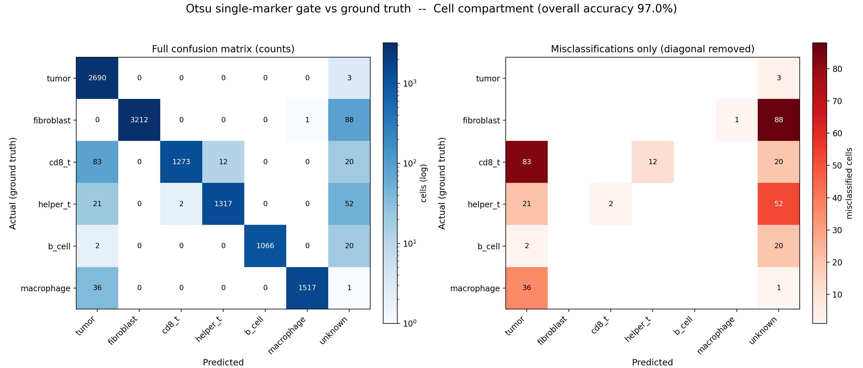
The matrix, on the workshop demo data
4
Rows are the ground truth, columns the prediction; the diagonal is correct, off-diagonal is confusion. Here a deliberately crude single-marker gate reads some T cells as tumor (the cd8_t / helper_t -> tumor cells) because the 5 um cell expansion picks up PanCK from the neighbouring tumour nest. Right panel: errors only.

Slide 5
LIVE DEMO
Analyze Current Image
The N x N matrix appears, with per-class precision, recall, specificity and F1 beside it.
Pick a class with a wide confidence interval; count how many ground-truth cells it has. The CI is what makes "95%" honest.
drop a live screenshot of the
Confusion Matrix window here
Menu: Extensions > Confusion Matrix > Analyze Current Image...
5

Slide 6
LIVE DEMO
Click the biggest off-diagonal cell
Those cells highlight in the viewer. This is the moment worth watching.
"The classifier is 87% accurate" becomes "it confuses these two things, for this visible reason" -- the sentence that actually gets a classifier fixed.
It is also where you find out how often the ground truth itself was wrong.
drop a live screenshot of the
Confusion Matrix window here
Menu: Click any cell of the matrix
6

Slide 7
LIVE DEMO
Analyze Project, with outliers
Aggregate across images, with a per-image breakdown of each image's contribution.
Images whose accuracy diverges are flagged as outliers automatically.
Open a flagged image and look for the cause: the ground-truth labeling, the tissue or staining, or the classifier failing to generalise.
drop a live screenshot of the
Confusion Matrix window here
Menu: Extensions > Confusion Matrix > Analyze Project...
7

Slide 8
Probability metrics (OpenCV ML classifiers)
Not just whether the top class is right, but whether the predicted probabilities are trustworthy.
Log-loss, Brier score, AUC-ROC, PR-AUC, and a per-class calibration curve.
A model that is 95% confident and 70% correct is a different problem from one that is simply inaccurate -- and it needs a different fix.
Pairs with the DL Pixel Classifier (is the deep model really better?) and Class Distribution (the imbalance behind wide intervals).
8

Slide 9
Availability, and the one thing to take away
The extension itself is ready; only distribution is pending.
Repository is currently private, so there is no jar to install today -- this is why it is a demo, not a hands-on exercise. Ask us for access.
No hardware or server requirement; it would otherwise sit in the hands-on hour.
Report an interval. Accuracy with a confidence interval and a look at what is confused is a five-minute job, not a research project.
9

