Slide 1
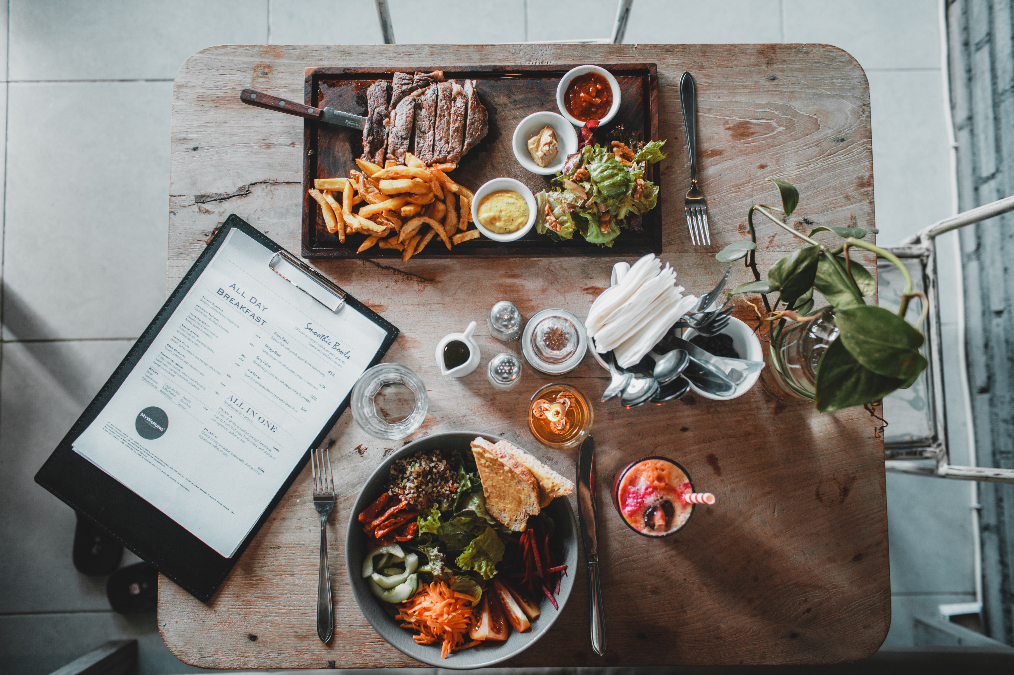
Recipe Site Traffic
Michael Sandilands

Slide 2
Business Problem
Currently the Product Manager chooses their favorite from a selection
and displays that on the home page.
A popular recipe can increase traffic to the website by as much as 40%
if a popular recipe is chosen.
More traffic means more subscriptions, so this is really important to the
company.

Slide 3
Can We Do Better?
We expect random chance to correctly pick High Traffic Recipes
63.73% of the time.
The product manager gave us a target of correctly predicting High
Traffic Recipes 80% of the time.
Our models can correctly predict High Traffic Recipes 80.42% of
the time on Never-Before-Seen Data, achieving our target!

Slide 4
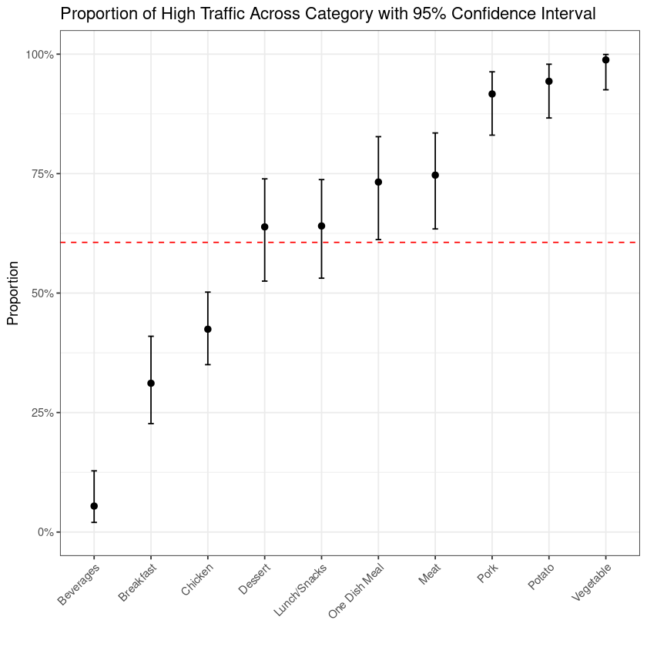
The Analysis
Recipe Category is the most important predictor.
Very popular recipes include:
Vegetable
Potato
Pork
Meat
One Dish Meal
Unpopular recipes include:
Beverages
Breakfast
Chicken

Slide 5
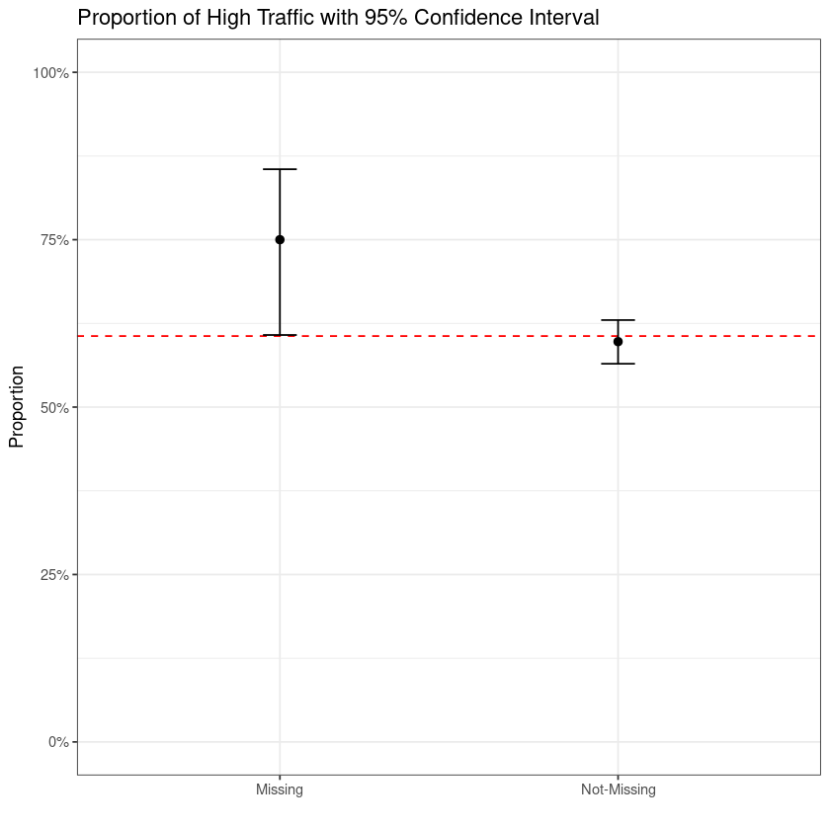
The Analysis
Missing values also have a relationship with High Traffic Recipes
Rows with missing values among the nutritional values, calories, Carbohydrate, Sugar & Protein, tend to have High Traffic Recipes
Further investigation with the product manager into these missing values will need to be pursued
Our best performing model used only these two predictors, Category and Missing

Slide 6
Business Value
How Can Our Models Deliver Business Value?

Slide 7

Explaining Gain
k
Actual Value | Predicted Value | Predicted Probability
High | High | 92.64%
High | High | 92.64%
High | High | 92.64%
High | High | 92.64%
High | High | 92.64%
High | High | 92.64%
High | High | 92.64%
High | High | 92.64%
High | High | 92.64%
High | High | 92.64%
Without the model, we're left to random chance, and we'd expect to correctly guess the global High traffic rate which is 63.73%
In other words, 6 out of the 10 rows in this table would be correctly guessed.
With our model we first sort the rows by highest to lowest Predicted Probability – then we use the model to guess if a recipe will generate High Traffic.
Our model correctly guesses 10 out of 10 of the first 10 rows.
If we have 600 popular recipes, random chance would have gained us 6 out of those 600 in the first 10 rows (or 1%)
Our model gained us 10 out of those 600 (or 1.7%)

Slide 8
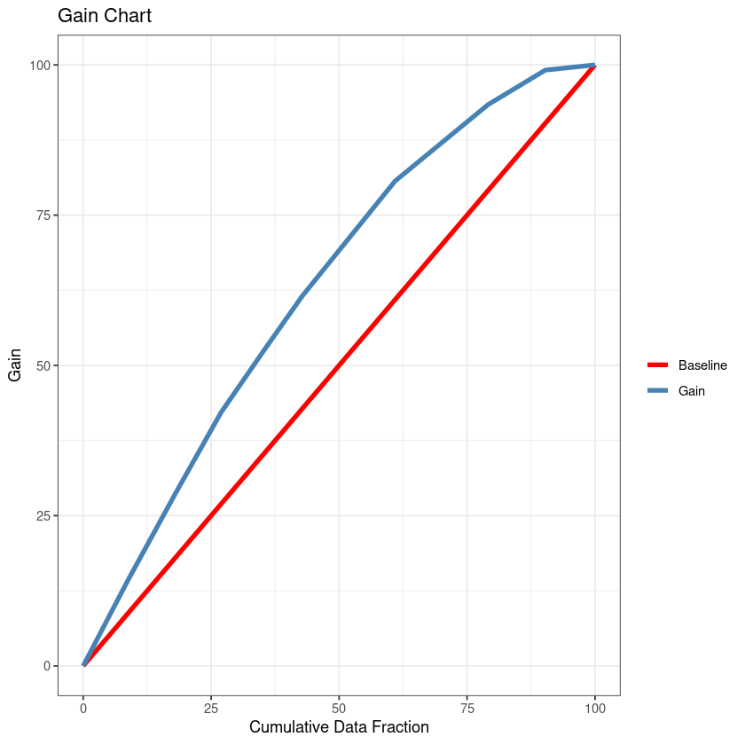
Gain Chart
The gain chart show us how much we gain as we progressively add more recipes.
With our model, the first 25% of our recipes gives us a gain of close to 40%
Meaning, out of 600 High Traffic Recipes, we just gained close to 240!
Whereas if we were using random chance, we would have gained 25% or 150 out of 600.

Slide 9
Recommendations
What Should The Business Do Now?

Slide 10
Improve The Model
Recipes may have more valuable predictors that have yet to be explored.
Predictors here that have yet to be explored are:
The Title
Time to Make
Cost Per Serving
Ingredients
Method

Slide 11
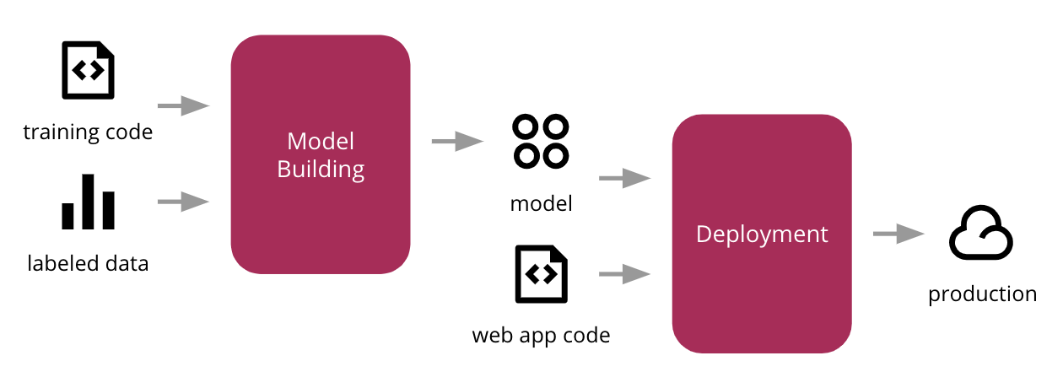
Deploy Current Model
We’ve achieved the Product Managers target.
Our model can correctly predict High Traffic Recipes over 80% of the time on never-before-seen data.
While improvements can be made to our current model
It’s ready to start delivering Business Value now!
Time to place our model into production

