Slide 1
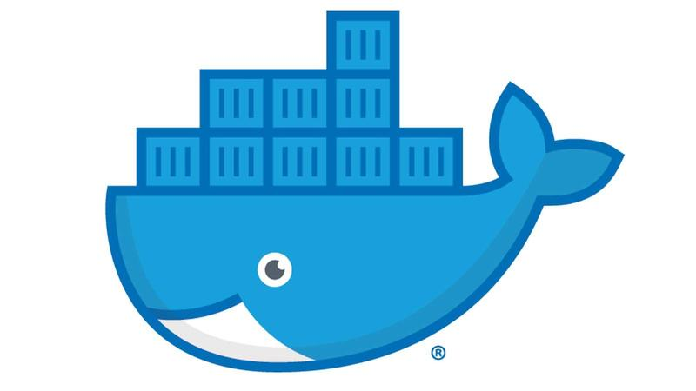
Docker Tips and Tricks
Michael Simons (msimons)

Slide 2
Agenda
Container Modes
Docker Layers
Multi-Stage Builds
Dockerfile Best Practices
Managing Disk Usage
Docker in Docker

Slide 3
Development Environments
Mac & Windows client (e.g. Windows 10) are considered development environments
Virtualization
QEMU to support running other architecture
Notes:
Consequences
Slower
May not support your scenario
Do not use for production environments

Slide 4
Windows Container Modes
Windows client supports both Windows and Linux containers
Must explicitly switch between environments
Default mode is Linux containers

Slide 5
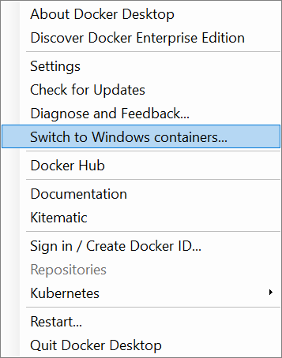
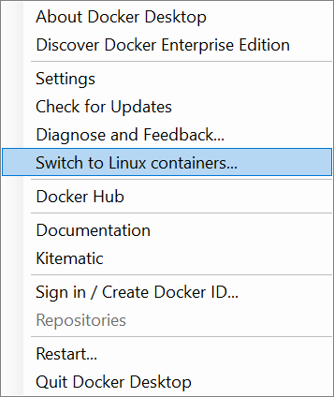

Windows Container Modes UI

Slide 6
Container Modes CLI
Retrieve Container Mode
docker version -f '{{ .Server.Os }}'
Switch Container Mode
$Env:ProgramFiles\Docker\Docker\DockerCli.exe –SwitchDaemon

Slide 7
Container Modes in Practice
PS D:\> docker pull debian:stretch
stretch: Pulling from library/debian
no matching manifest for unknown in the manifest list entries
PS D:\> docker version -f '{{ .Server.Os }}'
windows
PS D:\> & $Env:ProgramFiles\Docker\Docker\DockerCli.exe –SwitchDaemon
PS D:\> docker version -f '{{ .Server.Os }}'
linux
PS D:\> docker pull debian:stretch
stretch: Pulling from library/debian
6f2f362378c5: Pull complete
Digest: sha256:2b20d1b80dbcdef98ff4e747109c39d2b91539f7f12d7873fdd452306eddb04d
Status: Downloaded newer image for debian:stretch

Slide 8
Docker Layers
Each image consists of a series of layers
One of the reasons Docker is so lightweight
Each Dockerfile instruction corresponds to a layer

Slide 9
Union File System
Union file systems allows common layers to be shared between images and containers
Image 2 File 1, File 2
Image 3 File 2
Image 1 File 1, File 2
▲ File 1
- File 1
+ File 2
+ File 2
+ File 2
+ File 1
+ File 1
+ File 1

Slide 10
Shared Docker Layers
Image 1
app1 binaries
Image 2
Image 3
ASP.NET Core Runtime
app2 binaries
scripts
.NET Core Runtime
Python
Windows Nano Server (10.0.14393.693)

Slide 11
Docker Layering Example
FROM ubuntu:disco
RUN apt-get update
RUN apt-get install -y curl

Slide 12
View Docker Layers
PS D:\> docker image ls training-day
REPOSITORY TAG IMAGE ID CREATED SIZE
training-day curl 9686a8e92900 14 minutes ago 114MB
PS D:\> docker history training-day:curl
IMAGE CREATED CREATED BY SIZE
9686a8e92900 7 minutes ago /bin/sh -c apt-get install -y curl 15.2MB
f86b6d0f93c1 8 minutes ago /bin/sh -c apt-get update 23.5MB
9b17fc7d6848 4 weeks ago /bin/sh -c #(nop) CMD ["/bin/bash"] 0B
<missing> 4 weeks ago /bin/sh -c mkdir -p /run/systemd && echo 'do… 7B
<missing> 4 weeks ago /bin/sh -c rm -rf /var/lib/apt/lists/* 0B
<missing> 4 weeks ago /bin/sh -c set -xe && echo '#!/bin/sh' > /… 933B
<missing> 4 weeks ago /bin/sh -c #(nop) ADD file:b82101f178f1bebe3… 75.4MB

Slide 13
Bad Layering Example
FROM ubuntu:disco
RUN apt-get update
RUN apt-get install -y curl
RUN rm -rf /var/lib/apt/lists/*

Slide 14
View Docker Layers
PS D:\> docker image ls training-day
REPOSITORY TAG IMAGE ID CREATED SIZE
training-day curl-cleanup 8c8ccd7a25c2 2 minutes ago 114MB
training-day curl 9686a8e92900 14 minutes ago 114MB
PS D:\> docker history training-day:curl-cleanup
IMAGE CREATED CREATED BY SIZE
8c8ccd7a25c2 5 minutes ago /bin/sh -c rm -rf /var/lib/apt/lists/* 0B
9686a8e92900 16 minutes ago /bin/sh -c apt-get install -y curl 15.2MB
f86b6d0f93c1 17 minutes ago /bin/sh -c apt-get update 23.5MB
9b17fc7d6848 4 weeks ago /bin/sh -c #(nop) CMD ["/bin/bash"] 0B
<missing> 4 weeks ago /bin/sh -c mkdir -p /run/systemd && echo 'do… 7B
<missing> 4 weeks ago /bin/sh -c rm -rf /var/lib/apt/lists/* 0B
<missing> 4 weeks ago /bin/sh -c set -xe && echo '#!/bin/sh' > /… 933B
<missing> 4 weeks ago /bin/sh -c #(nop) ADD file:b82101f178f1bebe3… 75.4MB

Slide 15
Good Layering Example
FROM ubuntu:disco
RUN apt-get update \
&& apt-get install -y curl \
&& rm -rf /var/lib/apt/lists/*

Slide 16
View Docker Layers
PS D:\> docker image ls training-day
REPOSITORY TAG IMAGE ID CREATED SIZE
training-day curl-cleanup 8c8ccd7a25c2 2 minutes ago 114MB
training-day curl 9686a8e92900 14 minutes ago 114MB
PS D:\> docker history training-day:curl-cleanup
IMAGE CREATED CREATED BY SIZE
8c8ccd7a25c2 5 minutes ago /bin/sh -c rm -rf /var/lib/apt/lists/* 0B
9686a8e92900 16 minutes ago /bin/sh -c apt-get install -y curl 15.2MB
f86b6d0f93c1 17 minutes ago /bin/sh -c apt-get update 23.5MB
9b17fc7d6848 4 weeks ago /bin/sh -c #(nop) CMD ["/bin/bash"] 0B
<missing> 4 weeks ago /bin/sh -c mkdir -p /run/systemd && echo 'do… 7B
<missing> 4 weeks ago /bin/sh -c rm -rf /var/lib/apt/lists/* 0B
<missing> 4 weeks ago /bin/sh -c set -xe && echo '#!/bin/sh' > /… 933B
<missing> 4 weeks ago /bin/sh -c #(nop) ADD file:b82101f178f1bebe3… 75.4MB

Slide 17
ADD Instruction
FROM buildpack-deps:buster-scm
ADD https://dotnetcli.blob.core.windows.net/dotnet/Sdk/3.0.100-preview5-011568/dotnet-sdk-3.0.100-preview5-011568-linux-x64.tar.gz /
RUN mkdir -p /dotnet \
&& tar -zxf dotnet-sdk-3.0.100-preview5-011568-linux-x64.tar.gz -C /dotnet \
&& rm dotnet-sdk-3.0.100-preview5-011568-linux-x64.tar.gz

Slide 18
View Docker Layers

Slide 19
Correct ‘ADD’ Pattern
FROM buildpack-deps:buster-scm
RUN curl -SL --output dotnet.tar.gz https://dotnetcli.blob.core.windows.net/dotnet/Sdk/3.0.100-preview5-011568/dotnet-sdk-3.0.100-preview5-011568-linux-x64.tar.gz \
&& mkdir -p /dotnet \
&& tar -zxf dotnet.tar.gz -C /dotnet \
&& rm dotnet.tar.gz

Slide 20
View Docker Layers

Slide 21
Multi-Stage Builds
Multi-stage builds are another mechanism to help create smaller lightweight images.

Slide 22
Problem
FROM mcr.microsoft.com/dotnet/core/sdk:2.2 AS build
WORKDIR /app
COPY . ./
RUN dotnet publish -c Release -o out
WORKDIR /app/out
ENTRYPOINT ["dotnet", "dotnetapp.dll"]

Slide 23
Undesirable Image Size
PS D:\> docker image ls training-day
REPOSITORY TAG IMAGE ID SIZE
training-day dotnetapp-sdk f9c59aaf3e00 1.76GB
PS D:\> docker images mcr.microsoft.com/dotnet/core/sdk:2.2
REPOSITORY TAG IMAGE ID SIZE
mcr.microsoft.com/dotnet/core/sdk 2.2 08663b8eaa01 1.74GB

Slide 24
Solution
FROM mcr.microsoft.com/dotnet/core/sdk:2.2 AS build
WORKDIR /app
COPY . ./
RUN dotnet publish -c Release -o out
FROM mcr.microsoft.com/dotnet/core/runtime:2.2
WORKDIR /app
COPY --from=build /app/out ./
ENTRYPOINT ["dotnet", "dotnetapp.dll"]

Slide 25
Desirable Image Size
PS D:\> docker image ls training-day
REPOSITORY TAG IMAGE ID CREATED SIZE
training-day dotnetapp-runtime 97cae90eaf37 10 seconds ago 181MB
training-day dotnetapp-sdk f9c59aaf3e00 39 seconds ago 1.76GB

Slide 26
Dockerfile Best Practices
https://docs.docker.com/develop/develop-images/dockerfile_best-practices/

Slide 27
Disk Usage
PS D:\> docker system df
TYPE TOTAL ACTIVE SIZE RECLAIMABLE
Images 54 3 12.67GB 12.63GB (99%)
Containers 36 0 170.3kB 170.3kB (100%)
Local Volumes 0 0 0B 0B
Build Cache 0 0 0B 0B

Slide 28
Pruning Containers
PS D:\> docker container prune --help
Usage: docker container prune [OPTIONS]
Remove all stopped containers
Options:
--filter filter Provide filter values (e.g. 'until=<timestamp>')
-f, --force Do not prompt for confirmation

Slide 29
Pruning Images
PS D:\> docker image prune --help
Usage: docker image prune [OPTIONS]
Remove unused images
Options:
-a, --all Remove all unused images, not just dangling ones
--filter filter Provide filter values (e.g. 'until=<timestamp>')
-f, --force Do not prompt for confirmation

Slide 30
Pruning Everything
PS D:\> docker system prune --help
Usage: docker system prune [OPTIONS]
Remove unused data
Options:
-a, --all Remove all unused images not just dangling ones
--filter filter Provide filter values (e.g. 'label=<key>=<value>')
-f, --force Do not prompt for confirmation
--volumes Prune volumes

Slide 31
Docker in Docker
Scenarios
Execute script (e.g. Python, PowerShell, etc.) that depends on Docker CLI, but don’t want to install scripting technology locally.
Containerize CI pipeline that depends on Docker CLI

Slide 32
Docker CLI in Docker
Build image that contains the Docker CLI
Volume mount Docker Daemon socket/named pipe
Linux: -v /var/run/docker.sock:/var/run/docker.sock
Windows: -v \\.\pipe\docker_engine:\\.\pipe\docker_engine

Slide 33
Install Docker within Dockerfile
FROM debian:stretch
# install Docker
RUN apt-get update \
&& apt-get install -y --no-install-recommends \
apt-transport-https \
curl \
gnupg \
software-properties-common \
&& rm -rf /var/lib/apt/lists/*

Slide 35

Q & A

