Slide 1
Micro:bit Lunch & Learn

Slide 2
Problem
Software industry is facing a shortage of software engineers
High percentage of girls decide against STEM careers by the 5th grade
Limited STEM opportunities for students in rural areas
Many teachers are overwhelmed with teaching STEM

Slide 3
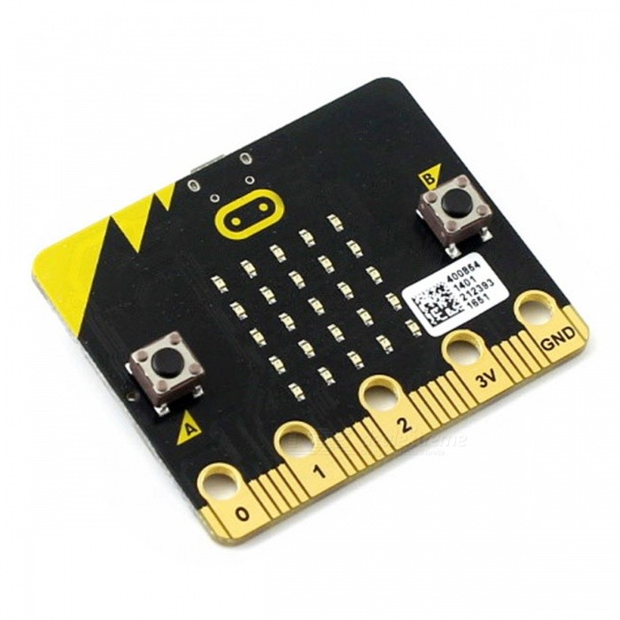
Solution: the micro:bit
A device you can use for all sorts of cool creations, from robots to musical instruments – the possibilities are endless.

Slide 4
Solution
Micro:bit is a good platform to teach with
Cost effective
$16.50 includes micro:bit, usb cable & battery pack
Appealing to a wide age range
Inclusive to a variety of backgrounds
Works with a variety of devices
Travel to rural areas
One engagement per month
Starting to encounter volunteer bandwidth limitations
Students get to keep micro:bits and continue exploration
Notes:
The micro:bit was designed to be classroom-friendly from day one. More approachable than just coding, it's a great way to achieve fun, practical results with motivated students.

Slide 5
Research Findings (BBC)
90% of students said the micro:bit showed them that anyone can code.
86% of students said the micro:bit made Computer Science more interesting.
70% more girls said they would choose Computing as a school subject after using the micro:bit.
85% of teachers agree it has made ICT/Computer Science more enjoyable for their students.
Half of teachers who’ve used the micro:bit say they now feel more confident as a teacher, particularly those who say they’re not very confident in teaching Computing.

Slide 6
micro:bit History
Created by BBC and partners (Microsoft, Lancaster University, Nordic Semiconductor, Farnell Element14, Samsung, etc)
Was designed to encourage children to get actively involved in writing software for computers and building new things
Distributed to all 7th graders in Britain (around 1 million devices)
Microbit Educational Foundation is a non-profit setup to handle the future

Slide 7
Physical Features
25 individually-programmable LEDs
2 programmable buttons
25 physical connection pins
Light and temperature sensors
Motions sensors (accelerometer and compass)
Wireless communication, via radio and Bluetooth
USB interface

Slide 8
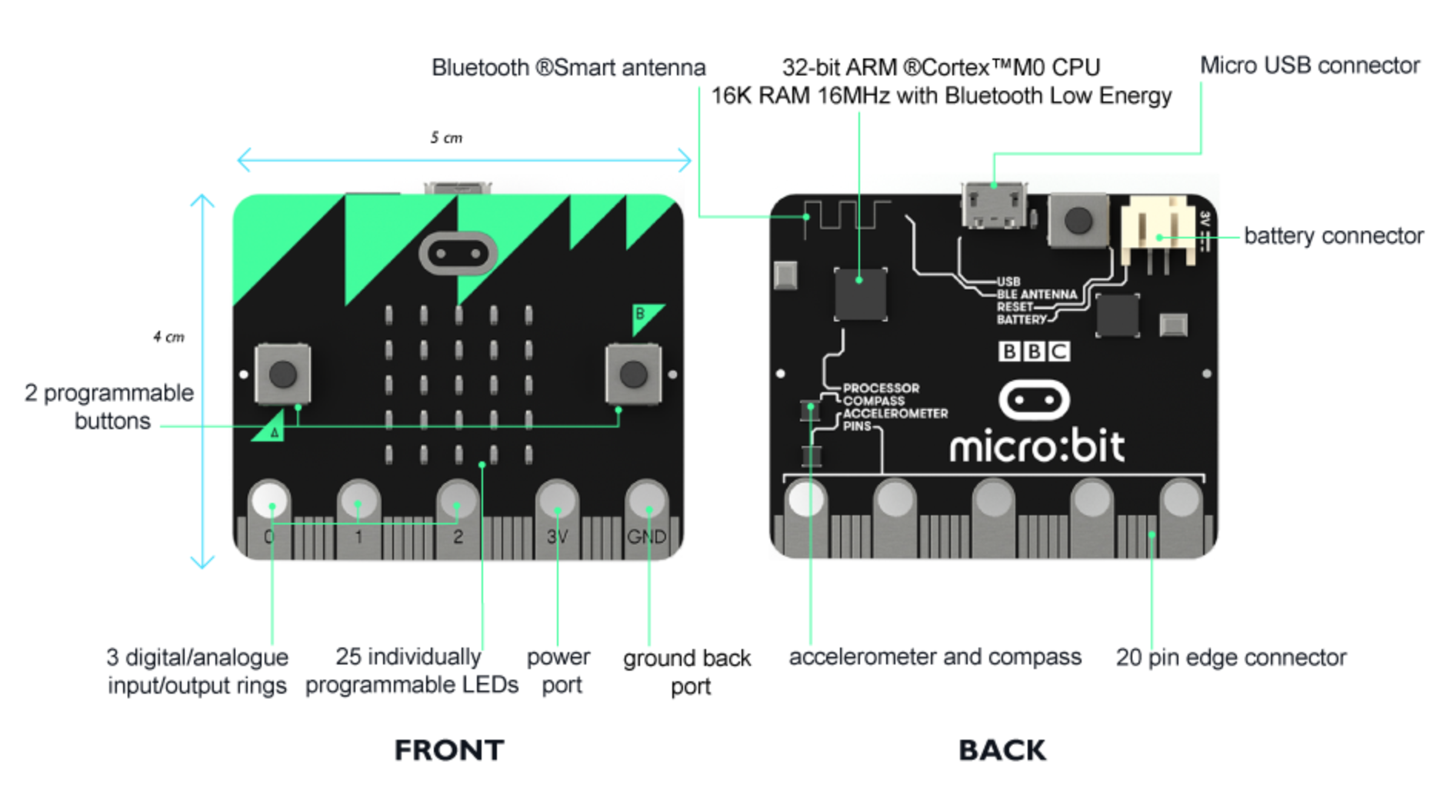

Slide 9
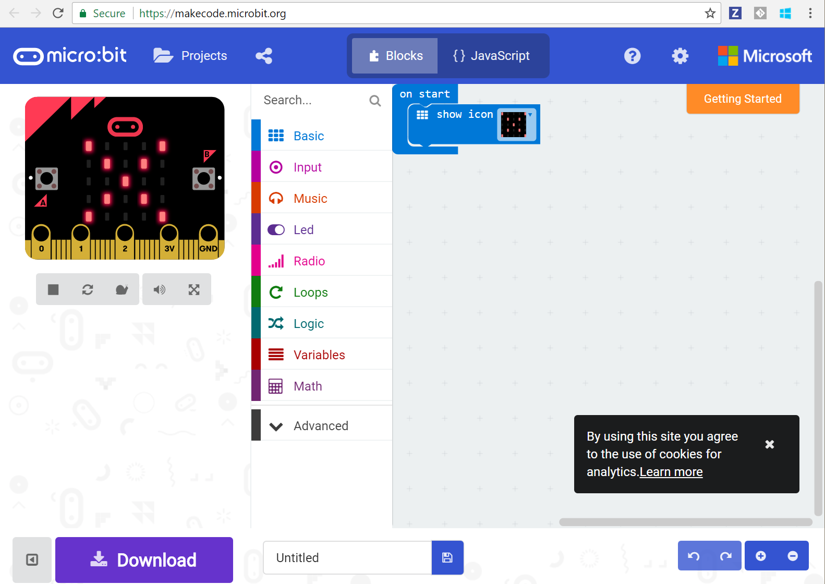
Coding Experience
Notes:
Block Editor (https://makecode.microbit.org/#)
Drag and drop experience
Built in emulator
Download program to run on your own micro:bit
JavaScript and Python experiences for more advanced students

Slide 10
Demo

Slide 11
Projects
Rock Paper Scissors
With Teams
Watch
Compass
Coin Flipper
Hot or Cold
Reaction Time
Voting Machine
Infection
Guitar

Slide 12
Engagements:
BAM (High School & College)
STEMtastic/TechSavvy (7th & 8th Grade)
Ed Clapp (4th Grade)
Edgeley (5th Grade)
Notes:
BAM – pilot – older age group
Jamestown – segregated by gender – such a different learning behavior
Ed Clapp - wanting to adopt curriculum (coming back and plans for next year)
Edgeley – school that triggered it all. Had all these STEM activities already but didn’t know how to get to the next level.

Slide 13
Experiences
Jamestown Quotes

Slide 14
Experiences
Numerous occasions of students not want to stop the exercise

Slide 15
Experiences
Hutterites - seemed uninterested at first - engaged at end.

Slide 16
Experiences - Inclusive
Non-native speaker
Girl w/limited mobility
Autistic child

Slide 17
Experiences
Always get questions on where to get
Cheers when they find out they get to keeps
Excited about Microsoft coming to town

Slide 18
How you can help
Volunteer by
Emailing msimons@Microsoft.com or nicolela@Microsoft.com
Joining DL: techmobile@Microsoft.com
Support us by sharing contacts of interested schools/organizations
Upcoming events
DigiGirlz
Train the Trainer Brownbag (June 4th ?)

