Slide 1
Get Creative, Get Connected, Get Coding!
Notes:
Michael\Nicole – introduce selves as workshop leaders. Also, introduce all the volunteers in the room by having them raise their hands.
Also, mention each person’s role at Microsoft – point being that everyone can learn to code on a micro:bit…software engineers, sales, etc. It’s both a fun activity and an important skill to have.
And, today, we’re going to show everyone here how to learn to code.
Overall timeframe:
1.) Slides - 10 mins
2.) Infection game - 10 mins
3.) Group intro coding exercises – 25 mins
4.) Team projects – 60 mins
5.) Closing

Slide 2

Raise your hand if…
you know how to write code.
90% of students agree that the micro:bit showed them that anyone can code.
86% of students agree that the micro:bit makes Computer Science more interesting.
70% of girls agree that they would choose to study Computing after using the micro:bit.
Notes:
Emphasize that by the end of the workshop, we will teach all of everyone how to write code. And, even for those of that already know how to write code, we’ll show you how you can continue to grow your coding skills using a micro:bit. The possibilities are endless with the micro:bit.
Also, prepare a handout for students at the end with resources and ways to continue their learning? Also, where to purchase the micro:bit.

Slide 3

Game Time!
There is a disease outbreak!
Will you survive?!?
Who is patient zero?!?

Slide 4
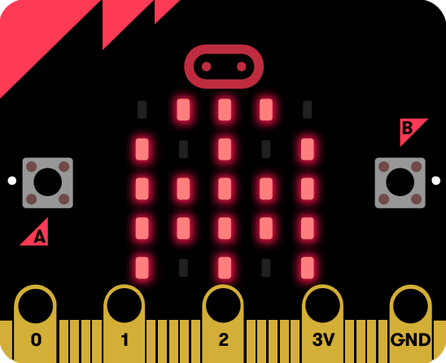
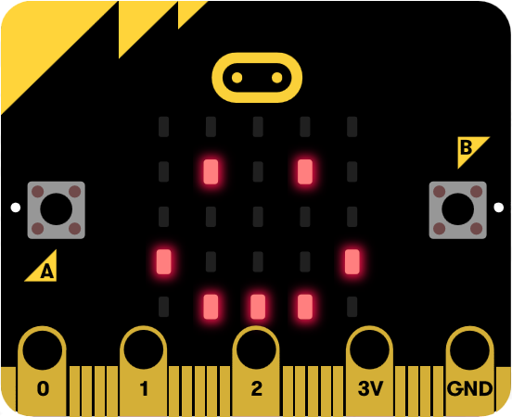
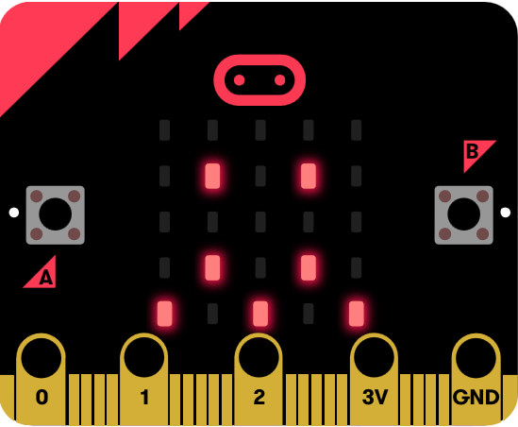
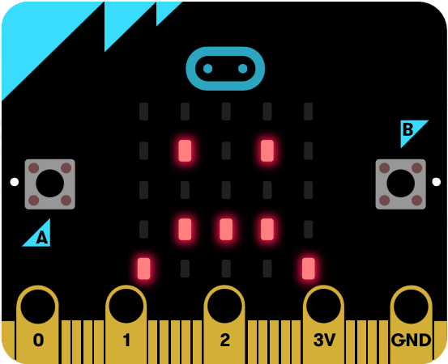
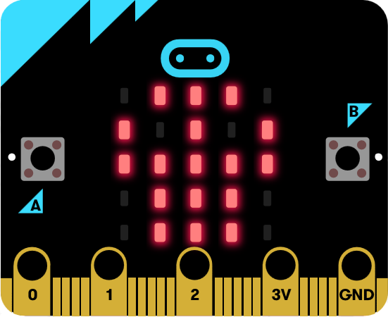
Mission: Stop the outbreak on your team!
Patient Zero
Randomly infected with the illness and is contagious, but shows no signs of sickness
Infected Player
Sickness is transmitted when two micro:bits are close enough to spread the disease
Player is contagious immediately, even during incubation time
Dead Player
Dead players are non-contagious and out of the game
Game Over
Game stops when all players are dead
Or, if at least one player on your team is healthy, your team has stopped the outbreak and won the game
Health Stages
Game Starting | Healthy | Incubating | Sick | Dead
Ghost | Happy | Confused | Sad | Skull
Notes:
After this slide – play the game for 10 minutes???
1.) Volunteers will break students up into groups of 5-8.
2.) Volunteers will handout microbits at this time that are preprogrammed with the game.
3.) Volunteers will need to familiarize themselves with the rules to lead the game for the group. They need to control the Master device which leads the game. Will provide handout with instructions to the volunteers. We should do a practice round with each volunteer.

Slide 5
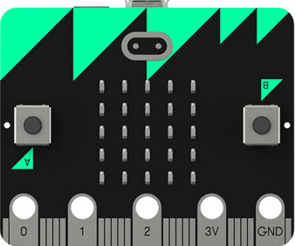
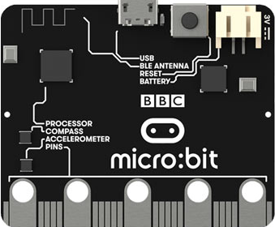
What can I do with a micro:bit?
Light Sensor
Thermometer
Reset button
LED lights
Mini USB port
Radio
Button A
Battery connector
Button B
Accelerometer
Compass
Connection pins
Connection pins
Notes:
Front:
25 individual LED lights – Each light is individually programmable so that you can write code that controls whether each light is off or on; you can create different patterns with the lights, to show numbers, letters, or shapes, as you already saw with the infection game.
2 programmable buttons (A & B) – This let’s you write code that causes the microbit to do something whenever a button is clicked. For example, you could write code that turns on one of the LED lights each time the button is clicked.
Back:
1.) Two motion sensors:
* Accelerometer – detects acceleration, such as when you tilt the microbit left\right, backward\forward and up and down. For example, you could write code that does something when the microbit gets shook.
Compass – measure magnetic field to gauge gauge position. You could use this to create a digital compass.
2.) Thermometer:
Isn’t used to measure the exact room temperature, but instead measures the ambient temperature of the surrounding chip which gets warmer as you turn on and use it. You could use this to gauge temperature differences and write code that does something in response – such as change the LED light pattern when a temperature change occurs.
3.) Radio:
The radio chip lets you send and receive messages between microbits. This is what the infection game used to trigger an outbreak – each infected microbit would send messages to infect other microbits around it.
4.) Reset button – let’s you restart the program on the device
Battery connector – attaches the battery pack
Mini USB port – allows you to connect the micro:bit to a computer so that you can download the program to the device.
5.) 25 physical connection pins and input\output rings
Let’s you connect additional sensors and external devices to the micro:bit.
For example, you can connect a speaker using alligator clips and program the microbit to play sounds and music.

Slide 6
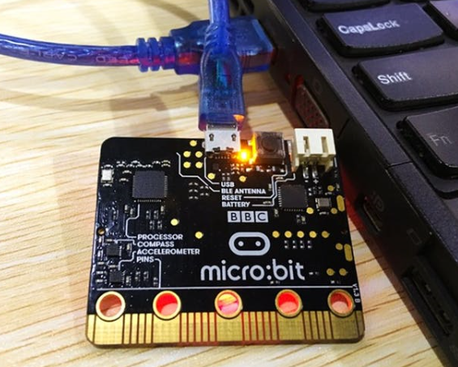
Let’s Code!
1.) Open up your computer/tablets
2.) Open a browser, and navigate to makecode.microbit.org
3.) Let’s build two programs together:
Hello World
Coin Flip
Notes:
Volunteers should ensure all students have their micro:bit attached to laptop and have navigated to microbit.org. And, walk around to help students through the exercises that Nicole\Michael will lead.

Slide 7
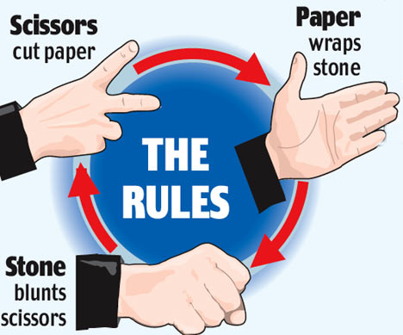
Rock-Paper-Scissors
Build the classic rock-paper-scissors game to play against your friends
Notes:
We have a total of 12 volunteers (including Michael\Nicole)
How should we divide students? Have them raise their hand if they are interested in project #1, divide them up into groups of 5-6 students per volunteer…then repeat same process for projects 2 and 3?
Need handouts to give to students for their projects. Also, need the same for the volunteers.

Slide 8
Raise your hand if…
The micro:bit showed you that anyone can write code.
The micro:bit makes Computer Science Interesting.
Notes:
Emphasize that by the end of the workshop, we will teach all of everyone how to write code. And, even for those of that already know how to write code, we’ll show you how you can continue to grow your coding skills using a micro:bit. The possibilities are endless with the micro:bit.
Also, prepare a handout for students at the end with resources and ways to continue their learning? Also, where to purchase the micro:bit.

Slide 9
Keep Coding!
1.) You get to keep your micro:bits
2.) Use the learning resources available on microbit.org
3.) Be creative, explore, and try new things with your micro:bit – the possibilities are endless!
Notes:
We have a total of 12 volunteers (including Michael\Nicole)
How should we divide students? Have them raise their hand if they are interested in project #1, divide them up into groups of 5-6 students per volunteer…then repeat same process for projects 2 and 3?
Need handouts to give to students for their projects. Also, need the same for the volunteers.

