Slide 1
Introduction to the micro:bit

Slide 2
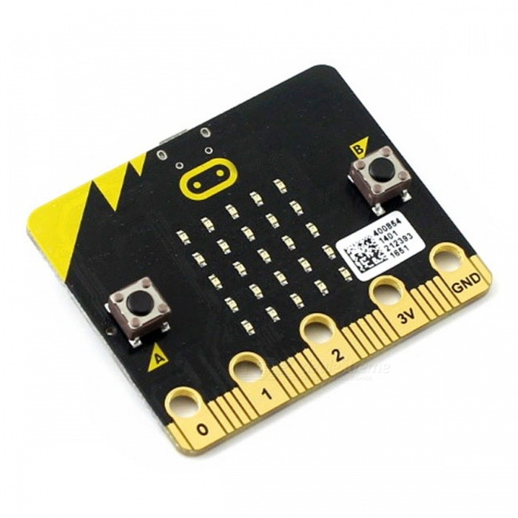
What is a micro:bit
A device you can use for all sorts of cool creations, from robots to musical instruments – the possibilities are endless.

Slide 3
Physical Features
25 individually-programmable LEDs
2 programmable buttons
25 physical connection pins
Light and temperature sensors
Motions sensors (accelerometer and compass)
Wireless communication, via radio and Bluetooth
USB interface

Slide 4
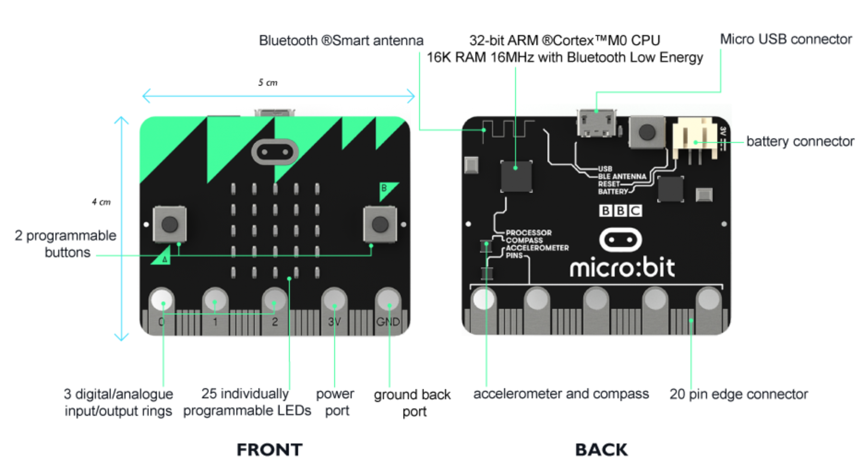

Slide 5
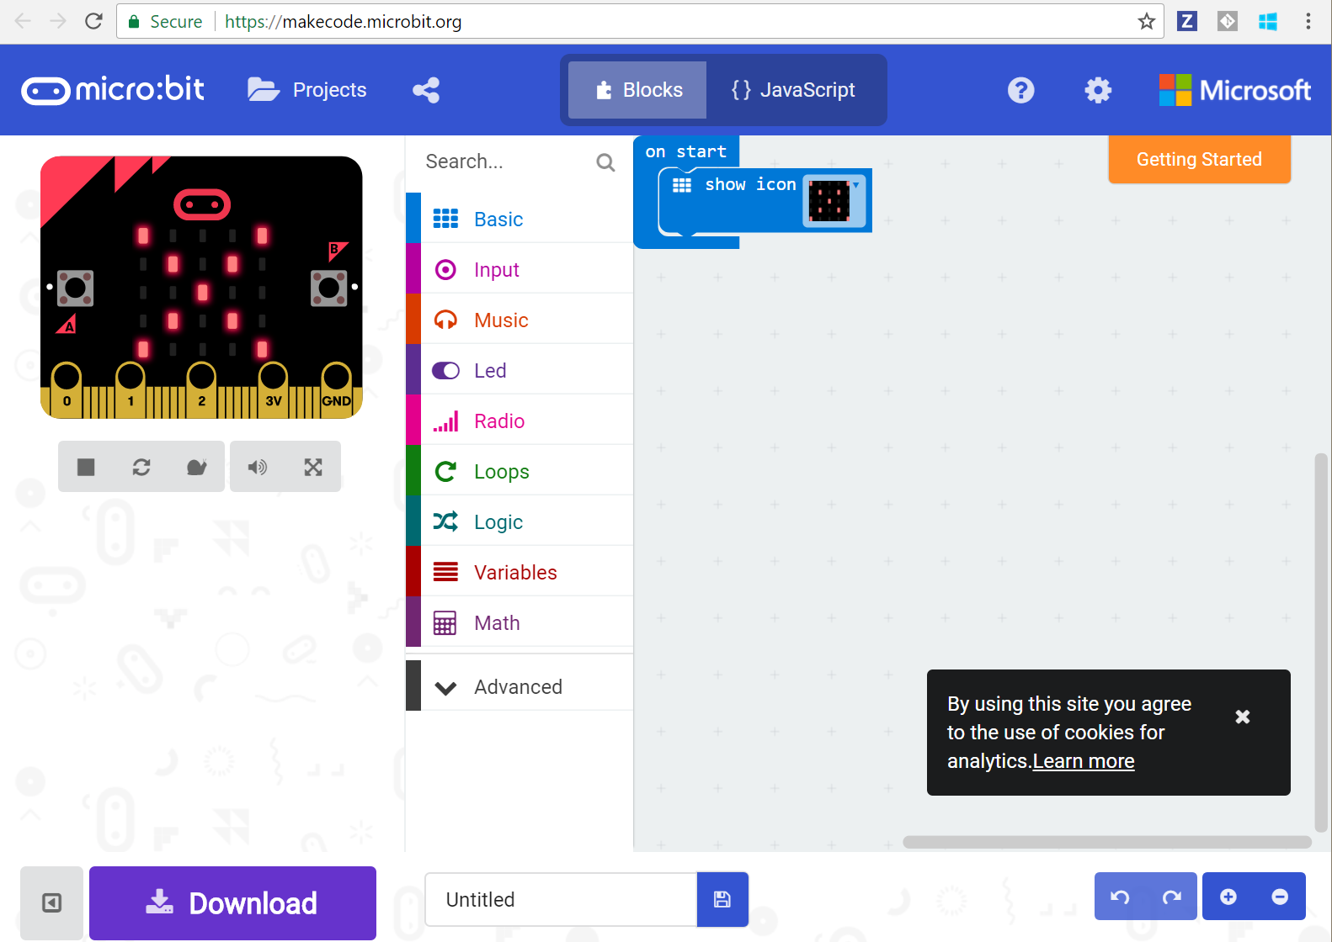
Coding Experience

Slide 6
Coding Experience
Block Editor (https://makecode.microbit.org/#)
Drag and drop experience
Built in emulator
Download program to run on your own micro:bit
JavaScript and Python experiences for more advanced students

Slide 7
Made for school
The micro:bit was designed to be classroom-friendly from day one. More approachable than just coding, it's a great way to achieve fun, practical results with motivated students.

Slide 8
Research Findings (BBC)
90% of students said the micro:bit showed them that anyone can code.
86% of students said the micro:bit made Computer Science more interesting.
70% more girls said they would choose Computing as a school subject after using the micro:bit.
85% of teachers agree it has made ICT/Computer Science more enjoyable for their students.
Half of teachers who’ve used the micro:bit say they now feel more confident as a teacher, particularly those who say they’re not very confident in teaching Computing.

Slide 9
micro:bit history
Created by BBC and partners (Microsoft, Lancaster University, Nordic Semiconductor, Farnell Element14, Samsung, etc)
Was designed to encourage children to get actively involved in writing software for computers and building new things
Distributed to all 7th graders in Britain (around 1 million devices)
Microbit Educational Foundation is a non-profit setup to handle the future

Slide 10
Purchasing
~$16.50
micro:bit
Usb cable
Power pack w/batteries
http://microbit.org/resellers/
Some resellers offer bulk discounts (10, 100, 300 packs)
http://www.akjeducation.com/products-search?qs=Micro%3Abit
http://www.newark.com/w/search/prl/results?brand=bbc-micro-bit

Slide 11
Projects
Rock Paper Scissors
With Teams
Watch
Compass
Coin Flipper
Hot or Cold
Reaction Time
Voting Machine
Infection
Guitar

Slide 12
Why is Microsoft interested?
Software industry is facing a shortage of software engineers
Getting kids interest in programming at a young age is key

Slide 13
Links
http://microbit.org/

