Slide 1
Word Embeddings
Michael Szczepaniak

Slide 2
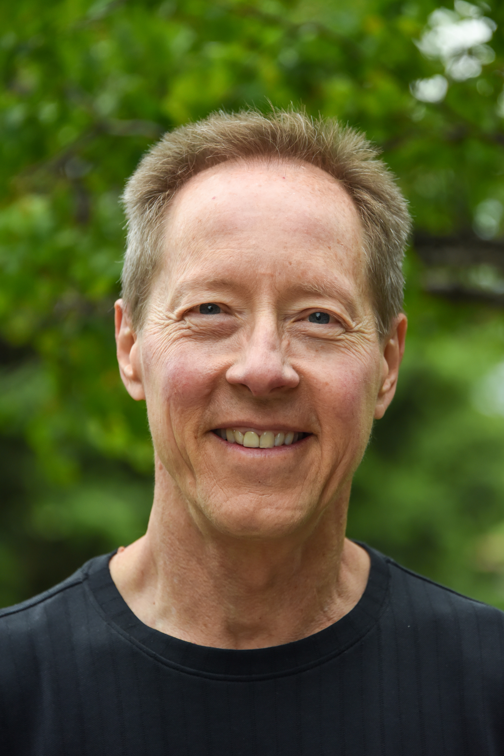


A bit about me...
Last two (of four) degrees
  MS Data Science, RIT (2024)
    Capstone: LLM assisted model development
  BS Computer Science, CSU (2008)
6 years as Sr. Data Scientist
  operations research for government contractor
7 years as software engineer
  couple of small companies

Slide 3
What we’ll cover
What are word embeddings?
A few important NLP tasks
What problems do word embeddings help solve?
Properties of word embeddings
Canned vs. Custom embeddings

Slide 4
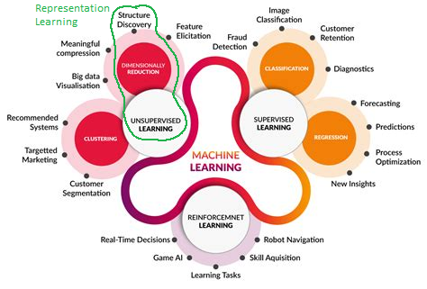
What are word embeddings?
Mapping of words to vectors
Results from representation learning
  Unsupervised learning
More than one way to create
  Canned vs Custom
  Word2Vec (Google)
  GloVe (Stanford)
  Others

Slide 5
A few important NLP tasks?
Text pre-processing!
  least sexy, but often very important
Text classification
Part of speech (PoS) tagging
Named Entity Recognition (NER)
  Canned vs Custom
  Word2Vec (Google)
  GloVe (Stanford)
  Others

Slide 6
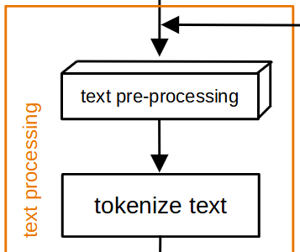
Text pre-processing (an example)
Before building a model that takes text as inputs...
  must convert text into numbers (vectors)
  before this conversion, text must be “cleaned up”
    analogy: cleaning vegetables before cooking them
Steps in the clean up
  normalize URLs and special twitter tokens (# and @)
  expand contractions: I’m ➔ I am, can’t ➔ can not, etc.
  remove stop words, singletons, punctuation, OOV words/tokens
  See Appendix C for detailed step-by-step example
Tokenize = break text into logical pieces (tokens ≈ words, “chopping the veggies”)
➔ original tweet
I can't bloody wait!! Sony Sets a Date For Stephen KingÛªs Û÷The Dark TowerÛª #stephenking #thedarktower http://t.co/J9LPdRXCDE @bdisgusting
➔ processed tweet
not bloody wait sony set date stephen dark <hashtag> <hashtag> <url> <user>
➔ tokenized tweet
not | bloody | wait | sony | set | date | stephen | dark | <hashtag> | <hashtag> | <url> | <user>

Slide 7
Text classification
tbd
  tbd
tbd
tbd
tbd
  tbd
  tbd
  tbd

Slide 8
Feasibility Study vs. FEMA System (text processing)
Before building a model that takes text as inputs...
  must convert text into numbers (vectors)
  before this conversion, text must be “cleaned up”
    analogy: cleaning vegetables before cooking them
Steps in the clean up
  normalize URLs and special twitter tokens (# and @)
  expand contractions: I’m ➔ I am, can’t ➔ can not, etc.
  remove stop words, singletons, punctuation, OOV words/tokens
  See Appendix C for detailed step-by-step example
Tokenize = break text into logical pieces (tokens ≈ words, “chopping the veggies”)
➔ original tweet
I can't bloody wait!! Sony Sets a Date For Stephen KingÛªs Û÷The Dark TowerÛª #stephenking #thedarktower http://t.co/J9LPdRXCDE @bdisgusting
➔ processed tweet
not bloody wait sony set date stephen dark <hashtag> <hashtag> <url> <user>
➔ tokenized tweet
not | bloody | wait | sony | set | date | stephen | dark | <hashtag> | <hashtag> | <url> | <user>

Slide 9
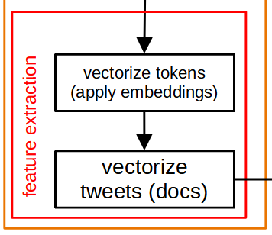
Feasibility Study vs. FEMA System (feature extraction)
Converting tokenized text to numbers (vectors)
  Each token (word) represented by vector of 50 numbers
  (can be more or less)
  Mapping between words and vectors = embedding
  How this mapping is created is interesting, but not important here
  What is important: After this conversion, text is in a form that can be used to train our models or to use our models to make predictions
Example - first 2 words of tweet from the previous slide: not bloody wait
  not = [0.49427, 0.13234, -0.023199, … 47 more numbers]
  bloody = [0.42033, 0.30658, 0.80744, … 47 more numbers]
First 100 dimensions of our example tweet vector:
not | bloody = [0.49427, 0.13234, -0.023199, … 47 more numbers, 0.42033, 0.30658, 0.80744, … 47 more numbers, ...]

Slide 10
Summary & Conclusions
Initial feasibility accuracy on kaggle tweet data ~75%
Primary factor preventing higher accuracy:
mislabeled training data
  Estimated approximately 1 in 4 DISASTER class tweets mislabeled
  Estimated 0.5% of NOT DISASTER class tweets mislabeled
High confidence that > 80% requirement can be reached
  Need to fix training data
  Models retrained on fixed data should significantly improve performance
  Demo on randomly selected tweets with new model
  (redesigned, tuned NN) on fixed train data

Slide 11
Summary & Conclusions (cont.)
Generative AI in the form of an LLM is a great fit for this RFP.
  Meets a customer “want” and makes sense in terms of our business
Using an LLM to augment training data for our models
will save us significant time & money.
  Every hand-labeled training sample can be amplified many times over
Using an LLM to augment training data will help make our models more accurate
  This project demonstrated improved accuracy on two types of models

Slide 12
Summary & Conclusions (cont.)
Experience with generative AI is becoming a competitive advantage
  Strategic investments can be made to strengthen our expertise while simultaneously enhancing our technology portfolio
A proposed system design was presented which satisfy FEMA requirements
Further details available in feasibility project report
  Last item in References

Slide 13
Appendices

Slide 14
Appendix A - Mislabeled kaggle train tweets
Summary of results from sample of 400 taken from each class:
target class | judged correct | judged incorrect | unsure
0 | 391 | 2 | 7
1 | 264 | 96 | 40
Examples where target class was considered “unsure”:
id | text | target | notes
5356 | It may seem like our fire has been a little burnt out.... | 0 | word sense is not clear here
9077 | @sirtophamhat @SCynic1 @NafeezAhmed @jeremyduns and of course you don't have to melt the steel in order to cause structural failure. | 0 | could have been referencing an active fire
3066 | 500 deaths a year from foodborne illness... @frackfreelancs dears... @DECCgovuk @frackfree_eu @tarleton_sophie http://t.co/JSccX8k0jA | 1 | ambiguous reference
6187 | Governor allows parole for California school bus hijacker who kidnapped 26 children in 1976. http://t.co/hdAhLgrprl http://t.co/Z1s3T77P3L | 1 | don’t see how this can be considered a disaster

Slide 15
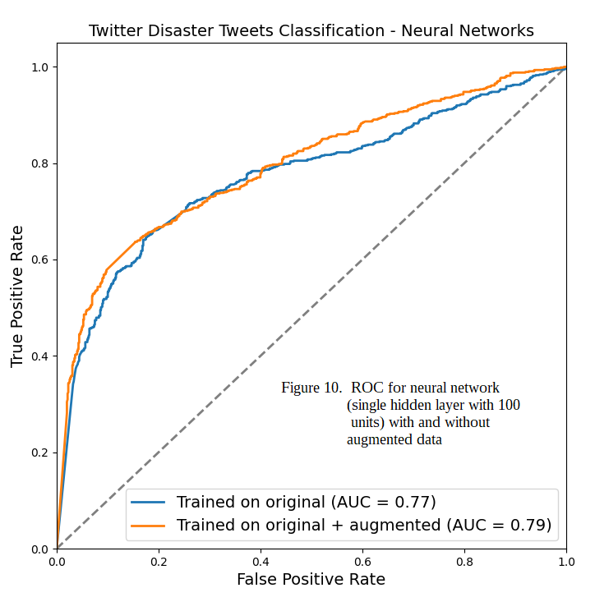
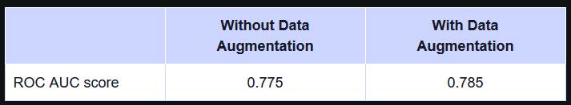
Appendix B - neptune.ai RNN vs.
Single hidden-layer NN
RNN trained on the same kaggle Disaster Tweets dataset.
https://neptune.ai/blog/data-augmentation-nlp

Slide 16
Appendix C - Text processing example
I can't bloody wait!! Sony Sets a Date For Stephen KingÛªs Û÷The Dark TowerÛª #stephenking #thedarktower http://t.co/J9LPdRXCDE @bdisgusting
➔ normalize URLs
I can't bloody wait!! Sony Sets a Date For Stephen KingÛªs Û÷The Dark TowerÛª #stephenking #thedarktower <url> @bdisgusting
➔ normalize twitter special chars
I can't bloody wait!! Sony Sets a Date For Stephen KingÛªs Û÷The Dark TowerÛª <hashtag>stephenking <hashtag>thedarktower <url> <user>bdisgusting
➔ expand contractions
I can not bloody wait!! Sony Sets a Date For Stephen KingÛªs Û÷The Dark TowerÛª <hashtag>stephenking <hashtag>thedarktower <url> <user>bdisgusting
➔ remove stop words
I can not bloody wait!! Sony Sets a Date For Stephen KingÛªs Û÷The Dark TowerÛª <hashtag>stephenking <hashtag>thedarktower <url> <user>bdisgusting
➔ remove punc, lemmatize, lower case, remove singletons and OOV words
not bloody wait!! Sony Sets Date Stephen KingÛªs Û÷The Dark TowerÛª <hashtag>stephenking <hashtag>thedarktower <url> <user>bdisgusting
not bloody wait sony set date stephen dark <hashtag> <hashtag> <url> <user>
➔ tokenize
not | bloody | wait | sony | set | date | stephen | dark | <hashtag> | <hashtag> | <url> | <user>

Slide 17
References
Word Embeddings notebook and supporting materials
https://github.com/MichaelSzczepaniak/WordEmbeddings/
Large Language Model Assisted Model Development project code, data, notebooks
https://github.com/MichaelSzczepaniak/llmamd
tbd:
https://
tbd:
https://
tbd:
https://

