Slide 1
Mercury Tickets Selling System
Group #2
David Zhang
Jay Zhao
Michael Tong

Slide 2
Technologies
Frameworks:
Front-End:
Others:
Spring Security
Spring MVC
Spring IoC
Spring DAO Support
Hibernate
REST Web Service
HTML5 & CSS3
AJAX
Bootstrap
JavaScript
jQuery
AngularJS
Responsive Design
Core JAVA
Oracle 10g
Google Chart API

Slide 3


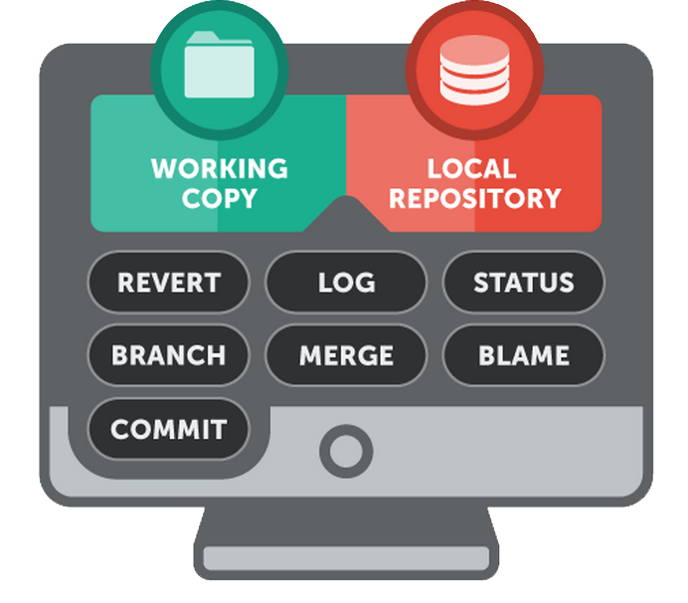
Version Control Github
Push Pull
Push Pull
Push Pull
Jay
David
Michael

Slide 4
Frameworks:
Spring

Slide 5
Hibernate Mappings
Annotation
Many to One:
Statistics ➔ Ads
Statistics ➔ Users
One to Many:
Users ➔ Orders
Ticket ➔ Orders
Ticket ➔ Station
Users ➔ Card
station
card
ticket
orders
users
ads
statistics

Slide 6
Front-End Design & Validation
HTML5 & CSS3:
Validation:
HTML5 new features:
header/nav/section
datetime-local
CSS3 New features:
border-radius
box-shadow
Responsive Design
Javascript & jQuery
AJAX
Luhn Algorithm
Data-Binding:
AngularJS
Google Chart API

Slide 7
Demo

Slide 8
Thank you!

Slide 9
Hibernate Mappings
First bullet point here
Second bullet point here
Third bullet point here
 | Group 1 | Group 2
Class 1 | 82 | 95
Class 2 | 76 | 88
Class 3 | 84 | 90

Slide 10
Framework

Slide 11
Two Content Layout with SmartArt
First bullet point here
Second bullet point here
Third bullet point here
Group A
Task 1
Task 2
Task 3
Task 4

