Slide 1
BIA-660 Midterm Project
Analytics & Comparison of Apple Products with Twitter
By:
Colin Mills
Qiang Tong
Xiangda Shi
Xin Gao
Instructor:
Prof. Winter Mason

Slide 2
Questions
Which Apple mobile OS is more popular? iOS4 ~ iOS7.
While version of iPhone is more popular? iPhone 3GS ~ iPhone 5S.
iPhone 5S vs. iPhone 5C?
Notes:
3 questions about our project

Slide 3
Headlines
Data Collection
Data Analysis
Data Visualization
Notes:
3 main topics

Slide 4
Data Collection
Why don’t we use Twitter API?
Twitter search URL: http://twitter.com/search?q=
topsy.com/tweets search URL:
Notes:
Twitter API cannot get tweets more than a week ago.

Slide 5
Data Collection
topsy.com/tweets search URL:
http://topsy.com/s?type=tweet&q=
iOS%204&language=en&offset=00&mintime=1277078425&maxtime=1308700814
iOS%204
&
language=en
&
offset=00
&
mintime=#
&
maxtime=#
“iOS 4”
“pages”
00, 10, 20
1277078425?
timestamp.
Another problem, Javascript?
Notes:
URL explanation.

Slide 6
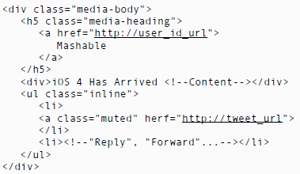
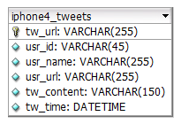
Data Collection
“Selenium” to the rescue!
HTML Code
MySQL DB
Selenium
BeautifulSoup
More than 2,200 tweets each keyword.
Notes:
Using tools of Selenium & BeautifulSoup to collect and parse data from webpage, then store the data into database.
I hope to make a demo about how “Selenium” works. Run a small demo code.
We managed to a large amount of data.

Slide 7


Data Analysis
“Time” matters.
Retrieve tweet content from database.
Positive or Negative?
Special Dictionary.
Pos_words.txt
neg_words.txt
Notes:
Time matters:
We chose to collect the tweets when the iPhone or iOS was release. About 4 days before and after the official release date. This reflects more about how people thought about the product/software. Also, it’s easier to get large amount of data.

Slide 8
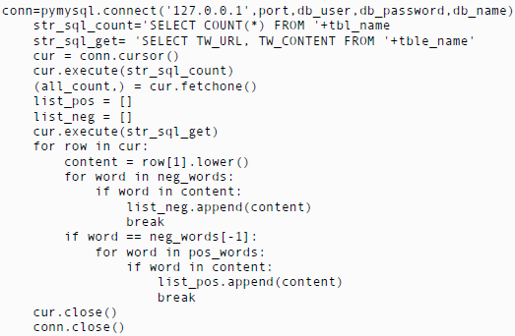
Data Analysis
Sample Code:
Notes:
Sample code, also the key algorithm of checking if the tweet is positive or negative.
Briefly explain how this works:
Before this code, we have read the .txt files of positive or negative and save them into two lists.
Open a database connection;
run SQL query to get number of all tweets and

Slide 9
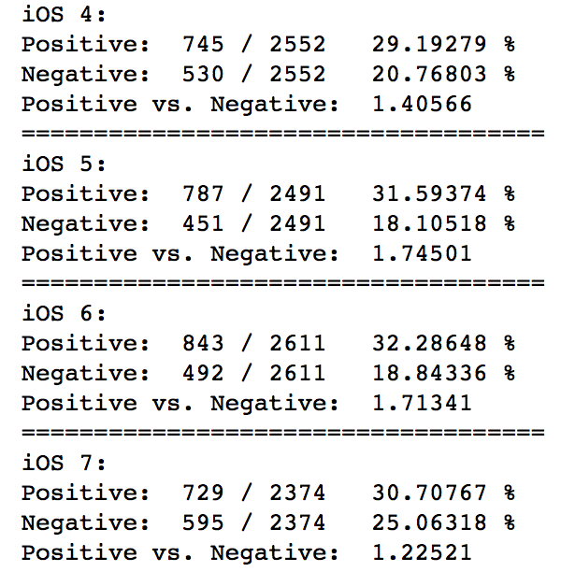
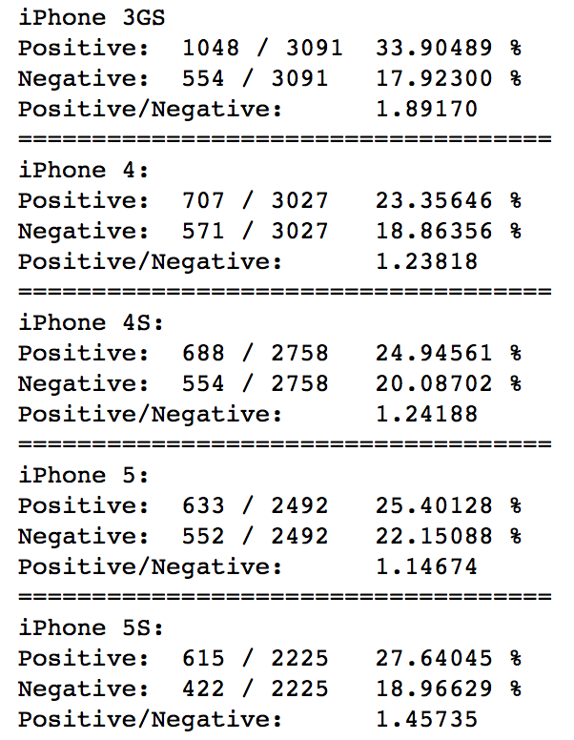
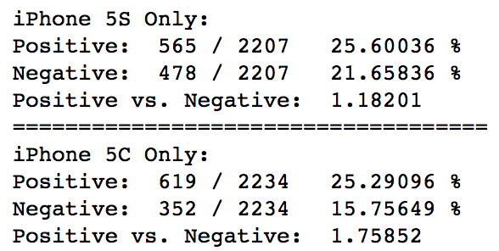
Data Visualization
positive/negative:
Notes:
Old school way, print out the data.

Slide 10
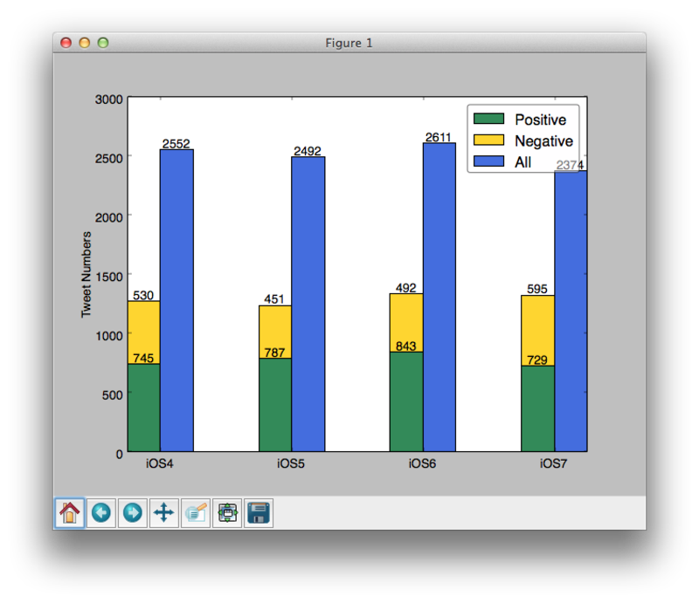
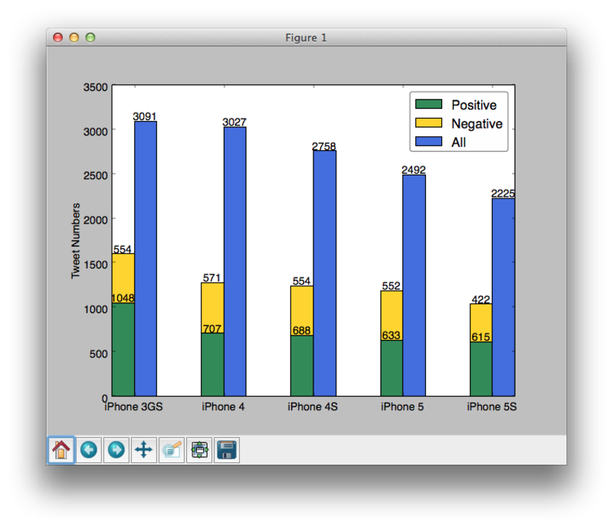
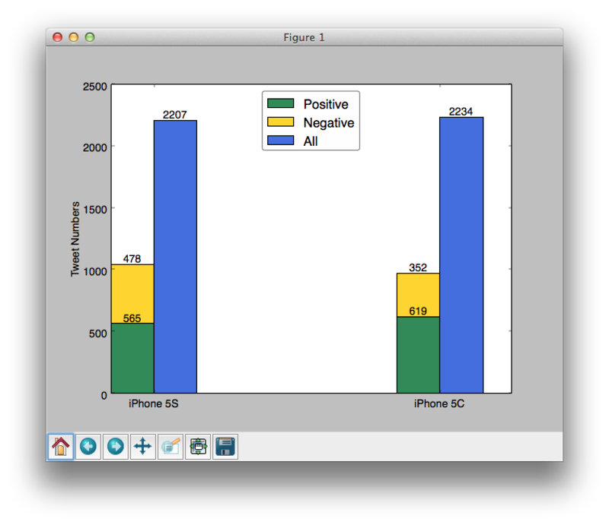
Data Visualization
Matplotlib - bar charts
iOS 4/5/6/7
iPhone 3GS/4/4S/5/5S
iPhone 5S/5C

Slide 11

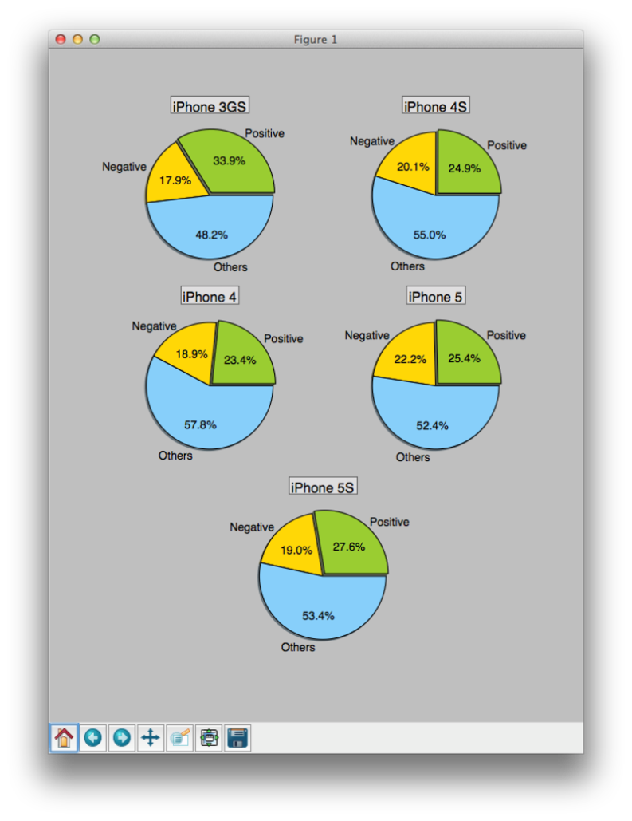
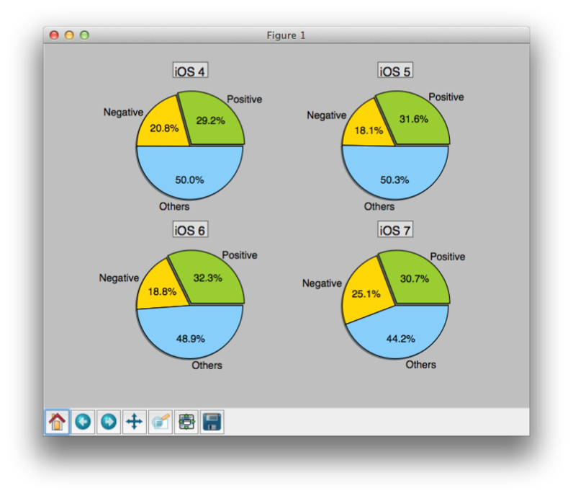
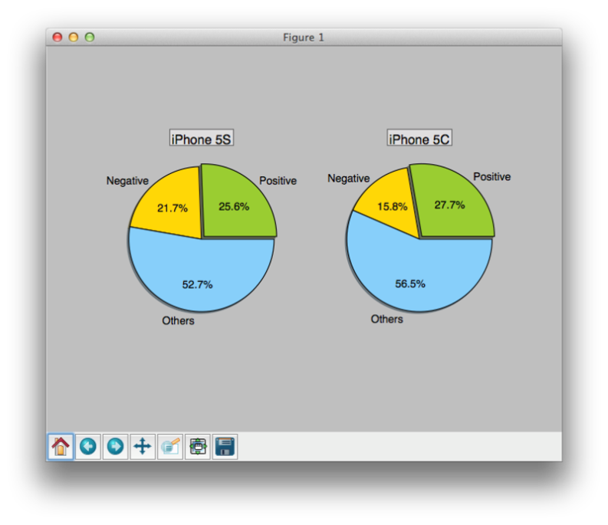
Data Visualization
Matplotlib - pie charts
iOS 4/5/6/7
iPhone 3GS/4/4S/5/5S
iPhone 5S/5C

Slide 12
Conclusions

Slide 13
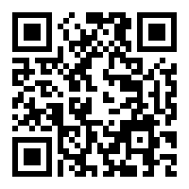
Q&A Thank you!

