Slide 1

SUCCESSFUL PROTOTYPING
Presented by: Michael Wakahe

Slide 2

Prototyping
Successful new products require constant, disciplined, experimentation
5 business stages are:
Discovery
Validation
Efficiency
Scale
Sustain

Slide 3
Premature Scaling
Premature scaling is the most common reason for startup failure
Is an internal problem
Startups can prematurely scale their team, their customer acquisition strategies or over- build the product.

Slide 4
Prototyping
Steps to follow:
Nailing the Customer Pain
Nail the Solution
Nail the Go-to-Market Strategy
Nail the Business Model
Scale It

Slide 5
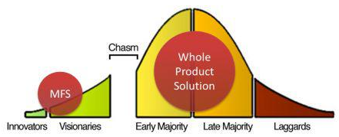
Prototyping
MFS = Minimum Feature Set

Slide 6
Prototyping Tips
You need to get into the field
MVP - display to clients
Need to measure in order to get a Product/Market Fit
Don't be scared of pivoting

Slide 7
Prototyping Tips
Not to be too emotionally attached to your creation/idea
Fewer features are better
Distinguish between Users vs Customers

Slide 8
Prototyping - References
Startup Genome Report Extra on Premature Scaling - August 29th, 2011
Nail It then Scale It: The Entrepreneur’s Guide to Creating and Managing Breakthrough Innovation by Nathan Furr and Paul Ahlstrom

Slide 9
Prototyping
Prototype Demo
Contact: michael@michaelwakahe.com

